Slide 1
Preparing Teachers to Deliver Intervention in Virtual Settings
June 30, 2020
Faculty Professional Learning Series: Webinar #1
Lindsey Hayes, M.Ed., & Amy Colpo, M.P.P., American Institutes for Research

Slide 2
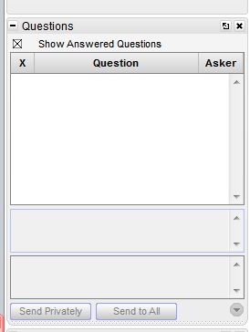
Webinar Format & Questions
Throughout the presentation, submit your questions into the question pod.
For technical issues/questions, a webinar team member will try to assist you as soon as possible.
For content related questions, there will be a time for Q&A at the end of the presentation. Submit your questions and we will share them with the presenters.

Slide 3
Faculty Professional Learning Series
Teacher preparation faculty and professional development providers will:
Learn from colleagues and NCII experts about available tools and resources to enhance coursework, field experiences, and professional development opportunities related to intensive intervention.
Share successes, challenges, and lessons learned from the process of enhancing preservice and inservice learning opportunities for educators responsible for delivering intensive intervention.

Slide 4
Agenda
Considerations for intensive intervention in virtual settings (15 min)
Strategies for faculty and professional development providers (20 min)
Q&A (15 min)
Closing (10 min)

Slide 5
Audience Poll

Slide 6
Teacher Expectations
How do we adjust preparation and professional learning experiences to prepare teachers for what lies ahead?
We need teachers who can:
Manage rapid transitions to online, virtual, and/or distance instruction.
Plan for blended or hybrid instructional models.
Maintain continuity of learning for our most vulnerable learners.

Slide 7
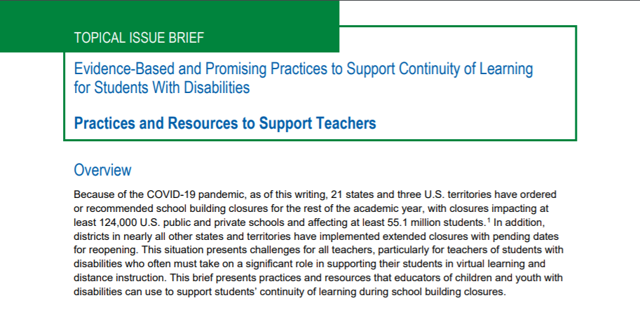
Continuity of Learning
The U.S. Office of Special Education Programs (OSEP) has a website with resources to address continuity of learning during COVID-19.
Topical issue briefs
Parents and families
Teachers
Related service providers
Webinars
Resource database

Slide 8
Shifts in Teaching and Learning
Infrastructure-Level Access
Student-Level Access
Hardware (e.g., computer, laptop, other devices)
Mobile device compatibility
Software (e.g., learning management systems, videoconferencing)
High-speed internet and/or Wi-Fi
Cognitive and executive functioning (e.g., processing, reasoning, working memory)
Physical or sensory concerns (e.g., visual, hearing, mobility)
Reading ability
Ability to use assistive technologies
Source: U.S. Department of Education Office of Special Education Programs, 2020.

Slide 9
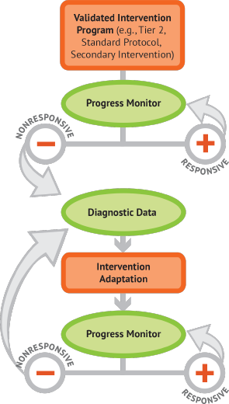
Shifts in Intensive Intervention Delivery
Shifts in the Virtual Setting:
Delivering Tier 2 with fidelity
Implementing progress monitoring procedures
Individualizing and intensifying interventions
Blending academic and behavioral supports
Collecting and using data

Slide 10
Strategy #1
Model using explicit instruction to intensify delivery of virtual instruction.

Slide 11
Explicit Instruction Is…
A way of teaching where the teacher:
Selects an important objective
Specifies the learning outcome
Designs structured instructional experiences
Explains directly
Models the skill being taught
Provides scaffolded practice to achieve mastery
Instructional modalities change. Technologies change. The principles of explicit instruction remain the same.
Source: Kearns, 2018.

Slide 12
Example: Lesson Opening
Lesson Opening
Identify learning objective
Review prior knowledge and skills
Delivery of Instruction
Model step-by-step (“I do”)
Group practice (“We do”)
Individual practice (“You do”)
Lesson Conclusion
Review critical content
Assign independent practice
Monitor and assess progress
Design Questions:
How will I ensure students know their learning objective?
How will I activate my students’ interests and prior knowledge?
Strategies For the Virtual Setting:
Students complete an online quiz as a “do-now” activity as they enter the virtual classroom. Teacher monitors responses and re-teaches as necessary.
Teacher screen shares the lesson objective. Students paraphrase the objective in their own words in the chat pod.

Slide 13
Example: Delivery of Instruction
Lesson Opening
Identify learning objective
Review prior knowledge and skills
Delivery of Instruction
Model step-by-step (“I do”)
Group practice (“We do”)
Individual practice (“You do”)
Lesson Conclusion
Review critical content
Assign independent practice
Monitor and assess progress
Design Questions:
How will I present the material?
How will I gradually release responsibility for the task?
How will I provide frequent and varied opportunities for student response?
How will I give specific and timely feedback?
Strategies For the Virtual Setting:
Teacher models the skill by drawing on the whiteboard while conducting a think-aloud.
Students respond to checks for understanding using polls, annotation features, and thumbs-up signals.
Teacher assigns heterogenous groups to breakout rooms during practice time and rotates among them.
Teacher gives feedback to individual students via the chat pod.

Slide 14
Example: Lesson Conclusion
Lesson Opening
Identify learning objective
Review prior knowledge and skills
Delivery of Instruction
Model step-by-step (“I do”)
Group practice (“We do”)
Individual practice (“You do”)
Lesson Conclusion
Review critical content
Assign independent practice
Monitor and assess progress
Design Questions:
How will I provide opportunities for students to demonstrate independent mastery of the task?
How will I assess and give feedback on student performance?
Strategies For the Virtual Setting:
Students take turns as presenter to share their work to the class.
Teacher assigns an online quiz for an exit ticket and follows up with individual students as necessary.
Students submit videos of their work, including think-alouds, for teacher feedback.

Slide 15
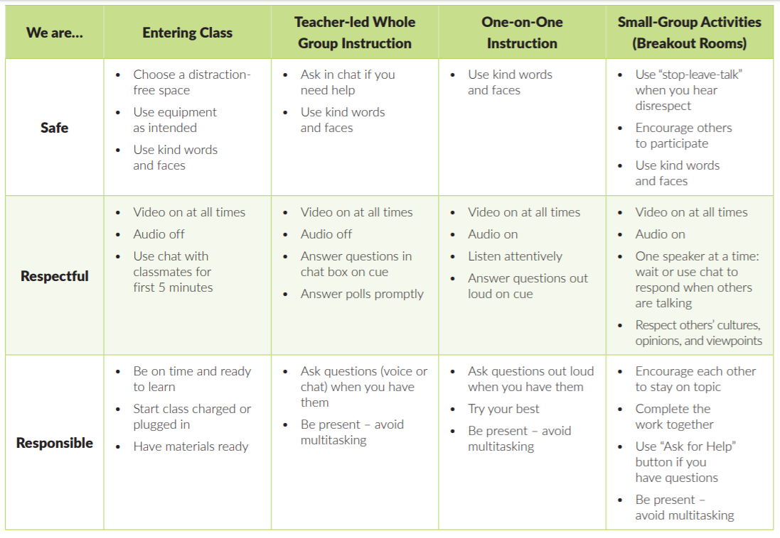
Example: Behavior
Teach and model expectations for virtual instruction: PBIS Behavior Teaching Matrix for Remote Instruction
Class procedures
Technology norms
Asking for help
Provide prompts, reminders, guides, rubrics, and checklists that focus on:
Self-regulation skills
Increasing length of on-task behaviors
Source: Center on Positive Behavioral Interventions & Supports, 2020.

Slide 16
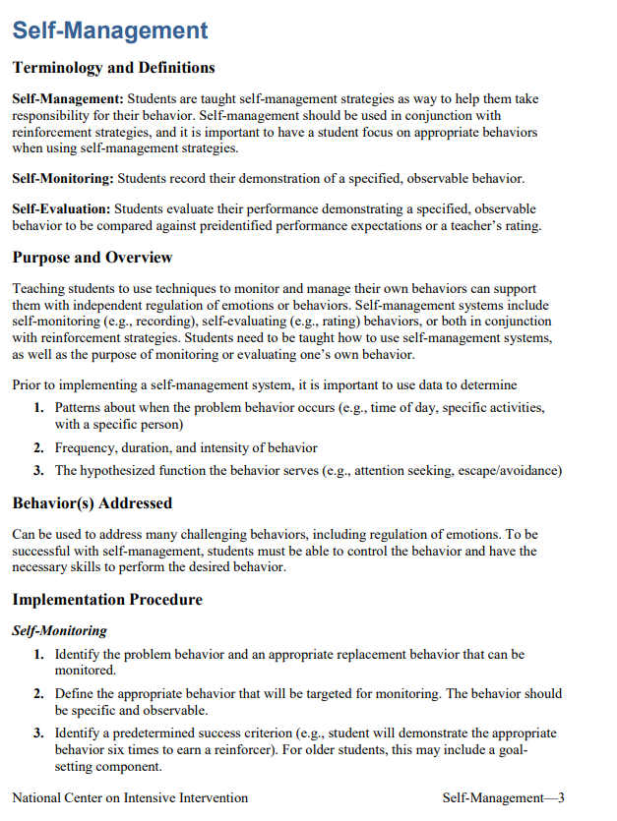
Sample Lessons
LITERACY
MATHEMATICS
BEHAVIOR

Slide 17
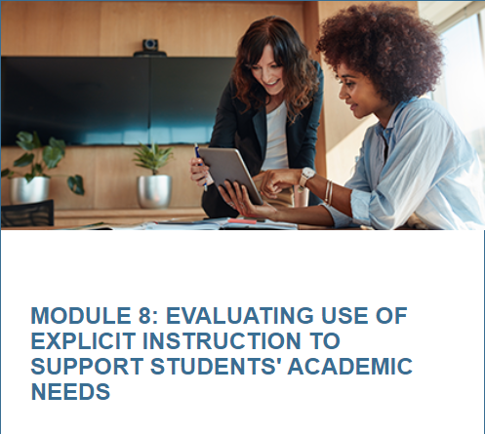
Intensive Intervention Course Content
Ready-to-use content for faculty and professional development providers!
Features of Explicit Instruction
Intensive Intervention in Mathematics
Intensive Intervention in Reading
Behavior Support for Intensive Intervention

Slide 18
Strategy #2
Blend synchronous and asynchronous learning supports.

Slide 19
Instructional Modalities
Synchronous instruction: Learning activities occur in real time
Teleconferencing
Virtual class sessions
Live-streamed lectures
Traditional classroom instruction
Asynchronous instruction: Learning activities occur independently of time
Discussion boards
Self-paced modules
Recorded videos or lectures

Slide 20
Blended Supports for Intensive Intervention
Intensification Practice Categories | Synchronous | Asynchronous
1. Change intervention dosage or time | Virtual features to increase response opportunities (e.g., polling, annotation) Shorter and more frequent sessions | Access to recorded intervention sessions Supports for parents and families to practice with their student
2. Change learning environment to promote attention and engagement | Small group or individual breakout groups Visual cues to remain on-task | Virtual class resource space Multimedia resources and activities
3. Combine cognitive processing strategies with academic learning | Virtual note-taking templates and graphic organizers Self-regulation and self-monitoring supports | Support with offline organization skills Self-regulation and self-monitoring supports
4. Modify delivery of instruction | Explicit, systematic instruction with visual and auditory aids Virtual features to increase feedback opportunities (e.g., chat pod, breakouts) | Structured independent practice opportunities with feedback (e.g., submission of video, online quiz, etc.)

Slide 21
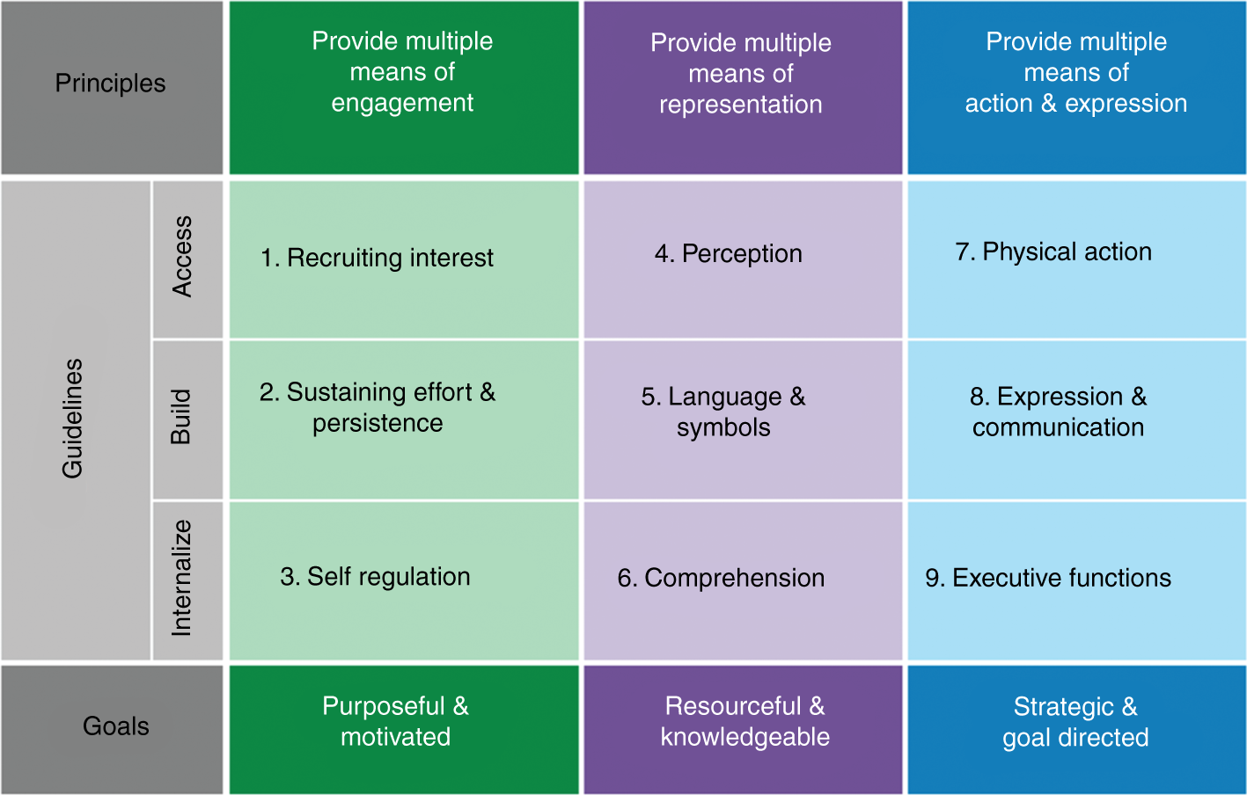
Planning Considerations
Student level
Age and/or grade
Self-regulation abilities
Availability of family support
Group level
Universal Design for Learning
Positive Behavioral Interventions & Supports
Source: CAST, 2018.

Slide 22
Strategy #3
Plan for adjusting progress monitoring and data collection procedures.

Slide 23
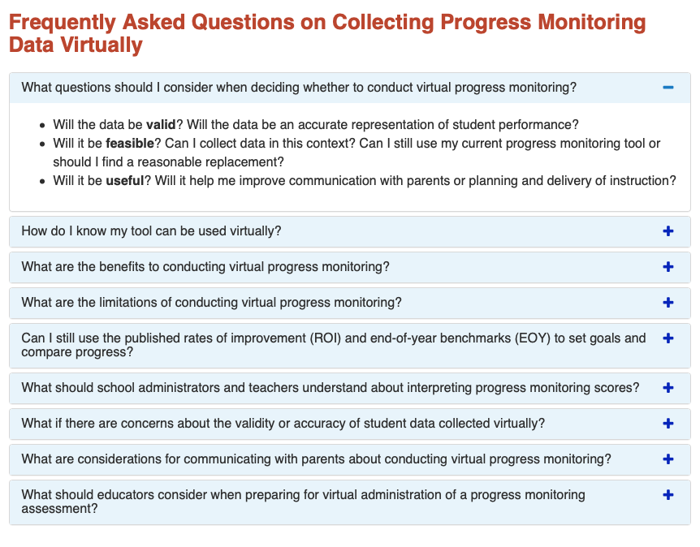
Virtual Progress Monitoring
Teachers and administrators need to plan for how they will collect and analyze progress monitoring data in a virtual setting.
This collection of Frequently Asked Questions on Collecting Progress Monitoring Data Virtually is intended to provide a starting place for consideration.

Slide 24
Tools Chart Updates
Academic Screening Tools Chart
Behavioral Screening Tools Chart
Academic Intervention Tools Chart
Behavioral Intervention Tools Chart
Academic Progress Monitoring Tools Chart
Behavioral Progress Monitoring Tools Chart

Slide 25
Strategy #4
Create additional opportunities for observation and feedback.

Slide 26
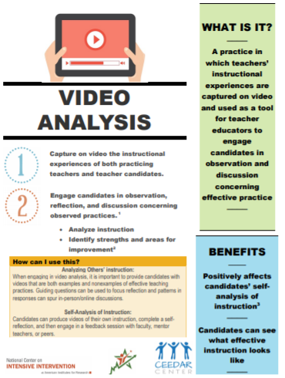
Video As a Teaching and Reflection Tool
Video observation and analysis can:
Provide teachers with examples of high-quality, effective instruction.
Increase the frequency of practice and feedback opportunities.
Allow teachers to reflect on and improve their own instruction.

Slide 27
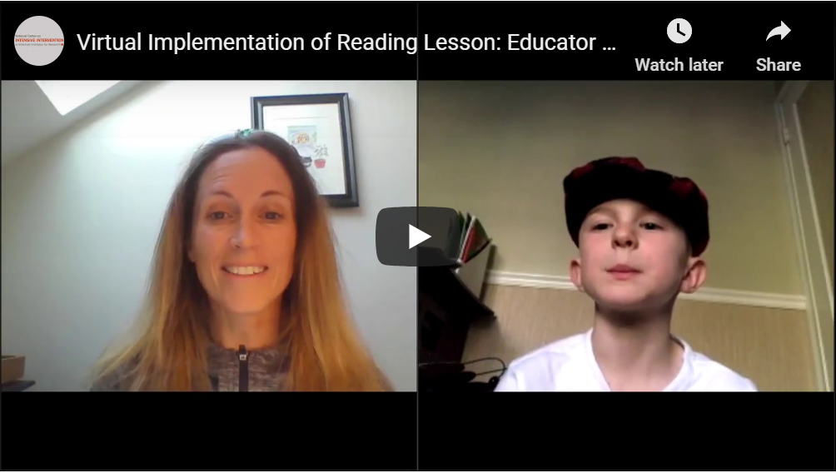
NEW! Virtual Lesson Implementation
Virtual Implementation of Reading Lesson: Educator Example
Sample Lessons: Literacy Strategies to Support Intensifying Interventions
Sample Lessons to Support Continuity of Learning During COVID-19: Tips for Educators

Slide 28
Strategy #5
Promote collaboration with team members.

Slide 29
Virtual Collaborators
Parents and families
General education teachers
Paraprofessionals
Related service providers
How do we prepare teachers to collaborate with team members for intensive intervention in virtual settings?

Slide 30
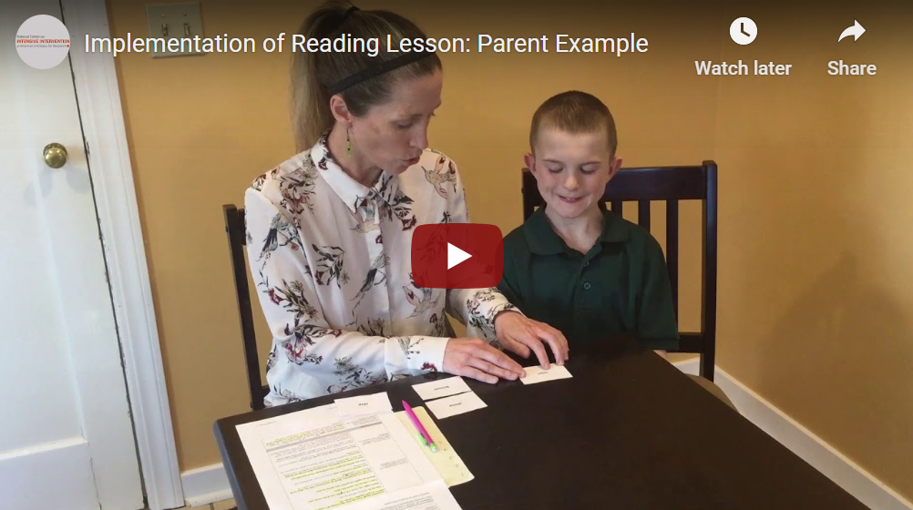
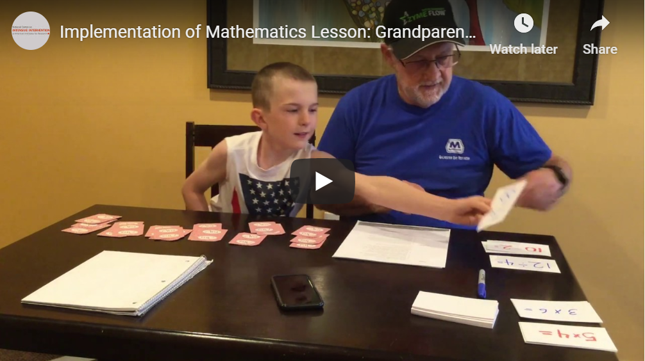
NEW! Parent Video Examples
Using Sample Lessons to Support Continuity of Learning During COVID-19:
Tips for Parents

Slide 31
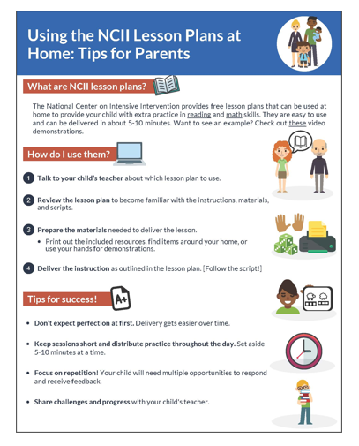
NEW! Parent Tip Sheets
Using Sample Lessons to Support Continuity of Learning During COVID-19: Tips for Parents

Slide 32
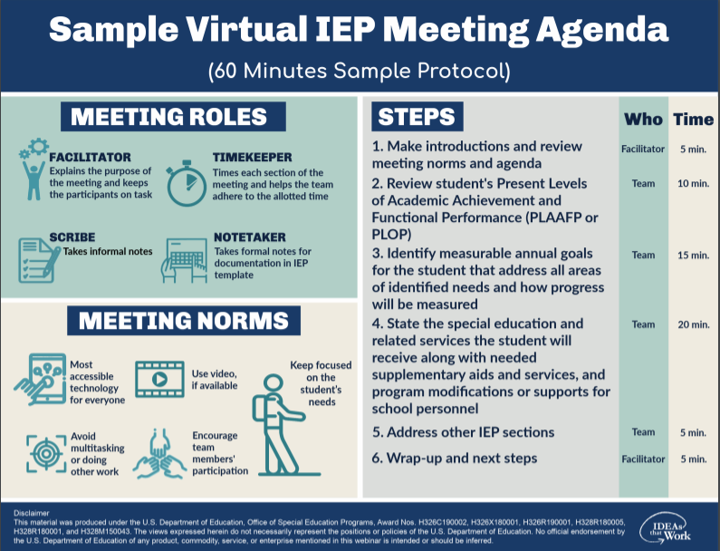
IEP Meeting Resources
PROGRESS Center:
Virtual IEP Meeting Tip Sheets
Virtual IEP Meeting Sample Agenda
NCII:
Tools to Support Intensive Intervention Data Meetings

Slide 33
Questions?

Slide 34
Final Considerations
Explore opportunities for action research.
Consider creating video examples of virtual instruction.
Share resources with colleagues.
Stay tuned for further NCII resources!

Slide 35
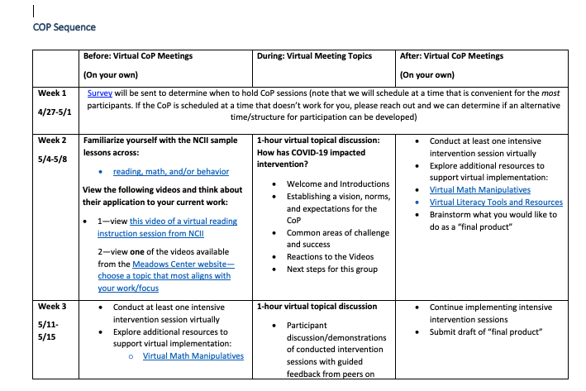
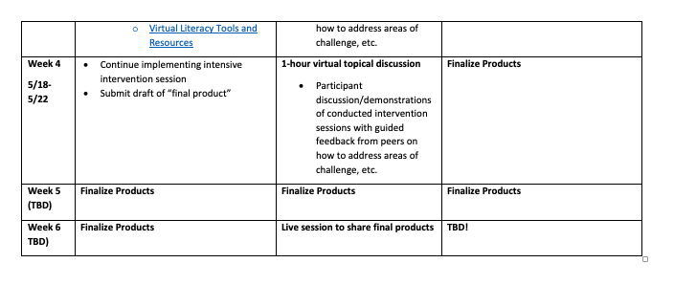
NCII Community of Practice (CoP)
Learn from NCII experts about available tools and resources with application for distance/virtual learning.
Pilot the use of tools and resources.
Share lessons learned with other educators.
Refine implementation.
Support NCII with developing products focused on delivering distance/virtual intensive intervention.

Slide 36
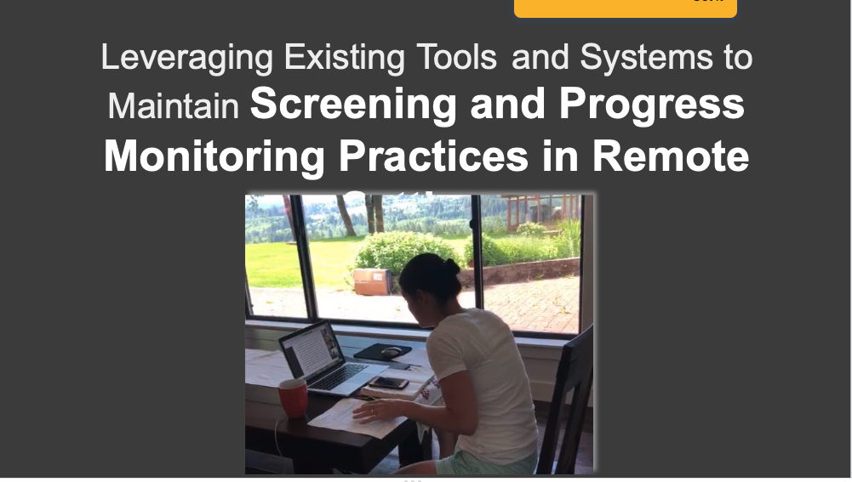
CoP Final (Draft!) Product Example #1
Virtual screening and progress monitoring delivery

Slide 37
CoP Final (Draft!) Product Example #2
Using mathematics manipulatives virtually

Slide 38
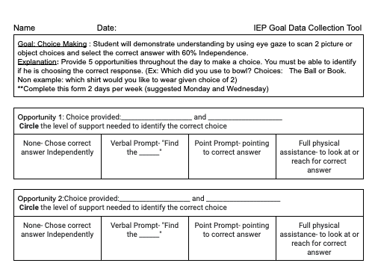
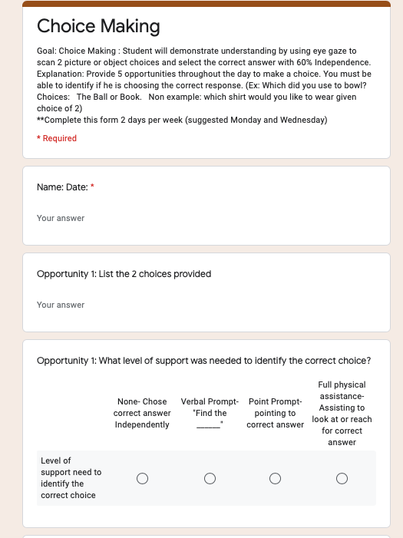
CoP Final (Draft!) Product Example #3
Supporting parents with collecting data on IEP goals

Slide 39
Upcoming Webinars
Webinar #2: Practice-Based Opportunities for Intensive Intervention
August 6, 2020 from 3:00-4:00pm ET
Webinar #3: Course Content Resources for Intensive Intervention
October 7, 2020 from 3:00-4:00pm ET
Webinar #4: Continuous Program Improvement
December 1, 2020 from 3:00-4:00pm ET

Slide 40
Questions or COmments
Lindsey Hayes: lhayes@air.org
Amy Colpo: acolpo@air.org

Slide 41
References
CAST (2018). Universal Design for Learning guidelines version 2.2. Retrieved from http://udlguidelines.cast.org
Center on Positive Behavioral Interventions & Supports. (2020, March 27). Creating a PBIS behavior teaching matrix for remote instruction. Retrieved from https://www.pbis.org/resource/creating-a-pbis-behavior-teaching-matrix-for-remote-instruction
Kearns, D. (2018). Intensive intervention course content: Features of explicit instruction. Retrieved from https://intensiveintervention.org/intensive-intervention-features-explicit-instruction
U.S. Department of Education, Office of Special Education Programs. (2020). Evidence-based and promising practices to support continuity of learning for students with disabilities: Practices and resources to support teachers. Retrieved from https://osepideasthatwork.org/sites/default/files/SWDLearning-Teachers-508.pdf

Slide 42
NCII Disclaimer
This presentation was produced under the U.S. Department of Education, Office of Special Education Programs, Award No. H326Q160001. Celia Rosenquist serves as the project officer. The views expressed herein do not necessarily represent the positions or policies of the U.S. Department of Education. No official endorsement by the U.S. Department of Education of any product, commodity, service, or enterprise mentioned in this presentation is intended or should be inferred

