Slide 1
Continuous Program Improvement
December 1, 2020
Faculty Professional Learning Series: Webinar #4
Lindsey Hayes, M.Ed., & Amy Colpo, M.P.P., American Institutes for Research
Lynn Holdheide, M.Ed., CEEDAR Center
Cara McDermott-Fasy, NBCT, Ph.D., Rhode Island College

Slide 2
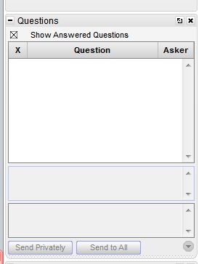
Webinar Format & Questions
Throughout the presentation, submit your questions into the question pod.
For technical issues/questions, a webinar team member will try to assist you as soon as possible.
For content related questions, there will be a time for Q&A at the end of the presentation. Submit your questions and we will share them with the presenters.

Slide 3
Faculty Professional Learning Series
Teacher preparation faculty and professional development providers will:
Learn from colleagues and NCII experts about available tools and resources to enhance coursework, field experiences, and professional development opportunities related to intensive intervention.
Share successes, challenges, and lessons learned from the process of enhancing preservice and inservice learning opportunities for educators responsible for delivering intensive intervention.

Slide 4
Agenda
Continuous improvement overview (10 min)
Resource example: Assessment Practices Within Multi-Tiered Systems of Supports (MTSS) Innovation Configuration (20 min)
Program example: Rhode Island College (20 min)
Closing (10 min)

Slide 5
Introduction: Continuous Program Improvement

Slide 6
What is Continuous Program Improvement?
Review
Reflect
Revise
Refine
Teacher Preparation Program

Slide 7
Why Does It Matter?
Complex skills such as designing and delivering intensive intervention must be reinforced throughout all stages of the preparation experience.
Course content grounded in evidence-based practices
Opportunities to practice teaching and receive feedback
Effective preparation

Slide 8
Strengthening Teacher Preparation
CONTENT:
Intensive Intervention
PROCESS:
Continuous Improvement
Evidence-based practices
Collaboration
High-quality course content
Alignment
Reflection
NCII Resources: Faculty Course Content
CEEDAR Resources: Innovation Configurations

Slide 9
Assessment Practices Within a Multi-Tiered System of Supports Innovation Configuration
Lynn Holdheide, CEEDAR Center

Slide 10
Assessment Practices Within a Multi-Tiered System of Supports
https://ceedar.education.ufl.edu/

Slide 11
Step 4: Review Programs

Slide 12
Innovation Configurations (IC) Purpose
ICs are designed to evaluate current teacher preparation and professional development by determining the extent to which evidence-based practices are taught, observed, and applied within teacher preparation and professional development programs.
A tool to guide the self-assessment of programs
Facilitate the course enhancement process

Slide 13
Innovation Configurations
Used to answer the following questions:
What types of instruction and experiences do teachers receive throughout their preparation and/or professional development that promote the use of evidence-based and/or high-leverage instructional practices?
To what extent are teachers and teacher candidates provided an opportunity to apply these strategies with explicit feedback and sustained implementation support to ensure fidelity?

Slide 14
Innovation Configuration Process
Consider a program or set of courses.
Identify strengths, gaps, and redundancies in programs.
One tool to examine and align programs.
Focus on the essential components of evidence-based practices.
Target opportunities for candidates to deliberately apply these practices.

Slide 15
Innovation Configuration Dimensions
Essential Components
- Descriptors
- Examples
- Based on evidence standards
Degree of Implementation
- Defined implementation variations or levels

Slide 16
Innovation Configuration Format
Implementation Levels
Essential Components

Slide 17
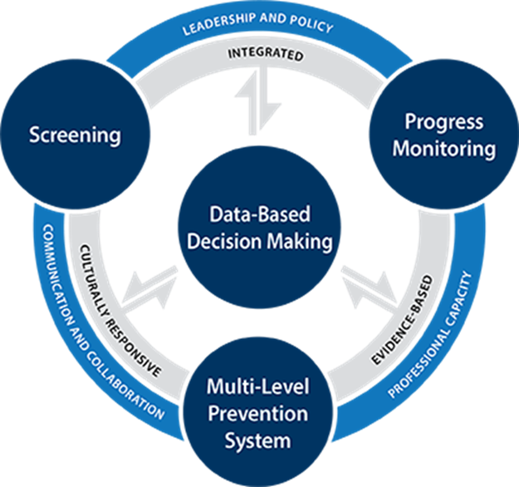
Essential Components
1.0 Foundations of MTSS Assessment
2.0 Universal Screening
3.0 Progress Monitoring
4.0 Intensifying Instruction Using Data-Based Individualization (DBI)
5.0 Using MTSS Data
Notes:
Reshley et al., 2011

Slide 18
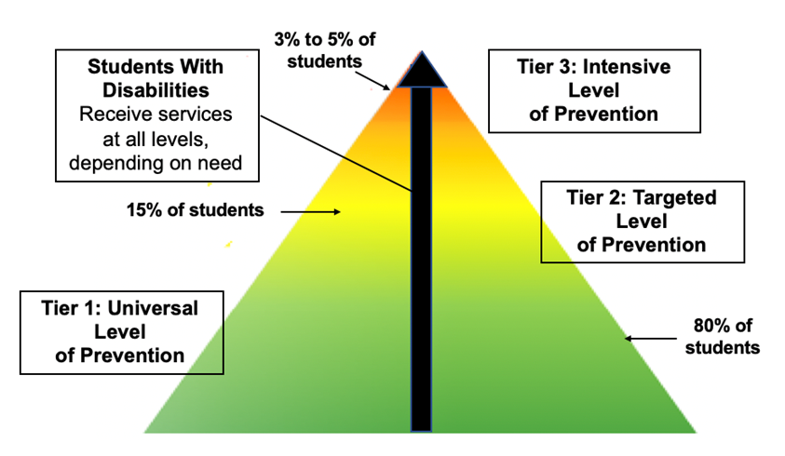
1.0—Foundation of MTSS Assessment
Prevention framework designed to integrate assessment data and intervention within a multi-level prevention system
Three tiers of intensity
Tier 1: Core programming
Tier 2: Small-group, standardized academic and behavioral interventions
Tier 3: Intensive supports for students with severe and persistent learning and/or behavioral needs
Assessment within the tiers
Formative
Summative
Diagnostic

Slide 19
2.0—Universal Screening
Purpose: To evaluate the efficacy of core programming to identify students who may be at risk for poor learning or social, emotional, and behavioral outcomes (i.e., not meeting end-of-year benchmarks or schoolwide expectations) and who need more intensive services
Selecting a Screening Tool
Administering and Scoring Screening Assessments
Analyzing and Using Screening Data
Box 1. Educator Tools for Understanding and Evaluating the Technical Adequacy of Screening Tools
NCII’s Series: Understanding Screening: What Do the Technical Standards Mean?
Classification Accuracy—Extent to which the tool accurately groups students into at risk and not at risk
Validity—Extent to which the tool measures what it is supposed to measure
Reliability—Extent to which the tool results in consistent information
Bias Analysis—Extent to which the tool is biased against different groups of students
Sample Representativeness—Extent to which a group closely matches the characteristics of its population as a whole
NCII’s Screening Tools Charts
Academic Screening Tools Chart
Behavior Screening Tools Chart

Slide 20
3.0—Progress Monitoring
Selecting Progress Monitoring Tools
Progress Monitoring Goal Setting
Academic Goal-Setting Strategies
Behavior Goal-Setting Strategies
Administering and Scoring Progress Monitoring Tools
Progress Monitoring Data Decision-Making Strategies
Box 2. Educator Tools for Understanding and Evaluating the Technical Adequacy of Progress Monitoring Tools
Technical Adequacy of Progress Monitoring
Validity—Extent to which the tool measures what it is supposed to measure
Reliability—Extent to which the tool results in consistent information
Bias Analysis—Extent to which the tool is biased against different groups of students
Alternate Forms—Requires at least 20 alternate forms and strong evidence for comparability of alternate forms
NCII’s Progress Monitoring Tools Charts
Academic Progress Monitoring Tools Chart
Behavior Progress Monitoring Tools Chart

Slide 21
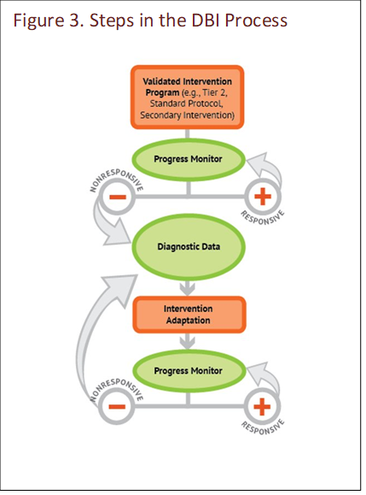
4.0—Intensifying Instruction Using DBI
Overview of Data-Based Individualization (DBI)
Role of assessment in DBI
Using diagnostic data to intensify interventions
Using progress monitoring data to monitor intensive intervention

Slide 22
5.0—Using MTSS Data
Conditions for Effective Use of MTSS Data
Teaming for MTSS Data Decision Making
Sharing Data With Other Educators, Families, and Students
Assessment Considerations for Students With Disabilities
Evaluating MTSS Implementation
Box 3. Using Student Achievement Data to Support Instructional Decision Making (Hamilton et al., 2009) Recommendation 1. Make data part of an ongoing cycle of instructional improvement. Recommendation 2. Teach students to examine their own data and set learning goals. Recommendation 3. Establish a clear vision for schoolwide data use. Recommendation 4. Provide supports that foster a data-driven culture within the school. Recommendation 5. Develop and maintain a districtwide data system.

Slide 23
Evaluating MTSS Implementation
Tiers of Support | Evaluation Questions for Consideration
Tier 1 | Is our core programming working for most students? Do staff have the knowledge and skills necessary to effectively use data and support students? What are the strengths and areas of improvement of our current MTSS implementation?
Tier 2 | To what extent are we under- or over-identifying students for intervention? Are most students benefiting from the Tier 2 intervention system? How can we improve our implementation of Tier 2 interventions and supports?
Tier 3 | To what extent are students under- or over-identified for Tier 3 or referred for special education evaluation? Are most students benefiting from intensive intervention at Tier 3? How can we improve the integration of data and intervention at Tier 3?

Slide 24
Questions? 1

Slide 25
Program Example: Rhode Island College
Dr. Cara McDermott-Fasy

Slide 26
Context

Slide 27
Continuous Improvement Related to Literacy
Overarching themes:
Equity and access
Framework: MTSS/RTI/DBI
De-siloed approach
Scope and sequence across departments
Right to Read Act

Slide 28
Goal #1: Intensive Intervention
Supporting students, and their families, with language-based learning differences including dyslexia from Day One.

Slide 29
Goal #2: Map Courses to MTSS/RTI/DBI Framework
X
X,X,X

Slide 30
Examples of Changes
Added a Tier 2 literacy course
Better aligned course content to science of reading, especially at Tier 1
Better aligned course content to Structured Literacy, especially at Tier 1
Reworked practice-based learning opportunities and course artifacts
Added a Capstone course

Slide 31
Literacy Scope and Sequence
Courses:
Foundations of Literacy I: Grades 1-3
Foundations of Literacy II: Grades 3-6
Assessment and Intervention in Literacy: Tier 2
Intensive Intervention in Literacy
Capstone: Specialized Language Instruction

Slide 32
Mapping Courses to MTSS/RTI/DBI Framework
X, X
X
X,X,X

Slide 33
What Informed Changes? CEEDAR Technical Assistance

Slide 34
Continuous Refinement
Innovation Configurations
Evidence-Based Reading Instruction K-5
Evidence-Based Practices for Writing Instruction
Networked Improvement Community (NIC)

Slide 35
Current Collaboration: Creating a Crosswalk
SEA’s 2020 Literacy/Dyslexia Endorsement Competencies
Evidence-Based Reading Instruction K-5 Innovation Configuration
Mount St. Joseph’s The Science of Reading in Teacher Preparation
International Dyslexia Association (IDA) Knowledge and Practice Standards

Slide 36
What Informed Changes? Advisory Committees

Slide 37
Continuous Feedback
Literacy specialists
LEA representatives
Parents
Community organizations

Slide 38
What Informed Changes? Participation in a Wider Community of Practice

Slide 39
Continuous Learning
Trainings, webinars, podcasts, etc. (i.e., LETRS)
Journals (i.e., The Reading League Journal)
Book clubs (i.e., Language at the Speed of Sight, Speech to Print, The Reading Comprehension Blueprint, The Knowledge Gap)
Professional learning communities (i.e., Virtual Community of Practice: #UFLI)
Social media: Twitter, Facebook, etc. (i.e., Teaching Reading Rocket Scientists)
Other (i.e., SEA’s Structured Literacy Webpage)

Slide 40
Timeline
Spring 2021 | ELED 222: Foundations of Literacy I: Grades 1-3
Fall 2021 | ELED 324: Foundations of Literacy II: Grades 3-6 ELED 326: Assessment and Intervention on Literacy: Tier 2
Spring 2022 | SPED 412: Intensive Intervention in Literacy
Fall 2022 | SPED 460: Capstone: Specialized Language Instruction
Spring 2023 | Elementary Education Student Teaching
Fall 2023 | Special Education Student Teaching
Spring 2024—Fall 2025 | Right to Read Act Requirements

Slide 41
How Are We Collecting Data On Our Continuous Improvement Efforts?
Unit Level
1
Program Level
2
Anticipated Proficiency Requirement
3

Slide 42
Resources for Continuous Improvement
CEEDAR technical assistance
Innovation Configurations
Advisory committees
Participation in a wider community of practice

Slide 43
Questions? 22)

Slide 44
Sample Innovation Configurations
Located at https://ceedar.education.ufl.edu/
Evidence-Based Reading Instruction
Universal Design For Learning
Culturally Responsive Teaching
Evidence Based Practices for Mathematics
Use Of Technology In The Preparation Of Pre-Service Teachers
Evidence-Based Practices For Classroom and Behavior Management: Tier 2 And Tier 3 Strategies
Classroom Organization and Behavior Management
Response to Intervention

Slide 45
Opportunity for Faculty
NCII can offer personalized, one-on-one supports to teacher preparation program faculty around intensive intervention.
Training for faculty on NCII course content resource and tools
Assistance reviewing programs for intensive intervention course content
Resources to enhance existing course activities
And much more!
If you are interested contact Lindsey Hayes (lhayes@air.org)

Slide 46
Questions or COmments
Lindsey Hayes: lhayes@air.org
Amy Colpo: acolpo@air.org
Lynn Holdheide: lholdheide@air.org
Cara McDermott-Fasy: cmcdermott@ric.edu

Slide 47
NCII Disclaimer
This presentation was produced under the U.S. Department of Education, Office of Special Education Programs, Award No. H326Q160001. Celia Rosenquist serves as the project officer. The views expressed herein do not necessarily represent the positions or policies of the U.S. Department of Education. No official endorsement by the U.S. Department of Education of any product, commodity, service, or enterprise mentioned in this presentation is intended or should be inferred

