Slide 1
To Be Clear: What Every Educator Needs to Know About Explicit Instruction
February 2019
Rebecca Zumeta Edmonds, Ph.D., Co-Director, NCII
Sarah Powell, Ph.D., University of Texas at Austin
Devin Kearns, Ph.D., University of Connecticut

Slide 2
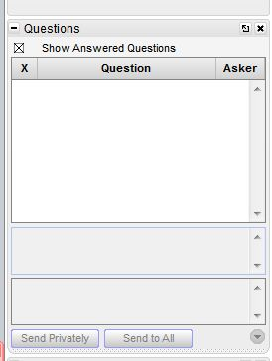
Webinar Format & Questions
Throughout the presentation, submit your questions into the question pod.
  For technical issues/questions, a webinar team member will try to assist you as soon as possible.
  For content related questions, there will be a time for Q&A at the end of the presentation. Submit your questions and we will share them with the presenters.

Slide 3


Today’s Hosts

Slide 4
Today’s Webinar
What is explicit instruction?
Research supporting explicit instruction
Essential practices: A deep dive into explicit instruction
Preview of free online course
Modeling and practice

Slide 5
What is Explicit Instruction?

Slide 6
Levels of instruction
systematic
direct
assisted
explicit

Slide 7
Explicit Instruction
Research rarely provides identical definitions (Hughes et al., 2017)
  Demonstration of a step-by-step plan that is specific for a set of problems; students use the same steps to solve the problem (Gersten, Chard, et al., 2009, p. 1210)
  Segmenting of complex skills, using modeling or think-alouds, systematically fading supports or prompts, providing opportunities for students to respond and receive feedback, and creating purposeful practice (Hughes et al., 2017, p. 141)
  Unambiguous and direct approach to teaching; includes both instructional design and delivery procedures (Archer & Hughes, 2011, p. 1)

Slide 8
Our Definition of Explicit Instruction
A way of teaching where the teacher selects an important objective, specifies the learning outcome, designs structured instructional experiences, explains directly, models the skills being taught, and provides scaffolded practice to help a student achieve mastery (Kearns, 2018).

Slide 9
Research Supporting Explicit Instruction

Slide 10


In Reading

Slide 11
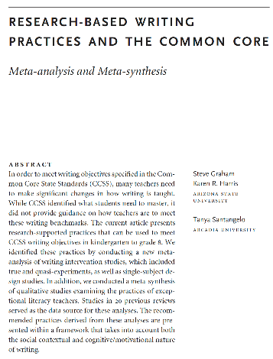
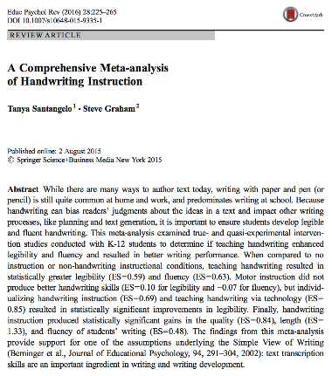
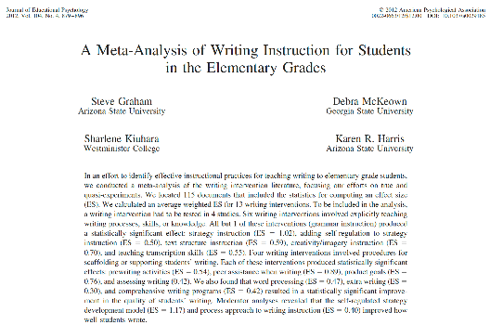
In Writing

Slide 12

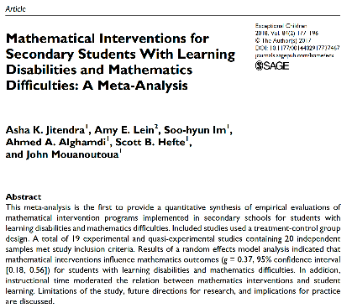

In Mathematics

Slide 13
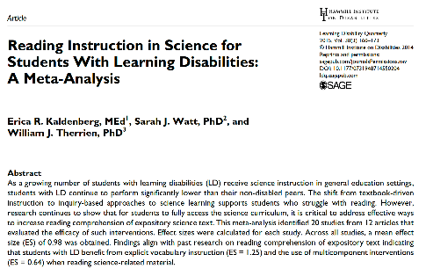
In Science

Slide 14
Essential Practices
Deep Dive into Explicit Instruction
Devin Kearns, Ph.D. University of Connecticut
devinkearns.org | @devin_kearns

Slide 15
Essential Practices:
Deep Dive into Explicit Instruction
Introduction: What is explicit instruction and why is it important?

Slide 16
You will
Describe the purpose of explicit instruction
List the elements of the explicit instruction model
Describe the characteristics of effective models and practice
Identify these characteristics in classroom examples
Objectives

Slide 17
Describe the purpose of explicit instruction
Describe why it is especially important for students with learning and attention issues
Part 1: Purpose

Slide 18
Focus on explicit instruction
Definition
Clear Objective
A way of teaching where the teacher
  selects an important objective,
  specifies the learning outcome,
  designs structured instructional experiences,
  explains directly,
  models the skill being taught, and
  provides scaffolded practice to achieve mastery
  uses a set of evidence-based practices to maintain engagement in cognitively processing lesson content
Important focus
Specific learning outcome
  important objective
Modeling
Practice
  learning outcome
Clear Explanation
Guided
Practice
  structured
  explains directly
Planned
Examples
Independent Practice
  models
  scaffolded practice
Supporting Practices
Using effective methods to elicit frequent responses
Providing immediate specific feedback
Maintaining a brisk pace
  evidence-based practices

Slide 19
Focus on explicit instruction
Rationale for using it
Research has shown repeatedly that it leads to student success (Adams & Engelmann, 1996; Hattie, 2009, 2018)
Specific parts are very effective (Alfieri, 2011; Hattie, 2018):
  Direct explanations
  Modeling
  Structured practice
  Providing feedback
It works in both language arts and mathematics classrooms (Cohen, 2018; Haas, 2005)

Slide 20
What is the role of explicit instruction?
Learning new skills places heavy demands on working memory
Why does this matter?

Slide 21
To make the point further…

Slide 22



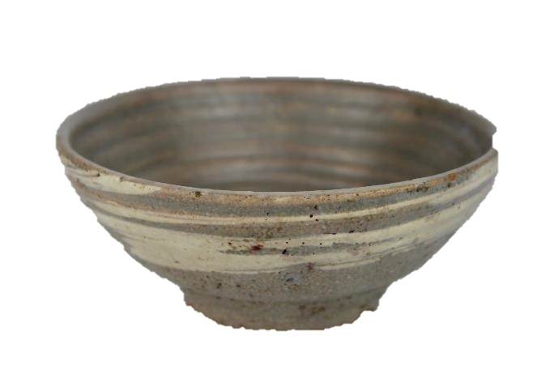
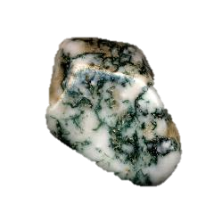
Stones and Vase
stones
… in a bowl

Slide 23
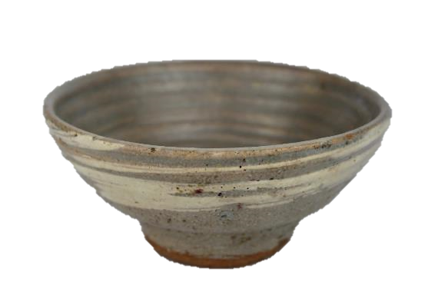
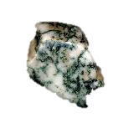
students who need intensive intervention
students with typical achievement
cognitive load
cognitive load
knowledge
How do we help both types of students acquire knowledge?

Slide 24
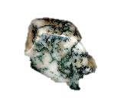
students with typical achievement
instructional approach

Slide 25
students who need intensive intervention
instructional approach

Slide 26


Slide 27

a cairn of knowledge…
through explicit instruction

Slide 28
Part 2: The Online Course
You will learn
  why the course was built
  how it related to NCII
  how the course was designed
  the instructional features
  how to get started with it

Slide 29
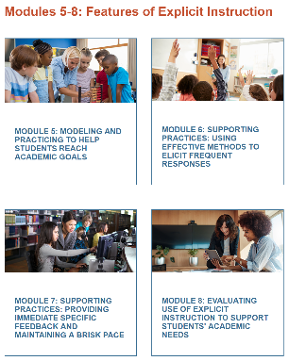
What is the course and why are you doing it?
The course includes
  a set of modules to help you learn about explicit instruction
  components related to all parts of the explicit instruction model
We are doing it because
  there are not enough carefully sequenced courses to help you understand the features of explicit instruction
  there are not resources to help university faculty design lessons on explicit instruction
  there is not a lot of information how explicit instruction fits into the DBI framework
  it is a critical practice for students who have intensive intervention needs

Slide 30
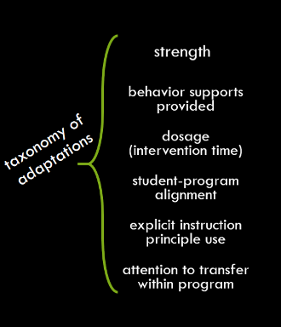
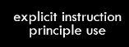
How does explicit instruction fit into DBI?
Teacher implements program with fidelity.
Student shows insufficient
response.
Work samples show students are confused.
Data show some progress
Teacher tries something simple.
Teacher realizes she needs to change instruction.
Progress remains insufficient.

Slide 31
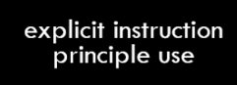
Explicit instruction within DBI
Teacher implements program with fidelity.
Student shows insufficient
response.
With a secondary prevention program
Work samples show students are confused.
Data show some progress
what to teach
  too many skills are jumbled together
  the expectations are not clear
  lessons are activity-driven
how to teach
  not specified at all
  not explicit
Teacher tries something simple.
Teacher realizes she needs to change instruction.
Without a program
what to teach
  you have to decide (very hard work)
how to teach
  you must design explicit instruction

Slide 32
What are the features of the course?
Videos to learn all of the content
Materials directly related to all of the videos
Examples from real curricula
Built-in real-world classroom examples
Activities to promote cognitive processing
Options for coaching to support the course

Slide 33
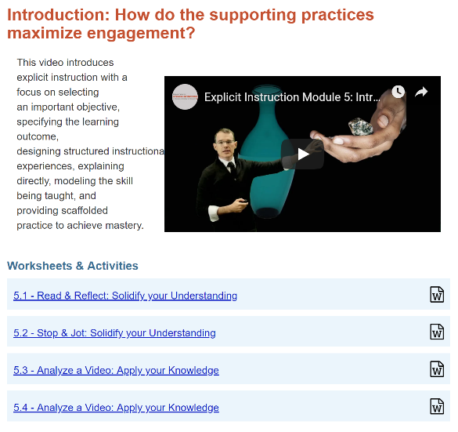
Videos to learn all of the content

Slide 34
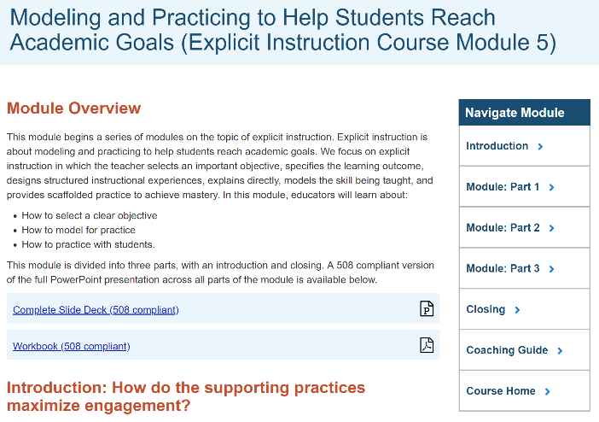
Materials directly related to all of the videos

Slide 35
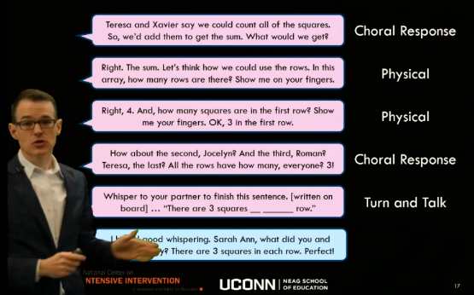
Examples from real curricula
Anonymized curriculum examples

Slide 36

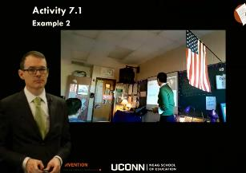
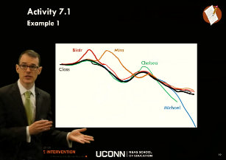
Built-in real-world classroom examples
watched within modules
taken from actual classrooms
examples, non-examples, and mixed cases
discussed within modules

Slide 37
Activities to promote cognitive processing

Slide 38
Options for coaching to support the course
Based on the work of McMaster and Lembke and colleagues and Snyder and Hemmeter and colleagues
Interactive
Non-evaluative
Targeted support of module content implementation
Combination of virtual and in-person activities
Collaborative work toward continuous improvement of the pilot

Slide 39
You will be able to
describe the modeling and practice structure of explicit instruction
identify these structures in real-world instructional examples
enumerate the supporting practices and explain how they relate to modeling and practice
Part 3: Modeling & Practice

Slide 40
Clear Objective
Important focus
Specific learning outcome
I Do
Modeling
Practice
Clear Explanation
Guided
Practice
We Do
Planned
Examples
Independent Practice
You Do
Supporting Practices
Supporting Practices
Using effective methods to elicit frequent responses
Providing immediate specific feedback
Maintaining a brisk pace

Slide 41
Checklist: Modeling
Give clear explanations
  Match the explanation the learning outcome
  Design the explanation so that it is correct, clear, and concise
  Use the explanation consistently
Model multiple planned examples
  Show all the steps or provide unique examples
  Verbalize your thinking
  Have students observe
Use supporting practices

Slide 42
Clear explanation
Objective: Student will add three-digit numbers with or without regrouping using the standard algorithm
Add the ones.
If the answer is more than 9, regroup.
Write ones answer.
Add the tens.
If the answer is more than 9, regroup.
Write tens answer.
Add the hundreds.
If the answer is more than 9, regroup. Write hundreds answer.
Accurate explanation:
correctly specifies critical elements of the skill or idea
does not include incorrect facts, an imprecise procedure, misspellings, or incorrect grammar
Complete explanation:
includes all critical elements of the skill or idea
matches the learning outcome exactly
does not leave students to intuit parts of skill or idea
Accurate?
  For the standard algorithm, this is correct
  Nothing is incorrect
Complete?
  All parts are there, including regrouping
  Perfect match
  Nothing intuited
    place value and regrouping knowledge are required
Resource available from NCII
https://intensiveintervention.org/sites/default/files/PlaceValueComp_508.pdf

Slide 43

Lead Teacher Demonstration
Modeling Planned Examples
Ms. Leonard teaches students about the A-consonant-E pattern
Compare and contrast the two examples
  Does her model align with the criteria here?
Model multiple planned examples
Show all the steps or provide unique examples
Verbalize your thinking
Have students observe

Slide 44
Modeling Planned Examples
Does Example 1 meet criteria?
Model multiple planned examples
Show all the steps or provide unique examples
Verbalize your thinking
Have students observe

Slide 45
Modeling Planned Examples
Example 1
Please follow the link until https://www.youtube.com/watch?v=OzkfpCn3wtA&feature=youtu.be

Slide 46
Modeling Planned Examples
Does Example 2 meet criteria?
Model multiple planned examples
Show all the steps or provide unique examples
Verbalize your thinking
Have students observe

Slide 47
Modeling Planned Examples
Example 2
Please follow the link until https://www.youtube.com/watch?v=HvpmCwpC1z0&feature=youtu.be

Slide 48

Lead Teacher Demonstration
Modeling Planned Examples
Example 1
  There were two steps, and she showed both
  She explained how she did it
  She did not make the students do it
Example 2
  There was a simple explanation but not a procedure
  There was no thinking to verbalize
  She immediately asked the students to do the work
Model multiple planned examples
Show all the steps or provide unique examples
Verbalize your thinking
Have students observe

Slide 49
Checklist: Practice
Decide what type of practice is appropriate
Design outcome-aligned practice likely to produce high accuracy
Provide guided practice
  Lead student in steps toward the learning outcome
  Provide appropriate prompts
  Observe and provide immediate feedback
Provide independent practice
  Review expectations and resources for meeting the learning outcome
  Allow student to work without support
  Observe and provide immediate and delayed feedback
Make strategic decisions about next steps

Slide 50
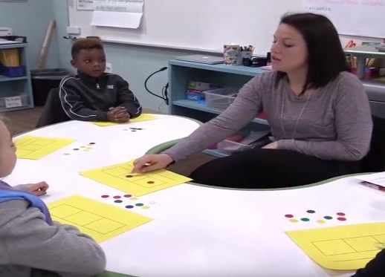
Classroom Lesson Example
Guided Practice
Learning outcome: Students will correctly segment spoken words orally and identify each sound with a token
Provide Guided Practice
Lead student in steps toward the learning outcome
Provide appropriate prompts
Observe and provide immediate feedback

Slide 51
Guided Practice
Does this lesson meet criteria?
Provide Guided Practice
Lead student in steps toward the learning outcome
Provide appropriate prompts
Observe and provide immediate feedback

Slide 52
Guided Practice
Classroom Lesson Example
Please start at 1:22 mark of the following link https://www.youtube.com/watch?v=6wjU03hjOvs&feature=youtu.be
These videos are part of professional learning community (PLC) materials for the IES practice guide Foundational Skills to Support Reading for Understanding in Kindergarten Through 3rd Grade prepared for the Institute of Education Sciences (IES) under Contract ED-IES-12-C-0011 by the Regional Educational Laboratory Southeast administrated by Florida State University

Slide 53
Classroom Lesson Example
Guided Practice-Review
Lead students in steps toward the learning outcome?
  This is precisely what she does
Provide appropriate prompts
  She provides brief verbal prompts
  She occasionally points at her mat or makes small gestures
Observe and provide immediate feedback
  She is clearly observing
  She says good job but is not more specific
Provide Guided Practice
Lead student in steps toward the learning outcome
Provide appropriate prompts
Observe and provide immediate feedback

Slide 54
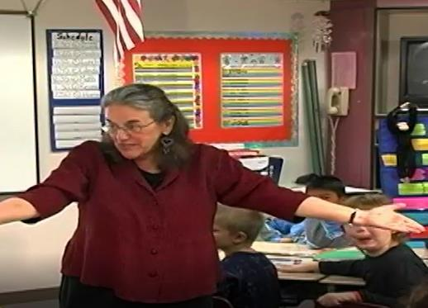
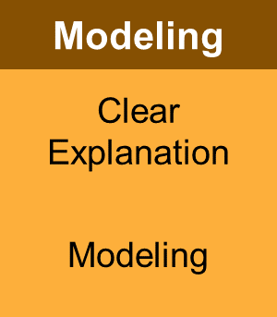
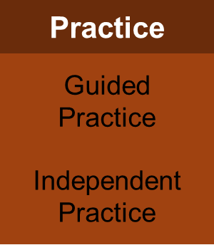
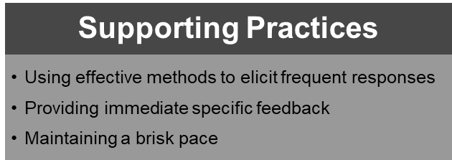
Representation of explicit instruction
Dr. Archer is an expert in explicit instruction (and co-author of the Explicit Instruction book)
Her objective is for students to use a response format she has not taught them before
She uses a short (but complete) cycle of explicit instruction
Anita Archer (n.d.) ExplicitInstruction.org
Archer, A., & Hughes, C. (2011). Explicit Instruction. New York, NY: The Guilford Press

Slide 55
A real classroom example: Dr. Archer
Please start at the 28:00 mark of the following link https://www.youtube.com/watch?time_continue=1699&v=OwFgF0RDeC0
Anita Archer (n.d.) ExplicitInstruction.org
Archer, A., & Hughes, C. (2011). Explicit Instruction. New York, NY: The Guilford Press

Slide 56
Supporting Practices
Supporting Practices
Using effective methods to elicit frequent responses
Providing immediate specific feedback
Maintaining a brisk pace
Using effective methods to elicit frequent responses

Slide 57



Engagement

Slide 58
Defining “Engagement” & “Supporting Practices”
Engagement:
when students’ cognitive effort is focused on processing lesson content
Supporting practices:
evidence-based techniques to maximize student engagement

Slide 59
Explicit instruction is a research-based strategy
It is part of a learning theory framework focused on reducing cognitive load
It is especially important for students with learning and attention issues
There is a clear model that involves a set of skills and techniques that you can learn
Wrap-Up

Slide 60
Questions?

Slide 61
NCII Disclaimer
This presentation was produced under the U.S. Department of Education, Office of Special Education Programs, Award No. H326Q160001. Celia Rosenquist serves as the project officer. The views expressed herein do not necessarily represent the positions or policies of the U.S. Department of Education. No official endorsement by the U.S. Department of Education of any product, commodity, service, or enterprise mentioned in this website is intended or should be inferred.

Slide 62


Thank you!
Devin Kearns
  devin.kearns@uconn.edu
  devinkearns.org
  Twitter: @devin_kearns
Sarah Powell
  srpowell@austin.utexas.edu
  www.sarahpowellphd.com
  Twitter: @sarahpowellphd

Slide 63
Closing Slide

