Slide 1
Getting Ready to Implement Intensive Intervention
Infrastructure for Data-Based Individualization
  Presenter’s Name
  Position
      Month 20XX
Notes:
Although permission to reprint this publication is not necessary, the citation should be
National Center on Intensive Intervention. (2014). Getting ready to implement intensive intervention: Infrastructure for data-based individualization (DBI). Washington, DC: U.S. Department of Education, Office of Special Education Programs, National Center on Intensive Intervention.
Introduction to the module
The purpose of this module is to introduce a school interested in implementing intensive intervention to the infrastructure needed to implement DBI. Participants should include the school’s principal and the core team likely to lead DBI implementation, which may include the behavior support team, interventionists, special educators, school psychologists, counselors, and other administrators, as appropriate. In districts working with the National Center on Intensive Intervention (NCII), the district contact and coach also should attend this meeting, if possible.
Note: Because of conversations that have occurred prior to this meeting, the facilitator may choose to adjust the purpose, audience, and content. For example, the content could be divided into (a) what school leadership needs to know to make a decision about participation in intensive TA versus (b) what the team that would oversee DBI implementation would need to know about infrastructure. If school leadership is already aware of expectations and is ready to commit, the meeting may target the team responsible for DBI implementation, focusing on assessing infrastructure strengths and needs.
Instructions for using the speaker notes
Text formatted in standard font is intended to be read aloud or paraphrased by the facilitator.
Text formatted in bold is excerpted directly from the presentation slides.
Text formatted in italics is intended as directions or notes for the facilitator; italicized text is not meant to be read aloud.
Text formatted in underline indicates an appropriate time to click to bring up the next stage of animation in an animated slide.
Materials
Teams will need pens to complete planning forms. They should also bring school and team meeting schedules to facilitate planning for technical assistance and DBI meetings. Participants should be provided with the following handouts:
Handout 1: DBI graphic
Handout 2: DBI Planning
Handout 3: Considerations for Implementation
Handout 4: Sample Progress Monitoring Meeting Agenda
Handout 5: Sample Progress Monitoring Note-Taking Template
Handout 6: DBI Infrastructure—Reflection Worksheet
Speaker Notes for Title Slide
Welcome participants to the session. Introduce yourself (or selves) as the facilitator(s) and briefly cite your professional experience with intensive intervention and DBI. Introduce the purpose of the meeting.

Slide 2
Overview
Rationale for Intensive Intervention and Introduction to Data-Based Individualization (DBI)
What Do You Need to Implement DBI? Overview of Essential Elements
Introduction to National Center on Intensive Intervention (NCII) Intensive Technical Assistance
Next Steps
Notes:
Today we will introduce you to data-based individualization (or DBI), NCII’s approach to intensive intervention. We will review key infrastructure elements needed for DBI implementation, highlighting the elements we consider key for successful implementation because of other sites’ implementation efforts. You will have time to work as a team to consider your school’s readiness for implementation.

Slide 3
NCII’s Mission
Our mission is to build district and school capacity to support implementation of data-based individualization in reading, mathematics, and behavior for students with severe and persistent learning and behavioral needs.
Notes:
A common misconception about working with NCII is that we will train teachers on how to implement a specific intervention. Data-based individualization is a framework for designing and delivering intensive intervention, rather than a single program. Our resources and services support school staff in learning how to use data to understand student needs and design individualized intervention aligned to those needs.

Slide 4

What Is Intensive Intervention?
Intensive intervention addresses severe and persistent learning or behavior difficulties. Intensive intervention should be:
Driven by data
Characterized by increased intensity (e.g., smaller group, expanded time) and individualization of academic instruction, behavioral supports, or both
Notes:
Paraphrase Slide

Slide 5
Intensive Intervention
Is
Individualized to meet student needs
More intense than standard instruction, often with substantively different content and pedagogy
Composed of more frequent and precise progress monitoring
Is Not
A single approach
A manual
A preset program or curriculum
More of the same Tier 1 instruction
More of the same Tier 2 instruction
Notes:
When we talk about intensive intervention, we are talking about a process for intensifying and individualizing intervention. It is not a single, standard-protocol intervention or approach. This process can apply to various grade levels and areas (both academics and behavior). It is more intensive than Primary (Tier 1) or Secondary (Tier 2) in terms of both the supports provided and the assessment data that guide intervention decision making.

Slide 6



Why Do We Need
Intensive Intervention?
Low academic achievement
Graduation rates
Arrest rates
Notes:
Students with disabilities also have poorer outcomes in their postsecondary education and employment.
Low Academic achievement: Intensive intervention is a highly relevant and timely topic considering the continuing academic underachievement of students with disabilities, as reflected in the National Assessment of Educational Progress. In 2013, 18% of 4th graders with disabilities performed at or above the “Proficient” level in mathematics, in contrast with 45% of their nondisabled peers (data retrieved from http://nationsreportcard.gov/reading_math_2013/#/student-groups). Patterns are similar in 4th grade reading (11% of students with disabilities and 38% of students without disabilities), 8th grade math (8% and 39%, respectively), and 8th grade reading (9% and 40%, respectively).
Graduation rates: Compared to the general population, SWDs are less likely to graduate on time. For the 2011-2012 school year, the U.S. public high school 4-year adjusted cohort graduation rate was only 61% for students with disabilities compared to 80% for all students (Stetser & Stillwell, 2014).
Arrest rates: Twenty-three percent of young adults with disabilities have been arrested at least once, almost twice the rate for youth in the general population (12 percent; p < .001). Rates for arrest and parole are highest among students identified as having Emotional Disturbance (49.4 percent). (Sanford et al., 2011).

Slide 7


Why Do We Need
Intensive Intervention?
More Help
Validated programs are not universally effective programs; 3 to 5 percent of students need more help (Fuchs et al., 2008; NCII, 2013).
More Practice
Students with intensive needs often require 10–30 times as much practice as their peers to learn new information (Gersten et al., 2008).
Notes:
What we know about many validated programs is that they are not universally effective. Even after implementing them with fidelity, 3 to 5% of students will need more help. Those students with intensive needs often require upwards of 10 to 30 times as much practice as their peers when they are learning new information.
Note: while the previous slide highlighted poor outcomes for students with disabilities, not all students with intensive needs have an identified disability. For example, the practice guide by Gersten et al. (2008) reflects data that include students without disabilities.

Slide 8

Who Needs Intensive Intervention?
Students with disabilities who are not making adequate progress in their current instructional program
Students who present with very low academic achievement or high-intensity or high-frequency behavior problems
Students in a tiered intervention system who have not responded to secondary intervention programs delivered with fidelity
Notes:
Students with disabilities who are not making adequate progress in their current instructional program
Students who present with very low academic achievement or high-intensity or high-frequency behavior problems (typically those with disabilities)
Students in a tiered intervention system who have not responded to secondary intervention programs delivered with fidelity

Slide 9
What Is NCII’s Approach to
Intensive Intervention?
Data-based individualization (DBI): A systematic method for using data to determine when and how to provide more intensive intervention.
Originated with data-based program modification (experimental teaching), which was first developed at the University of Minnesota (Deno & Mirkin, 1977).
It is a process, not a single intervention program or strategy.
It is not a one-time fix, but an ongoing process comprising intervention and assessment adjusted over time.
Notes:
The NCII’s approach to Intensive Intervention is called data-based individualization or DBI.
DBI is a systematic method that helps determine when and how to provide more intensive intervention. The concept of DBI is not new, it originated with Dr. Stan Deno’s work in the 1970s when data-based program modifications were first developed. This process also was called experimental teaching.
DBI is a process. It is not a single intervention, program, or one-time fix. It is a process that involves adjusting intervention and assessment over time.

Slide 10
DBI Assumptions
Students with disabilities who require special education need specially designed instruction to progress toward standards.
A data-driven, systematized approach can help educators develop programs likely to yield success for students with intensive needs (including those with and without disabilities).
Notes:
Students with disabilities need specially designed instruction to show progress. Now, if you are teaching a student who has an individualized education program and that plan is working for the student, you are not expected to stop doing what is working and begin DBI. The purpose is not to fix what is not broken. Often, however, students with disabilities have plans that are not working and as a result they do not progress. Those are the students for which DBI could be beneficial because systematic, data-driven approaches can help educators develop programs that are likely to yield success for students with intensive needs.

Slide 11
DBI: A More Intensive Approach
DBI is distinctively different from and a more intensive approach to intervention than primary prevention’s (Tier 1’s) core program and secondary prevention’s (Tier 2’s) validated, supplementary programs (NCII, 2013).
Research on DBI has demonstrated better reading, mathematics, and spelling outcomes than business-as-usual special education practice (e.g., Fuchs, Fuchs, & Hamlett, 1989).
Notes:
Note: if participants ask for more information about the research by Fuchs, Fuchs, and Hamlett, these findings were based on a longstanding program of field-based randomized controlled trials (this may need to be explained to the audience). DBI for behavior is supported by the research literature on functional assessment and single-case behavioral intervention.

Slide 12

Five DBI Steps
Secondary intervention program, delivered with greater intensity
Progress monitoring
Diagnostic assessment
Adaptation
Continued progress monitoring, with adaptations occurring as needed to ensure adequate progress
Notes:
Here are the steps for implementing DBI. The next slide shows a visual representation of this process and you should have that as a handout as well.
DBI begins at the point where secondary intervention is not working. It entails a process of progress monitoring, diagnostic assessment, and intervention adaptation.

Slide 13
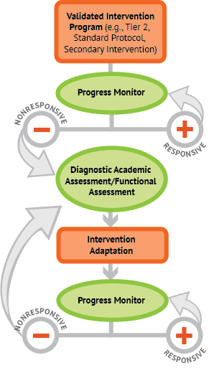

A Bird’s Eye View of DBI
Notes:
Animated slide. Click at underlined text.
See Handout 1: DBI Graphic for easier viewing.
NCII uses this graphic to illustrate the progression of DBI. We begin with a secondary intervention program, delivered with greater intensity, and progress monitor to determine the student’s response. If the student is responsive, we should continue to monitor progress and maintain the successful intervention. We may consider reducing intensity as goals are met (depending on rate and duration of response and nature of skill deficits). If the student is not sufficiently responsive, we gather additional information through informal diagnostic assessment, which identifies student needs to guide intervention adaptations. We continue progress monitoring to make decisions about whether or not the student is responding to the adapted intervention.

Slide 14

Is DBI the Same as RTI?
Special Education?
Many components of DBI are consistent with elements of special education and tiered service delivery systems.
Tiered Interventions
(RTI, MTSS, PBIS)
Universal, secondary, and tertiary interventions
Progress monitoring
Team-based decisions based on data
Special Education
Individualized program
Progress monitoring
Team-based decisions based on data
Notes:
When thinking of students with the most intense needs, it may be natural to think of students who qualify for special education services, or those students who require the most intensive services available in tiered intervention systems such as response to intervention (RTI), multitiered system of support (MTSS), or positive behavioral interventions and supports (PBIS).
Many components of DBI characterize elements of high-quality special education and tiered service delivery systems. The individualization aspect of DBI is aligned with the principles of serving students with diverse needs, including students with disabilities.
DBI is often built upon tiered systems, with strong universal and secondary interventions serving as precursors to individualization.
Progress monitoring and team-based decisions based on data are shared, key components of DBI, tiered interventions, and special education. Students who are likely to benefit from DBI may be, but are not necessarily, receiving special education. DBI can be used for any student with intensive needs.

Slide 15
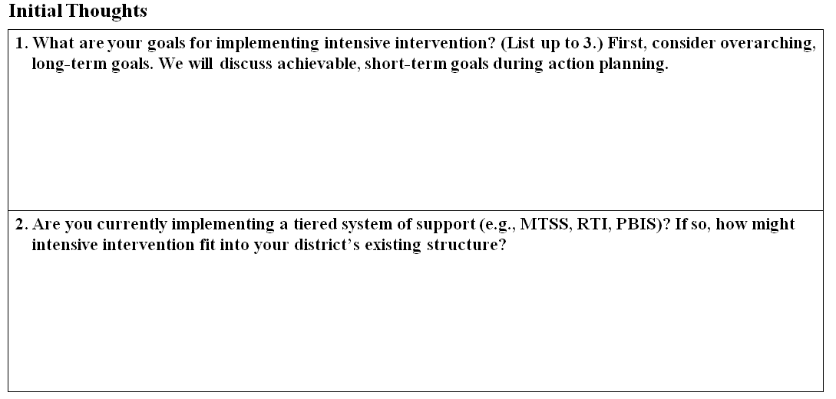
Handout 2: DBI Planning
Thinking About Intensive Intervention in Your School
Notes:
Look at Handout 2: DBI Planning. We will not be completing this entire handout now, but I would like you to take a few minutes to think about the first two questions. This is intended to serve as a brainstorming session for you, and we understand we have not detailed the entire DBI process at this point. It is important, however, that you start to conceptualize how this process may work in your district.
So, take a few minutes to talk to your partners and jot down a couple of ideas about what your preliminary goals for implementing intensive intervention might be and how might intervention fit into your district’s or school’s already-established structure. These goals and ideas are intended to be fluid and flexible and may change throughout this process—that is okay.
In the next few slides, we will be discussing key elements necessary for implementing DBI.

Slide 16
What Do You Need to Do to Implement DBI?
Overview of Essential Elements

Slide 17
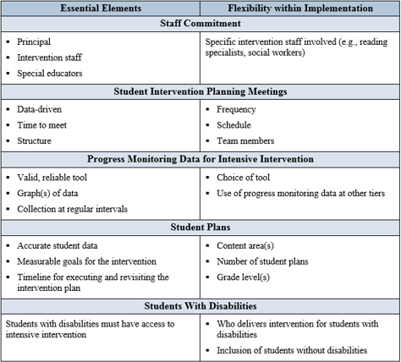
Handout 3: Essential Elements for DBI Implementation
Notes:
NCII provides intensive technical assistance to several districts to support DBI implementation. Through this work, NCII has identified several key elements for implementation. Within each area, some aspects are critical or “nonnegotiable.” We believe these pieces must be in place for successful implementation. The “negotiables” column lists areas that are more flexible. Some aspects will vary with school context and others reflect quantifiable aspects of implementation that are expected to increase over time (e.g., the number of student plans, the grades and content areas to which DBI is applied).

Slide 18

Staff Commitment
Key Components
Leadership
  Principal
Staff Buy-In
  Interventionists
  Special educators
  Others
Notes:
The first key area is staff commitment. We all know that leadership support is needed for interventions and strategies to work. NCII has found that principal support is particularly important for implementing DBI. Even when you are receiving outside training and coaching supports, it is critical that members of the leadership team are on board and actively involved, ensuring that intervention teams have time, resources, and support to work with students with intensive needs.
Leaders also play a key role in securing staff buy-in. Why does your school want to implement DBI? What changes do you hope to see in intervention practices or student outcomes? Agreeing on a common purpose and focus for DBI can provide the impetus for implementation.

Slide 19

Staff Commitment:
Leadership helps…
Establish vision and goals for DBI
Promote staff buy-in
  Make DBI relevant, shaping culture and expectations
  Involve staff in decision making
Provide supporting structures and resources
  Including assessments, interventions, professional development, staff time
Notes:
Shaping effective school culture for DBI often begins with administrators setting clear expectations that DBI is pivotal and necessary for meeting the needs of their students. Develop common language and knowledge about DBI, including assessment and intervention practices, so that staff can contribute to decision making.
Leaders also play an important part in setting up the logistical elements to support DBI implementation. Such elements include establishing measurable outcome goals; providing time in the schedule for meetings, assessments, instruction, and intervention; securing necessary resources; monitoring and evaluating; and asking tough questions.

Slide 20

Student Intervention Planning Meetings
Key components
Data-driven
Consistent time to meet
Structure
Notes:
The next key element in Handout 3 is student intervention planning meetings. The first nonnegotiable is that meetings should be data-driven. Progress monitoring data tell us when the intervention plan needs to be changed; we will talk a bit more about this later. Diagnostic assessment tells us what kind of changes are needed.
The last two nonnegotiables are logistical—team meetings should have a consistent structure and a regular meeting schedule. We will soon share some tools that can help guide student intervention planning meetings, including a sample agenda.

Slide 21

Teams
Lead and coordinate schoolwide DBI implementation
Collect and analyze data
Make student-level intervention decisions (student intervention planning meetings)
Notes:
Teams are needed for student intervention planning meetings as well as coordinating schoolwide implementation of DBI.

Slide 22
DBI Leadership Team
Oversees implementation efforts
Has decision-making authority
Aligns policies and other initiatives with DBI
Allocates resources
Supports individual student intervention planning meetings
Notes:
The DBI leadership team serves multiple functions. For example, the team:
Oversees implementation efforts
Has decision-making authority
Includes principal or designee
Aligns policies and other initiatives with DBI
Allocates resources
Supports individual student intervention planning meetings
The leadership team must have knowledge and understanding of DBI. Various members of this team will be involved in meetings for individual students; a student’s needs will determine which staff members will work with the student.
The next slide lists potential team members for student intervention planning meetings. Consider how these teams and meetings may overlap with existing teams (RTI or PBIS teams).

Slide 23
Student Intervention Planning Meetings: Potential Attendees
Core Team Members
Intervention provider
Administrator
Rotating Team Members
Referring teacher
School psychologist
Coach
Parent (as available and appropriate)
Student (when appropriate)
General educator or classroom teacher
Special educator
Content specialist
Behavior specialist/ social worker
Related service provider
School nurse
Notes:
Although roles may vary from school to school, core team members are likely to be critical for most student intervention planning meetings. Other staff members, as well as students and family, may be invited, as appropriate for the case at hand.

Slide 24
Team meetings should have…
  Clear purpose, roles, responsibilities, and norms
  Consistent meeting schedule and agenda
  Time to plan and to assess effectiveness of intervention
  Clear decision rules (based on data)
  Communication system
Notes:
When scheduling DBI team meetings and planning, it is important to promote consistency and protect designated meeting times.
When meetings are consistent, it reinforces the notion to team members that DBI is a priority and not a fleeting initiative. When meeting dates and times are predictable and known well in advance, it helps to ensure that team members come prepared with any necessary data.
The frequency of team meetings may depend the number of students requiring intensive intervention. Each student’s plan and data should be reviewed at least every six weeks. After creating the initial plan, schedule a time to review implementation and progress in 2 to 6 weeks. This interval will vary by the intensity of need and by how long a plan is likely to need to work. For example, behavior may change more quickly than many academic skills.
In addition, it is crucial that meetings be scheduled during a time when all members are able to attend. As we discussed earlier, team members bring different areas of expertise and knowledge of specific students that are crucial for decision making.
Some potential solutions to scheduling team meetings when all members can attend include
- Grade-level/data meetings occur during common planning.
- Grade-level/data meetings replace traditional faculty meetings.
- Substitutes are called in, and grade-level meetings are held throughout the day.

Slide 25
Considerations for Secondary School Settings
Team composition
  Will you have a single core DBI team, or will you want subteams by content area or grade?
  Which of a student’s many teachers are most needed for planning?
Scheduling meetings
  Can you repurpose existing meeting times?
  Can you schedule common planning times?
(National Center on Response to Intervention, 2011b)
Notes:
The very different schedules found in high schools and middle schools have implications for team composition and meeting schedules.
When possible, repurpose existing meeting times (e.g., staff meeting times, other team meetings, or professional learning communities).

Slide 26
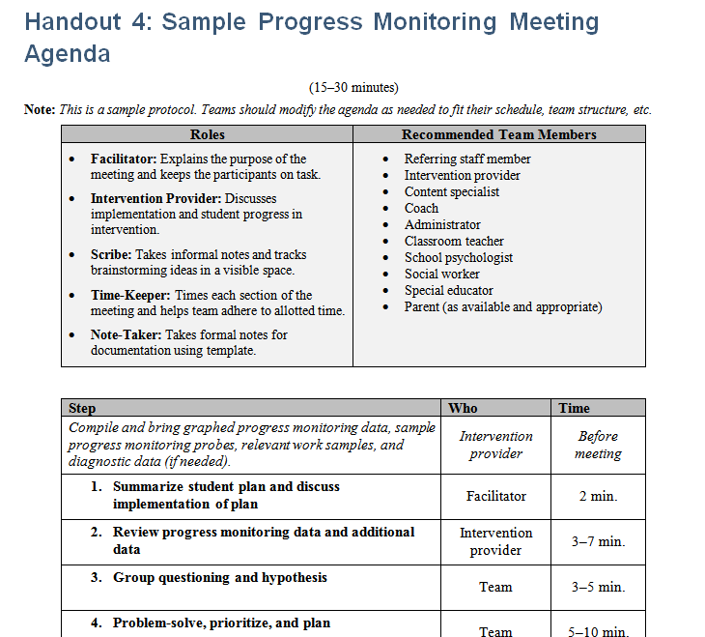
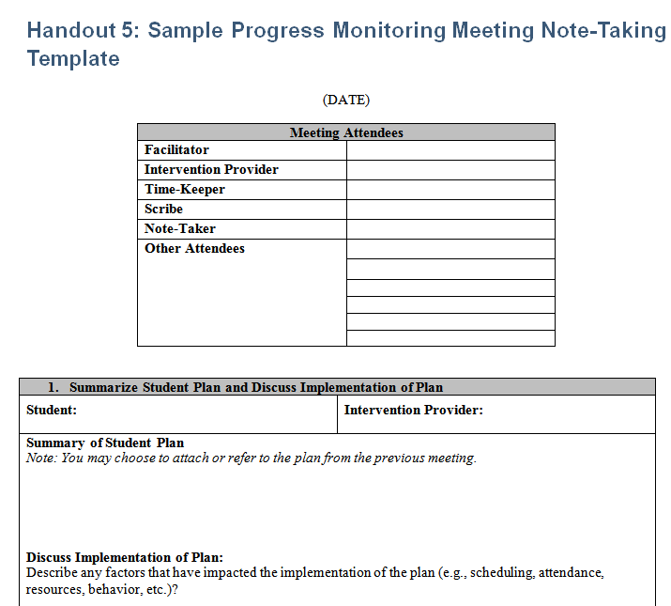
Examples of Student Intervention Planning Meeting Tools
Notes:
Briefly review Handouts 4 (Agenda) and 5 (Note-Taking Template)
We have provided our coaches with a set of tools that schools can use and modify as needed. These forms reflect important components of intervention planning, but these exact forms are not required—if you have already have a system in place that is working well for you, that is great!

Slide 27
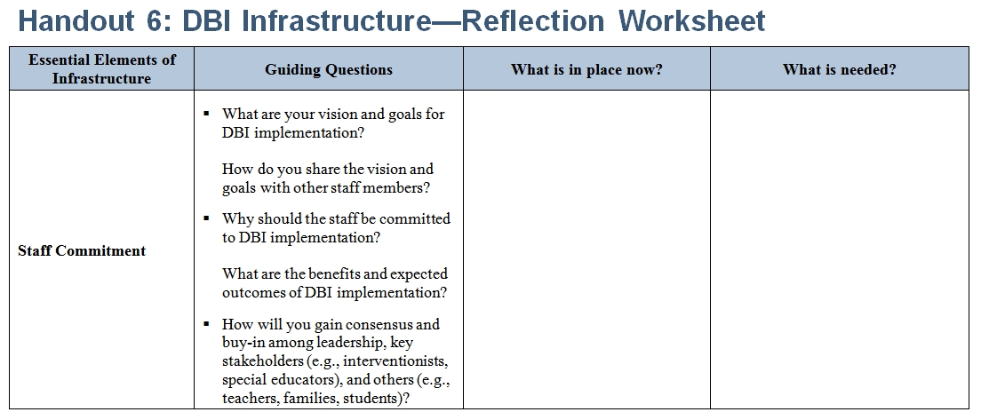
Reflection: Leadership and Teaming
Notes:
Now that we have reviewed considerations for staff commitment and student intervention planning meetings, let’s take time to review how your school’s infrastructure can support these areas.
Look at Handout 6, the DBI Infrastructure handout. You will see four columns that cover the essential elements of infrastructure, guiding questions, what is currently in place, and what is needed. Take 5 minutes to think about the first two rows, for staff commitment and team or collaboration, and complete the blank sections.
Your initial thoughts from Handout 2 may help inform your vision statement and think about the teams that are already in place.

Slide 28
Returning to the Essential Elements for DBI Implementation
Staff Commitment
Student Intervention Planning Meetings
Progress Monitoring Data for Intensive Intervention
Student Plans
Students With Disabilities
Notes:
Look back and Handout 3. We have already talked about the first two essential components. Now let’s discuss the rest, starting with progress monitoring data.

Slide 29
Progress Monitoring Data for Intensive Intervention
Key Considerations
Use valid, reliable progress monitoring tool.
Graph the data.
Collect data at regular, frequent intervals within intensive intervention.
Notes:
DBI requires valid, reliable data on student performance to determine when and how an intervention should be changed. For these data to be useful, they need to be regularly collected and readily available to those making decisions. Progress monitoring tools must be sensitive to student growth, and data should be graphed. Clear decision rules should provide guidance on when an intervention needs to be changed.

Slide 30
Other Data Sources
Assessment data
  Universal screening
  Diagnostic assessment
  Progress monitoring data at other levels (secondary intervention)
  Other formative data
  Prior state assessment data
  Behavioral history
Notes:
Additional data sources that may be used to support intensive intervention include universal screening, diagnostic assessment, and progress monitoring data occurring in secondary interventions. As mentioned in the previous slide, it also is important that these data be valid and reliable and that clear decision rules be used for informing instructional decisions.

Slide 31
Resources for Identifying Assessment Tools
NCII staff or other technical assistance providers
NCII website
  Academic Progress Monitoring Tools http://www.intensiveintervention.org/chart/progress-monitoring
  Behavioral Progress Monitoring Tools http://www.intensiveintervention.org/chart/behavioral-progress-monitoring-tools
Notes:
The NCII DBI Training Series (http://www.intensiveintervention.org/content/dbi-training-series) has modules on both academic and behavioral progress monitoring.

Slide 32
Considerations for Secondary School Settings
Potential challenge: fewer tools for adolescents and high school standards
See the webinar “The High School Tiered Interventions Initiative: Progress Monitoring.” http://www.rti4success.org/video/high-school-tiered-interventions-initiative-progress-monitoring
Notes:
Several tools on the academic progress monitoring tools chart extend to middle school students. Some can be used through grade 12.

Slide 33
Student Plans
Key considerations
  Accurate student data
  Measurable goal(s) for the intervention
  Timeline for executing and revisiting the intervention plan
Notes:
Now let’s consider our fourth essential element for implementation, student plans.

Slide 34
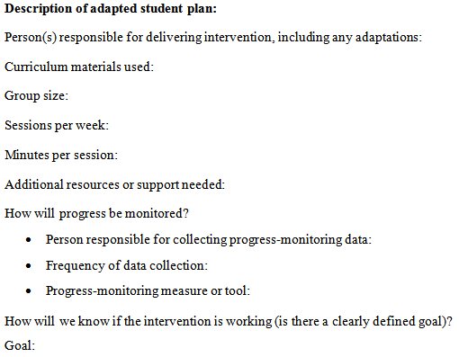
Handout 5: Description of Plan
Notes:
Handout 5 prompts you to record important elements of the student plan, including plans for intervention and progress monitoring.

Slide 35

Scheduling Intervention Time to Execute Plans
Intervention should supplement core instruction when possible
Considerations:
  Length of sessions?
  Days per week?
  Who will deliver interventions?
Structure
  Within classroom
  Within grade
  Across grades
Notes:
In general, interventions should supplement core instruction and provide an extra dose of instruction beyond the core. In extreme situations, however, intensive intervention may supplant (replace) part of core instructional time. This is decided case by case.
When scheduling intervention time, you need to consider how long intervention sessions will be, how many days per week interventions will be provided, and who will be teaching each intervention.
Making these determinations will require that you look at the specific intervention programs you are using and the developer requirements to ensure fidelity. For example, if an intervention program requires four sessions a week for 30 minutes, students should receive that amount of intervention in order to receive the intervention the way it was intended to be delivered.
Many schools report that it can be a challenge to have enough time and staff to deliver interventions. Remember that the goal is to provide intervention to the greatest number of students your existing resources can support. DBI is reserved for students with the most intensive needs.
There are multiple approaches schools can take to structuring intervention times.
Consider: Given existing resources, which approach will best allow students with intensive needs to receive intensive intervention?

Slide 36
Considerations for Secondary School Settings
What should plans target?
  Grade level or foundational skills
  Behaviors that support school success, graduation, and college or career
Who delivers interventions?
  Content teachers? Specialists or interventionists? Special educators?
How can we schedule intervention time?
  Consider elective classes or adding an intervention period.
(National Center on Response to Intervention, 2011a & 2011b)
Notes:
Intensive intervention may represent a culture shift for high schools, where teachers are often used to focusing on a grade-level content area.

Slide 37
Communicating Student Plans
Provide parents and staff with
Overview of DBI process
Involvement in decision making
Updates on student’s progress
Notes:
Parents of students who need intensive intervention need to know how the DBI process is used in your school. This also applies to staff members who work with students with intensive needs, even if they are not interventionists or members of the problem-solving team. Your school will need a system for sharing information on a student’s progress and changes in intervention with both parents and staff. Frequent teacher team collaboration and communication with parents will provide more information for making good intervention decisions.

Slide 38
Students With Disabilities
Intensive Intervention
Students with disabilities
Receive services at all levels, according to need, including intensive intervention.
Targeted Level of Prevention
Universal Level of Prevention
Notes:
Policies and practices within schools should ensure that students with disabilities have access to intensive intervention. When students with disabilities do not respond to Tier 1 and Tier 2 supports, they must have access to intensive intervention if they require it.
Students may receive services at different levels of support in different areas. For example, a student with a learning disability in reading may need intensive intervention in reading while needing only core instruction in mathematics.

Slide 39
Reflection: Complete Handout 6 (Infrastructure Worksheet)
Data Use: What data do you collect? How are they used?
Student Plans: How are plans developed, communicated, implemented, and reviewed?
Students with Disabilities:
  How are data used for special education decisions (e.g., eligibility and individualized education program planning)?
  How are students with disabilities included within the intervention process (e.g., tiered framework)?
  Are there policies or practices in place that preclude the inclusion of students with disabilities within intensive intervention?
Notes:
Support teams in considering these areas and completing worksheet. Note that the worksheet contains additional and more detailed questions for Data Use and Student Plans.

Slide 40
Introduction to NCII Intensive Technical Assistance
Notes:
NCII Intensive technical assistance is a specific activity conducted in partner districts; this section applies only to these districts. Other schools and districts can email ncii@air.org to discuss available supports. They also may consider working with local, regional, or state technical assistance providers.

Slide 41
Intensive Technical Assistance
Intensive implementation supports include
Training on key aspects of DBI
  Implementing or refining team meetings
  Application of the progress monitoring/assessment/adaptation cycle to reading, mathematics, or behavior
On-site coaching supports, targeting
  Application of training content and resources
  Implementation of the DBI process with students with intensive needs
Notes:
As a reminder:
A common misconception about working with NCII is that we will train teachers on how to implement a specific intervention. DBI is a framework for designing and delivering intensive intervention, rather than a single program. We will support school staff in learning how to use data to understand student needs and design individualized intervention aligned to those needs.

Slide 42
Professional Development
All other aspects of DBI infrastructure hinge on professional development.
Professional development
  Increases staff knowledge
  Provides continuous implementation support
Notes:
Professional development is needed to provide teachers and other staff with the knowledge, skills, and resources they need to implement DBI.
In this way, all other aspects of DBI infrastructure hinge on professional development.
Professional development provides two primary functions:
1. Building staff knowledge
This often involves helping staff to understand the purpose, goals, and expected outcomes of DBI (which is pivotal to ensuring the school culture is conducive to DBI).
It also involves establishing a common language.
2. Providing continuous support for implementation
Professional development offers a means for leadership to listen to staff concerns and provides a mechanism for those concerns to be communicated.
Professional development should be
Aligned to the essential components of DBI
Flexible
Ongoing
Job-embedded
Research-based

Slide 43
Essential Professional Development for DBI
Key topics
DBI process
Assessment for decision making
  Progress monitoring
  Diagnostic assessment
Intensive intervention practices
Student intervention planning meeting structures
Plan for
Initial training with coaching supports
Refresher training
New staff training
Ongoing implementation and refinement
Notes:
DBI training includes an introduction to the DBI process as well as training specific to academics and behavior, addressing assessment and intervention. We recommend starting in one area so you can move to implementation more quickly. You also will learn more about meeting structures and processes. You will work with your NCII trainer, coach, and liaison to develop a training schedule that reflects your needs.
Although NCII may support initial training with follow-up coaching, in the long term you will need to consider school and district resources for providing any needed refresher training as well as training new staff. You also will need to provide training and support for specific tools and programs your school chooses to use.

Slide 44

Scheduling Professional Development
Get training dates on your calendar as soon as possible!
  How many trainings are anticipated this year?
Schedule a regular coaching and planning time
  Plan for a monthly meeting.
  With whom does the coach need to meet to support implementation?
  Does it make sense for the coach to work with an existing team?
Notes:
Today or at a later time, trainers and coaches should discuss training needs and priorities with the school team. To allow schools to start student intervention planning meetings and plans as quickly as possible, we encourage schools to select an initial area of implementation (academics or behavior). Guiding questions might include
Does the school want to first receive training in DBI for academics or behavior? If academics, does the school want to focus more strongly on mathematics or reading?
Once implementation is underway in the first area, you can starting training in the other area.
Look back at the key topics on the previous slide. In what areas does the school already feel comfortable?
Within each area, identify the specific components within the DBI training series modules that are most relevant for the school.
What training should be completed by NCII trainers? What areas can district staff support? For example, can current NCII schools or other district staff who have received training share their knowledge?
Also consider NCII website resources, such as webinars, for refreshers or introductions to certain topics.

Slide 45
Expectations for Working With NCII
Leadership support
Participate in regular training and coaching
Implement DBI with individual students
  Identify a focus area for initial training and implementation
  Goal is to start holding student intervention planning meetings and develop intervention plans before the end of the school year
Help us improve!
Notes:
After today’s session, you will have time to think about whether your school is ready to work with NCII to prepare for DBI implementation. This slide outlines some key expectations for participating in intensive technical assistance.
Leadership support
The principal’s support is key! Are you willing to commit the school’s time and resources to DBI implementation?
You will want to involve key support systems already in the school related to MTSS/RTI, PBIS, and special education.
Participate in regular training and coaching
approximately monthly
time for planning today
Implement DBI with individual students
Later we will discuss selecting a focus area, such as behavior, reading, or mathematics, for initial training and implementation.
Begin with a few students (school identifies students and preferred grade, content area)—after needed training.
Goal is to have 3 to 5 student plans before end of the first year and add more over time.
Once DBI implementation is underway in one area, you can expand to others.
Help us improve!
We would like your feedback, e.g., via survey or interview, to help us improve our supports.

Slide 46

Ensuring Critical Features of DBI Implementation
Staff commitment
Student intervention planning meetings and plans
Progress monitoring data for intensive intervention
Access to intensive intervention for all students with intensive needs (including students with disabilities)
Notes:
We expect our partner schools to commit to the critical features in Handout 3. Staff commitment, particularly leadership support, is a key precursor to successful TA and initial implementation. Other features will not be implemented until at least some training has occurred, but we want to know that the school is willing to commit the time and resources for implementation when the time comes.

Slide 47
Next Steps
Notes:
Now that you have done some reflection on the DBI process and what is happening at your site, we want to talk a little more about additional considerations and what we have learned in the process of our work at NCII.
You will need the DBI planning handout we started at the beginning of this training.

Slide 48
Next Steps:
Is Your School Ready for DBI?
Identify infrastructure strengths and needs.
What areas can you address as a school? What can the district support? What areas require external training or coaching support?
Are you ready for DBI this year?
  If yes, what are your next steps?
Notes:
Identify infrastructure strengths and needs. (Refer to your completed infrastructure handout.)
What areas can you address as a school? What can the district support? What areas require external training or coaching support?
Are you ready for DBI this year?
If yes, what are your next steps?

Slide 49
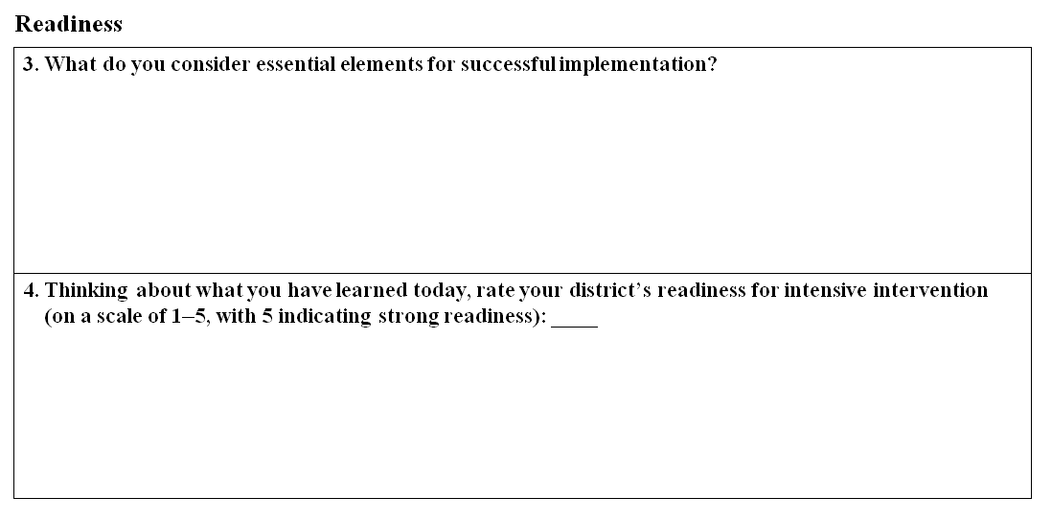
Handout 2: DBI Planning
Thinking About Readiness
Notes:
Take a look back at the DBI Planning handout we started at the beginning of today’s presentation. Take 5 minutes to complete questions 3 and 4. On the basis of what you have learned, what are the essential elements for successful implementation and how would you rate your school’s readiness overall?

Slide 50

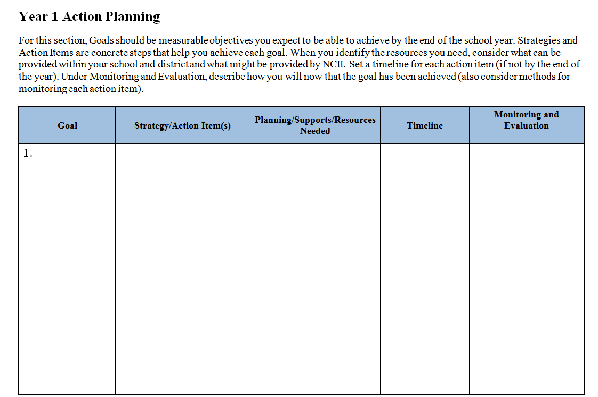
Handout 2: DBI Planning
Thinking About Goals for Year 1
Notes:
At the end of the DBI Planning handout, we have given you room to think about your goals for year 1 and what you need to do and have in order to achieve them. If you believe you are ready to implement, you can start working on this now. Otherwise, wait until your team has further discussed readiness.
We encourage you to choose a focus area for initial training and implementation (e.g., academics or behavior). Within academics, you may want to focus more on reading or mathematics, taking into account your school’s strengths and needs.

Slide 51
References
Deno, S. L., & Mirkin, P. K. (1977). Data-based program modification: A manual. Minneapolis, MN: Leadership Training Institute for Special Education..
Fuchs, L. S., Fuchs, D., & Hamlett, C. L. (1989). Effects of instrumental use of curriculum-based measurement to enhance instructional programs. Remedial and Special Education, 10, 43–52.
Fuchs, L.S., Fuchs, D., Powell, S. R., Seethaler, P. M., Cirino, P. T., & Fletcher, J. M. (2008). Intensive intervention for students with mathematics disabilities: Seven principles of effective practice. Learning Disability Quarterly, 31, 79–92.
Gersten, R., Compton, D., Connor, C. M., Dimino, J., Santoro, L., Linan-Thompson, S., & Tilly, W. D. (2008). Assisting students struggling with reading: Response to intervention and multi-tier intervention for reading in the primary grades. A practice guide (NCEE 2009-4045). Washington, DC: U.S. Department of Education, Institute of Education Sciences, National Center for Education Evaluation and Regional Assistance. Retrieved from http://ies.ed.gov/ncee/wwc/PracticeGuide.aspx?sid=3

Slide 52
References
National Center on Intensive Intervention. (2013). Data-based individualization: A framework for intensive intervention. Washington, DC: U.S. Department of Education, Office of Special Education. Retrieved from http://www.intensiveintervention.org/sites/default/files/DBI%20a%20Framework%20for%20Intensive%20Intervention.pdf
National Center on Response to Intervention (2011a). RTI in middle schools: Frequently asked questions. Washington, DC: U.S. Department of Education, Office of Special Education Programs, National Center on Response to Intervention. Retrieved from http://www.rti4success.org/sites/default/files/0572%20MS%20RTI%20FAQs%20d5%5B1%5D.pdf
National Center on Response to Intervention. (2011b). RTI scheduling processes for middle schools. Washington, DC: U.S. Department of Education, Office of Special Education Programs, National Center on Response to Intervention. Retrieved from http://www.rti4success.org/sites/default/files/0681MS_RTI_Rescheduling_Brief_d2.pdf

Slide 53
References
Sanford, C., Newman, L., Wagner, M., Cameto, R., Knokey, A.-M., & Shaver, D. (2011). The post-high school outcomes of young adults with disabilities up to 6 years after high school. Key findings from the National Longitudinal Transition Study-2 (NLTS2) (NCSER 2011-3004). Menlo Park, CA: SRI International. Retrieved from http://www.ies.ed.gov/ncser/pubs/20113004/pdf/20113004.pdf
Stetser, M., & Stillwell, R. (2014). Public high school four-year on-time graduation rates and event dropout rates: School years 2010–11 and 2011–12. First Look (NCES 2014-391). U.S. Department of Education. Washington, DC: National Center for Education Statistics. Retrieved from http://nces.ed.gov/pubsearch
.

Slide 54
NCII Disclaimer
This presentation was produced under the U.S. Department of Education, Office of Special Education Programs, Award No. H326Q110005. Celia Rosenquist serves as the project officer. The views expressed herein do not necessarily represent the positions or polices of the U.S. Department of Education. No official endorsement by the U.S. Department of Education of any product, commodity, service, or enterprise mentioned in this website is intended or should be inferred.

Slide 55
Contact
Presenter Name
XXX-XXX-XXXX
xxxxxxxxxxx@air.org
1000 Thomas Jefferson Street NW
Washington, DC 20007-3835
866-577-5787
www.intensiveintervention.org
ncii@air.org

