Slide 1
Introduction to Data-Based Individualization
October 2020
Considerations for Implementation in Academics and Behavior
Notes:
Welcome to the National Center on Intensive Intervention’s (NCII’s) module introducing data-based individualization (DBI). This is the first in a series of training modules developed by NCII aimed at district or school teams involved in initial planning for using DBI as a framework for providing intensive intervention in academics and behavior. The audience for this module may include interventionists, special educators, behavior support team members, school psychologists, counselors, and administrators, as appropriate. Subsequent modules will provide additional information about specific components of the DBI process.
Introduce yourself and review the workbook materials and any additional handouts that you will use during the session. You may choose to add a slide with your picture and the workbook cover.
For more information about the DBI process you may want to direct participants to the following resources:
Self-paced online module introducing intensive intervention: https://intensiveintervention.org/resource/self-paced-introduction-intensive-intervention
Read about the DBI process in detail: https://intensiveintervention.org/sites/default/files/DBI_Framework.pdf
Explore DBI topics: https://intensiveintervention.org/intensive-intervention
Handout—Breaking Down the DBI Process: Questions & Considerations: https://intensiveintervention.org/sites/default/files/NCII-placemat-508.pdf
Dr. Chris Lemons (Vanderbilt) explains intensive interventions and why they are important: https://intensiveintervention.org/resource/what-are-intensive-interventions-and-why-are-they-important
Estimated time for full presentation: 3 hours. Time for this module may vary depending on how long you provide to teams to discuss their current level of implementation. You can shorten the module by focusing on the introduction to intensive intervention and DBI sections. An accompanying workbook is provided for all handouts included in the session.
Tentative Agenda
15 minutes Welcome and Introduction (variable based on introduction design)
20 minutes Introduction to Intensive Intervention
55 minutes Introduction to DBI
15 minutes BREAK
45 minutes Effective Implementation of DBI
15 minutes Things to Remember
15 minutes Closing and Next Steps
Although permission to reprint this publication is not necessary, the citation should be:
National Center on Intensive Intervention. (2020). Introduction to data-based individualization: Considerations for implementation in academics and behavior. Washington, DC: U.S. Department of Education, Office of Special Education Programs, National Center on Intensive Intervention.

Slide 2
Welcome and Introductions
Introduce yourself and share how you are currently supporting students who are persistently struggling academically and/or behaviorally, including those students who are nonresponsive to Tier 2 interventions or current specially designed instruction.
Notes:
Depending on time and audience, you may adapt the welcome and introduction activity.
For larger groups with limited space and time, this activity can be done through a think-pair-share activity for which you ask participants to:
1. THINK for 30 seconds about the proposed question,
2. PAIR with a tablemate or partner, and
3. SHARE what they are doing in their sites.
For larger groups, with participants from multiple schools or districts and in rooms where you have more space and time, you can encourage participants to stand up and partner and share with someone they don’t know and then to switch partners and share again.
For smaller groups, you can simply have pairs of participants introduce each other and share out.

Slide 3
Learner Outcomes
At the end of this session, participants will be able to do the following:
Explain the rationale for intensive intervention.
Describe the steps in the data-based individualization (DBI) process.
Apply lessons learned to improve implementation of DBI.
Access and use National Center on Intensive Intervention (NCII) resources to support implementation of DBI.
Notes:
In this session, we will introduce intensive intervention delivered through the data-based individualization (DBI) process.
At the end of this session, participants will be able to do the following:
Explain the rationale for intensive intervention.
Describe the steps in the data-based individualization (DBI) process.
Apply lessons learned to improve implementation of DBI.
Access and use National Center on Intensive Intervention resources to support implementation of DBI.

Slide 4
Introduction to Intensive Intervention
Notes:
Estimated delivery time: 20 minutes
Learning outcome: Explain the rationale for intensive intervention.

Slide 5
Why do we need intensive intervention?
Students with disabilities have a history of poor outcomes in several areas, compared to their peers without disabilities:
Academic achievement
High school completion
Postsecondary education
Employment
Involvement with the criminal justice system
Notes:
Outcome data suggest that our current system does not adequately prepare students with the most intensive needs, particularly students with disabilities. Although the performance of students with disabilities has improved during the past 2 decades, these students continue to fall behind their same-age peers in reading and mathematics, are more likely to experience discipline problems at school, and are less likely to graduate from high school and pursue post secondary education. Data also suggest long-term impacts on employment and involvement with the criminal justice system.
Some additional context is provided below. Note that this information may be need to be updated based on the most recent data available.
Low academic achievement. Intensive intervention is a highly relevant and timely topic, considering the continuing academic underachievement of students with disabilities, as reflected in the National Assessment of Educational Progress. Whether measured by grade-level proficiency, grade point average, or credits earned, students with disabilities consistently fall behind their classmates (Blackorby et al., 2007; Newman et al., 2011; Stark & Noel, 2015; Wagner, Newman, Cameto, Levine, & Garza, 2006).
The achievement gap between students with and without a learning disability increases as students advance from one grade to the next. By the secondary level, students with a learning disability are, on average, 3 years behind in reading and mathematics (Cortiella, 2011, p.15).
Graduation rates. Compared to the general population, students with disabilities are less likely to graduate on time. For the 2011–12 school year, the U.S. public high school 4-year adjusted cohort graduation rate was only 61% for students with disabilities compared to 80% for all students (Stetser & Stillwell, 2014).
Postsecondary education. Only 54.9% of young adults with disabilities have ever enrolled in any postsecondary education, compared to 62.1% of young adults in the general population. Completion rate is significantly lower among students with disabilities (38.4%) than young adults without disabilities (51.2%) (Sanford et al., 2011).
Employment. Students with disabilities earn lower wages than their peers without disabilities. When considered within the context of their low rate of participation in postsecondary education, this wage gap is likely to grow with time, because many students with disabilities will not develop the skills necessary to advance into higher paying jobs (Sanford et al., 2011, p. 27).
Arrest rates. Twenty-three percent of young adults with disabilities have been arrested at least once, almost twice the rate for youth in the general population (12%; p < .001). Rates for arrest and parole are highest among students identified as having emotional disturbance (49.4%). (Sanford et al., 2011).

Slide 6
Why do we need intensive intervention?
Validated programs are not universally effective programs; 3% to 5% of students need more help (NCII, 2013).
Students with intensive needs often require 10–30 times as much practice as their peers to learn new information (Gersten et al., 2009).
For students with intensive needs, co-occurring academic and behavioral needs are the rule not the exception (Kuchle & Riley-Tillman, 2019) .
Notes:
Despite our best efforts and the growing body of evidence-based practices, validated programs are not universally effective. Even after implementing the programs with fidelity, 3% to 5% of students will need more help. Those students with intensive needs often require upward of 10 to 30 times as much practice as their peers when they are learning new information. We also know that students with intensive needs often face co-occurring academic and behavioral challenges, which demand that we design intervention that addresses academic, social, emotional, and behavioral needs.
Note: while the previous slide highlighted poor outcomes for students with disabilities, not all students with intensive needs have an identified disability. For example, the practice guide by Gersten et al. (2009) reflects data that include students without disabilities

Slide 7
What is intensive intervention?
Intensive intervention addresses severe and persistent learning and behavioral difficulties.
Characterized by increased intensity and individualization
Driven by data
Notes:
Intensive intervention addresses severe and persistent learning and behavioral difficulties.
Intensive intervention is driven by data and characterized by increased intensity and individualization.

Slide 8
What is intensive intervention?
Intensive intervention is . . .
A process
Individualized based on student needs
More intense, often with substantively different content and pedagogy
A process that involves more frequent and precise progress monitoring
An approach that integrates academic and behavioral supports
Intensive intervention is not . . .
A one-time fix
A single approach
A manual
A preset program
More of the same Tier 1 instruction
More of the same Tier 2 instruction
Notes:
Briefly review slide and reinforce that intensive intervention is a process not a one-time fix, single approach or preset program.

Slide 9
Who needs intensive intervention?
Students with disabilities who are not making adequate progress in their current instructional program and not meeting individualized education program (IEP) goals
Students with persistently low academic achievement and/or high-frequency and/or high-intensity behavior
Students in a tiered intervention program who are nonresponsive to interventions delivered with fidelity
Notes:
Intensive intervention is intended for a small percentage of students with severe and persistent learning and behavioral needs, including: Read slide.
The decision to move a student directly to an intensive intervention should be made on an individual and case-by-case basis. In most cases, data should be collected over time to help demonstrate that the student’s low achievement or behavior challenges are both significant and persistent.

Slide 10
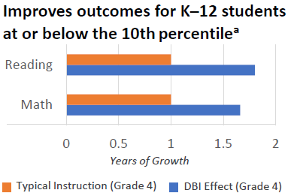
Benefits of Intensive Intervention
“In one year, 78% of students receiving intervention reached ambitious growth goals set using national norms. Thirty percent of students were exited from any kind of intervention.” —Bristol Warren Regional School District, Rhode Island
(Jung, McMaster, Kunkel, Shin, & Stecker, 2018; Scammacca, Fall, & Roberts, 2015)
Notes:
Review slide data.
The data from this slide come from Jung, P. G., McMaster, K. L., Kunkel, A. K., Shin, J., & Stecker, P. M. (2018). Effects of data‐based individualization for students with intensive learning needs: A meta‐analysis. Learning Disabilities Research & Practice, 33(3), 144–155 and Scammacca, N. K., Fall, A. M., & Roberts, G. (2015). Benchmarks for expected annual academic growth for students in the bottom quartile of the normative distribution. Journal of Research on Educational Effectiveness, 8(3), 366–379. The quote comes from Bristol Warren Regional School District in Rhode Island. This was one of the sites that NCII worked with intensively between 2012-2016.
Additional research and articles focused on intensive intervention are available at https://intensiveintervention.org/resource/what-does-literature-say

Slide 11
Where does intensive intervention fit within a multitiered system of support (MTSS)?
Characteristics | Tier 1 | Tier 2 | Tier 3
Instruction/ Intervention Approach | Comprehensive research-based curriculum | Standardized, targeted small-group instruction | Individualized, based on student data
Group Size | Classwide (with some small-group instruction) | 3–7 students (as defined by developer) | No more than 3 students
Progress Monitoring | 1x per term | At least 1x per month | Weekly
Population Served | All students | Students at risk (typically 15% to 20% of student population) | Significant and persistent learning and/or behavioral needs
Notes:
Given that a small percentage of students will not respond to validated Tier 1 and Tier 2 supports, intensive intervention is considered an important component of a successful tiered system of supports. Depending on your focus and district, this system may be called multitiered system of support (MTSS), response to intervention (RTI), or positive behavioral interventions and supports (PBIS). Intensive intervention in behavior and academics is considered the most intensive level of support and implemented through Tier 3.
Briefly review the table. Highlight the differences between the tiers in terms of the following:
Increasingly focused or tailored approach
Decreasing group size
Increasing frequency of progress monitoring
Increasing student need

Slide 12
How do Tier 2 and Tier 3 compare?
Characteristics | Tier 2 | Tier 3 - DBI
Instruction/ Intervention Approach | Follow standardized evidence-based programs as designed | Use standardized evidence-based program as a platform, but adapt instruction based on student data
Duration and Time Frame | Use duration and time frame defined by developer | Increase frequency and/or duration to meet student needs
Group Size | 3–7 students (as defined by developer) | Decrease group size to meet student needs (no more than 3 students)
Progress Monitoring | At least monthly | Weekly
Population Served | Students at risk (typically 15% to 20% of student population) | Significant and persistent learning and/or behavior needs (typically 3% to 5% of student population)
Notes:
As we focus in on Tiers 2 and 3, you can see some features that distinguish Tier 2 from intensive intervention. Although the instruction of Tier 2 interventions follows a standardized evidence-based program as it was designed, instruction at the intensive level involves adapting that standardized program based on student data, to meet the unique needs of the student.
At the intensive level, intervention is typically made more intensive by increasing the opportunities for practice and explicit feedback through smaller group sizes or increased frequency in sessions or duration. Although monitoring progress at least once a month is generally sufficient at Tier 2, at the intensive level, progress monitoring data should be collected weekly. You’ll note that the population served by Tier 2 interventions includes students who have been identified as at risk in a particular content area, which is typically about 15% to 20% of the student population. The population served by intensive interventions includes students with significant and persistent learning and/or behavioral needs, which is typically only 3% to 5% of the student population.

Slide 13
How does intensive intervention relate to special education?
Students with disabilities must have access to intensive intervention.
Many students who require intensive intervention also are students with disabilities.
Intensive intervention can help educators design and deliver special education programming.
DBI should be part of the educational program for students with disabilities, not a separate process.
In schools implementing MTSS, students with disabilities may receive components of their intensive intervention across the levels of support.
Notes:
Review slide. We will discuss this further in the next section.

Slide 14
Introduction to DBI
Notes:
Section delivery time: 45 minutes
Learning outcome: Describe the steps in the DBI process.

Slide 15
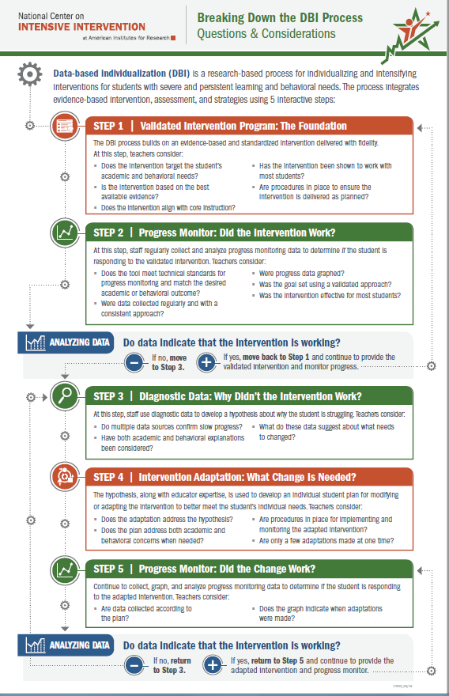
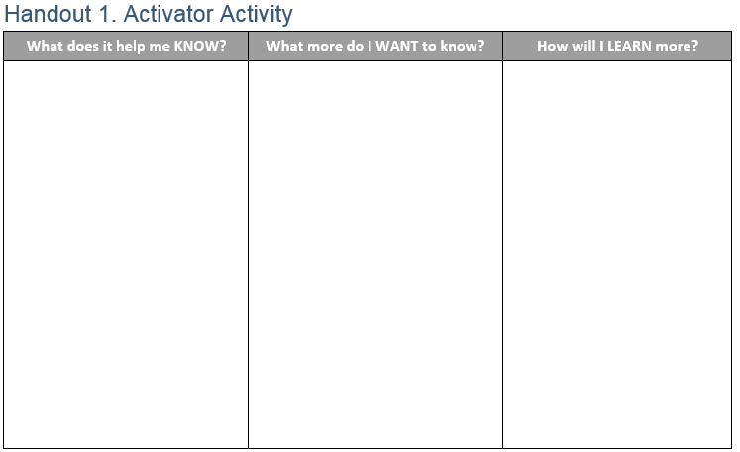
Activator Activity
Handout
Notes:
Each of you has two handouts in your workbook. The first handout includes a review of the steps in the DBI process. The second handout includes a table with three columns. Many of you are likely familiar with a K-W-L (for Know, Want to Know, Learn). This is a slightly modified version that includes space for you to document what you know from reviewing the resource, what questions you have or what you want to learn more about, and, finally, how you will learn more. For the next activity, you will focus on the first two columns (click for animation). Using the Breaking Down the DBI Process: Questions and Considerations handout, individually document what you know from reviewing the handout and what you want to know more about. You will have about 5–7 minutes to do this. Once you have completed documenting what you know and want to know more about, turn to your neighbor or tablemates and share some of the things that you documented.
Provide about 5–7 minutes for individual review, provide about 3–5 minutes for table/partner talk, and then provide time for group share-out. Note how you will address questions throughout the training.

Slide 16
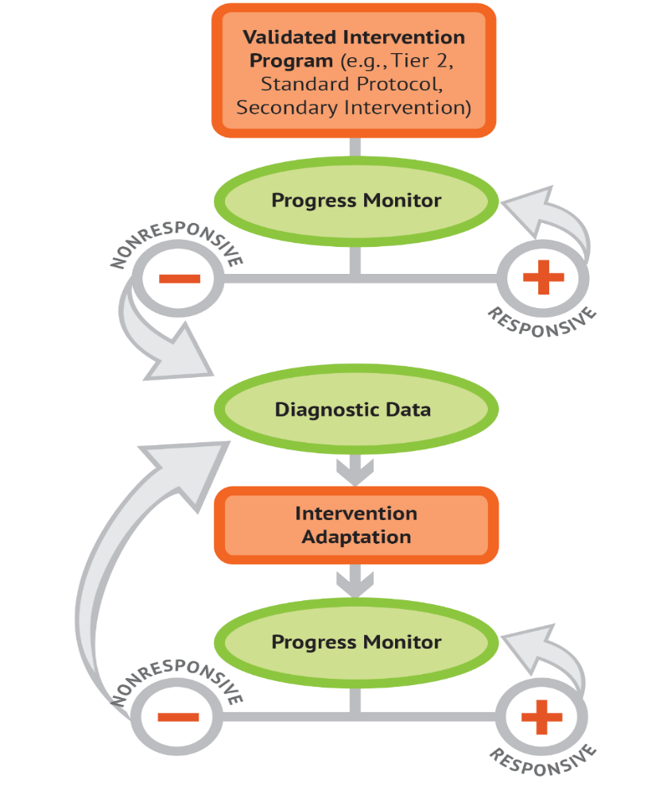
What is data-based individualization (DBI)?
DBI Process
Data-based individualization (DBI) is a research-based process for individualizing and intensifying interventions for students with severe and persistent learning and behavioral needs.
The process integrates evidence-based intervention, assessment, and strategies.
Notes:
NCII’s approach to intensive intervention is data-based individualization, or DBI. DBI is a systematic method for using data to determine when and how to individualize and intensify intervention for students with severe and persistent learning and behavioral needs. DBI is grounded in experimental teaching research conducted by Deno and Mirkin at the University of Minnesota and expanded upon by others (Capizzi & Fuchs, 2005; Fuchs, Deno, & Mirkin, 1984; Fuchs, Fuchs, & Hamlett, 1989). The DBI process integrates evidence-based intervention, assessment, and strategies.
In reality, DBI is the technical term for what many good teachers do naturally through the problem-solving process—frequently review student data and make changes to their teaching based on what works for students. DBI, however, makes this process systematic, explicit, and tailored to meet the needs of individual students through a multistep process that gradually intensifies instruction and support.

Slide 17
Do I need a DBI team to implement DBI?
No. Individual teachers can independently implement DBI.
But three (or more) heads are always better than one when engaging in problem solving!
Notes:
One question you might have is whether you need a team to implement DBI (click for animation). Although DBI can be implemented by an individual teacher, we recommend, when possible, using a team-based approach (click for animation). As the slide says, three (or more) heads are always better than one when engaging in problem solving.
Initial research on this was teachers learning to implement experimental teaching, not teams.

Slide 18
How does DBI support implementation of special education requirements?
DBI can help schools implement special education requirements within a comprehensive support system.
Referral and Eligibility Requirements
Ensure provision of intensive interventions to rule out lack of instruction.
Provide formal progress monitoring data that can be shared with parents.
Compare student performance to performance of peers.
IEP Development and Implementation
Provide data to develop present levels of academic achievement and functional performance statements.
Set ambitious, realistic IEP goals, and monitor progress toward those goals.
Develop specially designed instruction.
Provide estimates of level of service needed.
Notes:
Another question you might have is about how DBI relates to special education. Many components of DBI are consistent with elements of special education and can support referral and eligibility requirements, as well as IEP development and implementation. When implemented as part of MTSS, DBI provides information that can be used in eligibility decisions to help rule out lack of instruction, document student progress that can be shared with parents, and compare a student’s performance to performance of peers. In the development and implementation of the IEP, data collected through the DBI process can help with development of present level of academic achievement and functional performance statements, development of realistic and ambitious IEP goals, and ongoing monitoring of progress toward those goals. The process can also help educators develop specially designed instruction and provide estimates of the level of service needed.

Slide 19
DBI Process
Validated intervention program, delivered with fidelity
Progress monitoring
Diagnostic data used to develop a hypothesis
Adaptation to validated intervention
Continued progress monitoring, with adaptations occurring whenever needed to ensure adequate progress
Notes:
The DBI process includes 5 iterative steps:
Step 1: The DBI process builds on a validated intervention program delivered with fidelity. The validated intervention program is typically an evidence-based standard-protocol intervention.
Step 2: Regular progress monitoring data are collected to determine whether the student is responding or not responding to the intervention. If the student is responsive, the teacher continues to provide the validated intervention program and monitors student progress until the student reaches expectations. If the data suggest that the student is not responding while other students who have received the intervention have responded, then the teacher moves to the next step of the process.
Step 3: To determine why the student is not responding, collect and review diagnostic data to identify specific skill deficits or behavior concerns that are affecting the student’s progress. These data may include informal and formal academic and behavior measures. These data are used to develop a hypothesis about why the student is not responding.
Step 4: The hypothesis, along with educator’s expertise are used to develop an individual student plan for modifying or adapting the intervention to better meet the student’s individualized needs.
Step 5: While implementing the intervention adaptations, the teacher continues to collect progress monitoring data at regular intervals to determine responsiveness. Students whose data indicate responsiveness continue with the adapted intervention. Students whose data indicate nonresponse return to Step 3; the teacher will then analyze additional data and consider additional adaptations.

Slide 20
DBI Step 1: Lay the foundation for DBI.
STEP 1: Start with a standardized, validated intervention program.
Notes:
The first step lays the foundation of the DBI process with a validated intervention program. Although we know that there are no perfect interventions, the number of evidence-based standard-protocol interventions that can be used as a starting place is growing. What do we mean by standardized? A standardized intervention uses research-based instructional programs, is provided in a specific manner to students, and typically includes a step-by-step sequence. As we think about our validated interventions, we need to consider two elements—first, the interventions should be designed based on a key set of dimensions and, second, the interventions should be conducted with fidelity. In other words, we need to consider what we are going to implement and how we will implement it.
As noted on your Breaking Down the DBI Process handout, we want to think about the following questions:
Does the intervention target the student’s academic and behavioral needs?
Is the intervention based on the best available evidence?
Does the intervention align with core instruction?
Has the intervention been shown to work with most students?
Are procedures in place to ensure the intervention is delivered as planned?

Slide 21
Why use validated evidence-based practices?
“I think it’s our professional duty as educators to use what is most likely to bring about improved student outcomes. And if you believe, as I do and most educators do, that multiple high-quality experimental research studies are the best way, the most reliable way, to determine whether something works, then evidence-based practices just give you the best bet that a practice will work.”
Notes:
So, why use evidence-based standard-protocol interventions?
When properly aligned to students’ needs, they tend to work—teachers don’t need to “reinvent the wheel.”
They are efficient—teachers can plan instruction for groups rather than individual students.
Many of the intervention require only a modest amount of training—often, paraeducators can help with delivery.
These interventions are often inexpensive, although costs can vary.
As Bryan Cook shares within the IRIS module on evidence-based practice (You can find the audio and full transcript at the bottom of this page in the Evidence-Based Practices (Part 1): Identifying and Selecting a Practice or Program module from the IRIS Center https://iris.peabody.vanderbilt.edu/module/ebp_01/cresource/q1/p02/. If possible, play audio or simply share content): “The benefits of evidence-based practices are many. I first want to give a disclaimer and say that they’re not a panacea. They’re not guaranteed to work for everyone, and they aren’t easy to implement with fidelity and implement over time. If they were easy, we’d be doing them already. That being said, I think it’s our professional duty as educators to use what is most likely to bring about improved student outcomes. And if you believe, as I do and most educators do, that multiple high-quality experimental research studies are the best way, the most reliable way, to determine whether something works then evidence-based practices just give you the best bet that a practice will work.
“I have made the analogy to making a bet. Why would you make a 50/50 bet? Maybe it’ll work. Maybe it won’t work. Kind of like a flip of a coin, when an evidence-based practice represents about a 90/10 bet. You’ve got a 90% chance of the intervention or the practice or the program working and only a 10% chance of it not working. The primary benefit then is that it’s more likely to pay off in terms of improved student outcomes than using practices that aren’t evidence-based. But I think there are other benefits as well. There are benefits to the teacher in terms of feeling good about the instruction that you provide as a professional, and that you’re engaging with the research, and that you’re not wasting time just going from practice to practice more or less randomly hoping that something’s going to work, but you’re putting in the work up front to identify evidence-based practices, and that’s going to pay off in the long run in terms of saving time and being more efficient in your practice.
“And I think this also impacts school culture. If we can start to get people identifying and implementing evidence-based practices and supporting each other and talking to each other about using evidence-based practices, that becomes the school culture. And so, as new teachers come in, they become enculturated into that norm of highly effective practices, which then really kind of changes the game about how schools and other educational settings work. So I think there’s lots of different benefits to implementing and using evidence-based practices.”
Meet the needs of many students who are at risk
Efficient use of time and resources
Defined in policy and guidance (e.g., ESSA [Every Student Succeeds Act], RDA [Results Driven Accountability])

Slide 22
Can I still implement DBI if I don’t have a standardized, evidence-based program (EBP)?
I can tell you’re struggling with fractions, Tony, but there aren’t any EBPs for kids in your grade. Maybe check back in a few years?
Notes:
One question you might have is “Can I still implement DBI if I don’t have a standardized, evidence-based program?” As you can see in the cartoon, the teacher is saying “I can tell you’re struggling with fractions, Tony, but there aren’t any EBPs for kids in your grade. Maybe check back in a few years?” In reality, we are not able to do this. We have students showing up at school every day, and we have some areas that have limited or no EBPs. Our recommendation is to use a standardized, evidence-based program when it is available and consider augmenting current offerings if there are content areas where you have insufficient resources.
As Bryan Cook says in the Evidence-Based Practices (Part 1): Identifying and Selecting a Practice or Program module from the IRIS Center:
The number of available practices that meet EBP criteria are limited, but . . .
“Every evidence-based practice at some point started off as a non-evidence-based practice that we didn’t have enough research out yet to tell whether it was evidenced based. And so just because something’s not evidenced based doesn’t necessarily mean that it’s ineffective.”
-Bryan Cook https://iris.peabody.vanderbilt.edu/module/ebp_01/cresource/q1/p01/

Slide 23
Key Considerations When Selecting or Evaluating Validated Interventions for DBI
Does evidence suggest that the intervention is expected to lead to improved outcomes (strength)?
Will the group size, duration, and frequency provide sufficient opportunities to respond (dosage)?
Does the intervention match to the student’s identified needs (alignment)?
Does it assist the student in generalizing the learned skills to general education or other tasks (attention to transfer)?
Does the intervention include elements of explicit instruction (comprehensiveness)?
Does the student have opportunities to develop the behavior skills needed to be successful (behavioral support)?
Can the intervention be easily integrated into academic instruction (academic support)?
Can the intervention be individualized with a data-based process to meet student needs (individualization)?
Handout
Notes:
Often, when we consider our intervention, we focus only on whether a study or two (or sometimes a colleague) has said it is effective or has an evidence base. In fact, as we think about our validated intervention, we want to consider a series of dimensions. On the slide, you see seven questions, which map to the seven dimensions of the Taxonomy of Intervention Intensity that were initially proposed in a 2017 article in TEACHING Exceptional Children, by Lynn and Doug Fuchs and Amelia Malone (2017). These dimensions are intended to help educators consider the strengths and weaknesses of their intervention and guide intensification. Our understanding about these dimensions and the application of the dimensions to behavior was expanded upon through the work of the National Center on Intensive Intervention (NCII) and its technical work group.
Review the slide and demonstrate how these dimensions connect to the question in the DBI Overview One Pager. Refer participants to the workbook for a larger version of these questions.
Note: (See additional content to learn more.) This module provides a brief introduction to the content, but additional details about this topic are available in the Using the Taxonomy of Intervention Intensity to Select, Design, and Intensify Intervention and companion modules focused on reading, mathematics, and behavior. These modules are available at https://intensiveintervention.org/taxonomy-intervention-intensity.

Slide 24
Five Elements of Fidelity
Student Engagement How engaged and involved are the students in this intervention or activity?
Adherence How well do we stick to the plan, curriculum, or assessment?
Program Specificity How well is the intervention defined and different from other interventions?
Exposure and Duration How often does a student receive an intervention? How long does an intervention last?
Handout
Quality of Delivery How well is the intervention, assessment, or instruction delivered? Do you use good teaching practices?
(Dane & Schneider, 1998; Gresham et al., 1993; O’Donnell, 2008)
Notes:
The second consideration for the validated intervention program focuses on implementation fidelity. This graphic provides one example of a way to think about fidelity and includes the elements of adherence, exposure, quality of delivery, program specificity, and student engagement.
Schools should have procedures in place to monitor the fidelity of their implementation of interventions. Although these procedures don’t have to be formal, it is important for schools to consider whether they’re implementing programs the way they are intended to be delivered. Amid all the responsibilities of educators, small checks can make a big difference in keeping services for students on track.
When we discuss adherence, we are focused on how well we stick to the plan/curriculum/assessment or implementing the plan/curriculum/assessment as it was intended to be implemented based on research. For a secondary intervention, adherence may mean how well teachers implement all pieces of an intervention, in the way they were intended to be implemented. Adherence doesn’t necessarily mean that teachers should follow a script word for word, but adherence does mean that covering certain content with appropriate pacing and relevant language and techniques is important.
2. Duration and exposure refer to how often a student receives an intervention and how long an intervention lasts. When thinking about fidelity, we are considering whether the exposure and duration being used with a student match the recommendation by the author or publisher of the curriculum. In the case of secondary interventions, developers and researchers typically specify the required exposure and duration that are needed for the intervention to be effective for most students. If the intervention developer calls for the intervention 3 days a week for 45 minutes each day, is the student receiving this dosage?
3. Not only is it important to adhere to the plan/curriculum/assessment, it is also important to look at the quality of delivery. Quality of delivery refers to how well the intervention, assessment, or instruction is delivered. For example, do you use good teaching practices? Quality instructional delivery also means that teachers are engaged in what they’re teaching and animated in their delivery, not simply reading from a script. Providing teachers with constructive feedback on their instructional delivery is one way to improve the quality of delivery for secondary interventions.
4. Another component is program specificity, or how well the intervention is defined and how different it is from other interventions. Having clearly defined interventions/assessments allows teachers to more easily adhere to the program as defined. Is the intervention a good match for the student’s needs? Or does every low reader get the same intervention?
5. Just as quality of delivery is critical, it also is important to focus on student engagement, or how engaged and involved the students are in the intervention or activity. Following a prescribed program alone is often not enough. Consider whether competing behaviors make it difficult for students to take part in the intervention as designed. During the delivery of secondary interventions, teachers may need to use behavior management strategies to manage student behaviors, including providing choice, adding elements of competition, and offering frequent opportunities to respond.
Note: Throughout discussions of fidelity it is important to ensure that teachers believe that they work in an open, nonthreatening environment that values their skills and expertise and where they can learn from their colleagues. With a system of open communication and productive feedback, fidelity checks of classroom techniques and the essential components of MTSS can be a useful and supportive way for teachers to collaborate and become a stronger teaching network. This may be a useful discussion point for some groups.

Slide 25
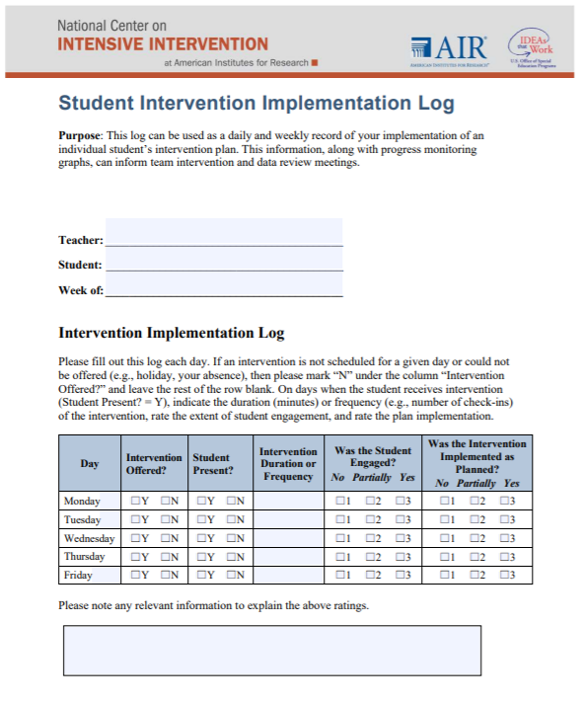
Tools to Support Monitoring Implementation Fidelity
Notes:
Although some interventions may provide a fidelity monitoring tool, if your intervention does not provide this resource, NCII has developed a quick log that can be used by individual teachers to monitor fidelity to the intervention. This log includes a place for teachers to mark whether the intervention was offered, if the student was present, the amount of time the intervention was provided, whether the student was engaged, and whether the intervention was implemented as planned. Note that many factors may impact the ability to deliver an intervention with fidelity:
You may have a fire drill, snow day, or other event that impacts the delivery of the session.
A behavioral issue from the student or a fellow student in the intervention may distract from instructional delivery time.
You may be absent, and the substitute may not have the same knowledge level.
Although many of these factors are outside of your control, it is important to document these factors so that you can use the information when making decisions about the student’s response to the intervention.

Slide 26
Team Time: Validated Intervention Programs
Reflect: To what extent do students in your school have access to validated interventions in reading, mathematics, and/or behavior delivered with fidelity?
Review the tools introduced in the previous three slides. How can these tools help support your implementation of validated intervention programs?
Consider: What additional information or support might we need?
Notes:
In teams, reflect on the extent that students in your school have access to validated interventions in reading, mathematics, and/or behavior delivered with fidelity, and review the handouts referenced on the previous three slides.
Estimated time: 5 minutes. As time permits, have groups share out reflections.

Slide 27
DBI Step 2: Did the intervention work?
STEP 2: Develop a progress monitoring plan that includes an ambitious goal.
Notes:
The second step of the DBI process focuses on progress monitoring. This step involves the development of a progress monitoring plan that outlines the measure that will be used and the frequency of data collection, establishes the baseline of where the student is starting from, and establishes an ambitious goal. The goal of this step is to understand whether the intervention worked.
As noted on the DBI process handout, for progress monitoring, we want to consider the following questions:
Does the tool meet technical standards for progress monitoring and match the desired academic or behavioral outcome?
Were data collected regularly and with a consistent approach?
Were progress data graphed?
Was the goal set using a validated approach?
Was the intervention effective for most students?

Slide 28
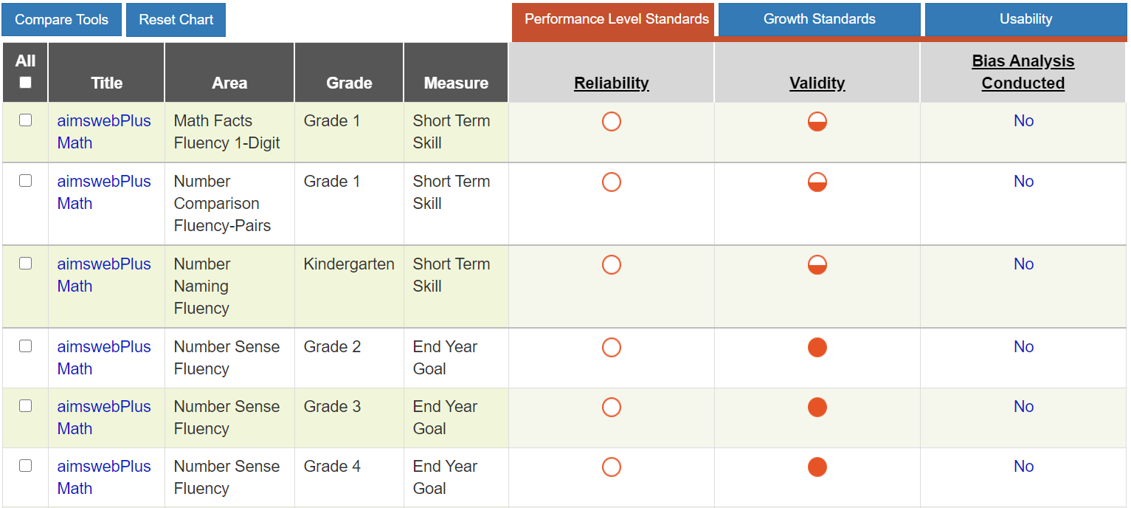
Tools to Support Collecting Valid Reliable Data for Progress Monitoring
Academic Progress Monitoring Tools Chart
Behavior Progress Monitoring Tools Chart
Strategies for Setting High-Quality Academic Individualized Education Program Goals
Strategies for Setting Data-Driven Behavioral Individualized Education Program Guide
Notes:
NCII has developed numerous resources to help educators select valid and reliable progress monitoring measures, graph progress monitoring data, and establish ambitious goals using validated goal-setting techniques.
NCII has developed two tools charts focused on progress monitoring. One chart focuses on academics, and the other chart focuses on behavior. NCII also has two guides to support the setting of goals using validated goal-setting techniques.

Slide 29
Analyzing Data: Academics
Intervention
Notes:
Let's look at a progress monitoring graph. This graph includes an orange star indicating a baseline and a green star indicating the student’s goal. A line connecting the baseline to the goal illustrates the student’s goal. In looking at this graph, do you think the student is responding or not responding to the intervention?
Ask participants to respond as a large group or discuss with partners/tables.
Even without specific training on progress monitoring, we can see that it looks like the student is on track to outperform the goal. With deeper training in progress monitoring, we would be able to use some additional information to interpret the graph, including noting that the four data points are above the goal line. We can also see that the trend line of the data points (indicated by a dashed line) is steeper than the goal line. From this information, we can see the student is responding to the intervention.
Additional training on academic progress monitoring and resources related to goal setting are available on the NCII website, including the following:
https://intensiveintervention.org/resource/using-academic-progress-monitoring-individualized-instructional-planning-dbi-training
https://intensiveintervention.org/resource/high-quality-academic-IEP-goals
https://intensiveintervention.org/resource/using-academic-progress-monitoring-individualized-instructional-planning
https://intensiveintervention.org/resource/data-rich-information-poor-making-sense-progress-monitoring-data-guide-intervention

Slide 30
Analyzing Data: Academics
Intervention
Notes:
What about this student? How is this student responding to the small-group standardized intervention delivered with fidelity? Is this sufficient progress?
Ask participants to respond as a large group or discuss with partners/tables.
In this case, the student is not making progress, as indicated by the flat or downward trend line (red dashed). The team confirms that the other students receiving the intervention are responding. The team must now review informal diagnostic data and identify intensification strategies that will help the student reach their goal.

Slide 31
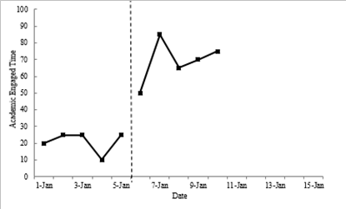
Analyzing Data: Behavior
Goal line
Notes:
This graph illustrates behavior data. The graph illustrates student engagement, with a goal of 80%. What do you see in this graph?
Ask participants to respond as a large group or discuss with partners/tables.
As we see in this graph, although the student’s progress is improving, only one data point is above the goal line.
For additional information and training on behavioral progress monitoring, view the following links:
https://intensiveintervention.org/resource/monitoring-student-progress-behavioral-interventions-dbi-training-series-module-3
https://intensiveintervention.org/resource/webinar-strategies-setting-data-driven-behavioral-IEP-goals
https://intensiveintervention.org/resource/high-quality-behavior-IEP-goals

Slide 32
Team Time: Progress Monitoring
Reflect:
How do we know whether a student is responding to an intervention?
How do we currently collect and use progress monitoring data?
Consider:
What additional information or support might we need?
Notes:
In teams, reflect on the extent that your school supports a progress monitoring system that allows for frequent (e.g., weekly, biweekly) progress monitoring?
Estimated time: 5 minutes. As time permits, have groups share out reflections.

Slide 33
DBI Step 3: Why didn’t the intervention work?
STEP 3: Use informal diagnostic data to develop a hypothesis about WHY the student is not responding.
Notes:
For students who are not responsive to the validated intervention program, the team uses diagnostic data to develop a hypothesis about why the student is not responding. Diagnostic data may also be used to understand a student’s specific skill deficits and strengths or to identify the environmental events that predict and maintain the student’s problem behavior.
Diagnostic data may be collected through various formal and informal approaches, which may include standardized tools available through publishers; more informal approaches, such as error analysis of frequent progress monitoring data; or review of class assessments and work samples. In the behavior domain, diagnostic assessment occurs through functional behavioral assessment (FBA). In addition to this in-depth process, teachers also may use more informal measures and checklists to identify the function of the behavior. Other sources of diagnostic data may include feedback from parents, teachers, and others who work with the student.
Educators use diagnostic data to develop a hypothesis about the potential cause(s) of the student’s academic and/or behavioral difficulties. As we remember from science class, a hypothesis is our best guess for why something may be occurring based on the evidence we have available. A hypothesis also needs to be something that we can test. Within the DBI process, the hypothesis drives the team’s decisions about how best to support the student and adapt the intervention. For example, a team might use the behavioral data collected to alter variables that predict or maintain the student’s problem behavior (i.e., change or eliminate events that trigger or follow problem behavior) and promote more adaptive and acceptable skills that allow the student to appropriately access desired outcomes.

Slide 34
Integration of Academics and Behavior
Skill deficit
Avoidance behavior
Removal from task
Notes:
As teams consider why a student is not responding, it is important to consider the intersection between academics and behavior. We know that students who struggle often use escape or avoidance behaviors to delay or remove the task they are struggling with. The student then misses instruction and falls further behind. Looking comprehensively at academic, social, emotional, and behavioral and/or in relationship to trauma exposure can help the team generate a hypothesis that looks more comprehensively at the student’s needs.

Slide 35
Using Diagnostic Data to Develop a Hypothesis
Teacher reviews classroom assessment data and conducts observations of the student’s learning behavior. Behavior observations suggest that the student struggles to master skills as quickly as the student’s same-age peers and needs more practice than the peers.
Hypothesis: If the student is provided additional opportunities of direct instruction, feedback, and practice on target skills, then the student would move to mastery of these skills more quickly.
Notes:
Let’s look at an example of what developing a hypothesis might look like in practice.
Review the slide.
When describing the hypothesis, click for animation. You will notice that the darker box is around dosage, because we are primarily focused on adding more opportunities to respond, but there are also call outs for alignment and comprehensiveness because we will focus our practice opportunities on the student’s skill gaps and use explicit instruction principles.

Slide 36
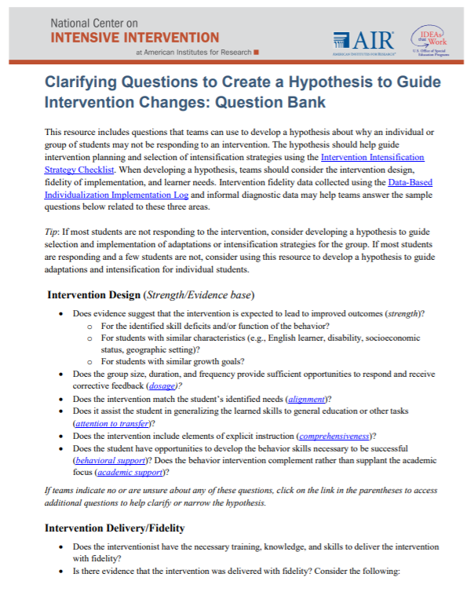
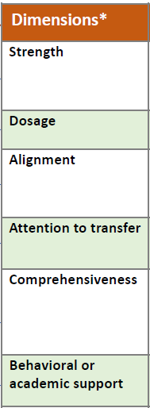
Tools for Analyzing Informal Diagnostic Data
Notes:
NCII has developed resources to support teams in developing a hypothesis. One area for teams to consider is the dimensions of the Taxonomy of Intervention Intensity. Teams may have noted that the intervention they selected did not provide enough behavioral supports or opportunities for practice and that they could be enhanced to support the student. Teams can also use the Clarifying Questions to Create a Hypothesis to Guide Intervention Changes: Question Bank to help them consider questions that may shape their hypothesis.
Provide tables or partners a couple of minutes to review the resource and discuss. Depending on time, have groups share out.

Slide 37
Team Time: Diagnostic Data
Reflect: What data do we currently use to try to understand why students are not responding to an intervention?
Review the Clarifying Questions to Create a Hypothesis to Guide Intervention Changes: Question Bank.
Are there questions included that you have not considered previously?
Are there things that you would add?
Consider:
What additional information or support might we need?
Notes:
In teams, reflect on what data you currently use to try to understand why students are not responding to an intervention. Turn to the clarifying questions handout in your workbook, and reflect on the questions. Are there questions you have not previously considered? Are there questions you would add to the handout?
Estimated time: 5 minutes. As time permits, have groups share out reflections.

Slide 38
DBI Step 4: What change is needed?
STEP 4: Intensify and individualize the intervention to address the hypothesis.
Notes:
Once the hypothesis is developed by the team, the team brainstorms possible adaptations that address the hypothesis.
As noted on your Breaking Down the DBI Process handout, we want to consider the following questions:
Does the adaptation address the hypothesis?
Does the plan address both academic and behavioral concerns when needed?
Are procedures in place for implementing and monitoring the adapted intervention?
Are only a few adaptations made at one time?

Slide 39
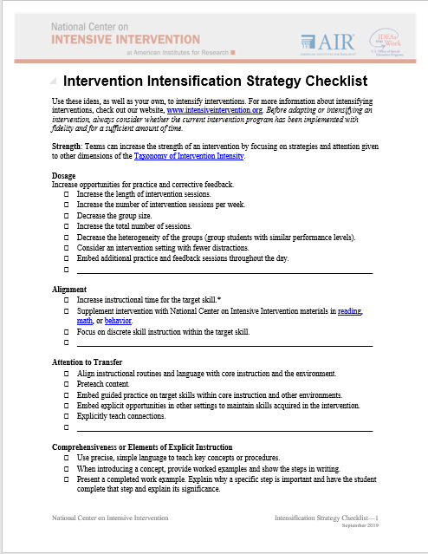
Adapting the Intervention
Tips for Successful Intensification
Select strategies that address the hypothesis.
Select a few important strategies.
Consider easier change(s) first:
Increase dosage (i.e., intervention frequency, length of sessions, or duration).
Decrease group size.
Decrease heterogeneity of the intervention group.
Notes:
As we consider adapting the intervention, consider the following:
Review the slide.
Some additional intensification strategies may include adapting the following:
Instruction based on learner characteristics (e.g., addressing working memory or attention problems)
Skill level of interventionist
Content delivery
How students respond
Amount of adult feedback and error correction students receive
Frequency and specificity of checks for retention
Materials, curriculum, or whole intervention (could be a complete change in program)
The Intervention Intensification Strategy Checklist provides some suggested intensifications that teams might consider as they determine how to address the hypothesis. This resource is included in your workbook for reference.

Slide 40
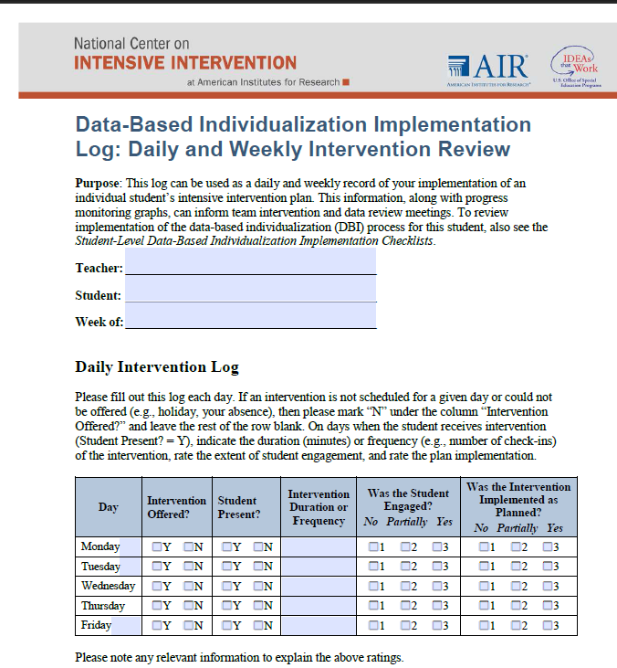
Implementation Monitoring: Was the adapted intervention delivered with fidelity?
Fidelity is still important!
Focus on fidelity to the adapted student plan.
Notes:
Teams should document the adaptations within an individual intervention plan because, when implementing the adapted plan, it is still important for teams to consider fidelity and implement the plan as intended. NCII provides an intervention plan template to assist with the planning and documentation of dimensions of an intervention for small groups or an individual student within the DBI process. You can see an example of this plan in the workbook, and it is also available in a Word format on the NCII website.

Slide 41
Team Time: Intensification
Review the Intensification Strategy Checklist and Intervention Plan handouts and consider how these tools can be used to support intensification decisions in your teams.
Consider:
What additional information or support might we need?
Notes:
In teams, reflect on what data you currently use to try to understand why students are not responding to an intervention. Turn to the clarifying questions handout in your workbook and reflect on the questions. Are there questions you have not previously considered? Are there questions you would add to the handout?
Estimated time: 5 minutes. As time permits, have groups share out reflections.

Slide 42
DBI Step 5: Did the change work?
STEP 5: Monitor the student’s response to the adaptation (at least 4–6 data points).
Notes:
While implementing the intervention adaptations, the teacher continues to collect progress monitoring data at regular intervals to determine responsiveness. Students whose data indicate responsiveness continue with the adapted intervention. For students, whose data indicate nonresponse, the team returns to reviewing diagnostic data—the teacher will analyze additional data and consider additional adaptations.
When thinking about considerations for collecting progress monitoring data at this step, teachers should consider the following questions:
Are data collected according to the plan?
Does the graph indicate when adaptations were made?

Slide 43
Academics: Is the student responding to the adapted intervention?
Intervention
Adaption 1 Phase Line
Notes:
Because the teacher made a change to the original intervention, the teacher draws a phase line illustrating when the teacher started implementing the adapted intervention. This allows the teacher to assess the impact of the intervention with the new adaptation in comparison to goal line and the intervention without the adaptation. Let’s consider this example: Is the student responding to the intervention with greater dosage? Is this sufficient progress?
Ask participants to respond as a large group or discuss with partners/tables.
In this case, the student is making progress, as indicated by the upward trend line (red dashed line). However, the progress in not sufficient to help the student reach the goal of 90 words read correctly. The team must reconvene to review additional diagnostic data and identify intensification strategies that will help the student reach the goal.

Slide 44
Behavior: Is the student responding to the adapted intervention?
Notes:
In this case, the teacher collected baseline data for the student receiving Check-In/Check-Out to reduce disruptive behavior (DBR-DB) and increasing academic engagement (DBR-AE) using direct behavior rating (DBR). After noticing that Check-In/Check-Out (CICO) was not improving student engagement or minimizing disruptive behaviors, the team made an adaptation introducing a modified behavior chart to support the intervention.
With the introduction of the modified behavior chart, the student's disruptive behavior decreased and academic engagement increased, but the student still displayed some disruptive behavior. Next, the team decided to make an additional adaptation. At that time, the teacher conducted a functional behavior assessment (FBA) and created a behavior action plan. The behavior action plan supported the modified behavior chart.
What do you notice after the second adaptation?
Review the data with participants.

Slide 45
DBI is an ongoing process based on student responsiveness to the intervention.
Notes:
(Click for animation) Review the slide.

Slide 46
Activator Activity: Revisited
Handout
Notes:
Estimated time: 5 minutes
Now let’s revisit our KWL chart. At the beginning of the session, we completed the “Know” column, what you know from reviewing the resource. Now, we will shift our focus to the “What” column. Review any questions you had noted earlier. Have you answered them? What additional questions do you have? Share your thoughts with a partner.

Slide 47
Effective Implementation of DBI
Notes:
Estimated time frame: 60 minutes
Learning outcomes: (1) Apply lessons learned to improve implementation of DBI. (2) Access and use National Center on Intensive Intervention resources to support implementation of DBI.
We just spent time learning about intensive intervention and DBI, and you started to reflect on your current practices and some areas you might want to improve in the future. In this next section, we will share some lessons learned from implementation of DBI and considerations to support effective implementation.

Slide 48
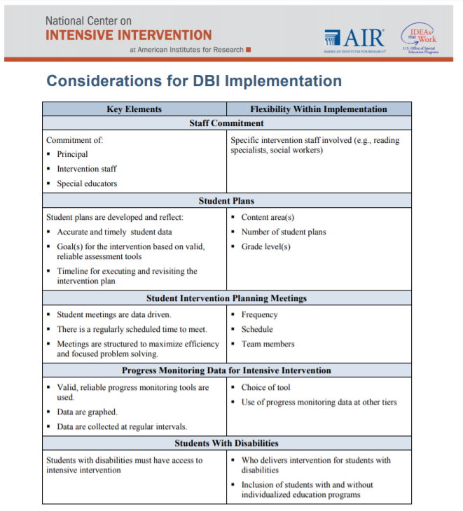
Key Elements for DBI Implementation
Staff commitment
Student plans
Student intervention planning meetings
Progress monitoring data for intensive intervention
Students with disabilities
Handout
Notes:
Understanding the DBI process is important, but what does it take to implement DBI? These considerations were developed by NCII, school staff, and coaches to highlight some of the key areas that schools need to consider and ensure are in place when implementing DBI. The handout, available in your workbook, illustrates five key areas (staff commitment, student plans, student intervention planning meetings, progress monitoring data for intensive intervention and involvement of students with disabilities). The document illustrates what implementers believe must be in place for each of those areas as well as areas where there was some flexibility.

Slide 49
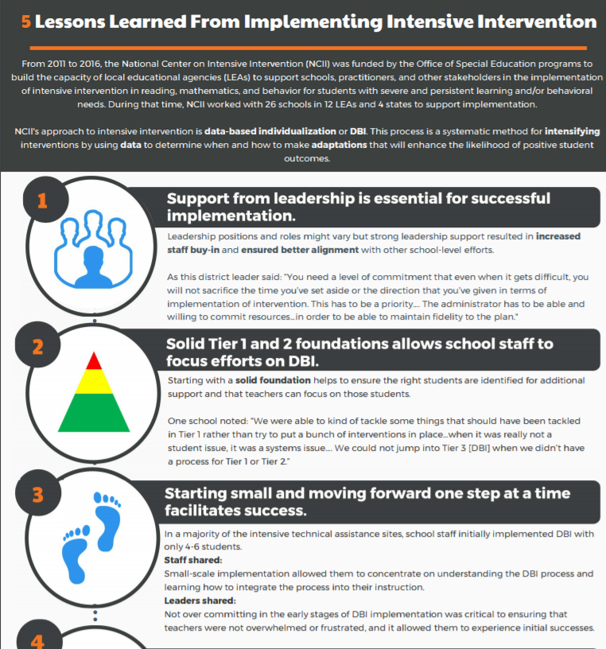
5 Lessons Learned From Implementing Intensive Intervention
Handout
Notes:
In addition, school and district staff who worked with NCII from 2011–16 identified five general lessons learned from implementing intensive intervention. Turn to this document in your handouts, and review the lessons that sites shared. How do these lessons learned connect to the considerations for DBI implementation shared on the previous slide? How do these lessons learned connect to previous implementation experiences you have had?
Provide partners/teams 3–5 minutes to review the two documents.
Let’s unpack these lessons learned in a little more depth.

Slide 50
1. Support from leadership is essential.
“You need a level of commitment that even when it gets difficult, you will not sacrifice the time you’ve set aside or the direction that you’ve given in terms of implementation of intervention. This has to be a priority. . . . The administrator has to be able and willing to commit resources . . . in order to be able to maintain fidelity to the plan.”
District Administrator
Notes:
The first lesson was that support from leadership is essential. As we see on this slide, a district administrator shared, “Review quote.”

Slide 51
Leadership . . .
Establishes purpose and focus to build a shared vision:
What is the work that you are trying to implement, and why is this work important to you and others you work with?
Why should we care about DBI and intensive intervention?
Shapes culture and expectations
Communicates with and promotes buy-in and involvement of staff in decision making
Provides supporting resources and structures, including assessments, interventions, professional development, and staff time
Leading by Convening
Notes:
Review the slide.
Leading by Convening (http://www.ideapartnership.org/building-connections/the-partnership-way.html) provides tools that can support leaders in helping to ensure that all stakeholders have coalesced around a shared core message (Defining our core) and making connections to what different stakeholders value and are already undertaking (four simple questions).

Slide 52
Considerations for DBI Implementation
Strong leadership provides the enabling context to ensure the key elements are considered
Culture and vision
Time to implement
Resources
Time to implement
Resources
Policies and practices
Notes:
Strong leaders also support each of the elements outlined in the Considerations for DBI Implementation document. For example, strong leaders help create the shared vision and culture that are instrumental in ensuring staff commitment; they provide time and resources to support the development of student plans, student meetings, and access to progress monitoring data and help to establish the policies and practices that ensure that students with disabilities can access intensive intervention.

Slide 53
School Example
Leading by example—“Walk the talk”
Superintendent has been involved throughout the process.
Special education director is working to connect this work and special education processes.
Principal is always present at trainings, meetings, and coaching sessions.
All other staff members see this level of commitment from leadership and understand the importance of the work.
School/staff culture actively engages in learning and is not afraid of change.
Notes:
Review the school example.

Slide 54
Leadership Resources
Four Keys to Support Intensive Intervention
Administrators & DBI
Notes:
NCII has developed a couple resources to specifically support leaders, including a handout—Why Administrators Should Support Data-Based Individualization (DBI) overviews some of the big picture reasons to support DBI implementation and a voices from the field post sharing advice from a principal supporting intensive intervention implementation.

Slide 55
2. Ensure solid Tiers 1 and 2.
Starting with a solid foundation helps to ensure the right students are identified for additional support and that teachers can focus on those students.
Ensure appropriate infrastructures are in place:
Screening
Progress monitoring
Data-based decision making
High-quality instruction and intervention
Notes:
The second lesson learned was to ensure solid Tiers 1 and 2. Participants shared that it was easier for teachers to implement DBI when the school had already established high-quality instructional foundations and systematic processes for Tiers 1 and 2. Embedding DBI into these systems fostered staff buy-in and facilitated communication by ensuring that common language was used to describe various levels of intervention, data, and general procedures.
This helped to ensure that the appropriate infrastructure was in place regarding screening, progress monitoring, and data-based decision making and allowed teachers to focus on the students who truly needed intensive intervention. Teams also shared that working on implementing DBI helped them to strengthen their Tiers 1 and 2.

Slide 56
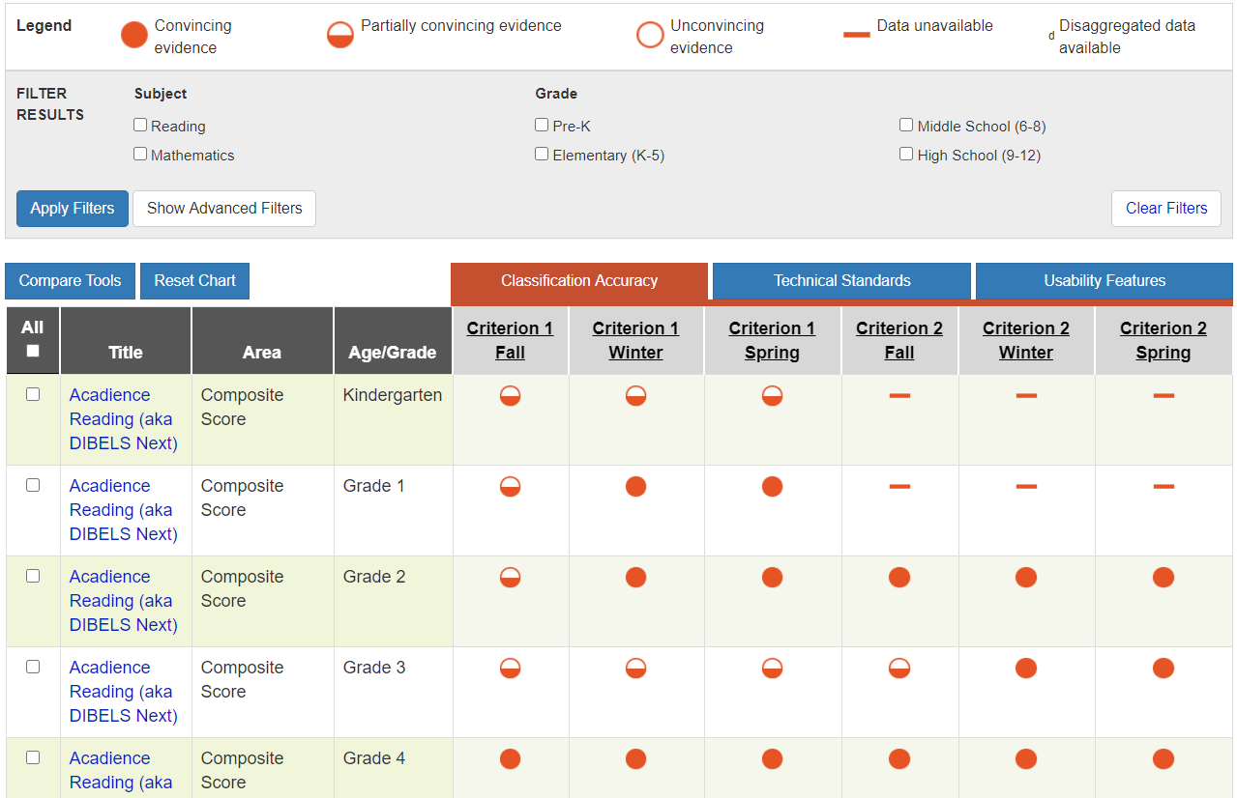
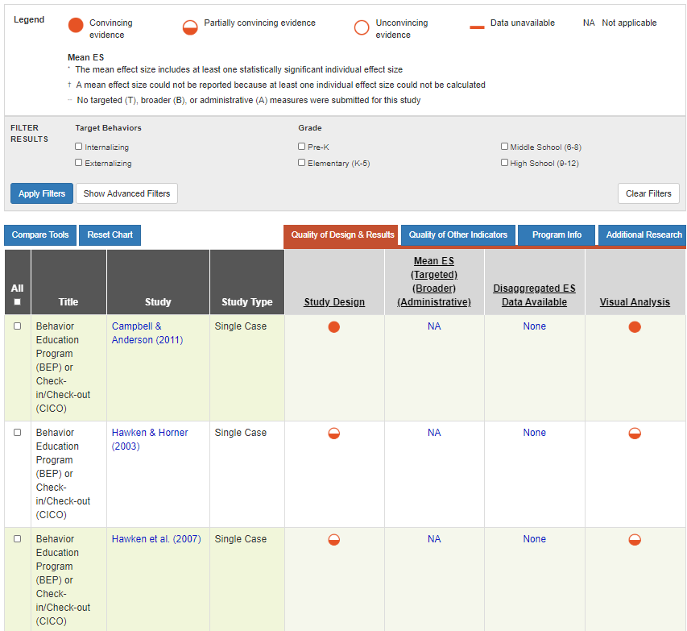
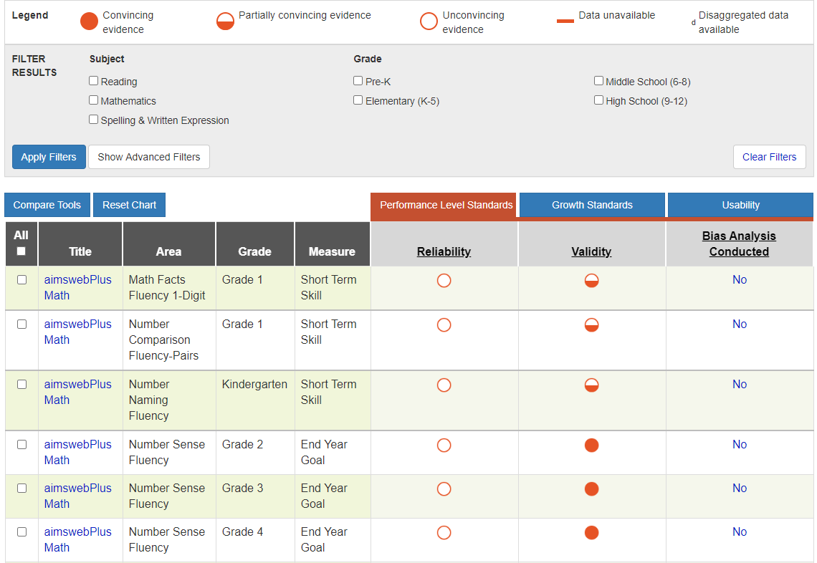
Tiers 1 and 2 Resources: Academic and Behavior Assessment and Intervention Tools Charts
Screening Tools Chart
Intervention Tools Chart
Progress Monitoring Tools Chart
Notes:
NCII has a series of tools charts that schools and districts can use to identify interventions and assessments to support Tiers 1 and 2 in addition to DBI.
These charts include academic and behavior charts focused on screening, intervention, and progress monitoring tools that can be used to assess students’ academic, social, emotional, or behavioral performance, to quantify a student rate of improvement or responsiveness to instruction, and to evaluate the effectiveness of instruction. The charts display ratings for the technical adequacy of assessment measures and the strength of interventions and are intended to assist educators and families in becoming informed consumers who can select tools that address their specific needs.

Slide 57
3. Start small and focus on one step at a time.
Staff shared: Small-scale implementation allowed them to concentrate on understanding the DBI process and learning how to integrate the process into their instruction.
Leaders shared: Not overcommitting in the early stages of DBI implementation was critical to ensuring that teachers were not overwhelmed or frustrated and to allowing them to experience initial successes.
Notes:
The third lesson learned from implementers was to start small and focus on implementing successfully. Staff shared that small-scale implementation allowed them to concentrate on understanding the DBI process and learning how to integrate the process into their instruction. And leaders shared that not overcommitting in the early stages of DBI implementation was critical to ensuring that teachers were not overwhelmed or frustrated and to allowing them to experience initial successes.
Being realistic about current challenges, available resources, and personnel can help schools design a feasible plan for integrating DBI into their intervention systems.

Slide 58
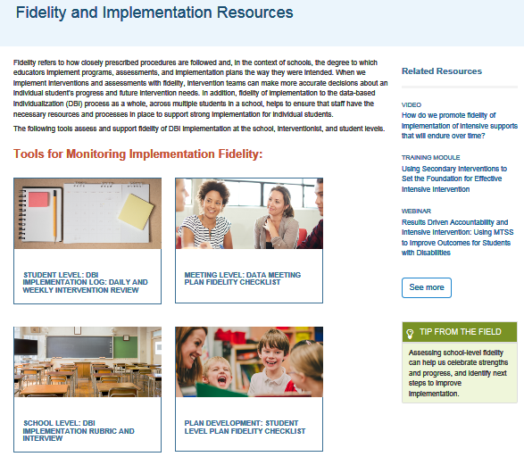
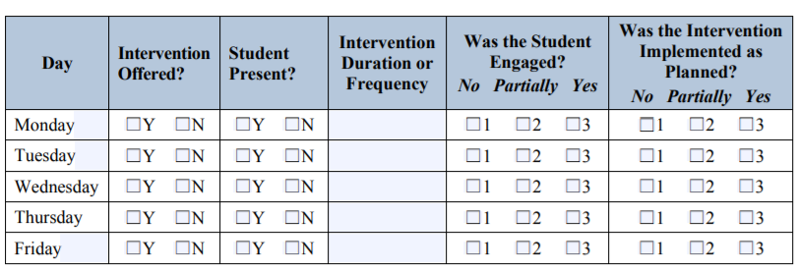
Resources: Monitoring Fidelity
Start by focusing on doing things consistently as designed before scaling up.
https://intensiveintervention.org/implementation-support/fidelity-resources
Notes:
Some sites found that focusing on understanding if they were consistently doing what they said they would do by using the student-level log allowed them to identify that they were not actually implementing the intervention as it was designed. By focusing on improving the implementation first, they could see if the intervention would be effective as designed for the student before they jumped into adaptations.

Slide 59
4. Use formalized procedures and standard protocols.
Ensure processes are clearly documented (e.g., scripted meeting agendas and clear guidelines).
Provide ongoing professional development to ensure that the knowledge is not placed with a few key individuals and to ensure sustainability when staffing changes.
Notes:
The fourth lesson learned that sites identified was to formalize procedures and development standard protocols, which was necessary to address changes in staffing and to ensure that meetings and processes were implemented efficiently. Sites also noted the importance of providing ongoing professional learning to ensure sustainability despite staff changes.

Slide 60
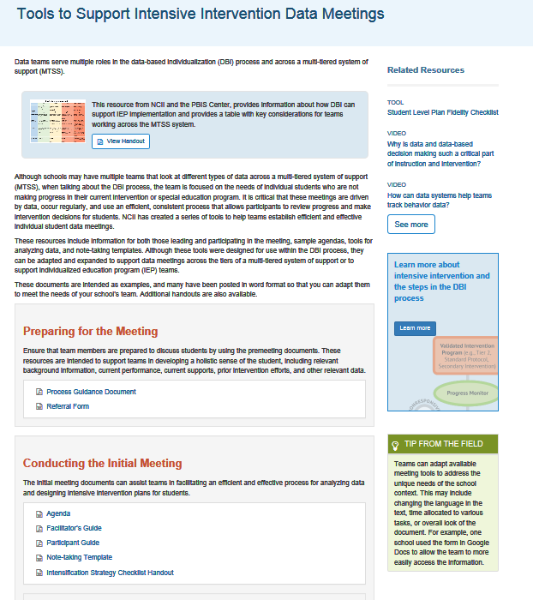
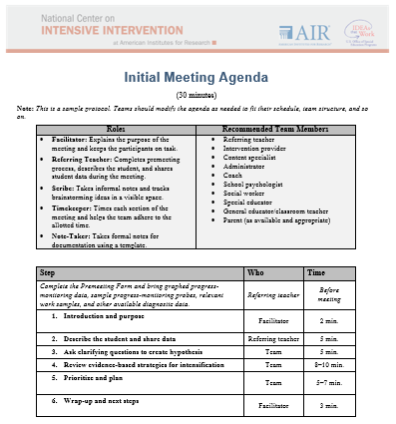
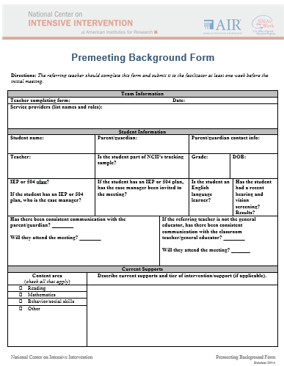
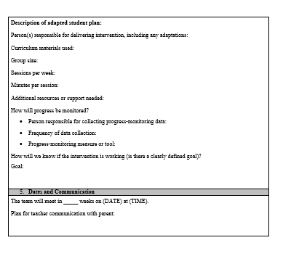
Facilitating Meetings to Review Data
https://intensiveintervention.org/implementation-support/tools-support-intensive-intervention-data-meetings
Notes:
NCII provides several resources to support schools in establishing clear roles, responsibilities, and processes. The data meeting tools provide sample agendas, note-taking forms, and facilitator and participant materials. Although these resources can be adapted to better meet the needs of schools, they help to highlight essential elements of meetings and ensure meetings run efficiently.

Slide 61
Developing Student Plans
Clearly articulate:
Scheduling
Fidelity data collection
Responsibilities
Communication
Follow-up
61
Notes:
In addition, clearly documenting student plans ensures that all team members understand the schedule; how fidelity and student-level data will be collected; what the intervention should look like; how information will be communicated with others, including families; and when teams will come back together to discuss student responsiveness. Ensuring this information is clearly documented not only supports fidelity but can also help with sustainability when team members change.

Slide 62
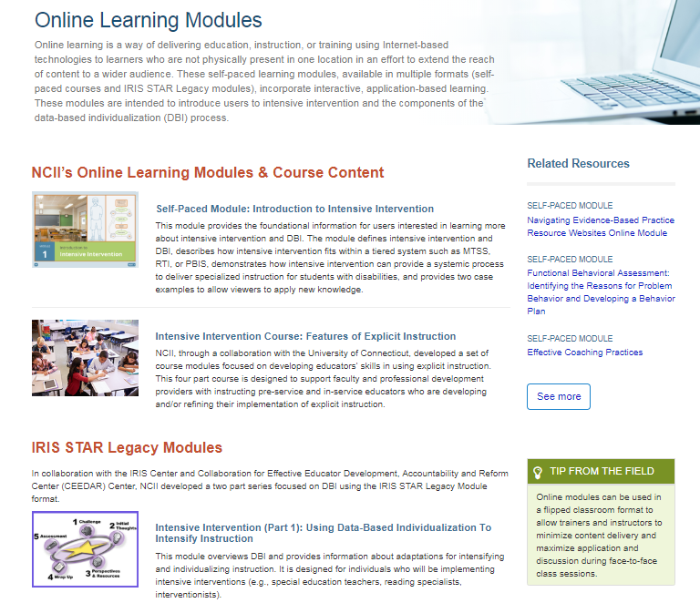
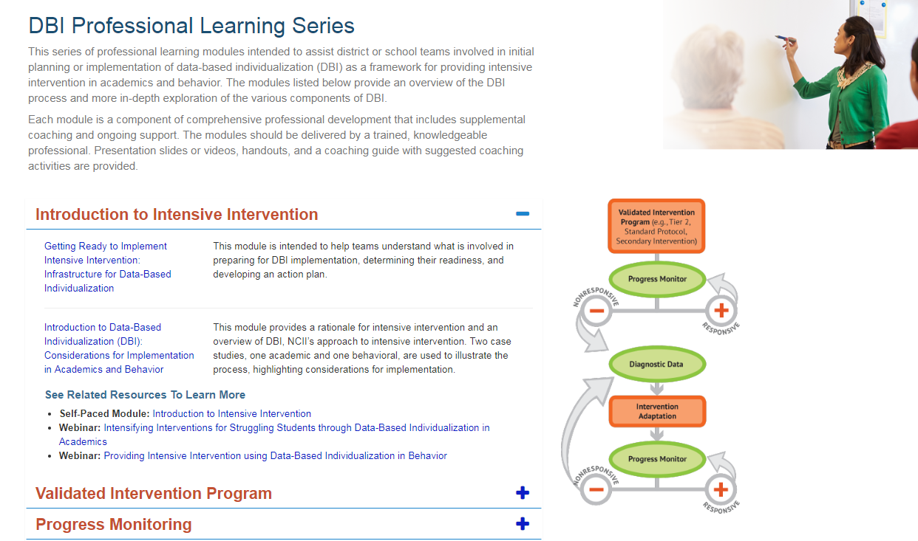
Professional Learning Resources
https://intensiveintervention.org/implementation-support/dbi-training-series
https://intensiveintervention.org/implementation-support/online-learning-modules
Notes:
As noted, ongoing professional learning is important. NCII has developed a range of in-person and online learning modules to support teams in understanding DBI and the steps of the DBI process.

Slide 63
Formalized Procedures
These procedures ensure that:
Student plans are consistently developed.
Student meetings occur at regular intervals.
Data are collected and graphed consistently.
Notes:
The considerations for DBI implementation also emphasize the importance of formalized procedures and processes. Specifically, formalized procedures ensure student plans are consistently developed, student meetings occur at regular intervals, and data are collected and graphed consistently.

Slide 64
5. Commit to the process.
It is important to commit to implementing the DBI process for an extended period of time and to know that the process will likely be bumpy along the way.
“Data-based decision making is not for wimps . . . You really got to go in knowing that it’s hard work. . . . Once you’ve made that commitment, you can’t just give up. . . . The only answer we’ve found so far is sometimes just going ahead and doing what we need to do and having the people look at the success.” (Participate of NCII 2012-2016)
Notes:
The final lesson learned is committing to the process despite challenges. One participant shared, “Data-based decision making is not for wimps . . . You really got to go in knowing that it’s hard work. . . . Once you’ve made that commitment, you can’t just give up. . . . The only answer we’ve found so far is sometimes just going ahead and doing what we need to do and having the people look at the success.”

Slide 65
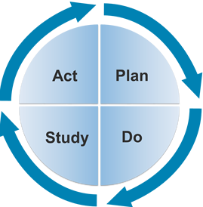
Create a culture of continuous improvement.
“The last piece of advice I would give to an administrator would be to never be satisfied with your school or district’s current level of performance. There is always room for improvement! An effective administrator continuously works with staff to reflect on the successful implementation of MTSS and how to make the system even more efficient and effective for students.”
~Paul Elery, Principal, Harvard Elementary School, Franklin Pierce School District
Notes:
Paul Elery, the principal of Harvard Elementary School, specifically noted the importance of creating a culture of continuous improvement. He shares, “The last piece of advice I would give to an administrator would be to never be satisfied with your school or district’s current level of performance. There is always room for improvement! An effective administrator continuously works with staff to reflect on the successful implementation of MTSS and how to make the system even more efficient and effective for students.”

Slide 66
Reflection
Review the Lessons Learned From Implementing Intensive Intervention Infographic with your neighbor or team.
Which lesson(s) do you think are most critical for your school to focus on for DBI implementation to be successful in your school?
What are potential challenges or barriers to DBI implementation?
Notes:
As you think about these lessons learned, consider the following questions:
Which lesson(s) do you think are most critical for your school to focus on for DBI implementation to be successful in your school?
What are potential challenges or barriers to DBI implementation?
Provide teams with 5–10 minutes to discuss.

Slide 67
Things to Remember
Notes:
Estimated delivery time: 15 minutes
As we wrap up, we want to review some of the big themes that we discussed today.

Slide 68
Validated interventions
VALIDATED
UNIVERSALLY EFFECTIVE
Notes:
Intensive intervention is grounded in the research showing that validated interventions are not universally effective. A small subset of students will need the intervention to be adapted and individualized through the DBI process.

Slide 69
Variations exist in the availability of evidence-based interventions.
I can’t find an evidence-based intervention that meets my students’ needs. Can I implement DBI?
We can still implement DBI! Use the best available evidence and collect student data to document effectiveness.
Notes:
As we discussed earlier, we know variations exist in the availability of evidence-based interventions. Although we want to start with the best evidence available, we can still implement DBI.

Slide 70
If a student is not responsive, consider fidelity first.
Student factors
Teacher and school factors
Text and material used
Notes:
One of the first questions we need to ask ourselves when we see a student has not responded to the intervention is whether we delivered the intervention as designed. We know that numerous factors may impact our ability to implement the intervention as designed. If we see that the intervention has not been implemented with fidelity, let’s first focus on improving the implementation before we make changes to the intervention.

Slide 71
Identify whether group-based or individualized adaptations are needed.
Are all students not responding?
Are most students responding, but a few students are not responding?
Consider group-based adaptations.
Consider individualized adaptations.
Notes:
We also want to consider whether we need to make a group-based or individualized adaptation. If numerous students are not responding, we may want to make a change for the whole group. In contrast, if most students are responding, but a few students are not responding, we may need to consider individualized adaptations.

Slide 72
“I don’t know what to do if the intervention isn’t working.”
Revisit your hypothesis.
Collect additional diagnostic data.
Communicate with others (e.g., related service providers, educators, intervention team, or administrators).
Consider integration of academic and behavioral support.
Notes:
When implementing the intervention and unsure what to do next? Review the slide.

Slide 73
Perseverance
“It all works out in the end . . .”
Notes:
Last, this adage (unknown source) is relevant to the DBI process because it’s about perseverance. DBI helps us find programs that work for our students with the highest needs, even when our initial attempts are not successful. Insufficient progress means that we haven’t found the right solution yet, not that we should stop trying to intervene. DBI helps us know when changes are needed and allows us to inform those changes so that, in the end, the intervention works for the individual student.

Slide 74
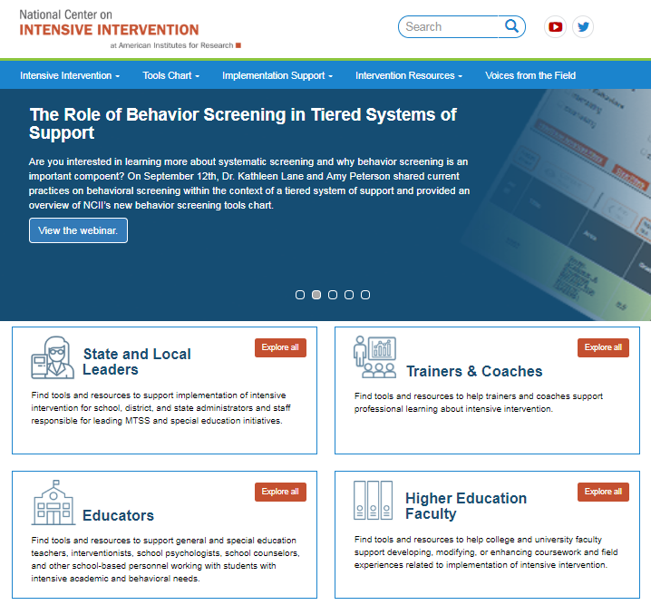
Resources to Learn More
NCII’s website www.intensiveintervention.org has a wealth of resources to support this process!
Notes:
Many resources are available to support educators in implementing intensive intervention. Explore the NCII website at www.intensiveintervention.org to find tools and check back often to find new tools and resources.
Learning outcome: Access and use National Center on Intensive Intervention resources to support implementation of DBI.

Slide 75
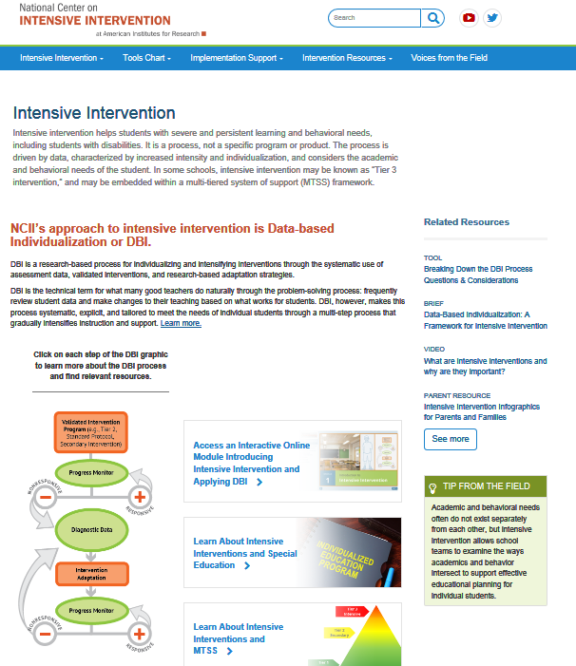
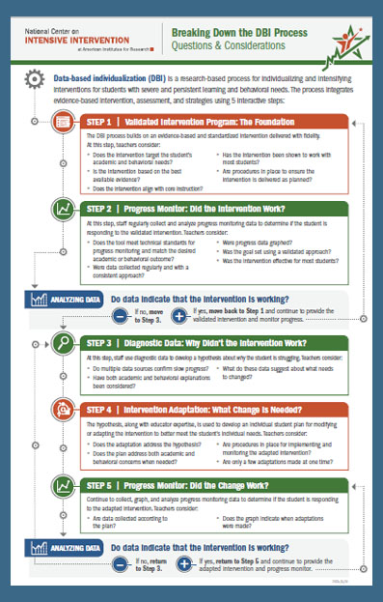
Introduction to DBI and Intensive Intervention
Self-paced module
Web toolkit
One-page overview
Notes:
As you return to your schools, you will likely want to share what you have learned with your colleagues. Here are a few places to start.

Slide 76
Activator Activity Update
Handout
Notes:
Estimated time: 3–5 minutes
Now let’s revisit our KWL chart. With a thought partner, complete the next column, focusing on how will you “Learn” more about the DBI process.

Slide 77
Closing and Next Steps

Slide 78
Did we achieve our outcomes?
Can you…
explain the rationale for intensive intervention,
describe the steps in the data-based individualization (DBI) process,
apply lessons learned to improve implementation of DBI, and
access and use NCII resources to support implementation of DBI?
Notes:
Read the slide.

Slide 79
Reflection
What am I most excited about? | What am I unsure of or want to learn more about? | What changes will I make as a result of what I learned today?
Handout
Notes:
As we wrap up, take a minute to reflect on what we discussed today. Note what you are most excited about, what you are still unsure of and want to learn more about, and what changes you will make as a result of what you learned.
Read the slide.
Estimated time: 5 minutes
Have participants complete the self-reflection activity independently or with a thought partner. Another option is to have participants complete the reflection in small table groups or on chart paper as exit slips with self-sticking notes.
Included in the workbook is an optional team reflection and planning activity that may be used as a supplement to this training. The DBI reflection tool is intended to help teams, as they reflect on their readiness to implement DBI, consider what they have in place related to each of the steps of the DBI process and additional supports that they may need.

Slide 80
Thank you
Thank you!

Slide 81
References
Blackorby, J., Knokey, A., Wagner, M., Levine, P., Schiller, E., & Sumi, C. (2007). What makes a difference? Influences on outcomes for students with disabilities. Menlo Park, CA: SRI International. Retrieved June 12, 2007.
Capizzi, A. M., & Fuchs, L. S. (2005). Effects of Curriculum-Based Measurement With and Without Diagnostic Feedback on Teacher Planning. Remedial and Special Education, 26(3), 159–174.
Cortiella, C. (2011). The state of learning disabilities: Facts, trends, and indicators. Washington, DC: National Center for Learning Disabilities.
Dane, A. V. and Schneider, B. H. (1998) Program integrity in primary and early secondary prevention: are implementation effects out of control? Clinical Psychology Review, 18, 23–4.
Fuchs, L. S., Deno, S. L., & Mirkin, P. K. (1984). The effects of frequent curriculum-based measurement and evaluation on pedagogy, student achievement, and student awareness of learning. American Educational Research Journal, 21(2), 449–460.
Fuchs, L., Fuchs, D., & Capizzi, A. (2005). Identifying appropriate test accommodations for students with learning disabilities. Focus on Exceptional Children, 37(6). https://doi.org/10.17161/fec.v37i6.6812

Slide 82
References
Fuchs, L. S., Fuchs, D., & Hamlett, C. L. (1989). Effects of instrumental use of curriculum-based measurement to enhance instructional programs. RASE: Remedial & Special Education, 10(2), 43–52.
Fuchs, L. S., Fuchs, D., & Malone A. S. (2017). The taxonomy of intervention intensity. Teaching Exceptional Children, 50(1), 35–43.
Gersten, R., Compton, D., Connor, C.M., Dimino, J., Santoro, L., Linan-Thompson, S., and Tilly, W.D. (2009). Assisting students struggling with reading: Response to Intervention and multi-tier intervention for reading in the primary grades. A practice guide. (NCEE 2009-4045). Washington, DC: National Center for Education Evaluation and Regional Assistance, Institute of Education Sciences, U.S. Department of Education. Retrieved from https://ies.ed.gov/ncee/wwc/PracticeGuide/3
Gresham, F. M., Gansle, K. A., Noell, G. H., Cohen, S., et al. (1993). Treatment integrity of school-based behavioral intervention studies: 1980–1990. School Psychology Review, 22(2), 254–272.
Jung, P. G., McMaster, K. L., Kunkel, A. K., Shin, J., & Stecker, P. M. (2018). Effects of data‐based individualization for students with intensive learning needs: A meta‐analysis. Learning Disabilities Research & Practice, 33(3), 144–155

Slide 83
References
Kuchle, L. B., & Riley-Tillman, T. C. (2019). Integrating behavior and academics in intervention planning. In R.Z. Edmonds, A.G. Gandhi, & L.C. Danielson (Eds.). Essentials of intensive intervention (pp. 51-70). The Guilford Press.
National Center on Intensive Intervention. (2013). Data-based individualization: A framework for intensive intervention. Washington, DC: American Institutes for Research. Retrieved from https://intensiveintervention.uat.air.org/resource/data-based-individualization-framework-intensive-intervention
Newman, L., Wagner, M., Knokey, A. M., Marder, C., Nagle, K., Shaver, D., et al. (2011). The post-high school outcomes of young adults with disabilities up to 8 years after high school: A report from the National Longitudinal Transition Study-2 (NLTS2) (NCSER 2011–3005). Washington, DC: National Center for Special Education Research.
O’Donnell, C. L. (2008). Defining, Conceptualizing, and Measuring Fidelity of Implementation and Its Relationship to Outcomes in K–12 Curriculum Intervention Research. Review of Educational Research, 78(1), 33–84.
Sanford, C., Newman, L., Wagner, M., Cameto, R., Knokey, A. M., & Shaver, D. (2011). The post-high school outcomes of young adults with disabilities up to 6 years after high school: Key findings from the National Longitudinal Transition Study-2 (NLTS2) (NCSER 2011-3004). Washington, DC: National Center for Special Education Research.

Slide 84
References
Scammacca, N. K., Fall, A. M., & Roberts, G. (2015). Benchmarks for expected annual academic growth for students in the bottom quartile of the normative distribution. Journal of Research on Educational Effectiveness, 8(3), 366–379.
Stark, P., & Noel, A. M. (2015). Trends in High School Dropout and Completion Rates in the United States: 1972-2012. Compendium Report. NCES 2015-015. National Center for Education Statistics.
Stetser, M. C., & Stillwell, R. (2014). Public high school four-year on-time graduation rates and event dropout rates: School years 2010–11 and 2011–12. First look (NCES 2014-391). Washington, DC: National Center for Education Statistics.
Wagner, M., Newman, L., Cameto, R., Levine, P., & Garza, N. (2006). An overview of findings from wave 2 of the National Longitudinal Transition Study-2 (NLTS2) (NCSER 2006–3004). Washington, DC: National Center for Special Education Research.

Slide 85
NCII Disclaimer
This presentation was produced under the U.S. Department of Education, Office of Special Education Programs, Award No. H326Q160001. Celia Rosenquist serves as the project officer. The views expressed herein do not necessarily represent the positions or policies of the U.S. Department of Education. No official endorsement by the U.S. Department of Education of any product, commodity, service, or enterprise mentioned in this webinar is intended or should be inferred

