Slide 1
Designing and Delivering Intensive Intervention in Behavior
Name
Position
January 2014
Notes:
Introduction to the Module
This is the seventh in a series of training modules developed by the National Center on Intensive Intervention (NCII) aimed at district or school teams involved in initial planning for using Data-Based Individualization (DBI) as a framework for providing intensive intervention in academics and behavior. The audience for this module may include, as appropriate, the behavior support team, interventionists, special educators, school psychologists, counselors, and administrators. Subsequent modules will provide additional information about specific components of the DBI process. More information about NCII’s approach to intensive intervention can be found in the NCII concept paper Data-Based Individualization: A Framework for Intensive Intervention. The concept paper is available at http://www.intensiveintervention.org/sites/default/files/DBI%20a%20Framework%20for%20Intensive%20Intervention.pdf.
Instructions for Using the Speaker Notes
Text formatted in standard font is intended to be read aloud or paraphrased by the facilitator.
Bold text is excerpted directly from the presentation slides.
Italic text formatted is intended as directions or notes for the facilitator; italicized text is not meant to be read aloud.
Underlined text indicates an appropriate time to click to bring up the next stage of animation on an animated slide.
Speaker Notes for the Title Slide
Welcome participants to the training on Designing and Delivering Intensive Intervention in Behavior. Introduce yourself (or selves) as the facilitator(s) and briefly cite your professional experience with regard to intensive intervention and DBI.
The following handouts should be provided to participants:
Handout 1: History of Evidence-Based Intervention (see slides 16 and 17)
Handout 2: Tier 3 Planning Checklist (see slide 26)
Handout 3: Examples of EBI (see slide 34)
Handout 4: Monitoring a Plan (see slide 58)
Handout 5: Coaching Guide (see slides 14, 38, and 42)
Handout 6: Summary
While permission to reprint this publication is not necessary, the citation should be:
National Center on Intensive Intervention (February, 2014). Designing and Delivering Intensive Intervention in Behavior. Washington, DC: U.S. Department of Education, Office of Special Education Programs, National Center on Intensive Intervention.

Slide 2
Today’s Agenda
Introduction
Review of previous NCII modules
Training goals
Examples of evidenced-based interventions (EBIs)
Summary
Notes:
Read slide.
The agenda may be changed to fit the time frame and the focus of the training. This module takes about 3.5 hours to complete (including the slide presentation and the integrated activities).

Slide 3
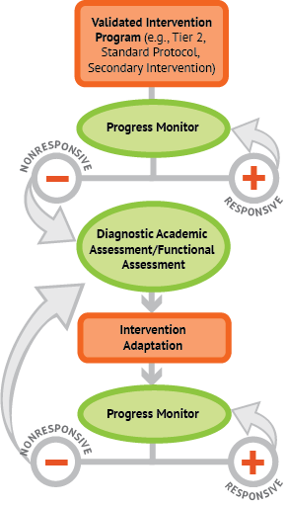
A Bird’s-Eye View of DBI
Notes:
Animated slide. Click to reveal the red arrow.
NCII uses this graphic to illustrate the progression of DBI. We begin with a secondary intervention program, delivered with greater intensity, and progress monitor to determine a student’s response. If the student is responsive, we can either continue the current intervention or consider reducing the intensity as goals are met (depending on the rate and the duration of response and the nature of skill deficits). If a student is not sufficiently responsive, we gather additional information by using informal diagnostic assessment, which identifies student needs to guide intervention adaptations. We continue progress monitoring to make decisions about whether the student is responding to the adapted intervention.
Our training series describes the DBI process, and its goal is to give you the bigger picture in terms of where each part of the process fits in and how the process is not necessarily a linear progression. There are many moving pieces that can occur independently or in conjunction with other parts.
Today, we will focus on designing and delivering intensive intervention specifically in the area of behavior.

Slide 4
Learning Objectives
Relate assessment to function.
Select EBIs that align with the functions of behavior.
Link assessment and progress monitoring.
Connect data with the selected EBI.
Notes:
Read slide.
These are the four general training goals, and this module is divided into four sections that broadly relate to each goal. We will spend the majority of the time on Goal 2, but it also is important to review and contextualize the other key components.

Slide 5
.
Designing and Delivering Intensive Intervention
Tying It All Together!
1. Identification of Hypothesized Function
2. Selection of Relevant Intervention Based on Function
3. Assessment and Monitoring
4. Analysis Focusing on Both Effectiveness and Function
If Necessary
Notes:
This graphic represents the objectives for this training, first identifying a hypothesized function and then moving to an analysis of both effectiveness and function.
We envision teams starting by developing a hypothesis on what the function of behavior is. Often, a hypothesis is the equivalent to an educated guess. However, one point we want to highlight is that selecting an EBI should always relate back to the function. Following the selection process is assessment and monitoring and, finally, an analysis of effectiveness.
It also is worth noting that “evidence-based” as a construct changes when it comes to a student with intensive needs. More specifically, in some ways, an intervention for an individual student with intensive needs is not really evidence based until we have evidence that it works or is effective for the individual student. Students at Tier 3 have been resistant to interventions at Tier 1 and Tier 2, so it is likely that they also may be resistant (only initially we hope) to intervention or strategies at Tier 3.
It is critical when at the initial stages of selecting EBIs that the ones selected have some existing evidence, are related to function, and are likely to work. We also want to emphasize the importance of outcome data.
Before we look specifically at examples of EBIs, we will spend some time reviewing assessment, monitoring, and analysis as it relates to selecting an EBI and why these are important parts of the overall process.

Slide 6
Another Way of Thinking About It
Design and implement interventions carefully but quickly.
Collect data in a highly feasible manner.
Establish a consistent manner of data analysis that is efficient and easy for anyone to do.
Source: Evidence Based Intervention Network (http://ebi.missouri.edu)/
Notes:
These are the key considerations when designing and delivering intensive interventions. Read slide.
The main idea here is to give teams a framework that can work in schools. We want to provide careful but quick options so that teams do not have to double or triple their workloads. We want teams to be able to make educated guesses based on function and as early as possible in the process.

Slide 7
Part 1
Relating Assessment to Function
Notes:
Previous NCII training modules have discussed the basics of behavior, so we will not be reviewing that here. What we will focus on today is the assessment part of Functional Behavior Assessment (FBA) as it relates to designing and delivering intensive intervention and why that is important. Many of the materials related to FBA presented here were developed by Lori Newcomer, Ph.D., and NCII.

Slide 8
Relating Assessment to Function
A review of Functional Behavior Assessment (FBA)
Definition of FBA:
FBA is a process for identifying the events that reliably predict and maintain problem behavior.
Function refers to the purpose of behavior.
Notes:
Review the definition of FBA.
It is important to emphasize that assessment looks at the events or the circumstances that reliably predict and maintain problem behavior. In other words, knowing the function or why a behavior is happening will help determine how to best change it. It is worth noting the following:
FBA is an initial step to predict what will or can be effective; it is not a stand-alone procedure.
FBA is not a “fill in the form and walk away strategy”; rather, it is an initial hypothesis.
Remind participants that the function of behavior is important because it refers to the why or the purpose for a behavior. An additional complexity with behavior is that it also can serve more than one function. However, more often than not, the reason or the function of behavior is tied to wanting to get access to something or attempting to get out of or away from something.

Slide 9
Relating Assessment to Function
Assessment (in FBA): Need to quickly select the likely reason for the behavior.
Time is a precious commodity. Educators need to be efficient when problem solving.
Under many circumstances, the most efficient thing to do is to test the easiest hypothesis first, implement an intervention, monitor, and then evaluate the outcomes.
Source: Evidence Based Intervention Network (http://ebi.missouri.edu)/
Notes:
NCII has developed a module that looks specifically at FBA, so it will not be covered in depth in this module. Although a review of FBA is beyond the scope of this training module, what we would like to do is focus on the assessment part of FBA and parse out the relationship that assessment has to function.
However, there are different levels of FBA, ranging from simple to very complex. FBAs can be quick 10-minute assessments or very intensive, multi-faceted data collection and analysis programs. Consider the following,
A tier of FBA will be determined by and can be modulated, depending on the student. For example, a student with autism will likely require a deeper and more thoughtful analysis, whereas a student who has explosive behaviors (e.g., flips desks) would require a different level of analysis.
In some states, FBA also can be linked to a special education referral. FBA is a functional problem-solving method, and we always suggest that teams examine their local and state policies and laws.
In most classrooms, time is a precious commodity, and teachers have a litany of tasks throughout the day and need to be efficient when problem solving. Efficiency in a classroom would probably involve the following steps: test the easiest hypothesis first, implement an intervention, monitor, and then evaluate the outcomes. To accomplish this goal, we need a framework.

Slide 10
Common Reasons Why Students Misbehave
A student has not learned the behavior.
Inappropriate behavior removes a student from what he or she does not want to do (escape).
Inappropriate behavior gets a student something (typically attention).
A student has not had to do the behavior in that way before.
Source: Evidence Based Intervention Network (http://ebi.missouri.edu)/
Notes:
The purpose of this slide is to discuss the framework of assessment and function. Read the slide and review the common reasons for misbehavior among students.
It is worth noting that there is no new information on this slide; it is probably a simplistic way of looking at behavior. Students are generally more complex, but the idea is that it gives teams a framework to work from.
Note: Some participants may want to spend some time discussing the reasons listed in the slide.
Behaviors tend to fall within four categories or clusters: students who do not know how to “do” the correct or appropriate behavior, those who want to escape a task (usually academic but sometimes social), those who want attention of any kind (e.g., some or even negative attention is better than no attention), and those who do not have the prerequisite skills or are mismatched in terms of the task and their ability levels.
When it comes to the reasons for student behavior, there are generally logical answers. For example, with social behaviors, it is easy to pathologize students first, but it is important to think about whether the behaviors fall into the categories listed on this slide. It is much easier to describe behaviors that are exciting or “sexy” in a sensational way than to simply look at the function, which can seem boring in comparison. Let me give you two examples.
A young boy is in early elementary school. His father is a known drug dealer and has been in and out of prison. The student had some minor behavior challenges, such as aggressive and disruptive behavior. It is easier to pathologize this student and say that he is a budding sociopath or a future delinquent than to look closely at the function of his behavior.
In the 1990s, many teenagers were diagnosed with bipolar disorders. This sounds more exciting than thinking about how puberty and/or physical changes may have affected behavior.
Possible Activity: Ask the group the following questions:
What are some examples of situations in which students misbehave?
Where have you seen this occur?

Slide 11
Start With a Reasonable Hypothesis
If starting with a reasonable hypothesis fails to improve student performance, then something progressively more time intensive can be attempted until the probable cause of failure is identified.
Note: Easier solutions are more likely to be implemented consistently, whereas solutions that are more time consuming or technically difficult for teachers and support personnel are less likely to be implemented correctly (Gresham, 1989).
Source: Evidence Based Intervention Network (http://ebi.missouri.edu)/
Notes:
Read slide.
When working with students with intensive needs, a logical approach would be to begin with the easiest solutions first and adapt and individualize as needed. The idea of selecting strategies or interventions from the least to most time consuming or challenging is an important consideration. Put in another way, if you start off with the idea that “throwing the kitchen sink” is the best solution, then you will probably have to continue to throw the kitchen sink for the long term. Why not begin with something easier and less intensive and see if it works (e.g., what do the data tell you?).
Note: There are parallels between academic and behavioral approaches to intensive intervention. Not surprisingly, behavioral problems can seem more challenging or daunting to some (e.g., a six-year-old who cannot read seems less difficult to deal with than a six-year-old who throws desks).
Quite often, the complexity of the problem in academics and behavior is not that different, but “behavior problems” can feel harder or be more serious. Furthermore, the situation is exacerbated by the fact that many teachers leave education programs without having courses or modules on behavior management, whereas there are many supports in place for academic interventions.

Slide 12
Importance of Identifying Function First
Identify the hypothesized function of behavior and then select the intervention.
Selecting an intervention with the appropriate level of rigor based on the problem is essential.
After the intervention is selected, the analysis phase can begin. It is only in the analysis phase where a team will find out if the assessment phase was successful.
Source: Evidence Based Intervention Network (http://ebi.missouri.edu)/
Notes:
We need to use our best knowledge and expertise about a problem or a challenging behavior and then select an intervention with an appropriate level of rigor or quality to change or modify behavior in a positive way.
Provide the group with the following example:
Let’s presume that Johnny consistently engages in disruptive behavior during mathematics lessons (e.g., he gets very tense, balls his hand up into a fist, starts shaking, closes his eyes, refuses to speak, and engages in unusual facial gestures and posturing). After doing an FBA, it is determined that the function of the behavior is escape or avoidance of the task or activity because Johnny does not understand what needs to be done (e.g., the tasks are too hard) and/or he does not have the prerequisite skills.
An intervention that would not work (because it allows him to escape the task and is not aligned with the function of behavior) would be to reinforce Johnny every time he engages in disruptive or aggressive behavior by allowing him to escape completion of the task (e.g., his teacher assigns a teaching assistant or aide to take him out of the classroom and to the gym to bounce on a trampoline so that he can relax and center himself—this is a true story!).
Interventions that will likely work (because they are related to the specific function of the behavior) include breaking down the task into smaller, more manageable activities (e.g., instead of giving Johnny a full mathematics worksheet to complete independently, have him complete two or three problems, access a reinforcer, and then go back to work). Teaching him the prerequisite skills or adjusting the work so that it is at the appropriate level to match his abilities will likely yield a more positive outcome.

Slide 13
Part 2
Selecting Evidence-Based Interventions That Align With the Functions of Behavior
Notes:
This next section is the heart and substance of this module and builds on existing knowledge about FBA and the functions of behavior.
It also is important to note that this is part of the individualization phase of the DBI process. We are assuming that standardized tiered programs have been attempted and have not worked because the student is still struggling.
As part of this training series, a coaching activity is found in Handout 5 if teams want to spend more time on the EBI website looking at or through the resources and materials available.

Slide 14
Selecting Evidence-Based Interventions
EBIs are treatments that have proven effective through rigorous outcome evaluations.
Source: Evidence Based Intervention Network (http://ebi.missouri.edu)/
Notes:
There are two categories of EBIs: Some are general strategies that may be referred as non-branded interventions; some are commercially developed packages.
Activity: Ask participants if anyone was teaching in the 1990s. Are you familiar with the term EBI?
The term EBI was not really in the vocabulary or parlance of the field of education until the introduction of the Individuals With Disabilities Education Act (IDEA) in 2004. A new expectation emerged that all teachers would somehow know what to do with EBIs and “just do it.”

Slide 15
The History of Evidence-Based Interventions Across Professions
Medicine and clinical and counseling psychology
Lots of discussion and debate about the pros and cons of an EBI approach
Field agreement with a deep understanding of EBI
Education and school psychology
Very little discussion (if any) about whether we should use EBI
Field agreement with no real understanding of EBI
Source: Evidence Based Intervention Network (http://ebi.missouri.edu)/
Notes:
Tell the story of EBI across professions. Refer to Handout 1.
In medicine, there has been a clear shift to evidence-based practices (EBPs) across the years. There was a real debate in the profession initially because at one time medical practice was based on loose bodies of knowledge. It was not unusual to offer cures and remedies without valid scientific evidence on which to justify those practices and recommendations. For example, in very remote and rural locations, it was not uncommon for the local doctor to be a clinical practitioner who relied on folklore and traditions versus EBPs.
In medicine, there was a distinct paradigm shift, especially with developments in the Veterans Affairs (VA) system and insurance companies getting involved and refusing coverage of practices lacking in, for example, systematic evidence. More specifically, these groups essentially made clinical variability a thing of the past.
In education, the paradigm shift did not really happen in the same way. It was not a discussion and a progression in the field as a whole. EBIs did not really exist in the education vocabulary prior to the late 1990s. Of course, in areas such as clinical psychology, there was a history of evidence-based therapies with the understanding that EBPs did not capture everything (e.g., a depression therapy that is evidence based is going to work only if you also have a good therapist). Furthermore, being evidenced based does not guarantee that an intervention will work.
At the same time, most professions understood the importance of EBPs and interventions, and it was really difficult to argue not to use them. Randomized controlled trials (RCTs) were becoming the new normal (e.g., standard practice), but one of the biggest criticisms related to RCTs was that they often missed specific cultural groups or models. Evidence based does not mean that therapeutic relationships are not important parts of it.
With the passing of the Elementary and Secondary Education Act (ESEA) in the mid-1960s, equal access to education and the establishment of high standards and accountability came into the forefront of conversation in education. One of the aims of ESEA was to decrease achievement gaps between students by providing each student with fair and equal opportunities to achieve an exceptional education.
If you fast-forward to the 2004 legislation changes, accountability was introduced into education with ESEA, along with changes in teacher qualification standards. As a result, EBIs and EBPs were “slipped” into the profession/field as the new normal without really ever having had a discussion about it. Consequently, the argument and the general complaint that have emerged about EBIs indicate that validated interventions on their own do not always equal success. Selecting the best intervention is not always the solution. At best, EBIs are not “stupid” choices. However, there is some onus and responsibility on the teacher or the practitioner to breathe life into the intervention or the strategy for it to work as it is intended.
Possible Activity: Discuss the pros and cons of EBI.

Slide 16
The History of Evidence-Based Interventions (Handout 1)
Tier 3
Example: HIV drug cocktails
Tier 2
Examples: pass out condoms in school and health clinics; needle exchange programs
Tier 1
Examples: educational programs, national level of awareness—HIV conferences
Notes:
Refer to Handout 1.
It also is important to note that EBI at Tier 1 and Tier 2 will not be the same at Tier 3.
Let’s look at how tiered interventions work, using the example of preventing the development of AIDS through prevention efforts, starting with education about HIV. Interventions and strategies at Tier 1 are very different from those at Tier 3. Tier 1 addresses the public health mind-set, whereas Tier 3 is very individualized to meet the needs of a specific population. It is highly likely that you will catch about 80 percent of the people at Tier 1, which still leaves about 20 percent unaccounted for. If something is not working at Tier 1, then you probably need to think about trying a new approach in Tiers 2 and 3. As you can see, each tier is not just an acceleration of the previous tier. If we bring it back to a school example, this is why functional relevance is very important. It is a different mind-set when moving from Tier 1 to Tier 2 and especially to Tier 3.
Let’s look at another example. Think about medicine or the medical field. In medicine, no one is expected to work across the three tiers as such. For example, you very rarely find a surgeon in Chicago moonlighting at a clinic in Boston as a general practitioner.
The main point here is that only in education do we have the expectation that the same people “do” the selection and conduct Tier 1, 2, and 3 interventions. This means that educational professionals must be highly knowledgeable about each tier of EBI and how the differences in each tier impact daily practices.

Slide 17
What Are Evidence-Based Interventions in Schools?
Tier 3 (5 percent)
Functionally based
Tier 2 (15 percent)
Functionally related small groups and individuals
Tier 1 (80 percent)
Evidence-based curricula
Tier I: Whole-school best practices
Tier II: Functionally related small- group practices
Tier III: Individually functionally based practices
Source: Evidence Based Intervention Network (http://ebi.missouri.edu)/
Notes:
Read slide and provide examples.
Tier 1: Good curriculum; school wide Positive Behavioral Interventions and Supports (PBIS); Good Behavior Game; reward system; Praise, Redirection, Visual Schedule.
Success means that a low percentage of students is identified as being “at risk” (e.g., 20 percent).
Tier 2: Check In Check Out (CICO) approach, behavior contracts, peer tutoring, self-management, and so on. At Tier 2, you are aiming to reduce the risk of students needing intensive intervention in the future but not trying to “fix” or help one student specifically (e.g., getting a group of students together who seem to have the same general issues and using a group intervention).
Success means helping the majority of the students who are at risk (e.g., 15 percent).
Tier 3: Moving away from the percentages in Tiers 1 and 2, an EBI is defined by whether it is working for the individual student. It involves tailoring an intervention to a specific student based on a hypothesized function.
Success means helping the target student in terms of the desired outcome (e.g., decreased outbursts, increased engagement, and increased reading fluency) to achieve some specified level.

Slide 18
Selecting Evidence-Based Interventions That Align With Function
Why is it important to pick the “right” EBI for each case if they are all evidence based?
There are important limitations in EBI that we like to call the “fine print,” which are important to understand to effectively use this technology.
Source: Evidence Based Intervention Network (http://ebi.missouri.edu)/
Notes:
We want to acknowledge that it is an enormous challenge to deal with and address behaviors at all three tiers. Many schools struggle with it, which is not surprising. NCII’s goal is to provide more information and supports and make things easier, especially at Tier 3. We want to begin the conversation with teachers that EBIs are not likely universally effective for all students.
Possible Activity: Do a think-pair-share or have a group discussion.
Ask: What does this mean for students with intensive needs?

Slide 19
Fine Print I: Tiers 2 and 3
EBIs are validated for a specific purpose with a specific population.
Implication: EBIs are useful only for a range of problems and, as such, must be paired up with the right situation.
“A hammer is an effective tool but not with a screw.”
Source: Evidence Based Intervention Network (http://ebi.missouri.edu)/
Notes:
The next few slides discuss what we call the fine print of EBI. They are essentially three quick points that help to contextualize the function and the purpose of using behavioral approaches.
The takeaway message here is that validation is not universal but specific to a target population and goal. Many teachers treat an EBI as something that should fix all problems across all areas (e.g., behavior, reading, and mathematics) when in reality they have been validated only fore specific group of students who have a specific problem.
The implication for schools is that the selection of an intervention needs to be related to the function. More specifically, it needs to demonstrate effectiveness with cases similar to the target student. For example, if the function of a behavior is attention and you select an intervention that is escape based, then the intervention selected is likely to be ineffective.
Facilitators: You can use the analogy of the hammer and the screw.

Slide 20
Fine Print II
Evidence-based Tier 3 interventions assume implementation integrity.
Implications
Changing parts of an intervention, while typical, can invalidate an EBI.
How can an intervention be changed—frequency, materials, target, style, and so on?
Source: Evidence Based Intervention Network (http://ebi.missouri.edu)/
Notes:
The key focus here is that teachers will likely alter interventions in some manner, so it is critical that they consider what they are changing and if it such changes invalidate an EBI.
Evidence based refers to an intervention done with integrity or implemented as intended.
However, we also need to recognize the reality that interventions, especially at Tier 3, will not always be done with intervention integrity. It is much easier at Tier 1 and less likely at Tier 3.
The important message we want to impart to school teams is that you can change some parts but not all parts of an intervention. More specifically, some parts are central to the intervention or the strategy and cannot be changed and still remain effective. For example, if a reinforcement strategy is selected, the component of reinforcement must be kept. However, a change in the method of delivery of reinforcement would be acceptable.
Let’s look at another example of a teacher who tends to yell or is not a “happy praise” person. By simply reducing the frequency of yelling at students and instead choosing to walk up to students and get in close proximity and, for example, touch their shoulders (or do anything but yell at the students) can function as positive praise. However, if you try to force that same teacher to do positive praise statements when he or she is not a positive praise person, the results or outcomes will likely be unsuccessful.
What we want to highlight is the importance of maintaining the function and where there may be some room for change in form or delivery.

Slide 21
Fine Print III
EBIs are typically validated with large-group research or a series of small-group studies.
Implications
EBIs have been documented as likely effective, not surely effective.
Even the most effective interventions are often ineffective with a specific case.
As such, you cannot assume an EBI will work for every student in every situation.
Source: Evidence Based Intervention Network (http://ebi.missouri.edu)/
Notes:
EBIs will not work indefinitely, and outcome data need to be collected at regular intervals to assess effectiveness. The overarching message is that an EBI is a good starting point. However, you won’t know if it is actually evidence based for the target student until implementation and outcome data can be analyzed and you have data to support effectiveness.

Slide 22
Implications of Evidence-Based Interventions
A list of EBIs is just a good place to start, but even if selected carefully, they may not be effective.
Additional steps are necessary.
Need to select EBIs that make sense for the current case.
Need to implement EBIs with integrity.
Need to collect outcome data—progress and outcomes.
Need to evaluate the effectiveness in some manner to see if it worked and make adaptations as necessary.
Source: Evidence Based Intervention Network (http://ebi.missouri.edu)/
Notes:
Read slide.

Slide 23
A Bird’s-Eye View of DBI
Notes:
Animated slide. Click to reveal the red arrow.
Remind participants that previous slides about the implications of EBI and the additional steps are what we do in the DBI process. More specifically, tying intervention selection to hypothesized function is exactly what happens in intervention adaptation.
EBI is the starting point and is truly evidence based only when it is working for the individual student. The only way to determine efficacy is to collect data. DBI is the process by which you determine if an intervention is evidence based or truly data based.
We feel it is important to highlight that not everything will fit seamlessly; there are shades of gray. More specifically, a tension exists between procedure and being flexible or responsive to student need at Tier 3.
The takeaway message should be that at Tier 2, an intervention may or may not work for a student with intensive needs, but the point is that there is another step—Tier 3—that individualizes interventions for students who need it.
Behavior interventions at Tier 3 are not multi-function, evidence-based, fix-all solutions. For some, PBIS may be a solution, but it also can be seen as an overall enhancement to the curriculum or a whole school model. Problems arise when students are resistant to PBIS or Tier 1 interventions.
On the behavior side, we are likely creating mixed interventions that take pieces of evidence-based strategies.
On the academic side, there are “easier” or “clear-cut” multi-function programs.
Determining function is critical, but there are parallels between academic and behavioral solutions.

Slide 24
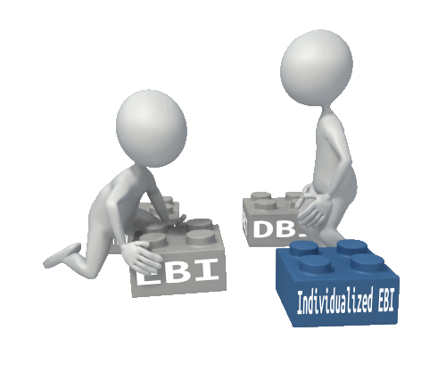
Decoding the Terminology: EBI and DBI
Notes:
Intervention adaptation is about collecting individual data or evidence that an intervention is working. When you get to Tier 3, evidence based means that the intervention is working for the individual student versus working for a group (e.g., Tier 2).
We want to acknowledge that there is a lot of terminology, which can be confusing. Summarize for the participants that clarifies the difference between DBI and EBI.
DBI is the process. EBI refers to the common term in schools of a starting point list of interventions. However, central to all of this is building interventions that are truly evidence or data based. Truly data based means that we have data or evidence to document that the intervention is working for the student, which in essence makes it evidence based—in essence an individualized EBI.

Slide 25
What Should Tier 3 Intervention Plans Include?
What the intervention will look like (i.e., steps or procedures)
What materials and/or resources are needed and whether these are available within existing resources
Roles and responsibilities with respect to intervention implementation (i.e., who will be responsible for running the intervention and preparing materials)
Source: Evidence Based Intervention Network (http://ebi.missouri.edu)/
Notes:
Refer participants to Handout 2: Tier 3 Planning Checklist. Remind them that this is a sample planning checklist that they can use when thinking about Tier 3 intervention plans.
Read slide.

Slide 26
What Should Tier 3 Intervention Plans Include?
The intervention schedule (i.e., how often, for how long, and at what times in the day)
Context (i.e., where and with whom)
How the intervention and its outcomes will be monitored (i.e., what measures, by whom, and on what schedule) and analyzed (i.e., compared to what criterion).
Source: Evidence Based Intervention Network (http://ebi.missouri.edu)/
Notes:
Review slide.

Slide 27
Considerations for Tier 3 Interventions: The “How”
When considering an intensive intervention, teams are asked to consider what they think are the most likely reasons for the problem behavior.
Once selected, these hypothesized reasons are then used to select interventions.
If there is more than one likely reason selected, try rank ordering from most to least likely.
Source: Evidence Based Intervention Network (http://ebi.missouri.edu)/
Notes:
Why is a student having the behavioral difficulty? Return to the considerations of how we select EBIs.
Reaview slide.

Slide 28
Considerations for Tier 3 Interventions: The “How”
Selected interventions should be customized to the student with care so as to not alter the function.
Change the icing, not the core ingredients. For example, although praise is often suggested in reinforcement-based interventions, other reinforcements can be used if praise does not act in a reinforcing manner for the target student. That being said, you cannot remove the reinforcement fully from such an intervention.
Implement.
Collect outcome data.
Analyze.
Source: Evidence Based Intervention Network (http://ebi.missouri.edu)/
Notes:
Optional activity: Before reviewing the bullet points, ask participants what they think are some of the considerations when selecting EBIs that align with function.
Read slide and go over the example as a way to summarize the considerations.

Slide 29
Considerations for Tier 3 Interventions: The “How”
The true documentation that an intervention is evidence based for a specific case occurs only when there are outcome data indicating a change in the target behavior.
Source: Evidence Based Intervention Network (http://ebi.missouri.edu)/
Notes:
Read slide.

Slide 30
Common Reasons Why Students Misbehave
A student has not learned the behavior.
Inappropriate behavior removes a student from what he or she does not want to do (escape).
Inappropriate behavior gets a student something (typically attention).
A student has not had to do the behavior in that way before.
Source: Evidence Based Intervention Network (http://ebi.missouri.edu)/
Notes:
Ask participants if they remember this earlier slide about some of the common reasons students misbehave.
The task for your problem-solving teams will be to think about students falling into one of these four categories. Review the bullets. School teams tend to overestimate a student’s ability to “do” these behaviors and acquire certain skills.
The next section of the training will focus on some specific examples of EBIs that primarily address escape or attention-based functions.

Slide 31
Selecting Evidenced-Based Interventions That Align With Function
NCII does not endorse any of the interventions presented in this training. We would like to acknowledge that these examples were selected for training and illustrative purposes and in large part because they are commonly used in tiered systems and have an intriguing evidence base.
However, NCII, through its Technical Review Committee (TRC), has not yet validated any of the strategies or interventions listed in this training. It is planning to review interventions in the next several years to provide endorsed options.
Notes:
Note: NCII does not endorse any of the interventions discussed in the training, but these are and do represent some of the more common and commercial interventions at Tier 3. It is important to note that these examples have not been validated through NCII’s TRC as of yet.

Slide 32
Examples of Evidence-Based Interventions
Check In Check Out (CICO)
Non-contingent reinforcement (NCR): attention seeking
Antecedent modification: escape
Instructional match: prerequisite skill or ability
Source: Evidence Based Intervention Network (http://ebi.missouri.edu)/
Notes:
In the next section we will discuss a few important considerations when delivering intensive interventions and then present some specific classroom examples that address escape, attention, and instruction cases. Please refer to Handout 3: Examples of Evidence-Based Interventions. We will review four examples.
Note: The first two examples are more attention based; the final two examples are escape based. This gives teachers some choice in terms of selecting interventions.
The four examples are as follows:
CICO: common and effective strategy for attention-motivated behaviors
NCR: excellent and possibly underrated or underused strategy
Antecedent modification: very effective for escape-motivated behaviors
Instructional match: ties well to antecedent modification

Slide 33
Check In Check Out
An empirically supported strategy for reducing problem behavior
Relatively quick and easy; provides structure
Increases positive adult contact
Excellent intervention when the function of behavior is attention seeking
Also useful for students who escape because they do not want to do a task if teach praise is more reinforcing than the task is punishing.
Source: Michigan’s Integrated Behavior and Learning Support Initiative (http://miblsi.cenmi.org)/
Notes:
CICO is an intervention that is also known by several other names, including the Behavior Education Program; Check, Connect, and Expect; and Hello, Update, Goodbye (HUG).
CICO is commonly used because of the research base supporting the positive impact for students. It is an excellent intervention when the function of behavior is attention based. It is also a quick and easy intervention that requires minimal amounts of time before and after school and provides predictability and structure to a student’s day. It increases the frequency of positive adult contact for a student that is structured to encourage, motivate, and support the student.
Note: If a teacher is a really, really nice teacher and likes to attend to students if they have had a rough or tough day and wants to do a therapy session or provide additional social-emotional support, such teachers may unwittingly destroy or take away the effectiveness of CICO. More specifically, if you attend to students after a bad day as much or more than you attend to students on a good day, then you are giving them systematic attention regardless of what behavior they exhibit.
Review an example. This is a great example of further intensifying or individualizing an intervention (e.g., behavior intensification).
A student was exhibiting some behaviors that were determined to be attention seeking. The counselor was the point of contact; she was the loveliest person and just all-around nice. She was not the type of person who could “cold shoulder” a student or not provide additional support and attention irrespective of behavior.
It was clear that she was not the person to lead CICO, but functioned more as the “reinforcer” or reward for the student. The school found a different teacher who was able to be more contingent with her attention (e.g., a bad day did not equal unconditional attention for the student).
In this school, notes from class would be sent home. Unfortunately, on “bad days,” the student was being punished at home; on “good days,” the student was being ignored. As a result, what was happening at home undermined the effectiveness of the intervention at school.
The decision was made to stop sending notes home relating to CICO to make it effective. The takeaway message from this example is that it took truly understanding the function of the behavior to make this intervention truly effective and evidence based for this student.

Slide 34
Elements of Check In Check Out
Focus on teaching
Check-in check-out system
Daily classroom report card
Home-school partnership
Collaborative team-based process
Source: Michigan’s Integrated Behavior and Learning Support Initiative (http://miblsi.cenmi.org)/
Notes:
We will not review all of the CICO elements on this slide, but Handout 3 has more details about CICO. If you would like to learn about all of the different elements, please see the MiBLSi website because there is a section specifically about CICO. The website details are at the bottom of each appropriate slide and on the handout.

Slide 35
For Whom Should Check In Check Out Be Used?
Students engaging in externalizing behaviors
Less than 15 percent of students
Students with multiple referrals (two to five major referrals)
Students who receive several minor referrals
Students who receive referrals in multiple settings
Students who find adult attention rewarding or reinforcing
Source: Michigan’s Integrated Behavior and Learning Support Initiative (http://miblsi.cenmi.org)/
Notes:
CICO is a commonly used Tier 2 intervention. However, for those students who need intensive intervention, CICO may not be sufficient on its own or address more complex behavioral challenges. Typically, en route to a Tier 3 Intervention, you can implement individual level changes, such as changing the CICO adult, adding peer support, and adding extra check-in times.

Slide 36
The Benefits of Check In Check Out
On a daily basis, there are increased structure, feedback, and adult support.
There are daily home and school communications and collaborations.
Data are collected, reviewed, and used to make decisions about the intervention success (or lack there of).
Source: Michigan’s Integrated Behavior and Learning Support Initiative (http://miblsi.cenmi.org)/
Notes:
Read slide. This slide lists some of the benefits of CICO.

Slide 37
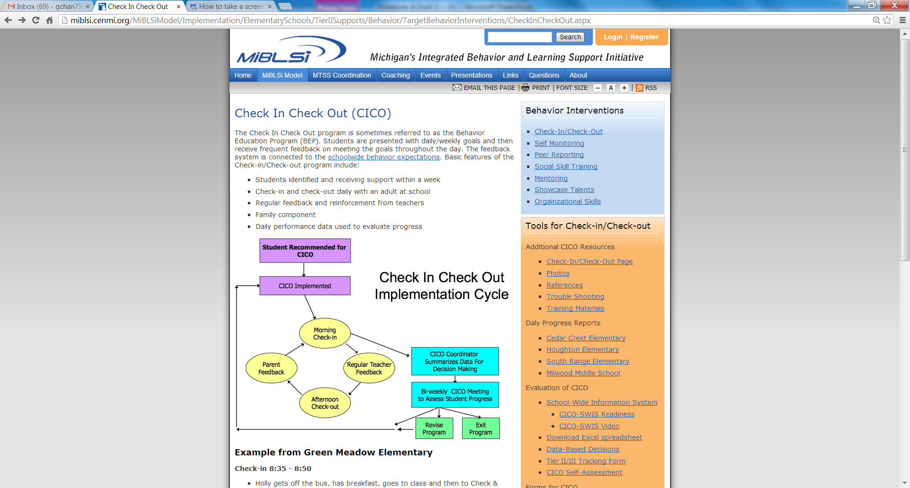
.
Source: Michigan’s Integrated Behavior and Learning Support Initiative (http://miblsi.cenmi.org)/
Notes:
All of this information about CICO is available on the MiBLSi website.
Also, there is a suggested activity in the coaching guide if teams want some help with building or customizing CICO for their schools or districts.

Slide 38
.
Non-contingent Reinforcement
Photo Credit: http://www.flickr.com/photos/familymwr/4919451795/; http://creativecommons.org/licenses/by/2.0/deed.en
Notes:
Click to show arrow.
Remind the participants that NCR is the second example in Handout 3: Examples of Evidence-Based Interventions.
We should note that NCR was first trialed with severely autistic students. It was developed with very severe behaviors in mind and has been shown to be universally effective across students.
This picture represents an example of NCR in the classroom. Three students are gathered around a table and the teacher is reading a story. The student sitting to the left of the teacher looks quite unhappy.
With NCR, the idea is to give a student access to a preferred reinforcer frequently enough so that he or she is no longer motivated or interested in engaging in maladaptive behaviors (e.g., being cross, disruptive, or aggressive).
On the next few slides, we will discuss some features of NCR and provide some examples.

Slide 39
What Is Non-contingent Reinforcement?
NCR is a powerful method to reduce attention-seeking problem behavior. NCR involves giving a student access to a reinforcer frequently enough so that he or she is no longer motivated to exhibit disruptive behavior to obtain that same reinforcer (e.g., saturate the environment with the reinforcer before the behavior occurs).
Source: Evidence Based Intervention Network (http://ebi.missouri.edu)/
Notes:
Read slide. This slide gives a brief description of NCR and assumes that the selection and the use of this intervention is the result of determining that the function of behavior is attention based.
Note: NCII works with model sites in Missouri, and they playfully refer to NCR as “puking praise on children.” More specifically, the idea behind NCR is to inundate a student with positive attention until he or she satiates and no longer wishes to engage in disruptive or maladaptive behaviors to get attention (e.g., give students positive attention until they no longer have attentional needs).
For students who have attention-motivated behaviors, we suggest using or thinking about a fish tank analogy. The students are the fish tank, and the water is attention. Regardless of whether the water is clean or dirty, the students will fill it up with what is available. Similarly, for attention-seeking students, any attention is good attention, and some attention is better than no attention.

Slide 40
An Example of Non-contingent Reinforcement
Example: A student wants teacher attention and calls out or engages in disruptive behaviors to get attention consistently during a group activity, such as art or story time.
Possible solution: The teacher will provide appropriate attention prior to the student “asking” for attention with the “problem behavior” (e.g., have the student sit with the teacher while she is reading a book to the class).
Notes:
Review the example and work through it with the group (e.g., pairs, small groups, or teams). Click once to reveal a description of the example and click again to reveal the possible solution.
This intervention requires intensive and very high levels of positive attention (e.g., 15–20 times per hour).
It is worth noting that instead of fading this intervention as you might others, a good solution may be to generalize the positive praise or behavior to other students in the class.
It is actually a positive to increase teacher praise or the use of praise in the classroom; if teachers do want to fade it, then do it in systematic manner and not too soon so as to take away the effectiveness or the impact of the intervention.

Slide 41
a
Critical Components for Success
You need to identify the reinforcer for the problem behavior. NCR will not work if you do not know the function of the disruptive behavior.
The problem behavior must be attention seeking.
You need a schedule for NCR delivery that minimizes problem behavior.
NCR is most effective with a heavy dose of reinforcement early in the day.
You must ignore problem behavior after the schedule is initiated.
You should fade the process as problem behavior declines but make sure the student does not reengage in behavior by fading too quickly.
Slowly reduce the amount of NCR given. Note: NCR is good teaching practice, so it should never be “stopped.”
Notes:
Review the slide about four critical components for success in NCR.
Identify something that is actually reinforcing to the student.
Establish a metric for teachers to do this and a system to remind them to do it (e.g., timer, paperclips).
A massive, high, and heavy dosage early on typically yields more positive results (e.g., it is better to have 20 instances of reinforcement in the first 30 minutes or hour versus 40 instances throughout the day).
It is also very important to follow all the components because implementing only some of the components will not yield success.
Ideally, inappropriate behavior should be ignored, but at the very minimum, one should increase the latency in response to the behavior. More specifically, try not to immediately attend to maladaptive behavior if the behavior must be attended to. The goal is to make this a less efficient means to get attention.
Collect some kind of outcome data to determine the effectiveness of the intervention.
Note: There is an activity in the coaching guide for teachers and coaches for demonstrating NCR. Please refer to the coaching guide handout.

Slide 42
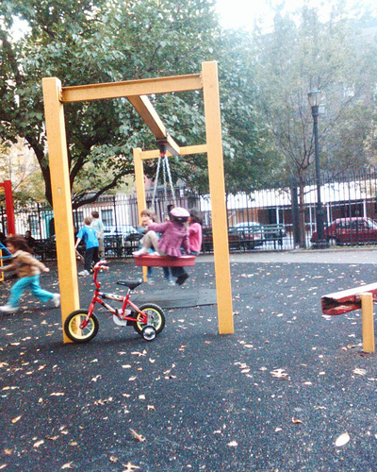
.
Antecedent Modification
The “Great Escape”
Photo credit: http://www.flickr.com/photos/edenpictures/2969677793/; http://creativecommons.org/licenses/by/2.0/
Source: Evidence Based Intervention Network (http://ebi.missouri.edu)/
Notes:
Refer participants to the third example on Handout 3.

Slide 43
What Is Antecedent Modification?
The student does not have to do something when he or she exhibits the problem behavior.
The problem behavior is “working” for the student by allowing him or her to escape something that he or she does not want to do.
Source: Evidence Based Intervention Network (http://ebi.missouri.edu)/
Notes:
Read slide.
Antecedent modification is typically associated with escape-based behaviors. For many years, teachers have been told that they should not let students escape or remove the “escape.” The logic followed that if you keep them there, they will (eventually) complete the task.
The reality is that this is not true. What often results is an extinction burst, and changes occur in behavioral topography, intensity, and/or frequency, yielding more problematic behavior.
More specifically, it is possible that removing the escape or not letting a student escape from a task will shape a more problematic behavior unintentionally.
What we are suggesting as an alternative is antecedent modification. For example, if the behavior is a student flipping a desk, the questions that a teacher should be asking may include but are not limited to the following:
What was happening right before the behavior?
What was I doing and what was the student doing? The realization is that, perhaps, you should not repeat those behaviors because it results in student misbehavior. Here are some examples:
If a student was working on a mathematics worksheet, we need to look at the worksheet or the student’s level or ability to do the task or assignment.
If the teacher was yelling at a student and getting in his or her face and then got punched in the face, then the teacher may want to consider not escalating a particular situation that resulted in the physical attack.

Slide 44
An Example of Antecedent Modification
Example: A student wants to escape a non-preferred activity, such as mathematics or physical education. Every time the teacher announces the start of a specific activity, the student starts engaging in disruptive behaviors (e.g., runs away, shouts out, pretends to sleep).
Possible solutions:
Minimize the need for the escape by making the target activity less punishing!
Alter antecedents to increase task engagement, appropriate behaviors, and general success (e.g., preteaching, offering choice, and modeling).
Notes:
Review the example.
Antecedent modifications are considered a class of interventions or strategies. Antecedent modification is not a package intervention, but you can build the intervention (e.g., alter the antecedent) so that it works for the student and minimizes the need for escape behavior.
If we return to the example of the student who engages in disruptive behavior every time a specific activity occurs and the hypothesized function has been identified as escape, what’s next? What are some of the possible questions you can ask so that you can take the next steps and ensure that the solution or the strategy you choose is one that will likely be effective because it is tied directly to the function of the behavior?
Escape-motivated behavior, such as attention-based behavior, happens for different reasons and exists along a continuum. As a general rule, to decrease escape behavior, the activity needs to be less punishing from the student’s perspective. What we mean by punishing is that the activity is or has become aversive to the student and he or she would rather engage in an inappropriate behavior than engage in the activity.
Altering the antecedent of the target behavior has the substantial advantage of being proactive. As such, with appropriate modifications of the antecedents, a problem behavior (e.g., disruptive behavior or task demand refusal) can be avoided. For students who want to escape non-preferred activities, altering antecedents can increase task engagement. Antecedent-based procedures can be used to decrease inappropriate behaviors or increase appropriate behaviors.
Depending on the type and the intensity of the escape behavior, there are a few strategies or changes that are likely to help (e.g., changing the antecedents to increase engagement in the activity or success with the activity). Other examples would be preteaching the necessary skills, offering choices, modeling the desired behavior, or breaking down tasks.

Slide 45
Critical Components for Success
Positive reinforcement (e.g., praise) for engaging in the activity
Reinforce appropriate behaviors in shorter intervals initially (e.g., change the schedule of reinforcement or task demand)
Source: Evidence Based Intervention Network (http://ebi.missouri.edu)/
Notes:
Another critical component for success is to provide positive reinforcement for participating in an activity. Positive reinforcement serves to strengthen behavior you would like to see more of in the future (e.g., in this case, engagement in an activity).
Furthermore, redirecting or providing instructional feedback in shorter intervals also will strengthen appropriate behaviors (e.g., instead of having to do a page of mathematics problems independently before accessing some kind of reinforcer, perhaps the student has to do only five problems). One of the main reasons for providing reinforcement at a higher schedule initially is to “catch” instances of good behavior and strengthen the future probability of their occurrence. The goal is to slowly fade the reinforcement to more realistic and manageable levels.

Slide 46
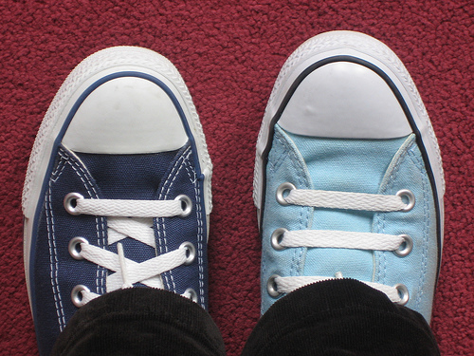
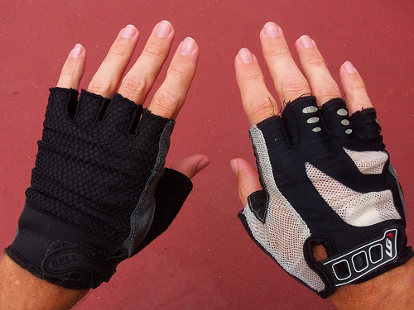
.
Instructional Match
Photo credit: http://www.flickr.com/photos/charlottel/154443920/; http://www.flickr.com/photos/dno1967b/8703319368/; http://creativecommons.org/licenses/by/2.0/
Notes:
Remind participants that more information on instructional match is available in Handout 3.
Instructional match is a fairly simple intervention if the academic work is too hard for the student and the student is acting out in a behavioral manner. For a student who cannot read because the book is too hard and advanced given his or her abilities, it will not matter if you inundate the student with positive reinforcement or use CICO too much. If the student does not have the necessary prerequisite skills, the student will not be able to do the activity.

Slide 47
.
What Is Instructional Match?
Escape behavior related to academic tasks that are simply “too hard.”
For example, a student might not be successful because the instructional materials are too difficult, or he or she may not have the prerequisite skills.
Source: Evidence Based Intervention Network (http://ebi.missouri.edu)/
Notes:
Read slide.
With instructional match, it is important to use academic data and make sure that students have materials that are compatible with their abilities.
Let’s use a real-world example to illustrate the point. Think about yourself. If for every 10 things you were asked to do—whether it be at home, at work, or in your personal life—and you could not do nine of them as a normally developing adult with no behavior problems, it is possible that you would develop or engage in maladaptive behaviors as a result of feelings of frustration, inadequacy, or the like.

Slide 48
Characteristics of Instructional Match
There is a mismatch between student skill and the level of difficulty of the task: the assessment of a student’s current instructional level is inaccurate in some way (e.g., knowledge, difficulty, pace, and/or level).
Students who are failing academically are frustrated and often act out!
Notes:
Review slide.

Slide 49
Examples of Instructional Match
Examples:
Doing addition problems without being able to count
Journal writing without being able to form two- or three-word sentences
Drawing without fine motor skills, such as pencil grip
Running without proper gait (e.g., can walk only on tippy toes)
Possible Solutions:
Preteach content or skill.
Reduce the difficulty of the task.
Break down tasks into smaller, more manageable subtasks.
Use curriculum-based measurement (CBM) to determine the appropriate instructional level.
Source: Evidence Based Intervention Network (http://ebi.missouri.edu)/
Notes:
Click to reveal the examples. Click again to reveal the possible solutions.
Activity: Ask the group or do a think-pair-share about which solutions they might pair with each example and why.

Slide 50
.
Critical Components for Success
Must be able to accurately assess a student’s current level of ability and implement a curriculum and teaching materials that are appropriate to the student’s instructional level.
Must match task demands with current skill levels to ensure success.
Differentiate instruction whenever possible and appropriate.
Source: Evidence Based Intervention Network (http://ebi.missouri.edu)/
Notes:
Read slide.
Optional activity: The facilitator can lead a discussion on the following points and ask the group the following questions:
How will teams know when this is working?
Decreased problem behavior and increased academic engagement. It is likely that academic success will occur prior to or concurrent with the change(s) in behavior.
How will progress be measured?
This is a rather unique behavior intervention in that the first line of assessment is academic and/or academic engagement. Direct academic assessment (e.g., CBM) and formative assessment of engagement and the problem (Direct Behavior Ratings [DBRs]) are ideally suited to these cases.

Slide 51
Learned Helplessness Studies
Underestimate performance and behavior problems
Low motivation, expectations, perceived control, and confidence
Repeated failure plus generalization of failure
Learned helplessness response style
Focus on limitations and weaknesses
Source: Seligman & Maier (1967)
Notes:
Remind participants about the studies by Seligman and Maier (1967) and what happened. Talk about the parallels between the learned helplessness studies with dogs and human behavior. For example, dogs were shocked and kept in cages with no escape. Long term, this lead to behaviors of withdrawal mixed with high levels of aggression.
Learned helplessness also can extend to human behavior. Let’s take an example at the classroom level, which is related to instructional match and the importance of making sure that tasks are matched to skills and abilities.
Students who are asked repeatedly to do work or tasks that they cannot do and fail at consistently will, across time, focus on their weaknesses and limitations, underestimate their own performance, and develop a learned helplessness style. Once in this cycle, it can become self-perpetuating. Repeated failure intensifies learned helplessness, which can cause a range of maladaptive behaviors from withdrawal to externalizing behaviors, such as outbursts and aggression.
Repeated school failure is hugely problematic and reinforces students to disengage from school activities.
Note: Repeated school failure was in part why Response to Intervention (RTI) became part of special education law.
It is not surprising to see students “freak out” or engage in inappropriate behaviors if you repeatedly put a book in front of them and they cannot read it.
This also is why a multi-tiered system of supports (MTSS) was more broadly developed.
This further reinforces the need for prevention and to build on what students can do. It supports the point that inclusion and differentiation of instruction are both important and needed.
Presenters: Be prepared if participants ask you about teaching the Common Core State Standards (e.g., the district or state won’t let us do certain things…what are your thoughts on this?)
This is a part of a broader conversation about the fundamental piece of what students need to learn and how you accommodate or modify the environment to allow them to access at least some of what they can do.
It might be worth noting that it is a common misunderstanding about curriculum. For example, to achieve fourth-grade standards does not necessarily mean you need to teach all students in the exact same way, but you still want the outcomes to be the same.

Slide 52
Part III
Linking Assessment and Monitoring
Notes:
This is the third of four sections of the training module.

Slide 53
Implementing and Monitoring Outcomes
Determine the plan and who is responsible for execution at each step.
Identify training and resources.
Monitor the plan.
Use a cycle of support.
Notes:
Read slide.

Slide 54
Plan for Integrity of Implementation
Teaching
Coaching and feedback
Scripts for adults to follow
Data collection
Follow-up support meetings
Follow-up data evaluation
Notes:
Read slide.

Slide 55
Monitor the Plan: Five Considerations
Evaluate the effects of interventions, comparing baseline data to data during intervention. Is your plan working?
If your plan is not working, consider some reasons why it might not be working. What changes are needed in your plan? Make those changes.
Notes:
Review the slide about the five considerations for linking assessment and monitoring the plan.
Remind participants that this information is also available on Handout 4: Linking Assessment and Monitoring.

Slide 56
Monitor the Plan: Five Considerations
If your plan is working, consider what you will do next. Will you simplify the plan to make it more efficient? Will you fade, change, or terminate your interventions?
Continue to implement your interventions until you feel they are no longer needed or working.
After terminating the plan, continue to collect data to determine whether any positive effects are maintained following plan termination.
Notes:
Read slide.

Slide 57
Data-Based Decisions
Were the goals of the support plan achieved?
Was implementation done consistently and with integrity?
Is more assessment needed?
How should the plan be modified?
Notes:
A note about data-based decisions. Read slide.
Remind participants that data-based decisions are a critical part of the monitoring process.

Slide 58
Part IV
Connecting Data With the Evidence-Based Intervention Selected
Notes:
Remind participants that this is the last section of the training module.
Part IV is about the analysis of data and making sure that you are connecting the data with the selected EBI. We want teams to think about questions like the following:
What are the data telling you?
How do I use the data to inform practice and assess whether the intervention selected is working?
Data provide the only objective way to know whether an intervention is effective. Let’s look at a few examples before wrapping up this module.

Slide 59
Connecting Data With the Selected Evidence-Based Intervention
Target Behavior
Questionnaire
Checklist
Anecdotal Report
Direct Observation
Notes:
This graphic is taken from a previous NCII module on behavior progress monitoring.
There are many different ways to collect data and progress monitor. This graphic lists some of the more common methods.

Slide 60
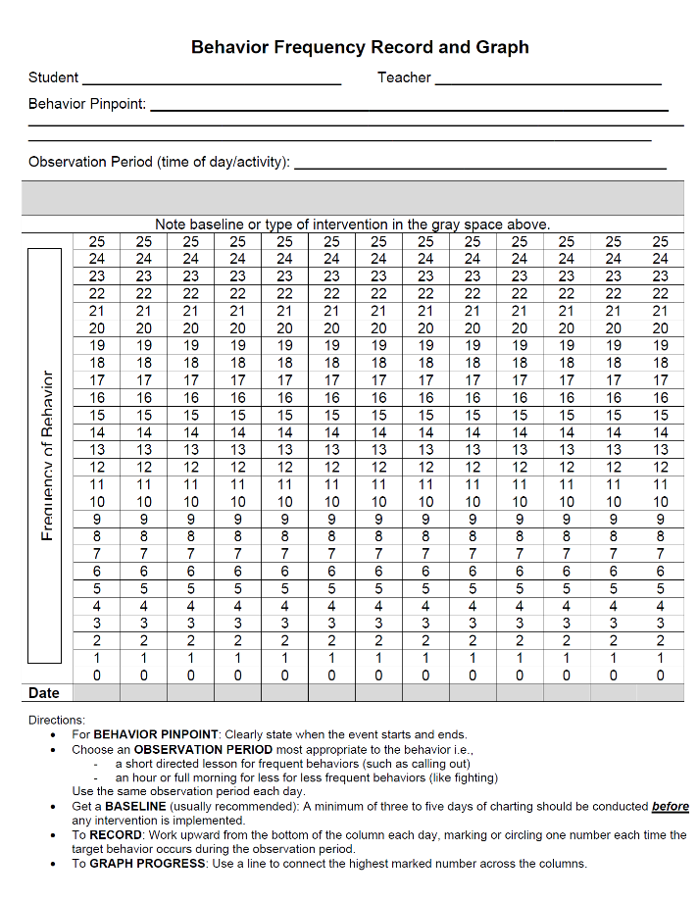
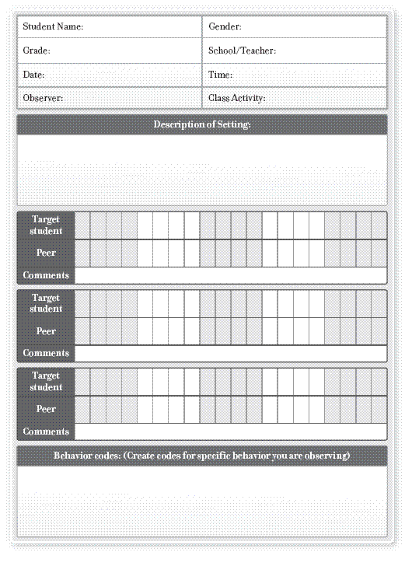
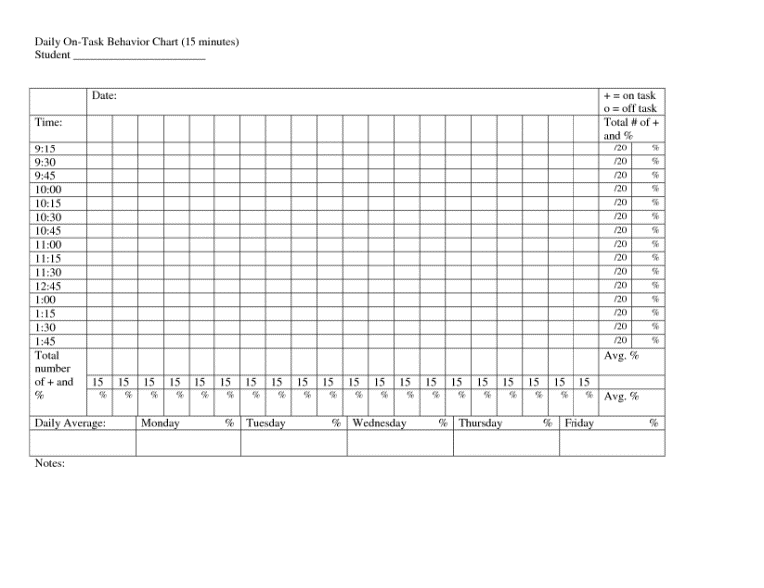
Direct Behavior Rating
Notes:
Direct observation methods—and specifically DBR—have been previously covered in other NCII training modules. Consequently, the specifics of DBR will not be reviewed in this module.
Note: NCII is not recommending or endorsing any particular method of data collection. If your school or district already has a system or a method in place that is working, continue to use that. The examples on the slide represent other options available that are commonly used (e.g., behavior frequency record and graph and on-task behavior chart).

Slide 61
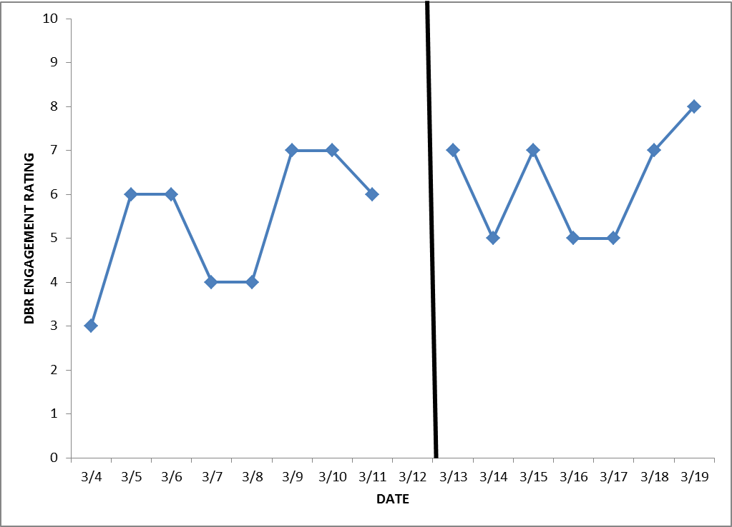
Comparing Non-intervention and Intervention Patterns: Example 1
Notes:
As we near the end of this particular training, we wanted to revisit the previous NCII trainings on progress monitoring and FBA (see http://www.intensiveintervention.org/content/dbi-training-series).
Possible Activity: Ask the group to do a think-pair-share on data.
If these are the kind of data you see preintervention and then postintervention, using visual analysis, what are the data telling you? Let’s assume that the behavior being observed was disrespect (e.g., language, physical gestures, and threats).
The data show a slight increase—albeit not very significant—but the more important information to draw from this graph is that the intervention selected is resulting in high levels of variability (e.g., the selected intervention is not working very well).
A reasonable data-based decision would be to reevaluate the intervention.
Let’s look at a few more examples.

Slide 62
Comparing Non-intervention and Intervention Patterns: Example 2
Notes:
Possible Activity: Ask, “In which instance is the intervention working?” Provide the following background information to the participants.
If the y-axis is the DBR rating, what are the data telling you here? Let’s take two different examples of behavior.
What do the data tell you about the following:
Behavior = being respectful
Behavior = disrespectful

Slide 63
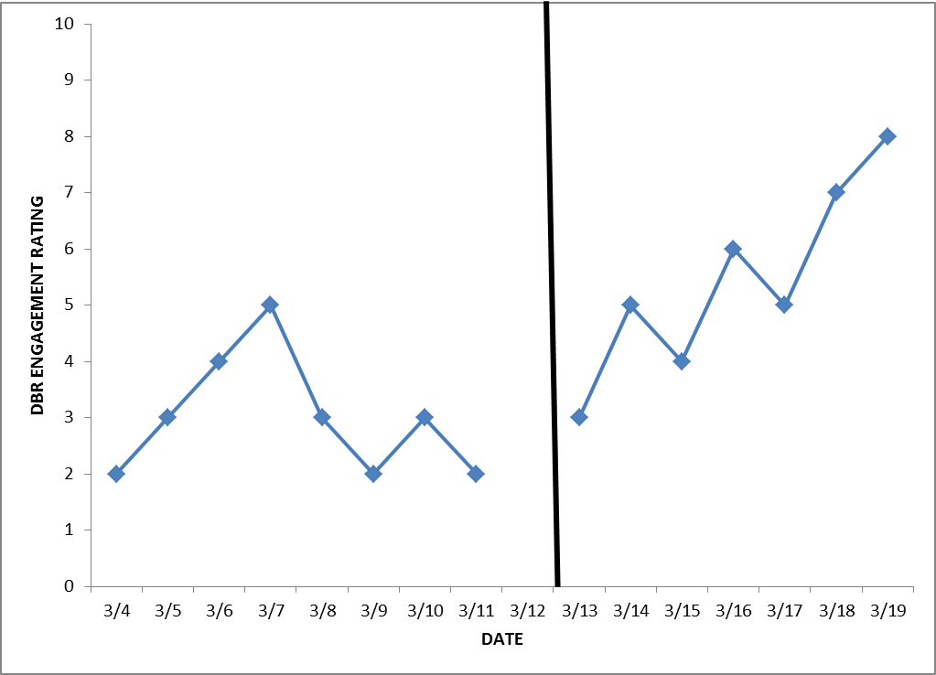
Comparing Non-intervention and Intervention Patterns: Example 3
Notes:
Activity: Ask, “In which instance is the intervention working?”
If the y-axis is the DBR rating, what are the data telling you here? Let’s take two different examples of behavior.
What do the data tell you about the following:
Behavior = being respectful
Behavior = disrespectful

Slide 64
Quick Review
What is an EBI?
What are some of the reasons why it is important to align EBIs and the function of behavior?
What are the four EBIs we mentioned today and can you give a quick description of them?
Bonus question: Can you describe the components of the DBI process and where EBIs fit in? (Hint: Think of all the NCII trainings.)
Notes:
Review slide. Ask the participants these summary questions to check for understanding.
Possible answers:
1. Evidence-based intervention
2. EBIs are useful only for a range of problems and, as such, must be paired up with the right situation. EBIs have been documented as likely effective, not surely effective; they must be functionally relevant.
3. CICO, NCR, antecedent modification, and instructional match
4. Secondary platform, progress monitoring, intervention adaptation, and so on

Slide 65
References
Direct behavior ratings. (2010). Storrs, CT: University of Connecticut. Retrieved from http://www.directbehaviorratings.com/cms/
Gresham, F. M. (1989). Assessment of treatment integrity in school consultation and prereferral intervention. School Psychology Review, 18, 37–50.
Michigan Department of Education. (n.d.). Michigan’s integrated behavior and learning support initiative. Lansing, MI: Author. Retrieved from http://miblsi.cenmi.org/
National Center on Intensive Intervention. (2013). Data-based individualization: A framework for intensive intervention. Washington, DC: Author. Retrieved from http://www.intensiveintervention.org/sites/default/files/DBI%20a%20Framework%20for%20Intensive%20Intervention.pdf
Notes:
Review slide.
Let participants know how they can access the sources from which we developed this module.

Slide 66
References
School of Psychology at Mizzou. (2011). Evidence Based Intervention Network. Columbia, MO: University of Missouri. Retrieved from http://ebi.missouri.edu
Seligman, M. E. P., & Maier, S. F. (1967). Failure to escape traumatic shock. Journal of Experimental Psychology, 74(1). Retrieved from http://psych.hanover.edu/classes/learning/papers/seligman%20maier%201967.pdf
Notes:
Review slide.

Slide 67
Disclaimer
This presentation was produced under the U.S. Department of Education, Office of Special Education Programs, Award No. H326Q110005. Celia Rosenquist serves as the project officer.
The views expressed herein do not necessarily represent the positions or polices of the U.S. Department of Education. No official endorsement by the U.S. Department of Education of any product, commodity, service or enterprise mentioned in this website is intended or should be inferred.

Slide 68
/
Name:
Title:
E-mail:
National Center on Intensive Intervention
1000 Thomas Jefferson Street NW
Washington, DC 20007-3835
866-577-5787
www.intensiveintervention.org
Email: ncii@air.org

