Slide 1
Using FBA for Diagnostic Assessment in Behavior
Notes:
Introduction to the module
This module fits into series of training modules developed by the National Center on Intensive Intervention (NCII) aimed at district or school teams involved in initial planning for using DBI as a framework for providing intensive intervention in academics and behavior. This module specifically looks at using Functional Behavior Assessment (FBA) for diagnostic assessment in behavior.
The audience for this module may include the behavior support team, interventionists, special educators, school psychologists, counselors, and administrators, as appropriate. Subsequent modules will provide additional information about specific components of the DBI process. More information about NCII’s approach to intensive intervention can be found in the NCII concept paper Data-Based Individualization: A Framework for Intensive Intervention. The concept paper is available at http://www.intensiveintervention.org/sites/default/files/Data-based_Individualization_A_Framework.pdf.
Instructions for using the speaker notes
Text formatted in standard font is intended to be read aloud or paraphrased by the facilitator.
Text formatted in bold is excerpted directly from the presentation slides.
Text formatted in italics is intended as directions or notes for the facilitator; italicized text is not meant to be read aloud.
Text formatted in underline indicates an appropriate time to click to bring up the next stage of animation in an animated slide.
Preferred citation:
While permission to reprint this publication is not necessary, the citation should be: National Center on Intensive Intervention (October, 2013).Using FBA for Diagnostic Assessment in Behavior. Washington, DC: U.S. Department of Education, Office of Special Education Programs, National Center on Intensive Intervention.

Slide 2
Today’s Agenda
Introductions and overview of the day
Defining FBA
  ABCs; Reinforcement and Punishment
Functions and levels of FBA
Conducting FBA's – processes and procedures
Summary
Notes:
Read slide.
The agenda may be changed to fit the time frame and the focus of the training.
This module takes 2.5–3.5 hours to complete (including the slide presentation and the integrated activities).
The following handouts should be provided to participants:
“Handout 1: FBA and Behavior Support Plan Self-Assessment “(see Slide 11)
“Handout 2: Common Problem Behaviors and Some Usual Suspects for Functional Antecedents and Consequence “(see Slide 2 and 56)
“Handout 3a-d: FBA Process (3a: Slide 64 and 88), Functional Assessment Interview (3b: Slide 71 and 92 ), ABC Report Form (3c: Slide 57-59). Note: Handout 3d (Positive Behavior Support Plan Worksheet) is for informational purposes and not described in detail in the PPT presentation.
“Handout 4: ABC Report Form Example (Slide 60)

Slide 3

The Challenge
Lots to cover
Little time
Intro, not fluency
Notes:
Note:
FBA's or behavioral interventions are meant to occur within the context and support of a team of people within your districts. It is rare that an FBA will be the sole responsibility of just one individual (e.g., class teacher).
This training is an introduction to the core concepts and procedures rather than a fluency training in conducting FBA’s. We do not consider this module a quick fix “how-to guide” for behavioral diagnostic assessments. More specifically, we do not expect individuals to be able to conduct behavioral assessments following this training. Rather, it is our hope that after completing this module, you feel more comfortable with the steps involved and with being a member of a team that will conduct behavioral assessments.

Slide 4
Learning Objectives:
By the end of today, participants will be able to…
Define FBA
Develop a deeper understanding of core concepts in behavior (e.g., ABC; reinforcement, punishment, etc.)
Describe what “functions of behavior” refers to
      Describing levels of FBA
      Conducting FBA's – processes and procedures
Notes:
Review the learning objectives.

Slide 5
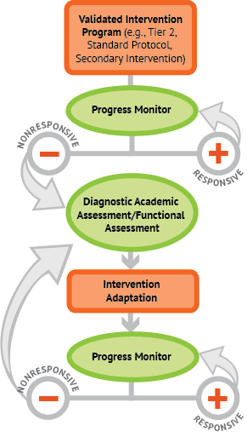

.
A Bird’s-Eye View of DBI
Notes:
Reminder:
This module fits into a series of training modules developed by the National Center on Intensive Intervention (NCII) aimed at district or school teams involved in initial planning for using DBI as a framework for providing intensive intervention, specifically diagnostic assessment in behavior.
NCII uses this graphic to illustrate the progression of DBI. We begin with a secondary intervention program, deliver it with greater intensity, and progress monitor to determine the student’s response. If the student is responsive, we can continue the current intervention or consider reducing intensity as goals are met (depending on rate and duration of response and nature of skill deficits). If the student is not sufficiently responsive, we gather additional information through informal diagnostic assessment, which identifies student needs to guide intervention adaptations. We continue progress monitoring to make decisions about whether or not the student is responding to the adapted intervention.

Slide 6
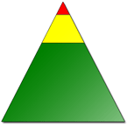
Triangle Intervention Logic
Individualized Intervention
Secondary Intervention
Preventative Methods
NCII MS 4a, 2013
Notes:
Review Intervention Logic.
The logic of the triangle suggests that most students (about 80%) will respond positively to strong, systematic prevention techniques. This implies that about 20% of students, therefore, will not be responsive to those supports widely available in schools to promote prosocial behavior. These students who are non-responsive will require further support to maintain appropriate behavior in schools.
The typical process is to move these non-responding students to an intervention that will provide additional feedback on student behavior and opportunities to access reinforcers and positive attention. Fortunately, many of these students who have demonstrated difficulty will show improvements over time. 15% of students will likely require secondary or Tier 2 supports, and that leaves an approximately 5% of students who have not been responsive to preventative or secondary intervention supports.
Put another way, those students at the top of the triangle have the most intensive needs and they constitute about 3-5%. It is imperative that we follow a systematic process to understand the reasons for their behavior and develop individualized interventions. These are the students who have not responded to Tier 1 or 2 interventions and continue to struggle. It is also very important to note that not all schools will fit this triangle intervention logic and there will be variation based on student population.

Slide 7
A Bird’s-Eye View of DBI
Notes:
Animated slide.
Click to reveal arrows and circle.
Remind participants that this training will focus on informal diagnostic assessment in behavior.

Slide 8
Note:
Diagnostic assessments for behavior may include but are not limited to functional behavior assessments (FBA's)
  Can include behavior change programs or other behavioral interventions
  We recommend you follow state laws whether you operate outside or within special education
Notes:
Review note.
For this training we are focusing on FBA's as an example of behavioral diagnostic assessments, but in some districts and states, FBA may or may not be the behavioral assessment most widely used.
We encourage you to follow state laws, but for the purposes of this training module, when talking about behavior diagnostic assessment, we are using the FBA as our mode of assessment.

Slide 9
Sample Behavioral Progression
*NCII does not endorse products. We use Check-in/Check-out (CICO) for illustrative purposes only.
Notes:
Animated slide.
Our behavioral illustration occurs in a school that uses check-in/check-out (CICO) as a secondary intervention for behavior. The CICO card also provides progress monitoring data. The left side of the graphic depicts the intervention progression. The right shows how progress monitoring tools may change as the intervention changes.
When a student is not responsive to the standard CICO intervention, the team will ask why the student is not responding and will adapt the intervention. If this is not sufficient, the team may conduct a functional behavior assessment and use it to develop an individualized behavior intervention plan.

Slide 10
Review of Core Concepts in Behavior
What is an FBA?
Very simply, an FBA is a functional behavior assessment
Definition:
Problem-solving process used to develop hypotheses about what is triggering, reinforcing and maintaining problem behaviors – **ABCs**
Notes:
Review definition of FBA.
It is a process of identifying the environmental events that predict and maintain patterns of problem behavior. Remind participants that the next section will focus on the ABC’s of behavior, which refer to antecedent-behavior-consequence.
Remind participants that for the purposes of this training and our work at NCII, we are focusing primarily on Tier 3 students or those students who have not responded to Tier 1+2 interventions and continue to struggle.

Slide 11
A Quick Self-Assessment
Handout 1: FBA and Behavior Support Plan Self-Assessment
  Use the FBA behavior self-assessment to evaluate a current function-based support plan.
  Note the areas of strength and weakness in your process and support document(s).
Notes:
Ask participants to refer to Handout 1 - FBA and Behavior Support Plan Self-Assessment and review.
Before we go over the main content, it is worth noting that this self-assessment is a summary or checklist of the type of information to consider when conducting an FBA or behavioral intervention. Most districts will probably already have some version of this in place.
We are not suggesting that districts change anything if they already have something in place that is working. Think of this as a resource, and if it helps to give you a structure because you would like to revise the system you currently have or do not have one in place, then this may be a useful resource to consider. However, we want to emphasize that it is not mandatory.

Slide 12
Part I: Core Concepts in Behavior
Notes:
The next section is a review of basic core concepts in behavior including antecedent, behavior and consequences.

Slide 13
Core Concepts in Behavior
Reviewing core terminology
Functional behavior assessment
Functional analysis
Functional analysis of behavior
Functional assessment
Notes:
Note: All of the terms listed in the slide are often used interchangeably when referring to FBA’s.

Slide 14

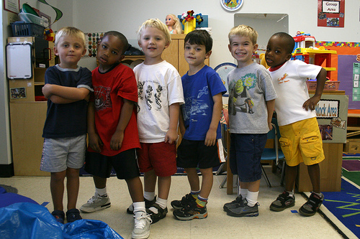
Core Concepts in Behavior
In the school setting, a functional assessment is conducted when staff are faced with serious and/or chronic challenging behavior.
Photo Credit: <a href="http://www.flickr.com/photos/73645804@N00/1384954600/">woodleywonderworks</a> via <a href="http://compfight.com">Compfight</a> <a href="http://creativecommons.org/licenses/by/2.0/">cc</a>
Notes:
One point that we want to emphasize throughout the module is that functional assessments should be (though we understand may not always be) a collaborative process and one that is conducted and supported by teams. Technically, an individual should not be conducting an FBA in isolation and without the support of a school team.

Slide 15
Core Concepts in Behavior
Basic Assumption
Behavior always serves a purpose.
It is performed to obtain a desired outcome or goal.
  Examples of outcomes or goal:
    Access to attention, tangibles, a preferred activity or sensory stimulation (positive reinforcement); or avoidance of tasks, specific environment or situations, social interaction, or unpleasant sensory stimulation.
Notes:
The basic assumption with any behavioral assessment is that behavior always serves a purpose or function (i.e., typically a behavior is present because you are either trying to get access to something or avoid something).

Slide 16
Antecedent…
Any event that happens before a behavior
 | A |  | B |  | C
Notes:
Review the next few slides about antecedent, behavior and consequence (ABC). Note that many school teams, especially those with strong behavior support teams, will have come across some form of ABC content in their teacher training.
‘A’ refers to “antecedent,” or the event that happens before a behavior.

Slide 17
Behavior…
 | A |  | B |  | C
Anything that an individual does –
Can be seen or heard and is measureable
Notes:
‘B’ represents behavior, or anything that is seen, heard, and done. Behavior must also be measureable.

Slide 18
Consequence…
 | A |  | B |  | C
Any event that happens after a behavior occurs
Notes:
‘C’ refers to the consequence, or any event that happens after a behavior. Consequence is often linked to concepts of reinforcement and punishment, which will be discussed in greater depth in the next section. Each component of the ABC’s will be viewed separately over the next few slides.

Slide 19
Core Concepts in Behavior
Antecedent: Any event that happens before a behavior
Notes:
Antecedents will be discussed over the next 3 slides.
When talking about an antecedent, we define it as any event that happens before a behavior. In essence we are trying to figure out what exactly triggered the behavior.
One way (and it is worth noting that this is not the only way) to look at antecedents is to think about them as either slow or fast triggers. More specifically, triggers are events that can happen very quickly and suddenly before a behavior or ones that are “slow burners” and can impact behavior, but not necessarily immediately.

Slide 20
Core Concepts in Behavior
Setting Events or Antecedents that are Slow Triggers
Situations are unique to individuals and may manifest over time
Tends to make the problem behavior more intense or more likely to occur (e.g., illness, fatigue, hunger, social conflict), though not always immediately
Notes:
Antecedents and setting events are terms that are often used interchangeably. For the purposes of this training, those two terms refer to the same concept.
Antecedents are unique to individuals. It should be easy enough to come up with a list that would generally apply to many individuals, but at the end of the day, there is not a list of universal triggers.

Slide 21

Core Concepts in Behavior
Examples of Slow Triggers
Argument with parent or sibling at home
Previous upset/conflict/emotional concerns
No breakfast (cranky or irritable)
Exclusion (e.g., from peers, adults)
Past failure with subject matter
Photo Credit: <a href="http://www.flickr.com/photos/12692384@N00/4950013606/">adwriter</a> via <a href="http://compfight.com">Compfight</a> <a href="http://creativecommons.org/licenses/by-nc/2.0/">cc</a>
Notes:
This slide lists examples of setting events that are commonly found in the literature. However, it should be noted that this is not an exhaustive list and you may know of or have experienced other “slow triggers”.

Slide 22
Setting Events or Antecedents that are Fast Triggers
Changes in the environment
Availability & organization of materials
Opportunity for choices
Times of day/activities
Clarity of expectations
Nature of interactions (tone, proximity, contact)
Amount & type of attention (peer, groups, adult)
Task difficulty
Length of engagement
Pace of instruction
**Hunger, fatigue, thirst, discomfort
**Hunger, fatigue, thirst, discomfort
Notes:
Click to reveal each box. The left column appears first, followed by the right and then a repeat of ** item.
There are many similarities between slow and fast triggers. Fast triggers are generally more prone to momentary change, especially in terms of the value of reinforcers (e.g., suddenly something is less effective because something else becomes more reinforcing).
Example #1: An intervention or strategy has been working with a student but has only been taught with one teacher and therefore, there has not been a chance for generalization to other individuals or situations. Following on with this example, the teacher is out sick one day and a substitute teacher runs the program and the behavior re-emerges.
Example #2: A specific reinforcer, such as access to a preferred DVD or toy, is working but you run out or can’t access it or try something else (e.g., student likes Dora the Explorer and the DVD doesn’t work so you try Sponge Bob Square Pants – not the preferred reinforcer) and the behavior emerges again.
** With hunger, fatigue, thirst, and discomfort, these examples can fall under both categories (e.g. fast or slow trigger). If we take hunger as an example, some people are cranky or unable to focus regardless if they are a little hungry or a lot hungry. This example would represent a fast trigger. Some people, can function fine without eating for hours and you don’t see a change in behavior until much later in the day. That is an example of a slow trigger.
Again, this slide is not an exhaustive list but some examples to get you thinking about what can happen before a behavior occurs.

Slide 23
Consequence…
 | A |  | B |  | C
Antecedent Behavior Consequence
Any event that happens after a behavior occurs
Notes:
Before discussing behavior, which is the main focus, it is important for us to also discuss consequence and what it means in the ABC process.

Slide 24
Consequences
(Any event that follows a behavior)
Reinforcement
Punishment
  We can tell whether the consequence is reinforcing or punishing only by its effect on future occurrences of the behavior, not by our intent!!
Notes:
Review definition again.
Consequence refers to any event that follows a behavior. When referring to consequences in behavioral terms, we are often referring to either reinforcement or punishment. Understanding these two concepts is very important and it is worth noting that the only way to determine if a consequence is changing behavior is to look at its effect on future behavior.

Slide 25
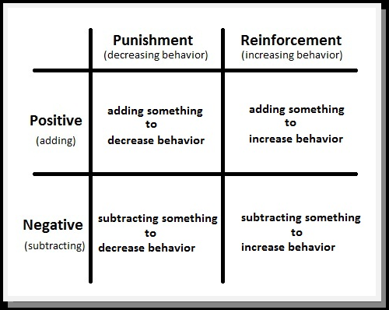
Consequences
Any event that follows a behavior
Notes:
Review quadrant with participants.
When thinking about consequences, there are two types: reinforcement and punishment. When referring to reinforcement and punishment, there are also two additional categories: positive and negative. In this context, positive does not refer to “good or desirable,” and negative does not refer to “bad or undesirable.” Think of positive as adding something and negative as subtracting something.

Slide 26
Consequence: Reinforcement
Reinforcement makes the target behavior more likely to occur in the future.
Positive Reinforcement
You ADD something pleasant / desired
(ex: toy, food, attention)
(+)
Negative
Reinforcement
You TAKE AWAY something unpleasant/ undesired (ex: aspirin to relieve migraine)
(-)
Notes:
Click to reveal bullets.

Slide 27
Consequence: Punishment
Punishments have the opposite effects of reinforcement. These consequences make the target behavior less likely to occur in the future.
Positive Punishment
You ADD something unpleasant/aversive (e.g., verbal reprimand)
(+)
Negative
Punishment
You TAKE AWAY something pleasant/ desired (e.g., no TV time, no attention
(-)
Notes:
Click to reveal bullets.

Slide 28
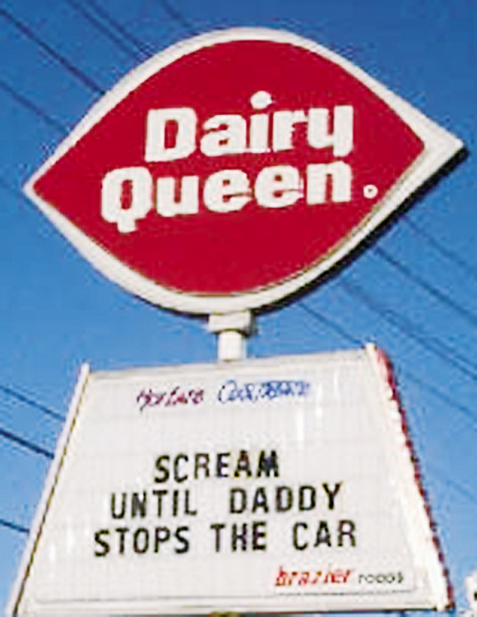

.
  Reinforcement
  An event that increases the likelihood of a behavior being repeated
  Negative reinforcement
  Removing an unpleasant stimulus after a response (-)
  Positive reinforcement
  Presenting a rewarding stimulus after a response (+)
Myers, 2011
Notes:
Automatic animation
Positive and negative reinforcement and punishment are important concepts in behavior and learning. As previously mentioned, the words “positive” and “negative” here do not mean good/bad but rather “add or subtract” in the mathematical sense.
In positive reinforcement, something is added. In negative reinforcement, something is subtracted or taken away.
However with reinforcement, the goal is still to increase the likelihood that the behavior will occur again in the future. Teachers often use positive reinforcement in the form of tangible items such as gold stars, stickers, and “student of the month” certificates to increase desired behaviors. Reinforcement is an event that increases the likelihood of a behavior being repeated.
Click to reveal negative reinforcement sequence.
Negative reinforcement involves the removal or avoidance of a negative condition in order to strengthen a behavior.
In the example on the slide, a child has asked daddy for some ice cream. Daddy says “no, not right now”. The child then proceeds to scream “I want ice cream NOW!” and begins to cry and continues to scream the same phrase repeatedly. An example of negative reinforcement would be if the child’s father gives the child ice cream after initially saying no (behavior) and the crying and screaming behavior stops (subtraction or removal of a negative condition).
Bonus question: How could “screaming until Daddy stops the car” be positive reinforcement?
Answer: The child’s screaming is positively reinforced if Daddy stops the car and buys ice cream! The child learns that screaming will get him or her a desired treat.

Slide 29
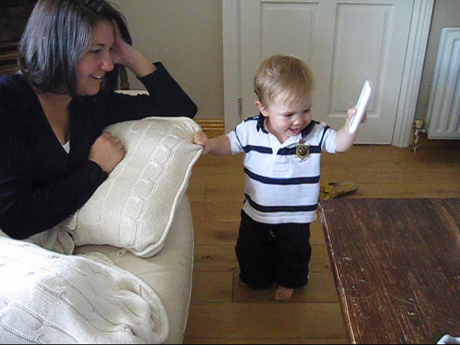
Positive Reinforcement
Following a behavior, any stimulus or event that is added and leads to increased probability that the behavior will occur again in the future.
Notes:
Play brief video clip.
Positive reinforcement example: A child is dancing to the Law and Order theme song (behavior). He proceeds to get positive attention from his mother (e.g., smile, touch, attention, praise). As a result, you see the child continue to dance. The behavior has been strengthened and will now more likely occur again in the future.

Slide 30

Examples of Positive Reinforcement
Smile, high five, pat on the back
Praise (“well done,” “super,” “you’re amazing”)
Extra ____ (time on computer, snack, recess, time with friends, break)
Awards, certificates, special recognition (e.g., letter or phone call home, star of the week)
Leadership duties (e.g., first in line for lunch, team captain)
Prizes (e.g., stickers, pencils, badges, snacks, toys)
Notes:
There are many types and examples of positive reinforcement and they will vary by individual. This slide has a list of general examples that most children would probably find reinforcing. Positive reinforcers can be activities, tangible items, intangible items, social praise, etc.
The most important thing to remember about reinforcers or examples of reinforcement is that it is very individualized. What one individual finds reinforcing may or may not be reinforcing to another individual.

Slide 31
Activity: Which one is the best example of reinforcement?
Tom waits to use the water fountain.
Tom waits to use the water fountain and the teacher gives him a thumbs up.
Tom waits to use the water fountain and the teacher gives him a thumbs up. The next time the class goes to the water fountain, Tom waits quietly in line.
Notes:
The answer is C because it increased the rate of the desired or target behavior.

Slide 32
Activity: Which one is the best example of reinforcement?
As Nathan and Shara argue over a toy, Nathan hits Shara. Shara lets go of the toy and Nathan takes it. Nathan hits peers more frequently during play time.
As Nathan and Shara argue over a toy, Nathan hits Shara. Shara lets go of the toy and Nathan takes it.
As Nathan and Shara argue over a toy, Nathan hits Shara.
Notes:
The answer is A because it increased the rate of the desired or target behavior.

Slide 33
Activity: Which one is the best example of reinforcement?
Lola cleans her room without being told and her mother lets her skip another chore.
Lola cleans her room.
Lola cleans her room without being told and her mother lets her skip another chore. Lola cleans her room again the next evening.
Notes:
The answer is C because it increased the rate of the desired or target behavior.

Slide 34

Negative Reinforcement
Following a behavior, the removal or termination of a stimulus or event that increases the future likelihood of that behavior occurring again
Notes:
One of the easiest ways to remember negative reinforcement is to think of it as something being subtracted or removed from the situation. Negative reinforcement involves the removal or avoidance of a negative condition in order to strengthen a behavior.
Note: We will go over both real-world examples and classroom examples shortly.
Activity: For the demonstration, play the audio for a few seconds but remember to click it off, as it is on a loop until you stop it. Go through the example below.
Some cars have a loud buzzing or alarm sound when the ignition key is turned on. It is a reminder to the driver to put on his/her seatbelt. Often times, if you do not, there is the audio reminder. Some people find it sufficiently annoying if brief and others find it very annoying or even aversive if unattended to.
With negative reinforcement, let’s assume that you find this sound very annoying. In this case, the sound is what you want to remove, avoid, or terminate, and the behavior you want to increase is putting on your seatbelt when you get in the car.
In other words, in the future you will probably put on your seatbelt to avoid having to hear the sound of the seatbelt alarm, provided that it is an annoying / aversive enough consequence to begin with.

Slide 35
Examples of Negative Reinforcement
Scenario | Negative stimulus (what you want to remove, terminate, or avoid) | Behavior that is reinforced (or will likely happen again in the future)
Teacher tells students that if they hand in their homework Monday through Thursday, she will not give them a quiz on Friday | Quiz or test | Doing homework
Notes:
Review the example of negative reinforcement. Classroom examples of negative reinforcement will be presented on the next few slides.

Slide 36
Examples of Negative Reinforcement
Scenario | Negative stimulus (what you want to remove, terminate or avoid) | Behavior that is reinforced (or will likely happen again in the future)
Teacher does not allow students to attend class if late (assuming student likes school and wants to be in class)
Notes:
Click to reveal responses in each box.

Slide 37
Examples of Negative Reinforcement
Scenario | Negative stimulus (what you want to remove, terminate or avoid) | Behavior that is reinforced (or will likely happen again in the future)
Teacher does not allow students to attend class if late (assuming student likes school and wants to be in class) | Missing class or not being allowed in class if late
Notes:
Click to reveal responses in each box.

Slide 38
Examples of Negative Reinforcement
Scenario | Negative stimulus (what you want to remove, terminate or avoid) | Behavior that is reinforced (or will likely happen again in the future)
Teacher does not allow students to attend class if late (assuming student likes school and wants to be in class) | Missing class or not being allowed in class if late | Time keeping (being on time)
Notes:
Click to reveal responses in each box.

Slide 39
Examples of Negative Reinforcement
Scenario | Negative stimulus (what you want to remove, terminate or avoid) | Behavior that is reinforced (or will likely happen again in the future)
You get migraine headaches on a regular basis
Notes:
Click to reveal responses in each box. This is a real world example.

Slide 40
Examples of Negative Reinforcement
Scenario | Negative stimulus (what you want to remove, terminate or avoid) | Behavior that is reinforced (or will likely happen again in the future)
You get migraine headaches on a regular basis | Pain from headache or migraine
Notes:
Click to reveal responses in each box.

Slide 41
Examples of Negative Reinforcement
Scenario | Negative stimulus (what you want to remove, terminate or avoid) | Behavior that is reinforced (or will likely happen again in the future)
You get migraine headaches on a regular basis | Pain from headache or migraine | Take a pain killer – removes the pain
Notes:
Click to reveal responses in each box.

Slide 42

Note About Reinforcement
Reinforcement has occurred only if the behavior maintains or increases.
Notes:
This slide is a final note or reminder about reinforcement. Review the slide.

Slide 43
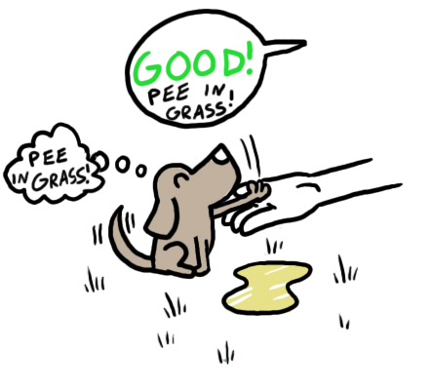
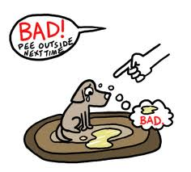
Quick Activity – Think of your own examples
Notes:
As a summary activity for the section on reinforcement, you can have participants each give examples of positive and negative reinforcement .

Slide 44

Punishment…
Punishment has only occurred if the behavior has weakened or decreased
Photo Credit: <a href="http://www.flickr.com/photos/35887806@N00/5121874643/">Sergey Sus</a> via <a href="http://compfight.com">Compfight</a> <a href="http://creativecommons.org/licenses/by-nc-nd/2.0/">cc</a>
Notes:
Punishment is used to help decrease the probability that a specific undesired behavior will occur with the delivery of a consequence immediately after the undesired response or behavior is exhibited.
A common misconception about punishment procedures being used is that something wrong or harmful is being done, but that is not necessarily the case.

Slide 45
Positive Punishment
The presentation or addition of unfavorable outcome or event that decreases or weakens behavior or the likelihood of the behavior occurring in the future
Notes:
Review the definition.
Positive punishment is an interesting concept and one that needs to be used carefully and thoughtfully in order to be effective. It is not something to use as a “go-to” and can become ineffective very quickly when used inappropriately.
An example of positive punishment in the classroom is a verbal reprimand. For instance, you forget to turn off your cell phone during class and your teacher reprimands you when your phone rings and disrupts the lesson. In this case, it is positive punishment because the teacher is “adding something” (e.g., verbal reprimand) to decrease or weaken the behavior (bringing your cell phone / ringing and disrupting the lesson; forgetting to turn it off).
Below are some real-world examples:
Getting a ticket or fine for speeding
Hitting a dog on the nose for peeing on the carpet

Slide 46
Positive Punishment cont…
Examples: Contingent exercise or overcorrection
Contingent exercise: Every time the target behavior occurs, the consequence is a series of exercises (e.g., use a profanity or hit a student – consequence is 10 jumping jacks)
Overcorrection: A student likes to chew gum, and instead of throwing it away, likes to put it underneath his desk. A consequence of this behavior is that in addition to cleaning his own desk, he then cleans all the desks in the class; another example is writing an apology on the chalkboard multiple times.
Notes:
Review the definitions on the slide. Click to reveal each example.
It is worth noting that the consequences of positive punishment should not in any way be dangerous, illegal, punitive, or the like. However, in order for the consequence to work, it should also be something that is not preferred.
A consequence will not have the intended effect if it is fun or if the student likes and wants to engage in the activity or item. For example, with contingent exercise, if a student enjoys physical activity and it functions as a reinforcer, using it as a consequence will not be effective. Contingent exercise only works or is effective as a consequence when it decreases or weakens the future likelihood of the target behavior.
Note about overcorrection:
Similar to contingent exercise, with overcorrection it will only work as a punishment if it decreases or weakens the target behavior. For example, if a student enjoys escaping a task and finds it relaxing to write repeatedly on the chalkboard (e.g., an apology or math equations), then overcorrection may not be the best tactic. It is only effective if the student does not like the activity and would like to avoid having to do it again in the future. The goal is that the student will learn that it is better to behave appropriately and make smarter choices than to engage in the undesirable behavior.

Slide 47
Negative Punishment…
The removal or termination of something good or desirable that decreases or weakens behavior or the likelihood of the behavior occurring in the future
Notes:
Review the definition of negative punishment.
Below are some real world and classroom examples:
Two children are fighting over a toy. Negative punishment would involve removing the toy altogether so that fighting does not occur again.
A teenager is late and misses his or her curfew. Negative punishment would involve being grounded for a week (e.g., removal of privileges) by his or her parents.
Response cost: With this strategy, you receive tokens for behaving well and when you misbehave, a token is removed (e.g., the “cost” of the response).
With negative punishment, it is most effective when it immediately follows the response and is applied consistently. If we take children fighting over the toy as an example, it is most effective when the toy is removed immediately following the argument. It will be less effective if there is a delay or inconsistent consequence (e.g., toys are taken away only some of the time that the children are arguing).

Slide 48
Negative Punishment continued…
Example: time-out, planned ignoring
Time-out: Withdrawal of opportunity to earn positive reinforcement or loss of access to positive reinforcement for specified time to decrease future probability of behavior
Ignoring: Withdrawal or removal of attention to weaken a behavior
Notes:
Review slides.

Slide 49
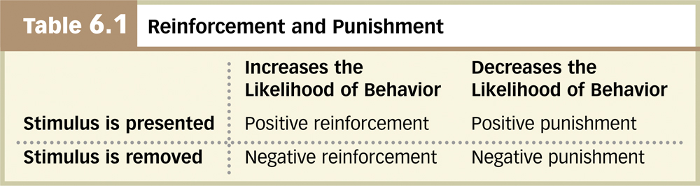
.
Punishment decreases the frequency of a behavior.
Positive Punishment
Negative Punishment
Administering an aversive stimulus
Withdrawing a desirable stimulus
Receiving a parking ticket
Revoked driver’s license
Verbal reprimand
Time-outs
Myers, 2011
Notes:
Automatic animation for Positive Punishment sequence.
We have talked about reinforcement, which refers to increasing the frequency of a behavior by either adding or subtracting a stimulus. What about punishment? Punishment refers to decreasing the frequency of a behavior happening in the future. Remember that in behavioral terms “positive” refers that something being added and “negative” refers to something that is subtracted or taken away.
An example of positive punishment is receiving a parking ticket for parking near a fire hydrant. It is positive punishment because:
Something is added (i.e., the ticket) and a behavior decreases (i.e., you are less likely to park in front of a hydrant).
Click to reveal Negative Punishment sequence.
An example of negative punishment is having your driver’s license revoked because of reckless driving. It is negative punishment because:
Something is taken away or subtracted (i.e., your license) and a behavior decreases (i.e., you are less likely to drive recklessly).
Click to reveal Reinforcement and Punishment table . Remind participants once more about the meaning of positive and negative (i.e., adding or subtracting) and reinforcement and punishment (i.e., strengthening or weakening).

Slide 50
Behavior as it relates to the ABC’s
Antecedent, behavior and consequence

Slide 51
Behavior 101
Behavior is learned.
  Do not assume children know the rules, expectations, or social skills.
  Every social interaction you have with a child teaches him/her something.
Behavior communicates need.
  Children engage in behavior to “get” something or to “avoid” something.
  Need is determined by observing what happens prior to and immediately after the behavior.
Notes:
We have spent some time reviewing the concepts of antecedents and consequences. Now we are going to look more closely at behavior.
The most basic concept in behavior is that it is learned. It also communicates some kind of need. The most basic function or reason for “misbehavior or bad behavior” is to get or avoid (something).

Slide 52
Why Determine a Behavior’s Function?
Because we know:
Challenging behaviors always serve a function
Challenging behaviors are contextual and vary by individual
Notes:
Why is the function of behavior important?
There are two reasons: behavior does not occur in isolation and there is always a reason and a purpose for behavior. Behavior is also contextual and will vary from individual to individual and be affected by context (e.g., activity, demand, location, time of day, mastery of skill).

Slide 53
Most Common Functions of Behavior
To Obtain/Get:
Peer attention
Adult attention
Desired activity
Desired object/ items
Sensory stimulation: auditory, tactile, etc.
To Avoid/Escape:
Difficult task
Boring task
Easy task
Physical demand
Non-preferred activity
Peer
Staff
Reprimands
Notes:
This slide lists common function of behavior. It is not an exhaustive list but one that shows some common reasons why we see challenging behaviors emerge and how they differ if the functions differ.

Slide 54
Function Based Interventions
When generating interventions we use function to develop ideas to change A, B & C
Targeted Routine
Antecedent
Problem Behavior
Maintaining Consequence & Function
FUNCTION
Function should guide selection of prevention strategies
Notes:
While it is beyond the scope of this presentation to discuss function and specific interventions, it is really important here to emphasize that in order for interventions to be successful in changing behavior, they need to specifically address the function of the behavior.
So for example if you have determined that the function of a behavior is attention seeking, selecting an intervention or strategy that addresses a skill deficit will not likely be effective.
Similarly, if you have identified the function of behavior as being a lack of prerequisite skill (e.g., a student cannot do problem solving in math because he/she doesn’t know how to divide), selecting a tactic or intervention that addresses attention (e.g., planned ignoring) is not going to yield successful outcomes.
On the next slide, we will review a student example.

Slide 55
Example:
Jason is nine and cries when asked to do difficult tasks. The crying is maintained by avoiding or escaping difficult tasks.
Possible behavioral interventions:
  Planned ignoring Jason when he cries
  Breaking down objectives into smaller parts;
  asking for help
  Stopping the activity
  Time out from reinforcement
  Increasing his schedule of reinforcement (e.g. giving him access to preferred activities more often)
Start w/ the function
Which one will address the function of the problem?
Notes:
55
Click to reveal text boxes, red lines and starred response or answer (7 clicks to reveal answer).
Why is it important to pick interventions related to the function of the behavior? Very simply, if you do not, you will likely see the target behavior continue or possibly escalate.

Slide 56
.
Common Problem Behaviors and Some Usual Suspects for
Functional Antecedents and Consequences (Handout 2)
 | Antecedents | Behaviors | Consequences
Grades K-2 | Teacher demand Task difficulty Lack of supervision Lack of classroom rules Little structure No planned consequences Transitions | Talking Making noises Moving around Attention seeking Fighting Crying Taking others’ things | Teacher attention Peer attention Escape from work Tangibles
Grades 3-5 | Teacher demand Confrontation Task difficulty Lack of supervision Lack of classroom rules Little structure No planned consequences Transitions | Talking Making noises Moving around Attention seeking Noncompliance Fighting | Teacher attention Peer attention Escape from work
Grades 6-12 | Teacher demand Confrontation Task difficulty Lack of supervision Lack of classroom rules Little structure No planned consequences Transitions | Disrespect of authority Talking Moving around Attention seeking Noncompliance Fighting Leaving school | Escape from school Escape from task Peer attention Status among peers Teacher attention Access to tobacco Access to drugs Access to alcohol
Witt, Daly, Noell, 2000
Notes:
Remind participants that this slide is also available in larger print in Handout 2 – Common Problem Behaviors. Review the slide.

Slide 57

Activity
A-B-C Assessment:
Script the Evan and Alex scenario in an
A-B-C format.
Notes:
Activity: Read the example on the next slide to your group or have participants read independently and complete the form. Refer to Handout 3c -- ABC Report Form for this activity as there is a blank ABC form attached.

Slide 58
A-B-C Practice Example
Setting:
Students are working independently on writing assignments. Students are seated in clusters with 4 students to a table. Alex and Evan are at the same table.
Target student: Evan
Notes:
Review the slide.
Refer participants to Handout 3c.

Slide 59
A-B-C Practice Example continued
Observation:
Evan asks Alex what he is writing about. Alex tells Evan it is none of his business. Evan tells Alex he has a new app on his iPad that he is going to play at lunch and asks if Alex wants to see it. Alex tells Evan he is lame.
Evan calls Alex a jerk. Alex tells Evan to shut up. The teacher tells the boys to stop talking and work. Evan raises his hand and tells the teacher Alex is calling him names. The teacher reprimands Alex. Evan laughs under his breath. Alex tells Evan, “Shut up or I’ll shut you up.”
Notes:
This slide gives the context of the observation and describes the series of events and behaviors of the students in the example.
Refer participants to Handout 3c.

Slide 60
.
Notes:
Refer to Handout 4 -- ABC Report Form Example as it is a larger print version of this slide.
Generally with ABC forms, a teacher or other member of staff can complete it as long as the individual understands the basic concepts of antecedents, behavior, and consequences. It is also good to include as much information as possible including but not limited to time of observation, location, activity/task, etc.
Note: Under the column with the heading ‘Antecedent’, the checkmark could refer to the presence of an antecedent or that a specific antecedent may even have multiple behaviors.

Slide 61
Quick Review of Core Concepts
1. What is an FBA?
2. ABCs
  Antecedent
  Behavior
  Consequence
3. Functions of Behavior
Notes:
Activity: A summary or review of topics covered until this point in the training (e.g., What is an FBA? What are the two main functions of behavior? Describe or define what the ABC’s are, etc.)
We will spend the remainder of the training talking about how to conduct an FBA and the processes involved in conducting an FBA.

Slide 62
Part II: Conducting FBA's –
Levels and Processes
Notes:
An FBA is not a “one size fits all” tool or resource. With diagnostic assessment, there are different levels of analysis and we are going to discuss that in the next section of the training. It should be noted that all materials that are used in this training are also cited (e.g., Horner et al., 2012).

Slide 63
Reminder About Core Terminology
Functional behavior assessment
Functional analysis
Functional analysis of behavior
Functional assessment
Notes:
Review terms with participants if needed.
All of these terms are used interchangeably and refer to the purpose of behavior. Also, please note that it is recommended that each school use terminology that is consistent with district and state laws and also in keeping with special education and referral policies or procedures.

Slide 64
Why Are FBA's Important?
(places problem behavior in “context”)
Behavior – defined in observable terms
Predictors/Controlling Antecedent Stimuli
  Cues, situations, events that set off (trigger) behavior
Maintaining Consequences
  What a person gets/avoids that keeps behavior recurring
Setting Events
  Conditions, events that “set a person up” for problem behavior when a “triggering” cue/event occurs
  Operate by changing the value of consequences
Notes:
FBA's are important because they give problem behaviors some context. We have already reviewed antecedents, setting events, the maintaining consequences, and functions of behavior.
Refer participants to Handout 3a – The FBA Process.
Consider this a resource about the FBA process and the different components. We will not be reviewing the document during this training in great detail but will highlight some of the important topics or themes as they relate to this module.

Slide 65
Levels of Analysis
Informal
Archival review
Problem-solving meeting
Indirect/simple
Functional assessment interview
Complex
Functional behavior assessment
Functional analysis of behavior
Functional assessment
Functional analysis
Functional behavior assessment
Notes:
There are 3 levels of analysis or FBA. It is beyond the scope of this presentation to discuss each one in depth. We will touch briefly on an example of an informal FBA but spend most of our time discussing indirect or simple FBAs (e.g., what behavior is, what a structured functional assessment interview for teachers entails) and complex FBAs and what they involve.
It’s important to remind ourselves that our focus with NCII is primarily around intensive intervention. We focus on the students with persistent learning and behavioral difficulties who have not responded to other tiered interventions and continue to struggle.

Slide 66
.
 | Teachers/ Staff | School Specialist | Behavioral Trained Specialist
Informal FBA | X
Indirect/simple FBA | X | X
Complex FBA | X | X | X
Notes:
Before we look at the different levels of FBA, let’s look at this graphic representation of the levels and expertise that are expected and required as the intensity increases in terms of the behavior intervention. For example, if we look at the second column (i.e., teachers and staff), it is unlikely that this group will ever be asked to facilitate an FBA on their own.
FBAs will most likely be led by the behavior specialist (or whoever has been trained – e.g., social worker) in the school or district. However, a general education teacher could certainly conduct an informal FBA and/or indirect/simple one as well.
Note: School Specialist category – each district and state will have different individuals in these roles. For example, a school specialist in one state could refer to a social worker, Title 1 teacher, psychologist and the like.

Slide 67
Level 1 – Informal
Informal
Archival review
Problem-solving meeting
Indirect/Simple
Functional Assessment Interview
Complex
ABC Data
Structured, Direct Observation\
Notes:
An example of an informal FBA is the archival review. It refers to reviewing previous records and information about students that are currently available.
Each state or district will likely have a process that is similar to an archival review, though we are aware that there is variation across states. On the next slide is a record review, which is very similar to an archival review.

Slide 68
Record Review
Attendance
Health history
Onset of current problems
Past services or interventions
Effectiveness of previous interventions
Previous educational functioning
Previous assessments
Sensory screening
Notes:
Review slide.

Slide 69
Problem Solving Meeting: ERASE
Explain | What is the problem? (e.g. referring teacher)
Reason | What is he/she getting out of it or avoiding? (e.g. referring teacher)
Appropriate | What do you want him/her to do instead? (school specialists: social worker, school psychologist, etc.)
Support | How can you help this happen more often? (school specialists: social worker, school psychologist, etc.)
Evaluate | How will you know if it works? (e.g. reconvene team; principal, RTI coordinator, etc.)
T.Scott
Notes:
This is an example of another informal FBA known as ERASE.
Typically, a problem solving team meeting will be convened if a student presents with specific behavior concerns and some of the questions that come up are listed under each category.
For example, it may be the case that the classroom teacher will present some information on what the problem is and what she has observed and believes is the reason or function of the behavior. (Explain and Reason). It is possible that some of the behavior specialists (e.g., behavior specialist, social worker, etc.) may weigh in by asking what some alternative and more appropriate behaviors would be and how that can be facilitated and supported (Appropriate and Support). As a last step, the team would want to evaluate if what has been suggested is working and how you will monitor that (e.g., reconvene team and meeting in 3 weeks time to report out).
This is one way to generate solutions for challenging behavior and similar to Tier 1 type interventions, many schools and districts have some variation of a problem-solving-type assessment.
Optional Activity: Ask participants to share similar informal FBA examples in their schools or districts.

Slide 70
Level 2 – Indirect/Simple
Informal
Archival Review
Problem-solving meeting
Indirect/simple
Functional assessment interview
Complex
ABC Data
Structured, Direct Observation\
Functional behavior assessment
Notes:
Read slide. Level 2 is more direct but still a relatively simple behavioral assessment.

Slide 71
Functional Assessment Interview
Identify goals and desired outcomes
Operationally define the typical target behavior(s)
Identify typical antecedent and consequent events
Schedule review
Summarize the information
Newcomer & Kern, 2012
Notes:
In this level, you really start to see how important it is to get the team involved in this process, as it can be far too overwhelming for one teacher or even a handful of teachers to complete.
Refer participants to Handout 3b – Functional Assessment Interview.
The functional assessment interview (FAI) sections are to be completed by the Behavior Support Team (or equivalent) to guide the functional behavior assessment and positive behavior support planning process. Parts A through D of the form can be completed by the team, or used to interview teachers and other school personnel who work with and have knowledge about the student.
These are the general steps in the FAI process, which we will revisit in an activity in a later part of this training.

Slide 72
Level 3 – Complex
Informal
Archival Review
Problem-solving meeting
Indirect/Simple
Functional Assessment Interview
Complex
Functional behavior assessment
Functional analysis of behavior
Functional assessment
Functional analysis
Notes:
Review the slide.
Complex FBAs can include FABs, Fas, and ABC direct observation.

Slide 73
Functional Behavior Assessment
Definition reminder…
FBA is a process for identifying the events that reliably predict and maintain problem behavior.
Notes:
Review slide.

Slide 74
Conducting a Functional Assessment:
The Starting Point:
Verify the seriousness of the problem
A teacher can eliminate many classroom problems by consistently applying effective classroom management strategies
Observations may indicate that the solution rests in systematic changes in classroom practices
Notes:
Review the slide.

Slide 75
Writing a Statement of Function
Why?
To provide information relevant to making effective intervention decisions
To clearly communicate the function of the behavior to other persons in crafting and implementing the intervention
Notes:
Review the slide.

Slide 76
Writing a Statement of Function
How?
Analyze patterns of behavior based on record review, interviews, and direct observation.
Include the following:
  The antecedent
  The student
  The target behavior
  The function(s) of the behavior
  Any brief information that may assist others to understand the statement
Notes:
Review the slide.

Slide 77

What Is Behavior?
Action or event that is observable, measurable, and repeated
Stated in objective, precise language
Photo Credit: <a href="http://www.flickr.com/photos/97831130@N00/1066368855/">horizontal.integration</a> via <a href="http://compfight.com">Compfight</a> <a href="http://creativecommons.org/licenses/by-nc-sa/2.0/">cc</a>
Notes:
Remind the participants that we have discussed the function of behavior and now want to focus on what behavior is and how we define it.

Slide 78
Dimensions of Behavior
Dimension | Definition
Frequency | How often the behavior occurs
Duration | How long the behavior lasts
Latency | How long before student begins the behavior
Topography | Shape of the behavior; what it looks like
Locus | Where the behavior occurs
Force | Strength or intensity of the behavior
Notes:
Review the table about the dimensions of behavior and how each dimension is defined.

Slide 79
Key Questions
Is the behavior observable?
Is the behavior measurable?
Is the behavior repeated?
Notes:
Review key questions when thinking about behavior.

Slide 80
Defining the Target Behavior
Behavior that is selected (targeted) for intervention
General format for describing target behavior:
    General descriptor for the behavior
    Series of specific observable, measurable, and repeatable examples
Notes:
Review slide.
When defining the target behavior for intervention, it is important to provide a general descriptor of the behavior (e.g., physical aggression) but be specific about what is observable (e.g., includes kicking, hitting, biting, etc.), ensure that it is easy to measure (e.g., frequency or duration) and that the behavior is repeatable (e.g., the behavior occurs often enough to verify and gather data on).

Slide 81

Target Behavior Example #1
The target behavior is destruction of classroom properties, which includes such behaviors as drawing in books, tearing worksheets, and breaking pencils.
Notes:
Read example to participants.
Remind them that you want to be as specific as possible.

Slide 82

Target Behavior Example #2
The target behavior is
self-stimulation, which is defined as hand flapping, rocking, stomping while seated, and head nodding.
Notes:
Review slide.

Slide 83

Target Behavior Example #3
The target behavior is aggression, which is defined as pushing, hitting, and making verbal threats to peers.
Notes:
Review slide.

Slide 84
Good Description of Target Behavior? Yes or No?
General Descriptor | Specific Example
The target behavior is destruction of property | This includes pushing books to the floor and tearing worksheets.
The target behavior is aggression towards peers | The target behavior is pushing peers in line while waiting for lunch.
The target behavior is aggression toward staff | This includes making staff members angry and irritated.
The target behavior is daydreaming | This includes thinking about anything other than work.
The target behavior is disrespect to staff | This includes cursing at staff, refusing to follow directions, and tardiness.
Notes:
Optional activity: Think-pair share or choral responding. Read each general descriptor and the associated specific example. Then ask the pairs or group to generate responses or suggest changes to make the descriptor better. The 3rd column is a confirmation if they are good descriptions of target behavior or not.
Click to reveal each answer. Note: the first two examples are better than the last three, which are fairly broad and non-specific.

Slide 85
Selecting a Replacement Behavior
Stated in terms of what you want the student to do
Something the student can do or learn to do
Supported by the natural environment
Notes:
We will not spend much time in this training reviewing the role of replacement behaviors or behavior intervention plans (BIPS).
What is important to know is that in developing an effective BIP, it is important to ensure that a student learns an appropriate replacement behavior. Without learning how to do something appropriate in place of a previously inappropriate behavior, circumstances will not likely change for the better. It’s important to think of what you want the student to do, to learn, and how that can be supported by the environment they are in.
For example, if a student consistently lashes out physically and violently (e.g., kicks, bites, or claws and scratches) whenever he comes across a task that he does not understand, part of what will help the student is to find an appropriate alternative to this particular behavior, based on the function. So for example, perhaps this student does not know how to appropriately ask for help, and when faced with a task demand that he does not understand, he gets physical. Identifying the function of the behavior and then selecting an intervention that addresses the function, will lead to the most successful outcomes.
Without determining the function or thinking about a replacement behavior, the likely scenario will be maintenance of the behavior, or worse, an increase in the inappropriate behavior. If we take the example above, if you don’t address the function (e.g., pre-requisite skills) it is possible that you may stop one behavior (e.g., clawing and scratching) but add a new one into the repertoire unintentionally (e.g., hair pulling or eye gouging). Similarly, if you are unable to determine the function, then the behavior may remain because the intervention did not address the function or purpose.

Slide 86
.
Target Behavior | Replacement Behavior | Yes/No
Disrupting class during group discussion, which includes talking out and talking with peers | Sitting quietly and raising a hand to be called on during group discussions
Off-task activities during math class, which include behaviors such as rearranging materials, sharpening pencils, and digging in a backpack | A grade of “A” in math class
Pushing peers while waiting in line | Not pushing peers while waiting in line.
Hitting staff, which includes open-hand slaps and closed-fist hits
Notes:
Optional activity : Ask participants to read the examples of the target behavior and identify if the examples in the replacement behavior category are good examples or not. Click to reveal Yes/No response on far right column.
This slide gives examples of good replacement behaviors based on determining the function (e.g., first example) or poor examples of replacement behavior that don’t address the function of the behavior (e.g., second and third examples)
For the final example (i.e., #4), have participants generate some responses for appropriate replacement behaviors.
Example: A student hits because he does not know how to complete a task. Hitting helps him to avoid doing the work or task. In that instance teaching the student prerequisite skills, breaking down the tasks, or teaching him to ask for help might be examples of appropriate replacement behavior.

Slide 87
Behavior Intervention Plan (BIP)
A plan for creating an instructional environment that predicts positive behavior in place of problems
Create environments that predict success
Teach replacement behaviors
Facilitate success
Provide functional consequences for positive and negative behavior
Monitor effectiveness of plan
Notes:
Briefly review this slide.

Slide 88
Steps to Guide an FBA…
Gather indirect and direct data
Analyze the data
Formulate a hypothesis about the function of the behavior
Develop Positive Behavior Support Plan (PBSP)
Monitor and adjust the plan as needed
*Steps 1-3 are the focus of the last activity in this training series. Steps 4-5 are beyond the scope of this presentation but Handout 3d provides information on PBSP.
Notes:
Click to show the full list of tools to guide an FBA. Refer participants to Handout 3a – FBA Processes.
Many tools and protocols exist to guide the process of conducting a functional assessment. The process is composed of five general steps, but we will only be looking at steps 1–3 today in the last activity.
Read the footnote.
Click again to only show 3 steps.

Slide 89
Examples of Summary Statements
Immediate situation (A)
When Perry is getting little attention in a large group in the classroom
Problem behavior (B)
He is likely to shout profanities and throw things
Notes:
After data have been gathered and analyzed, the next step is to formulate a hypothesis about the function of behavior. When thinking about the function of behavior, one should consider the ABCs and setting events.
Let’s look at an example over the next two slides.
Review slide.

Slide 90
Summary Statements continued…
Maintaining function (C)
To get peer attention
Distant event (setting event)
The less attention Perry has received during the day, the more likely this pattern is likely to occur.
Notes:
Review the slide.

Slide 91
Activity: Summary Statements
When Michael begins to have difficulty with a reading or math assignment, his behavior/he will:
put his head down, refuse to respond, and close his books,
try to avoid having to complete the assignment, and
intensify if Michael has received teacher reprimands earlier in the day (setting event).
Notes:
Activity: Ask participants or teams to think of a student with some behavioral concerns and to write a summary statement using the ABCs and setting events as a guide.
Read the example on the slide. Have participants or teams share their responses.

Slide 92

Handout 3b
Complete the functional assessment interview on your target student (pages 6–10 of Handout 3b)
Notes:
Activity: Ask participants to refer to Handout 3b – Functional Assessment Interview and complete the form for a student they believe would benefit from an FBA.

Slide 93
In Summary
ABC
FBA's
Functions of behavior
Levels of FBA
Greater understanding and awareness of FBA process
  Parts A–D of a functional assessment interview
Notes:
Review summary of training module content.

Slide 94
Quick Review…
What are the ABCs?
What are the two main functions of behavior?
What is the main difference between reinforcement and punishment?
How many levels of analysis are there and what are some examples?
Notes:
Answers:
Antecedent, Behavior, and Consequence
To get something or avoid something
Reinforcement strengthens or increases likelihood of behavior happening; punishment weakens or decreases future likelihood of behavior occurring.
3 – Informal = ERASE; record review; problem-solving meeting
Simple = ABC, functional assessment interview
Complex = FBA, functional analysis, functional assessment, etc.

Slide 95
Disclaimer
This module was produced under the U.S. Department of Education, Office of Special Education Programs, Award No. H326Q110005. Celia Rosenquist is the project officer.
The views expressed herein do not necessarily represent the positions or polices of the U.S. Department of Education. No official endorsement by the U.S. Department of Education of any product, commodity, service, or enterprise mentioned in this website is intended or should be inferred.

Slide 96
References
Newcomer, L. (2010). Functional Behavior Assessment [e-learning modules]. Missouri Department of Elementary and Secondary Education. Available: http://www.elearningmo.org/accessing-fba
Scott, T. Preparing for an FBA. What should I bring? PBIS Newsletter. Retrieved from http://pbis.org/pbis_newsletter/volume_2/issue3.aspx
Witt, J.C., Daly, E., & Noell, G. (2000). Functional assessment A step-by-step guide to solving academic and behavior problems. Longmont, CO: Sopris-West.
Notes:
The vast majority of the materials for this training module are from these three sources. References have been cited throughout the slides as applicable.

Slide 97
.
National Center on Intensive Intervention
1000 Thomas Jefferson Street NW
Washington, DC 20007-3835
866-577-5787
www.intensiveintervention.org
ncii@air.org

