Slide 1
Monitoring Student Progress for Behavioral Interventions
Notes:
Introduction to the module
This module is part of a series of training modules developed by the National Center on Intensive Intervention (NCII) aimed at district or school teams involved in initial planning for using data-based individualization (DBI) as a framework for providing intensive intervention in academics and behavior. This module is intended to follow the first module, “Introduction to Data-Based Individualization (DBI): Considerations for Implementation in Academics and Behavior.” The audience for this module may include school teams supporting behavioral intervention and progress monitoring, behavior specialists/interventionists, special educators, school psychologists, counselors, and administrators, as appropriate. It is assumed the audience already has some knowledge of progress monitoring. A separate module addresses Academic Progress Monitoring and can be found on NCII’s website, www.intensiveintervention.org. Subsequent modules will provide additional information about other components of the DBI process. More information about NCII’s approach to intensive intervention can be found in Data-Based Individualization: A Framework for Intensive Intervention (National Center on Intensive Intervention, 2013a).
Instructions for using the speaker notes
Text formatted in standard font is a sample script for the facilitator.
Text formatted in bold is excerpted directly from the presentation slides.
Text formatted in italics is intended as directions or notes for the facilitator; italicized text is not meant to be read aloud.
Text formatted in underline indicates an appropriate time to click to bring up the next stage of animation in an animated slide.
While permission to reprint this publication is not necessary, the citation should be:
National Center on Intensive Intervention (2013). Monitoring Student Progress for Behavioral Interventions. Washington, DC: U.S. Department of Education, Office of Special Education Programs, National Center on Intensive Intervention.
Note on Direct Behavior Rating:
This module describes the use of Direct Behavior Rating (DBR) with standard behaviors (Chafouleas, Riley-Tillman, Christ, & Sugai, 2009) and fill-in behaviors (Chafouleas, Riley-Tillman, & Christ, 2010). The authors granted permission to use these forms for educational purposes only. Additional forms and more information on DBR are available on the Direct Behavior Ratings website (www.directbehaviorratings.org). Copyright © 2010 University of Connecticut.

Slide 2
Agenda
Introduction: behavioral progress monitoring in the context of data-based individualization (DBI)
Selecting and prioritizing target behavior(s) to monitor
Developing a measurement system
Evaluating behavioral progress monitoring data to inform intervention decisions
Wrap-up and questions
Notes:
Welcome participants to the training. Introduce yourself (or selves) as the facilitator(s) and briefly cite your professional experience in regards to progress monitoring and intensive behavioral intervention.
The purpose of this session is to provide you with the skills to determine whether a selected behavioral intervention is working and to increase your ability to make data-based decisions on student behavior.
It is recommended that you allow participants to take a break approximately midway through the presentation. Consider taking a break between two sections, such as before you begin the section on developing a measurement system or the section on evaluating data.
Recommended presentation resources (available for download from this module’s page on the NCII website (http://www.intensiveintervention.org)):
Handouts 1−6
Case Samples 1 and 2
DBR Graphing Template
V 1.3 DBR Standard Form – Fill-in Behaviors
V 1.4 DBR Standard Form with 3 Standard Behaviors
Recommended preparation for participants:
Request that school teams come prepared to discuss a student with intensive behavioral needs, bringing data if available. This student will be used to practice the Case Applications (slides 14, 31, 35, 43, 69, and 99).
Participants may need a pen or pencil for some activities (see Handouts and Case Applications).

Slide 3
Learning Objectives:
By the end of today, participants will be able to:
Select and define meaningful target behaviors for progress monitoring.
Understand the advantages and disadvantages of using Systematic Direct Observation versus Direct Behavior Rating.
Plan and carry out data collection to monitor a target behavior; individualize Direct Behavior Rating forms.
Use graphed progress monitoring data to determine when intervention changes are needed.
Notes:
Read slide.

Slide 4
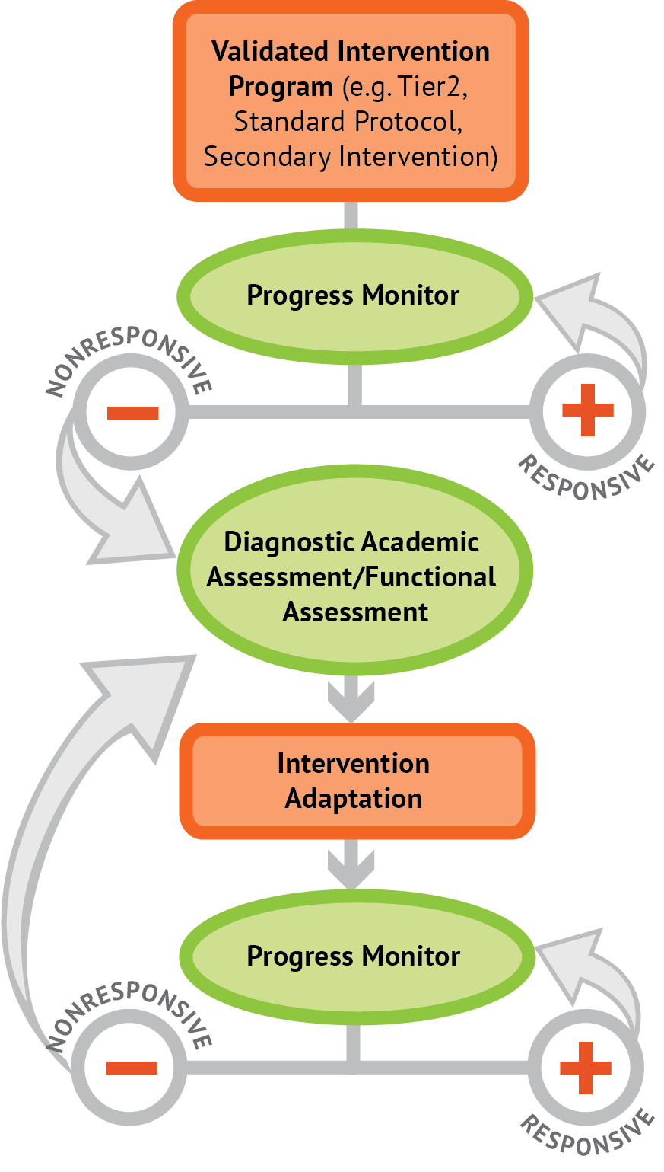

A Bird’s-Eye View of DBI
Notes:
Animated slide. Click where underlined text appears to bring up arrows.
In the past you may have used progress monitoring data to make group intervention decisions, but today we’re focusing how progress monitoring is used to inform DBI. The same progress monitoring data that tells us a student is not responding to school- or class-wide behavior supports may also tell us that secondary intervention is not sufficient to help the student reach his or her goal. Once the intervention has been adapted, we continue progress monitoring to determine if the changes have been sufficient or if we need to make additional changes.
A more complete overview of the DBI process is available in NCII’s module, Introduction to Data-Based Individualization (DBI): Considerations for Implementation in Academics and Behavior (National Center on Intensive Intervention, 2013b).

Slide 5

Triangle Intervention Logic:
Intensity of Supports
Individualized Intervention
Secondary Intervention
Preventative Methods
Notes:
Animated slide. Click at underlined text.
Most of you are probably familiar with triangle intervention logic or multi-tiered systems of supports. Although the focus of today’s presentation is not on intervention, the triangle provides a basis for understanding the uses of behavioral progress monitoring in relation to levels of support. Let’s begin at the bottom with Tier 1, or the green zone. This model suggests that most kids–about 80 percent–will respond positively to strong, systematic prevention techniques that promote prosocial behavior. This implies that about 20 percent of students will require further support to maintain appropriate behavior in schools. The typical process is to move these non-responding students to an intervention that will provide additional feedback on student behavior and opportunities to access rewards and positive attention. It is expected that these secondary or Tier 2 interventions will meet the needs of an additional 15 percent of the student population. That leaves 5 percent of students who are not responsive to preventative or secondary intervention supports. What do we do for these students with the most intensive needs? It is imperative that we follow a systematic process to understand the reasons for their behavior, develop individualized interventions, and track their responsiveness to those supports in order to make data-based decisions.

Slide 6
Triangle Intervention Logic:
Intensity of Assessment
Daily or Multiple Times per Week Progress Monitoring
Weekly or Monthly Progress Monitoring
Screening Instruments / Tools
Notes:
Animated slide. Click at underlined text.
The level of support is directly tied to the intensity of assessment. At the first level of the triangle, screening tools are used to determine whether or not a student is responding to preventative supports. These assessment procedures should be readily available for the entire student body and collected and reviewed systematically to identify those students who are non-responsive. Examples include office discipline referrals or standardized screening instruments. The second type of assessment technique is progress monitoring ,which is the repeated collection of data targeting specific behaviors. This type of assessment is typically used to determine a student’s response to secondary and intensive intervention. Progress monitoring may need to be done more frequently for more intensive interventions. For example, it may occur weekly for Tier 2 and daily for Tier 3. Although the purpose and process of progress monitoring is similar for Tier 2 and Tier 3, there are some important differences related to the intensity of intervention. These will be discussed in later sections.

Slide 7
Defining Progress Monitoring
Progress monitoring is the process of systematically planning, collecting, and evaluating data to inform programming decisions.
  Provides basis for determining whether an intervention is effective for a given student
  Assists with developing effective intervention plans
Notes:
Now that we’ve placed behavioral progress monitoring into context, let’s formally define the process. Behavioral progress monitoring is more than simply collecting assessment data—we must also analyze the data to determine whether the intervention is working or not. The data may also inform intervention design, a topic that will be addressed in future modules.

Slide 8
Progress Monitoring Benefits
Accountability
Evaluation
Transparency
Justification
Dissemination
Notes:
Ultimately, the products generated through progress monitoring will support evaluation of intervention effectiveness, increase the transparency of and provide justification for programming decisions, and allow for information to be readily disseminated among key stakeholders. Data-based individualization for behavior relies on the development of progress monitoring tools to support decision making.

Slide 9
Identifying Students in Need of DBI for Behavior—Meet Jeff
Notes:
As we learn about behavioral progress monitoring, we will illustrate the process by using a fictitious student, Jeff, as a case example. Let’s meet Jeff and learn how the team decides he is a candidate for DBI.

Slide 10
Case Example: Jeff
Jeff is a 12-year-old student who is consistently demonstrating disruptive behaviors in class such as calling out, talking back, and interrupting peers. These behaviors prompted his enrollment in the school’s Tier 2 intervention supports. Despite these extra supports, Jeff’s disruptive behaviors seemed to increase in frequency and intensity, leading to no significant reduction in the number of Office Discipline Referrals (ODRs). Jeff’s teacher, Mrs. Coleman, referred him to the school team.
10
Notes:
Read slide

Slide 11
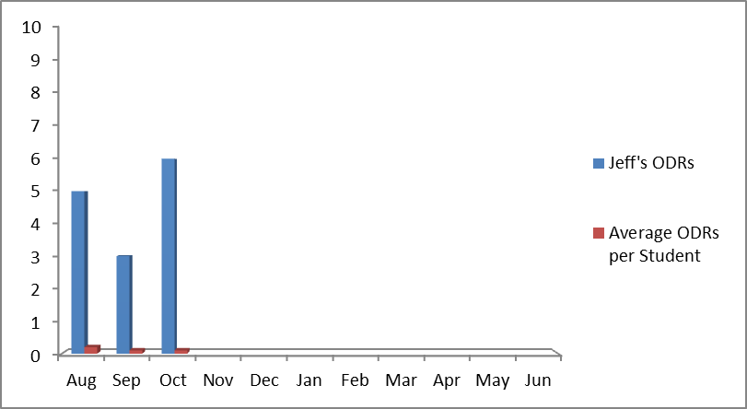
Jeff’s Rates of Office Discipline Referrals (ODRs) Before Tier 2 Intervention
11
Notes:
The data-based individualization process assumes that the student has been systematically identified as not responding to Tier 1 or Tier 2 intervention. Systematic identification refers to the use of a preplanned screening process that has clear, well-articulated decision points for making referrals. Jeff’s school uses Office Discipline Referrals as an initial screen for identifying students as eligible for intervention. The school leadership team has determined that students with two or more ODRs per month for two consecutive months qualify for the school-wide Tier 2 intervention. This decision rule assumes that teachers are applying school and classroom behavioral expectations, and making office referrals, consistently. Mrs. Coleman is experienced in classroom management and very familiar with school procedures. She rarely refers students to the office, so when she does, the team is confident that the student is exhibiting behavior that cannot be handled in the classroom. As you can see in this graph, she has referred Jeff three to six times per month for the past three months. Clearly, Jeff is eligible for additional supports!

Slide 12
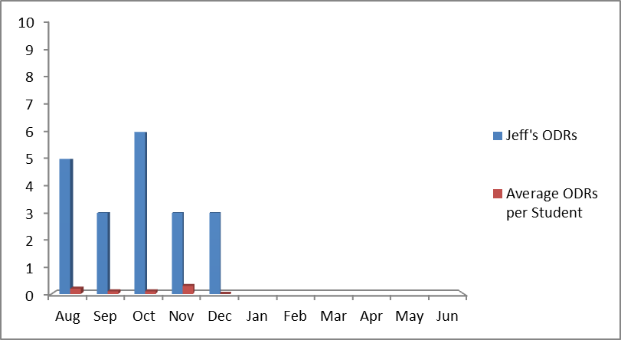
Jeff’s ODRs Following Introduction of Tier 2 Intervention
Tier 2 Intervention Introduced
12
Notes:
Jeff’s school determines whether a student is eligible for data-based individualization based on a student’s response to Tier 2 intervention. The team considers two sources of data: office discipline referrals (ODRs) and a classroom behavior point system, which we will cover on the next slide. For ODRs, the team considers students non-responsive if they continue to have two or more ODRs per month following the implementation of the intervention. The graph shows that Jeff had three ODRs each month since beginning Tier 2 supports.

Slide 13
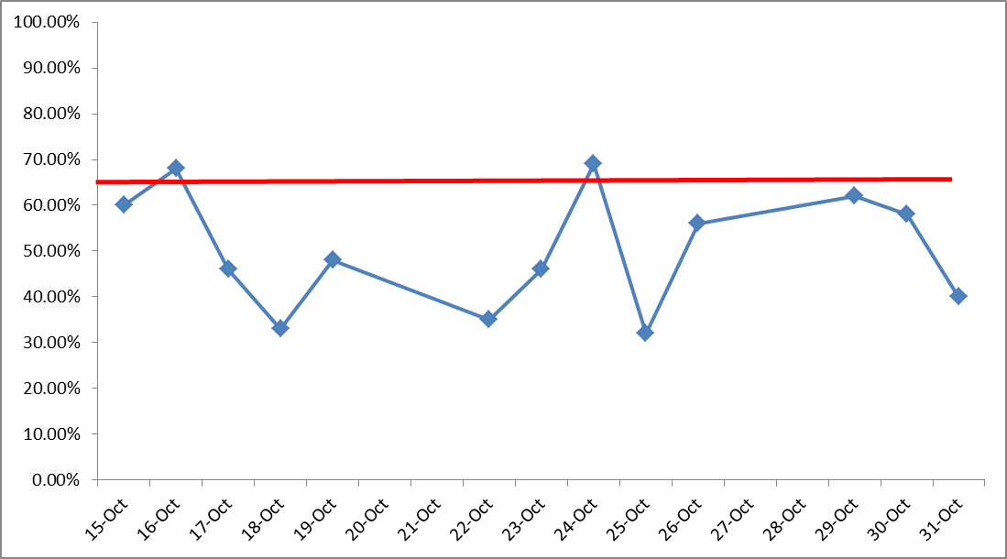
Jeff’s Percentage of Points Earned in
Tier 2 Intervention for Two Weeks
Tier 2 Intervention Introduced
13
Notes:
For students in Tier 2, teachers collect additional data on classroom behavior by monitoring the number of points a student earns for following classroom rules. As different classrooms may have a different number of possible points, teachers report the percentage of possible points earned. The school defines non-responsiveness to Tier 2 as earning fewer than 65 percent of points for 8 of 10 days. The graph shows Jeff’s data across 13 school days while he received the Tier 2 intervention. He earned only 65 percent of the total possible points (the red goal line) on 2 of those 13 days, well below the goal of 80 percent of days. Taken together with his ODRs, he can be classified as a good candidate for DBI.
Please note, this is just an example and these decision rules may not be consistent with the needs of your school. The point is that it is helpful to articulate what responsiveness and non-responsiveness mean. Moreover, these decision rules should not be viewed as static, but might have to be adjusted over time.

Slide 14
Case Application (Handout 1)
Identify a potential candidate for DBI
Complete the Student Qualification Sheet (Handout 1)
Keep this student in mind throughout the session
14
Notes:
Provide or reference Handout 1: Student Qualification Sheet.
Now that we’ve examined why Jeff’s school thinks he needs DBI, let’s take a moment to discuss the identification methods and process present in your school.
First, talk as a school team to identify a student in your school who you think may be a potential candidate for data-based individualization.
Next, use the Student Qualification Sheet (Handout 1) to guide you through thinking systematically about the assessment and intervention process that has been used with this student. What information do you currently collect? Are there decision rules? What makes you think this student might need DBI?
Keep this student in mind as we talk more about progress monitoring for intensive behavior intervention.
If time allows, have smaller groups share their thoughts with the whole group.

Slide 15
Selecting and Prioritizing Target Behaviors to Monitor
Notes:
Before we begin discussing how to select or develop a progress monitoring tool, we must first decide which behaviors we should track for a given student.

Slide 16
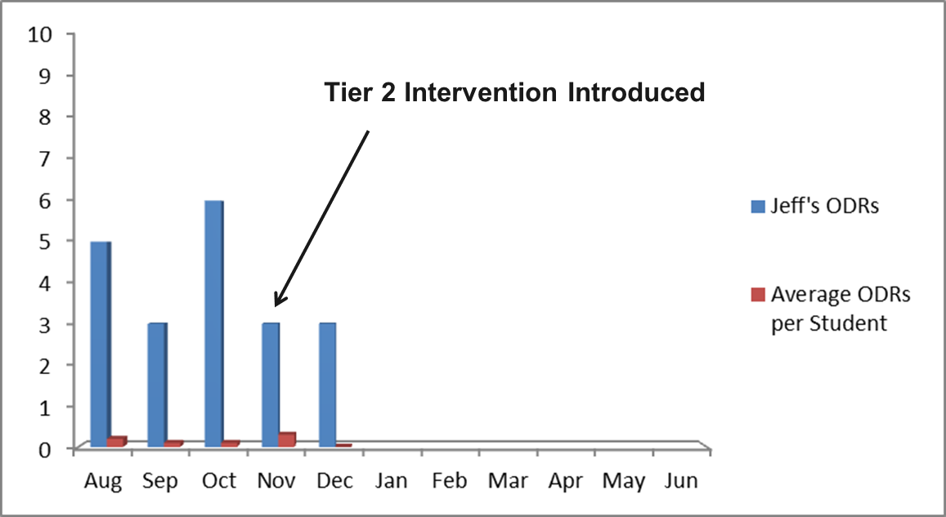
Jeff: Data-Based Individualization
Points Earned
ODRs
16
Notes:
Returning to Jeff, we have two data sources that suggest he is not responding to the school’s Tier 1 and Tier 2 programs. The team decides further analysis of the problem is warranted. Up to this point, the teacher broadly defined Jeff’s behaviors as disruptive and inattentive. While there is good evidence to suggest he is not responding, the team now wants to individualize data collection to his needs. How do we go about doing this?

Slide 17
Planning Progress Monitoring
Selecting target behaviors is part of planning for behavioral progress monitoring.
Plan for data collection
  Select target behavior(s) to monitor
  Choose method for monitoring that behavior
  Create plan for collecting data (e.g., schedule, who will collect)
Collect data
Evaluate data to make decisions
Notes:
As discussed previously, behavioral progress monitoring is a three-part system of planning, data collection, and evaluation. Just as we advocate for having a reasoned purpose and approach for developing individualized intervention, it is critical that we implement a formal plan for data collection and evaluation. The preplanning stages of the process will allow you to chart a course to determine whether the goals for the student are being met.

Slide 18
Steps for Selecting Target Behaviors
Identify the target behavior(s) of concern
Prioritize the target behavior(s)
Define the target behavior(s)
18
Notes:
We need to select one or more target behaviors to monitor before we can decide on the how, who, and when of data collection. This process will consist of three specific steps.
Review steps
Identifying and prioritizing target behaviors helps us ensure that we are monitoring a meaningful behavior. A clear definition allows us to collect more reliable data. It is important to remember that this process is going to be unique for each student. That’s what makes data-based individualization both effective and challenging.

Slide 19
Step 1: Identifying Potential Target Behavior(s)
Gather information on the context and features of behaviors of concern.
Questions to be addressed through this process include:
What does the behavior look like?
When does the behavior occur?
Why does the student present the behavior?
19
Notes:
First, we must select a behavior or set of behaviors to focus on. This requires the collection of some background information on the context and features of the behavior. The context of the behavior tells about the conditions under which the behavior occurs (e.g., the setting and events that tend to occur before or after the behavior). This will help us understand why the behavior occurs. The features of a behavior include various aspects of a behavior’s presentation, such as how long it lasts or how frequently it occurs, what it looks like, how intense it is, etc. These features will help us create a behavior definition that allows for objective, reliable measurement.

Slide 20
Target Behavior-Information-Gathering Methods
Questionnaires and interviews
Checklists
Anecdotal reports
Direct observation
20
Notes:
Determining what the behavior looks like, why it is happening, and when it is occurring can be supported through the collection and consolidation of key information. Some of this information is readily available in schools, and other information will have to be gathered from staff who work with the student or from direct observation of the student.

Slide 21
A. Questionnaires and Interviews (Handout 2)
Can you describe the behavior that led to your referral?
Be as specific as possible.
What are some specific features of the behavior?
How long does the behavior typically last?
How often does the behavior occur?
Does the behavior occur consistently at a particular time?
How do you typically respond to the behavior?
21
Notes:
Provide or reference Handout 2: Target Behavior Questionnaire
Questionnaires and interviews are typically completed by school personnel who commonly come in contact with the student. These tools can provide important information on the features of various behaviors of concern. The types of questions used in these instruments tend to focus on issues of what the behavior looks like and when it is occurring. Remember, the purpose here is to select a behavior for targeting rather than describing why it is happening. As such, the focus here is on being as descriptive and objective as possible. This part of the planning process is a critical part of developing an individualized tracking system. Possible questions include:
Read list.
Handout 2: Target Behavior Questionnaire can help a referring teacher better describe the behavior(s) of concern.

Slide 22
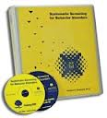
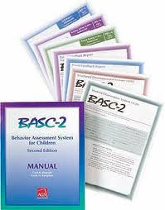
B. Checklists
Help identify and describe behaviors
Select from among many specific behaviors, often sorted into broader categories of behavior
*NCII does not endorse products.
22
Notes:
Checklists, another method often used to identify and describe behaviors, guide the respondent to consider the features and contexts of the behavior. Checklists often contain a range of broad factors of problem behavior such as compliance or academic engagement. These factors are then broken down into specific observable behaviors that the person completing the form can simply check off as having occurred. The information can be formally summarized and may provide a more objective foundation for identification. Checklists can be used in conjunction with information from questionnaires or interviews to gain a comprehensive picture of the behavior.
Examples of checklists include established rating scales such as the Systematic Screening for Behavior Disorders or the Behavior Assessment System for Children. When an area or scale suggests a potential concern, items related to that scale may be potential target behaviors. For example, if a checklist suggests a child is hyperactive, the items that fall under hyperactivity might be considered as target behaviors to track for that child.

Slide 23
C. Anecdotal (ABC) Reports (Handouts 3 and 4)
Used to describe the events leading up to and following a behavior.
  A = antecedent
  B = behavior
  C = consequence
Both narrative recording and checklist formats are available.
Requires use of objective language and focuses on actual events, not interpretations.
Notes:
Provide or reference Handout 3: ABC Checklist and Handout 4: Anecdotal (ABC) Recording Form
Anecdotal reports are common methods for recording the occurrence and context of behavioral problems. Whereas questionnaires and checklists require retrospective consideration of the behavior and surrounding events, the anecdotal report is usually completed soon after the behavior occurs. These reports typically prompt the teacher to briefly describe the events leading up to the behavior, the behavior itself, and the events that follow the behavior. This information is then used to help determine the conditions and contexts under which the behavior is typically occurring. A sample ABC checklist is found in Handout 3. Handout 4 provides a form for recording when behaviors of concern occur, along with a place to note the antecedents and consequences for each occurrence.

Slide 24
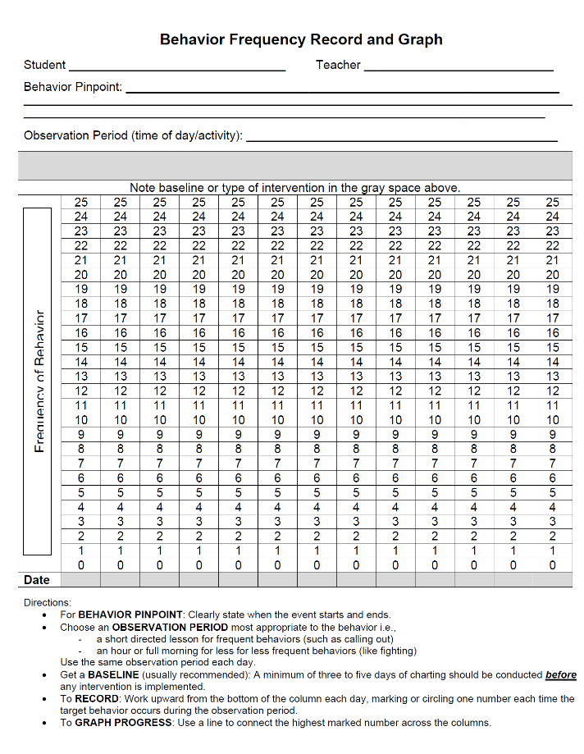
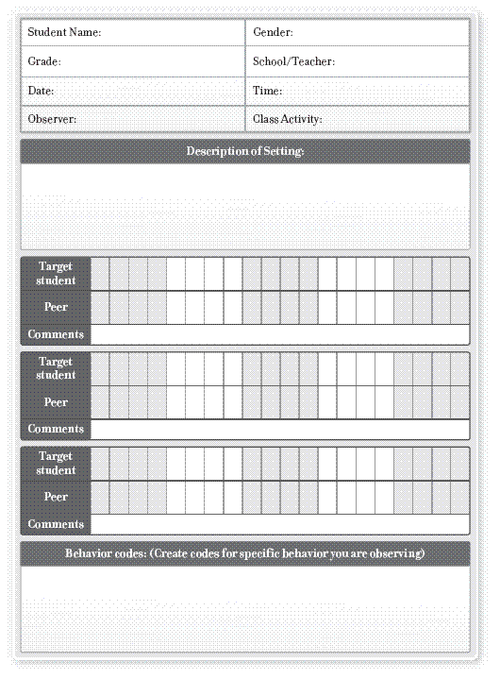
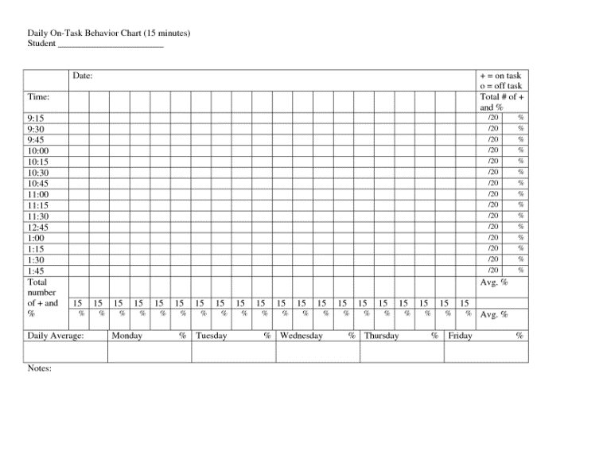
D. Direct Observation
24
Notes:
The fourth strategy for identifying target behaviors is to have a colleague, such as a school psychologist, conduct direct observations. Not only can direct observation be helpful for defining the behavior, but it also can provide important information such as how often or how long the behavior might last. As we will see later, this information can be used in the development of methods to collect student behavior data on a daily basis. For the present purposes, however, direct observation is presented as a method for determining what the behavior looks like, how often it occurs, and the conditions under which it occurs. The specific methods for the direct observation will vary by student.
Notes on sample direct observation forms: The left image of the Behavior Frequency Record and Graph was obtained from http://interventioncentral.mysdhc.org/measures/FreqRecord-Graph.pdf. The central image of the daily on task behavior chart was obtained from http://img.docstoccdn.com/thumb/orig/119574386.png. The right image of a peer comparison direct observation form was obtained from http://01.edu-cdn.com/files/static/wiley/9780470505168/REPRODUCIBLE_5_PEER_COMPARISON_DIRECT_OBSERVATION_FORM_01.GIF

Slide 25
Integrating Information to Identify Potential Target Behaviors
Target Behavior
Questionnaire
Checklist
Anecdotal Report
Direct Observation
25
Notes:
It is important to note that although we have been discussing various examples of tools and instruments that school personnel might consider using, not all of these methods need to be used for each student. The school team and classroom teacher collect background information to specify key behaviors that might become the focus of the individualized intervention. When multiple methods are used, the results can be integrated to identify particular behaviors consistently cited as being problematic. The goal is to identify patterns across the tools to determine the features and contexts of the behavior. This information will subsequently will be used when developing an approach for collecting progress monitoring data.

Slide 26
Case Example: Jeff
After two months of the Tier 2 program, it was clear to Mrs. Coleman and the school leadership team that Jeff was not responding. Specifically, his ODRs and point sheet totals did not reflect improvement.
The school team and Mrs. Coleman worked collaboratively to gather more information about the specific features and context of the behavior. Mrs. Coleman did the following:
  Filled out a questionnaire on Jeff’s behavior (Case Sample 1).
  Completed ABC checklists (Case Sample 2).
  Had a colleague observe Jeff’s behavior five times over a two-week period.
Notes:
Provide or reference Case Sample 1: Jeff’s Target Behavior Questionnaire, Case Sample 2: Jeff’s Target Behavior Checklist, and Case Sample 3: Jeff’s ABC Checklists
Read slide.

Slide 27
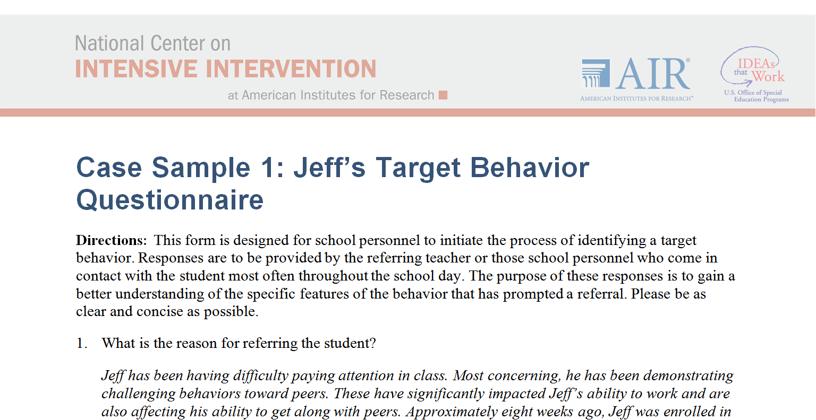
Jeff’s Target Behavior Questionnaire (Case Sample 1)
27
Notes:
See Case Sample 1: Jeff’s Target Behavior Questionnaire.
Review key information provided by Jeff’s teacher.

Slide 28
Identifying Potential Target Behaviors
Mrs. Coleman identified the following potential target behaviors for Jeff:
Out of seat
Curses
Talks out
Threatens
Fights
Argues
Hits, kicks
28
Notes:
Through the Target Behavior Questionnaire and team discussion, Mrs. Coleman identified the following potential target behaviors for Jeff:
Read list
The team decided to collect observational data to learn more about these behaviors.

Slide 29
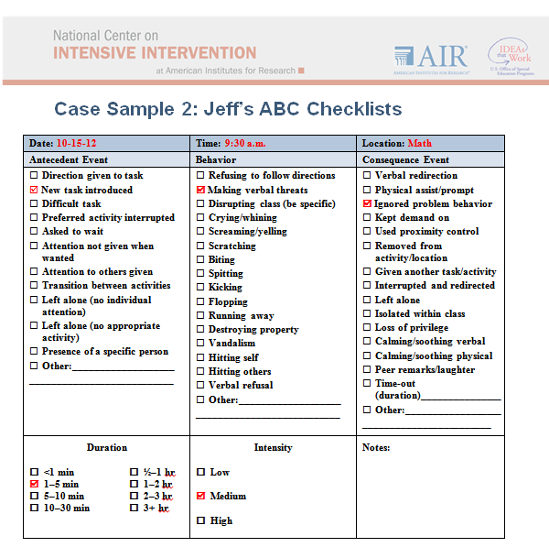
Jeff’s Anecdotal Reports
(Case Sample 2)
Mrs. Coleman completed a series of anecdotal checklists, recording the times and conditions when the behaviors occurred.
29
Notes:
See Case Sample 2: Jeff’s ABC Checklists

Slide 30
Jeff’s Direct Observation Data
Behaviors | Frequency (all observations)
Out of seat | 3 times
Curses | 7 times
Threatens | 11 times
Fights | 0 times
Argues | 5 times
Hits / kicks | 1 time
Talks out | 5 times
Structured direct observations were conducted by a colleague 5 times over a 2-week period. Each observation lasted approximately 20 minutes.
30
Notes:
The school psychologist agreed to observe Jeff to assist Mrs. Coleman and the school leadership team to better understand the nature of Jeff’s behavior. She observed a total of five times across two weeks for 20 minutes each. The focus of the observations was on the behaviors constituting Jeff’s disruptive behavior.

Slide 31
Case Application (Handout 2)
Take a moment to consider the student you believe to be a candidate for data-based individualization.
Complete the Target Behavior Questionnaire (Handout 2). Jot down some retrospective notes on the behavior of concern.
  What are some questions that arise?
  Any initial conclusions?
Notes:
Reference Handout 2 (Target Behavior Questionnaire already introduced through Case Sample 1).
Review the slide. Give teams a few minutes to talk through the case application. If time allows, share as a large group.

Slide 32
Step 2. Prioritizing Target Behaviors
If several potential target behaviors are identified, prioritizing only a few will make—
Data collection more feasible.
Data analysis and decision making more efficient.
Data-based individualization more effective, as decisions will be based on the most important behavior(s) for a given student.
32
Notes:
As we gather data for Step 1, we may sometimes clearly identify a single behavior for monitoring. More often, however, several behaviors will warrant further analysis. We want to prioritize only a few behaviors in order to make data collection and analysis more feasible. By individualizing based on fewer behaviors, we can make decisions more quickly and probably with more confidence, as we have selected the behaviors that are most meaningful for a given student.

Slide 33
Prioritization
Prioritization of behaviors requires assessing the overall importance of the behavior for school success.
Does the behavior present danger to the student or others?
How often does the behavior occur?
Does the behavior interfere with learning?
Will changing the behavior allow the student to obtain more positive attention?
33
Notes:
Prioritization requires evaluating the importance of each behavior to successful school functioning. For instance, you might consider if the behavior is potentially harmful to the student, teacher, or peers, or if the behavior occurs at a higher frequency than other identified behaviors. Those behaviors that are deemed most important are then defined using observable language to support subsequent measurement.

Slide 34
Jeff’s Target Behavior Prioritization
Considerations for prioritization
  Most frequent behaviors: threatens, curses, argues, and talks out
  Most dangerous behaviors: hits / kicks
  Most interfering behaviors: hits / kicks, threatens
Jeff’s target behaviors for progress monitoring:
  Threatens
  Hits / kicks
34
Notes:
The team reviewed the questions on the previous slide to help select target behaviors for Jeff. Direct observation data told the team which behaviors occurred most often: threatens (observed 11 times), curses (7 times), argues (5 times), and talks out (5 times). While hits / kicks only occurred once during the five observations, it is the most dangerous of all the behaviors Mrs. Coleman identified. It also strongly interfered with learning as Jeff had to be removed from the classroom when this occurred. Threatens also was particularly interfering as it disrupted instruction for the whole class.
Based on these considerations, the team identified two behaviors to monitor for Jeff: threatens and hits / kicks

Slide 35
Case Application
List the potential target behaviors for the student from your school.
Identify one or two behaviors to prioritize for progress monitoring based on the questions from slide 33.
Did you think some questions or considerations were most relevant in selecting a target behavior for this student?
Notes:
Review slide. Give teams time to list and prioritize behaviors. Share as a large group, if time allows.

Slide 36
Step 3. Defining the Target Behavior
Good target behavior definitions:
Use objective language referring only to observable characteristics of the behavior.
Allow for the behavior to be readily measured.
Delineate the boundaries of what the behavior includes and does not include.
36
Notes:
Now that we have identified two behaviors that are of the greatest concern for Jeff, it is time to develop a clear definition of each. Good operational definitions of target behaviors provide an accurate, complete, and concise description of the behavior to be measured. This includes ensuring that the definition allows for objective measurement. We accomplish this by using clear, concise language and constructing the definition in such a way that it can be readily applied by others. If two people have read the definition and observe the student at the same time, they should be able to agree when the behavior has, or has not, occurred. In order to accomplish this, we often need to clearly state which behaviors are included in the definition and which are not.

Slide 37
Objective, Observable Language
Ambiguous Terms
Apathetic
Aggressive
Bad attitude
Belligerent
Defiant
Disruptive
Hyperactive
Lazy
Unmotivated
Unambiguous Terms
Hits
Looks
Pokes
Raises hand
Requests
Scratches
Seated
Takes
Talks
Notes:
Behavior definitions must use clear, objective language to identify the behaviors being examined. This is best achieved by avoiding ambiguous terms that might represent several different behaviors or be labeled differently by various people. The list of terms on the left are ambiguous because they don’t specify the actual behaviors being focused on. The list on the right includes terms that can be readily seen and have wide agreement on when they occur. Note also that the unambiguous terms tend to be verbs rather than adjectives or characteristics.

Slide 38
Readily Measured
Readily measured behaviors are:
Objectively observable (clear guidelines for whether or not a behavior has occurred)
Able to be measured through frequency counts or time measures (e.g., duration)
38
Notes:
Unambiguous language also helps with the second condition of a strong target behavior definition—that it allows for ready measurement of the behavior. The description of the behaviors, therefore, should indicate the specific behaviors to be targeted, and how they will be measured

Slide 39
Delineate Boundaries
Behavior | Examples | Non-Examples
Kicks | The student extends his/her leg toward another person with the intent to injure or harm. | The student extends his/her leg for stretching or play.
Calls out | The student makes verbal statements during instructional tasks that were not prompted with a question or not focused on the academic material. | The student makes an incorrect choral response or asks questions about an assignment.
39
Notes:
The last step in defining a behavior is to delineate the boundaries of what the behavior includes and does not include. It often helps to provide examples of the target behavior as well as non-examples—behaviors that may be similar but do not count as an occurrence of the target behavior.

Slide 40
Target Behavior Definition Examples
Bad | Better | Best
Rick loses control. | Rick cries and tantrums. | Rick cries, flops to the floor, kicks feet, pounds fists on floor, and/or grabs at objects.
Tara is disruptive. | Tara makes inappropriate comments during class. | Tara curses at teacher or peers, talks excessively about unrelated tasks/work, or insults peers during class.
Robin has been acting withdrawn. | Robin is not engaging with peers. | Robin sits quietly by herself at her desk and does not speak with other students, even those who approach her to engage.
Notes:
Here are some examples of how vague behaviors can be better defined. What features make the last column of definitions the best?
Review and discuss as whole group or in teams.

Slide 41
Jeff’s Target Behavior Definitions
Behavior | Definition
Hits / Kicks | Jeff will be considered to be hitting or kicking if his foot or hand makes contact with another student with the intent to cause harm. The physical contact must be initiated by Jeff and put forth with sufficient intensity to cause harm for the intended target. Hitting and kicking will not include instances in which Jeff accidentally touches a student with his hand or foot.
Threatens | Threats are verbal statements that refer to harming other people including peers or teachers. Threats will include statements such as “I will throttle you” or “I will knock you out,” but will not include statements such as “I said, leave me alone,” or other statements indicating an attempt to cope with the situation.
41
Notes:
Here are the definitions Jeff’s team developed for his two highest priority behaviors.

Slide 42
Practice Defining Target Behaviors (Handout 5)
Complete Handout 5: Target Behavior Definition Practice.
Part I: Identify common behaviors of concern in your school.
  Do you have common definitions for these behaviors? Are they observable and measureable?
  Would different staff members agree on whether or not a given behavior has occurred?
Part II: Write definitions for common target behaviors.
  Alternatively, write stronger definitions for the common behaviors you identified in Part I. We will write definitions for your case student next.
Notes:
Provide or reference Handout 5: Target Behavior Definition Practice.
As time allows, provide time for teams to work on part or all of the form and discuss as a large group. Note that teams also will be practicing writing definitions for their case application student, so you may decide to spend less time on writing definitions for this activity.

Slide 43
Case Application
Examine the behavior(s) you prioritized for the student in your school (slide 35).
Develop a clear, measurable definition for each target behavior.
  Is the language objective and observable?
  Can the behavior be readily measured?
  Are the boundaries of the behavior established?
43
Notes:
Review the slide. Give teams a few minutes to talk through the case application. If time allows, share as a large group.

Slide 44
Developing a Measurement System to Track the Target Behavior
Notes:
Now that we know which behavior(s) we want to use for progress monitoring, we need to develop a plan to collect data on the target behavior(s).

Slide 45
Developing a Measurement Approach
Initial considerations:
  How often will data be collected?
    Related to intensity of behavior and timelines for making intervention decisions
  In what context(s) will data be collected?
  At what times will data be collected?
  Who will collect the data?
    Consider when, where, and how the data will be collected.
  When and how will the data be entered to allow for evaluation?
45
Notes:
The process of identifying, prioritizing, and defining the target behavior is designed to support the development of an individualized approach for data collection. We will review the various methods associated with actually collecting the data, but first it is worthwhile to discuss some considerations for developing an effective approach to measuring behavior. Recall that progress monitoring for students in need of individualized behavioral interventions requires data to be collected more often than for less intensive interventions. The teacher and school team must consider the most appropriate schedule. Is daily assessment needed? Or would it be more helpful to have data collected on a weekly basis? Other questions to consider relate to who will collect the data and at what times. Finally, it is necessary to design the procedures for ensuring the data is entered for evaluation. Most of these steps will be clear following the identification of the target behaviors and conditions of greatest concern.

Slide 46
Data Collection Methods
Systematic Direct Observation
Direct Behavior Rating (DBR)
46
Notes:
Many approaches to data collection are available, and each has its own strengths and limitations. The traditional method for collecting student data is through systematic direct observation techniques. Although we will briefly describe the methods associated with this approach, our emphasis here will be on using an emerging technology called “Direct Behavior Rating,” which increases the feasibility of data collection without sacrificing the quality of the data. Specifically, we will consider how to incorporate the target behaviors into the DBR form and use it in conjunction with standard behaviors included on the standard form.

Slide 47
Systematic Direct Observation
The process of watching a person
or environment for a period of time and systematically recording behavior.
Examples of observation:
  Total number of times a student raises hand
  Amount of time spent out of seat
  Percentage of appropriate peer interactions
47
Notes:
Before describing the “Direct Behavior Rating” or “DBR” approach to collecting data, it is useful to consider systematic direct observation techniques because these are widely considered the gold standard approach for collecting behavioral data. As we will see, there remain some limitations for practical application in schools. This introduction to direct observation techniques, however, will provide the basis for developing measurable anchors to assist with increasing the accuracy of the DBR.

Slide 48
Systematic Direct Observation Strengths
Observation data are a direct representation of the behavior.
Direct observation is applicable to a wide range of observable behaviors.
Adaptable procedures can measure various dimensions of behavior.
48
Notes:
Systematic direct observation offers several advantages. First, the data collected are closely aligned with the behavior being observed. Another advantage is its flexibility for collecting data on a wide range of behaviors. Virtually all behavior that can be seen can be the subject of direct observation techniques. Lastly, a wide range of procedures is available for collecting data. These methods can be readily adapted to allow behavior data to be collected along various dimensions and for a variety of purposes.

Slide 49
Systematic Direct Observation Dimensions
Behavior can be measured in terms of the following:
Frequency – number of times behavior occurs
Rate – number of times it occurs within a given time period (e.g., 10 times per hour)
Duration – amount of time the behavior lasts
Latency – temporal relation of behavior to other events (e.g., time to respond)
Intensity – the magnitude or strength of the behavior
49
Notes:
Systematic direct observation can measure behavior along several dimensions.
Review list.
We usually measure how often a behavior occurs or how long it lasts.

Slide 50
Practice: What dimension would you use for each behavior?
Kyle’s hand raising
Sara’s task completion
Brad’s following directions after request
Bonnie’s positive social interactions during recess
50
Notes:
Look at the sample behaviors listed. Which dimension would be the most appropriate measure for each?
Answers
Kyle – frequency or rate
Sara – percentage of tasks completed, frequency (assignments submitted)
Brad – latency (from time of request to execution of task), percentage of requests
Bonnie – frequency or rate

Slide 51


Systematic Direct Observation Procedures
Event-Based
Frequency
Time-Based
Whole interval
Partial interval
Momentary time
sampling
Latency
Duration
51
Notes:
Just as there are a number of ways to represent behavior, there are also several methods for actually observing behavior and collecting data. These methods can be divided into two broad classes: those that measure specific aspects of an event, such as how often an event occurs or how long the event lasts, and those based on recording what occurs within a particular time frame. We will not spend too much time reviewing these methods, but the common thread across all is the need to be vigilant on keeping notes and records. Unfortunately, this can often be cumbersome, time consuming, and overwhelming—even for the tools that are the easiest to complete.

Slide 52
Systematic Direct Observation Limitations
May not be feasible in classroom context
  Time intensive
  May require trained observer
  Can be difficult to implement if observer must perform
  other duties at same time, such as teaching
If not used because of these challenges, there is no
data-based individualization.
52
Notes:
While systematic direct observation can provide very strong and useful data, these methods are often time intensive and difficult to implement, particularly within the context of busy school classrooms. Because of the difficulty of having to attend to instruction, behavior management, and data collection (not to mention a whole host of other issues!), the primary advantage of systematic direct observation—that the method provides a direct index of behavior—might be lost. Moreover, if the method is not feasible and requires too much effort, it is not likely to be used. That would result in no progress monitoring data and no opportunity for data-based individualization.

Slide 53
Systematic Direct Observation Lessons
Align method with target behavior.
  Definition
  Dimension to be tracked
Data collection method should be feasible to implement.
53
Notes:
Despite these limitations, there are some important lessons to be learned from direct observation techniques. The primary advantage of this method is that it provides a direct reflection of the behavior. We want our data to provide accurate information on the chosen dimension of our clearly defined target behavior. For example, if the behavior of concern is desk flips during math, we need to choose a data collection method that tracks how often the behavior occurs (frequency or rate). Work refusal might be considered in terms of the percentage of work requests the student refuses, or we might want to know how long the student spent refusing to do work (duration). The final consideration is feasibility. If a strong method is too difficult to sustain, it will not be useful for progress monitoring.

Slide 54
Direct Behavior Rating (DBR)
54
Notes:
Fortunately, there is an alternative method to the often burdensome direct observation approach. Direct Behavior Rating (DBR) can be adapted to focus on a range of target behaviors while also providing an opportunity to measure broader, more general outcomes. The premise of DBR is that teachers can reliably and accurately rate student behavior on a continuum following some specified period of time. These ratings are then used to monitor student progress. There are several different DBR-like tools currently being developed. These include methods using multiple items to rate student performance and those using a single scale. However, these various tools are at different stages of development.

Slide 55
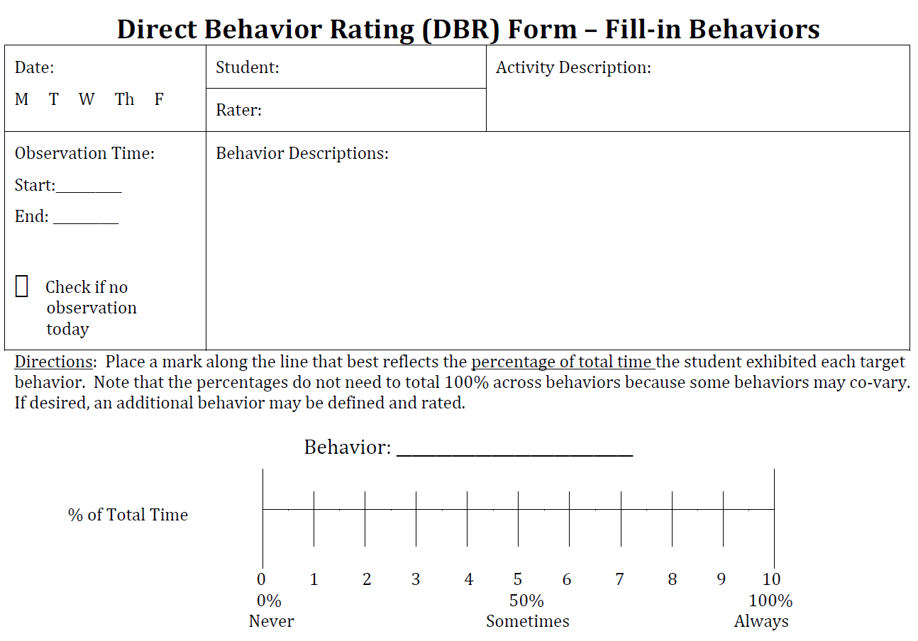
DBR Single-Item Scales (DBR-SIS)
(Chafouleas, Riley-Tillman, & Christ, 2010)
Permission for use granted by authors for educational purposes only.
www.directbehaviorratings.org
55
Notes:
The method with, perhaps, the greatest research to date is the single-item scale (e.g., Chafouleas, Riley-Tillman, Christ, & Sugai, 2009; Chafouleas, Riley-Tillman, & Christ, 2010). This particular approach allows the user to rate the behavior on a single continuum from 0 to 10. These numbers are anchored by terms such as the behavior “Never” occurred (0 percent), “Sometimes” occurred (50 percent), or “Always” occurred (100 percent) during the observation period. As you can see, the completion of the form does not require constant recording or attention to paper work; rather, it allows the teacher to instruct and manage freely while also providing a research-based method for tracking student behavior.
For more information on DBR, including various forms and instructions for their use, please see the Direct Behavior Ratings website at www.directbehaviorratings.org (University of Connecticut, 2010).

Slide 56
DBR Standard Behaviors
School Success
Academically Engaged
Non-Disruptive
Respectful
(Chafouleas, Riley-Tillman, Christ, & Sugai, 2009)
Permission for using DBR form as part of this module granted by authors for educational purposes only.
www.directbehaviorratings.org
56
Notes:
Provide or reference Direct Behavior Rating (DBR) Form: 3 Standard Behaviors (V 1.4 DBR Standard Form with 3 Standard Behaviors)
The DBR forms we will be using have three general behaviors already available for use: (a) academically engaged behavior, (b) non-disruptive behavior (looking for reduced occurrence of disruptive behavior), and (c) respectful behavior. The advantage of having these three behaviors on the standard form is that you will be able to track the target behavior you have identified for your student while also gaining a better understanding of broader behaviors that are needed for successful school functioning. We will consider the application of these examples and then discuss how to incorporate students’ individualized target behaviors into the instrument.

Slide 57
DBR-Academic Engagement
Academic engagement
Active or passive participation in the classroom activity
Examples include writing, raising hand, answering a question, talking about a lesson, listening to the teacher, reading silently, and looking at instructional material.
(Chafouleas, Riley-Tillman, Christ, & Sugai, 2009)
57
Notes:
Read slide.

Slide 58
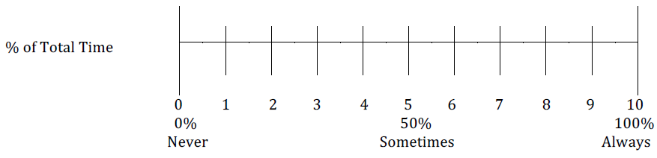
Academic Engagement Example
Academically Engaged
Place a mark along the line that best reflects the percentage of total time the student was academically engaged during math today.
Interpretation: The teacher estimated that the student displayed academically engaged behavior during 60 percent of large-group math instruction today.
Slide adapted from Chafouleas (2011) with permission.
58
Notes:
Animated slide. Click to bring up Interpretation.

Slide 59
DBR-Disruptive
Disruptive behavior
A student action that interrupts regular school or classroom activity
Examples include out of seat, fidgeting, playing with objects, acting aggressively, and talking/yelling about things that are unrelated to classroom instruction.
(Chafouleas, Riley-Tillman, Christ, & Sugai, 2009)
59
Notes:
Read slide.

Slide 60
Disruptive Example
Disruptive
Place a mark along the line that best reflects the percentage of total time the student was disruptive during small-group science today.
Interpretation: The teacher estimated that the student displayed disruptive behavior during 30 percent of small-group science instruction today.
Slide adapted from Chafouleas (2011) with permission.
60
Notes:
Animated slide. Click to bring up Interpretation.

Slide 61
DBR-Respectful
Respectful
Respectful behavior is defined as compliant and polite behavior in response to adult directions and/or peer interactions.
Examples include following teacher directions, prosocial interactions with peers, positive response to adult requests, and verbal or physical disruption without a negative tone or connotation.
Non-examples include refusing to follow teacher directions, talking back, eye-rolling, inappropriate gestures, inappropriate language and/or social interactions with adults or peers, and disruption with a negative tone/connotation.
(Chafouleas, Riley-Tillman, Christ, & Sugai, 2009)
61
Notes:
Read slide.

Slide 62
Respectful Example
Respectful
Place a mark along the line that best reflects the percentage of total time the student was respectful during language arts today.
Interpretation: The teacher estimated that the student displayed respectful behavior for 80 percent of whole-class language arts today.
Slide adapted from Chafouleas (2011) with permission.
62
Notes:
Animated slide. Click to bring up Interpretation.

Slide 63
DBR-SIS Standard Item Takeaways
All standard item behaviors are clearly defined.
Examples are provided for what constitutes the behavior.
All behaviors can be readily measured, and interpretations for responses are clearly stated.
63
Notes:
Read slide.

Slide 64
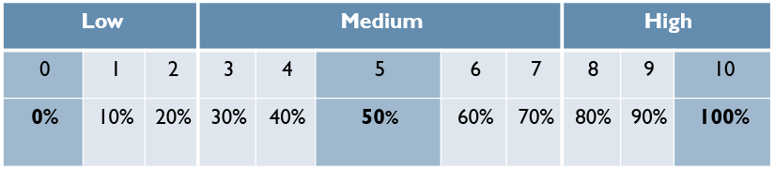
Integrating Target Behavior Into
DBR Form
Target behavior information is used to develop clear anchors for ratings.
Anchors are used to gauge whether the behavior was occurring at low, medium, or high levels.
Slide adapted from Chafouleas (2011) with permission.
64
Notes:
Animated slide. Click to bring up table.
Provide or reference Direct Behavior Rating (DBR) Form – Fill-in Behaviors (V 1.3 DBR Standard Form – Fill-in Behaviors).
The standard DBR items are useful for tracking a student on broad indicators of school success. However, the data-based individualization process often will require the tracking of behaviors specific to the particular student. The DBR form also provides an option to fill in your own target behaviors. This will require school personnel to clearly define the target behaviors and align them with specific criteria to increase the consistency of the ratings. Examples of this alignment include considering whether the behavior occurs a lot or little, or the percentage of time during which the behavior occurs.

Slide 65
Developing DBR Behavior Definition and Anchors
Preliminary target behavior information can be used to inform the development of anchors.
Operational Definition
Toby’s aggression is defined as any behavior that involves making contact with others in an attempt to injure or harm. This includes punching, hitting, kicking, spitting, scratching, pushing, and biting. This does not include patting on the back or shaking hands.
65
Notes:
DBR anchors are based on the preliminary information collected as much as possible. That is, the information collected to identify, prioritize, and define the target behavior can be used to determine whether the behavior is occurring at high, moderate, or low levels during a particular time period.

Slide 66
Using Preliminary Data to Develop DBR Anchors for DBI
Preliminary data indicated that:
Toby displayed aggression mostly during math periods.
Aggression encompassed many different behaviors.
It was estimated to occur between 0 and 12 times in this period of time.
66
Notes:
Read slide.

Slide 67
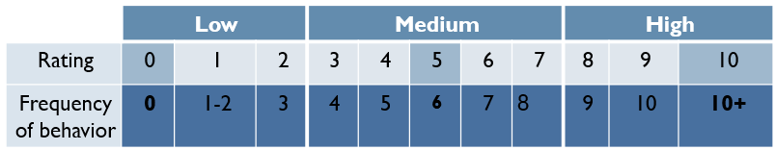
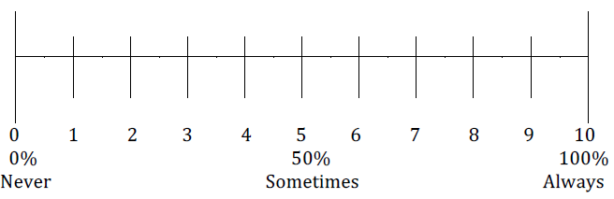
Using Preliminary Data to Develop DBR Anchors for DBI
Based on this information, the DBR anchors might correspond with the scale as follows:
67
Notes:
If your preliminary data included direct observation, you may know the range of frequencies for your target behavior, and you can set the upper range as a rating of 10.

Slide 68
Jeff’s Direct Behavior Rating Form
Threats are verbal statements that refer to harming other people, including peers or teachers. Anchors are 0 = 0 threats per observation, 1 = 1−2 per observation, 2 = 3 per observation, 5 = 6 per observation, 9 = 10 per observation, 10 = >10 per observation.
(Chafouleas, Riley-Tillman, & Christ, 2010)
68
Notes:
Review slide.

Slide 69
Case Application (Handout 6)
Take a moment to consider your candidate student and the target behavior(s) and definition(s) you developed. To help you create a DBR form for this student, complete the following sections of Handout 6: Direct Behavior Rating Individualization Form:
Behavior definition (already developed)
DBR anchors
Observation period
69
Notes:
Provide or reference Handout 6: Direct Behavior Rating Individualization Form and Direct Behavior Rating (DBR) Form – Fill-in Behaviors.
Review the slide. For the DBR Individualization form, complete sections 1 through 3. You may not yet have enough data to complete section 4. What would you need to do to know the current performance of the student and typical peers in order to fill out this section? We’ll talk more about goal setting in a later section.
Give teams a few minutes to talk through the case application. If time allows, share as a large group.
Now look at the DBR fill-in form. The information in Handout 6 would allow you to fill out the top portion of the DBR form.

Slide 70
Implementing DBR
Three steps for increasing the likelihood that the form will be applied consistently:
Review the definitions and anchors to ensure consistent application.
Have the form ready to be completed.
Complete ratings immediately after a prespecified time period.
Slide adapted from Chafouleas (2011) with permission.
70
Notes:
Read slide.

Slide 71
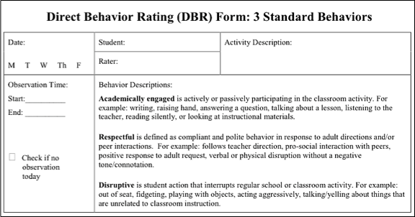
Implementing DBR
Ensure that the top portion of the form is completed
and includes behavior definitions and rating directions. Include anchors if needed.
Slide adapted from Chafouleas (2011) with permission.
71
Notes:
The quality of these ratings of student behavior depends on the ability of teachers to remain consistent in their application of the target behavior definition over time. Put another way, the teacher must be careful to apply the same criteria for student behavior from day to day for the ratings to be reliable. Fortunately, there are methods for protecting against this drift of rater accuracy.

Slide 72

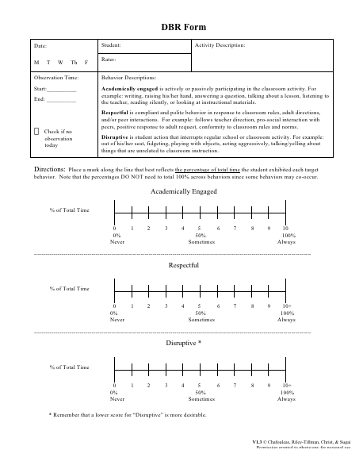
Implementing DBR
Make sure the form is ready to complete immediately after the observation period.
Possible observation periods include
  Reading block
  Science
  Independent seat work
  Social studies
  Math
  Circle time
  Lunch / recess
Slide adapted from Chafouleas (2011) with permission.
72
Notes:
Read slide.

Slide 73
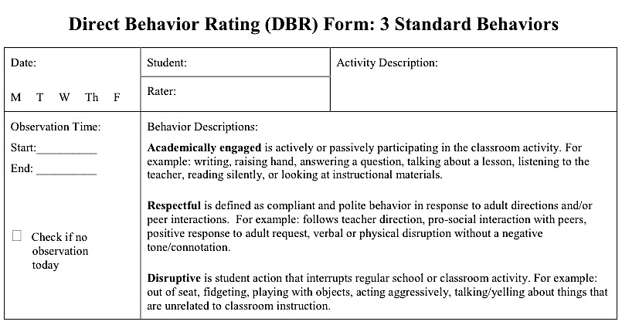
Implementing DBR
Immediately following the activity period, complete the ratings, only if:
You are confident you directly observed the student for a sufficient amount of time.
You are able to complete the form soon after the end of the activity.
Slide adapted from Chafouleas (2011) with permission.
73
Notes:
It is better to skip a day’s observation than to provide inaccurate data. If you are using a predated form, you can check a box to indicate an observation did not occur that day.

Slide 74
Evaluating Progress Monitoring Data to Inform Intervention Decisions
Notes:
Now that we know how to collect data, we will talk about how to use it to make decisions.

Slide 75
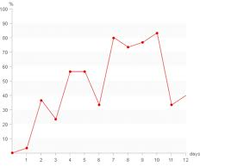
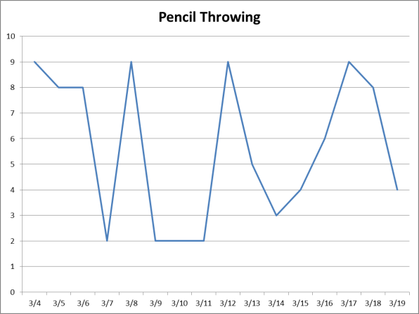
Monitoring and Evaluating Progress
Requires examining the DBR or other progress monitoring data to determine if the student is responding to the intervention.
Requires managing and organizing data to support summary and analysis.
75
Notes:
The data collected from the DBR form will be used to evaluate whether or not the student is responding to the intervention by monitoring progress toward predetermined goals. This process requires that DBR information be managed and organized in a way that supports summary and analysis. Because DBR data are collected on individual students, the most straightforward approach for displaying data is a line graph. This process will be described in the following slides.
The line graph on the right was downloaded from https://encrypted-tbn0.gstatic.com/images?q=tbn:ANd9GcQ8FCkz7GYENg1SqpIc6LBdnwC_RIWBLK1423d9cQc4nSf962NH.

Slide 76
Managing Data for Evaluation
Graphing data will allow for visual analysis to support evaluation.
The DBR Graphing Template will automatically create a graph of the DBR data you enter.
Questions to consider include
  Who will be responsible for inputting / graphing the data?
  How often will the data be reviewed?
  By whom will the data be reviewed?
76
Notes:
Provide or reference DBR Graphing Template. If time allows, consider demonstrating the spreadsheet.
The first consideration for evaluation is data management. This includes determining the process of moving the ratings from the DBR form into some tool for graphing. Graphing might be done by hand, online using a tool such as Chart Dog from interventioncentral.com, or using a spreadsheet program such as Microsoft Excel. For the purposes of this presentation, we will assume the graphing platform will be a computer program such as Excel. In fact, we have developed a spreadsheet template to support streamlined graphing.

Slide 77
Management Process for Jeff’s
DBR Data
Mrs. Coleman will complete the DBR form each day.
Once a week, she will transfer the data to the DBR Graphing Template to automatically generate a graph.
Mrs. Coleman and one member of the school team will review the data once a week, with full team review after four weeks.
77
Notes:
Read slide.

Slide 78
Begin Data Collection Before Intervention
Five or more data points recommended to:
  Pilot test the tool.
  Capture current performance level as measured by this tool.
Revisit tool and anchors if:
  Data do not seem accurate (inconsistent with other data on the target behavior).
  Tool seems unlikely to be sensitive to change in the target behavior.
78
Notes:
After the process for entering data has been outlined, it is necessary to pilot the tool and establish how the individual is currently performing on the tool before intervention begins. The purpose of this “try-it-out” phase is to make sure the DBR anchors and ratings are reflective of student behavior and to determine a present level of functioning. There are no set rules for how long this phase needs to last, but we need enough information to determine whether the tool is accurately reflecting student behavior. The general recommendation is five or more assessment points. Indications of problems with the tool might be the collection of data that are inconsistent with other data on the same target behavior or seem unlikely to be sensitive to changes in the target behavior. In such cases, it might be necessary to revise the definition or anchors to make sure the instrument is providing accurate assessments of individual performance.

Slide 79
Developing Intervention Goals
The piloting of the DBR tool will provide information that can be useful for establishing evaluation rules.
  The school team and teacher must define responsiveness up front to assist with evaluation.
  Because the process is individualized, it is difficult to give firm rules on what constitutes responsiveness—this will vary based on the target behavior and current levels of performance.
  Make goals ambitious, but feasible to obtain.
79
Notes:
Preintervention data collection allows us to test the accuracy of the DBR tool and also provides a baseline with which to compare student behavior after the intervention has been implemented. The school team can use baseline performance to determine what responsiveness will mean for the student, establishing guidelines for when to retain, remove, or revise the intervention procedures, based on student data. Because the data-based individualization process is unique to each student, there are no firm rules regarding what constitutes responsiveness.

Slide 80
Guidelines for Developing Intervention Goals
Link intervention goals to DBR anchors.
Specify an amount of time during which the intervention must be in place before reviewing progress.
Goals should not be static—they can change and evolve over time depending on student responsiveness.
80
Notes:
Read slide.

Slide 81
Example of Evaluation Rules
Jacob will be deemed non-responsive if his DBR rating for verbal aggression in math class averages more than 5 for a one-month period following introduction of the intervention.
Jacob will be deemed responsive if his DBR rating for verbal aggression in math class averages less than 5 for a one-month period.
The school team will review the data at the end of the month to determine whether Jacob was responsive and will decide on next steps.
81
Notes:
Read slide.

Slide 82
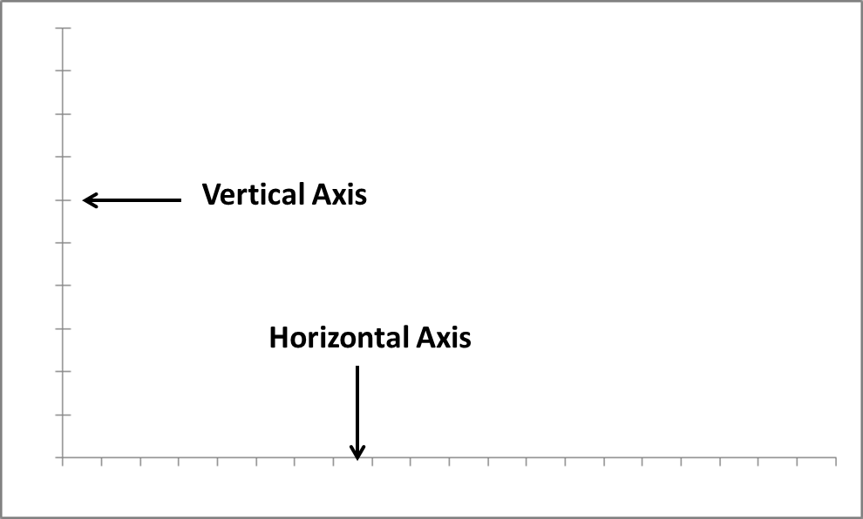
Progress Monitoring Graphs
Notes:
A graph has two axes. The vertical or y-axis and the horizontal or x-axis.

Slide 83
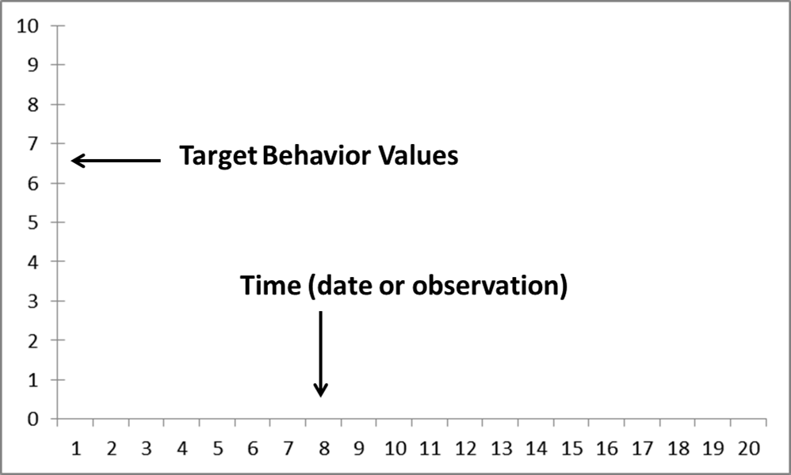
Progress Monitoring Graphs
Notes:
Time usually goes on the horizontal axis. Values for the behavior data go on the vertical axis.

Slide 84
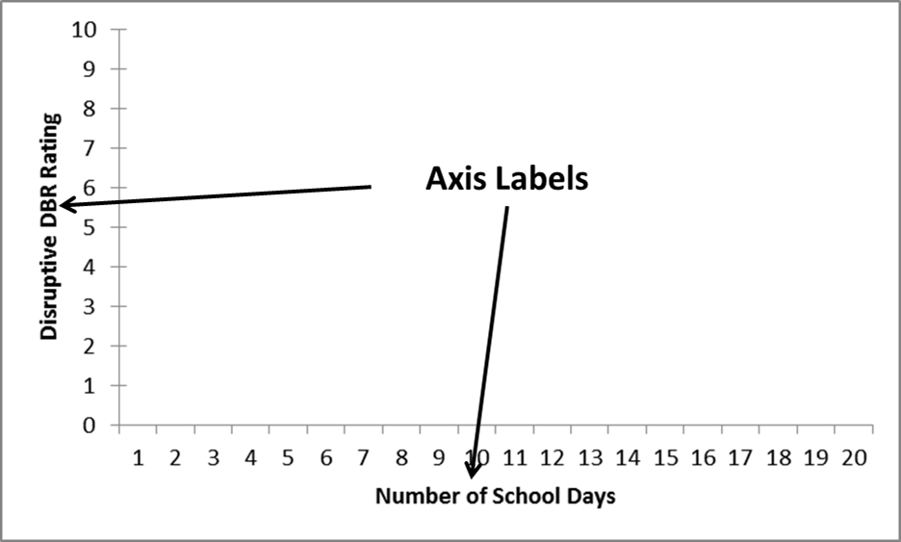
Progress Monitoring Graphs
84
Notes:
The axes are labeled so anyone can look at our graph and know what we are measuring, over what time period.

Slide 85
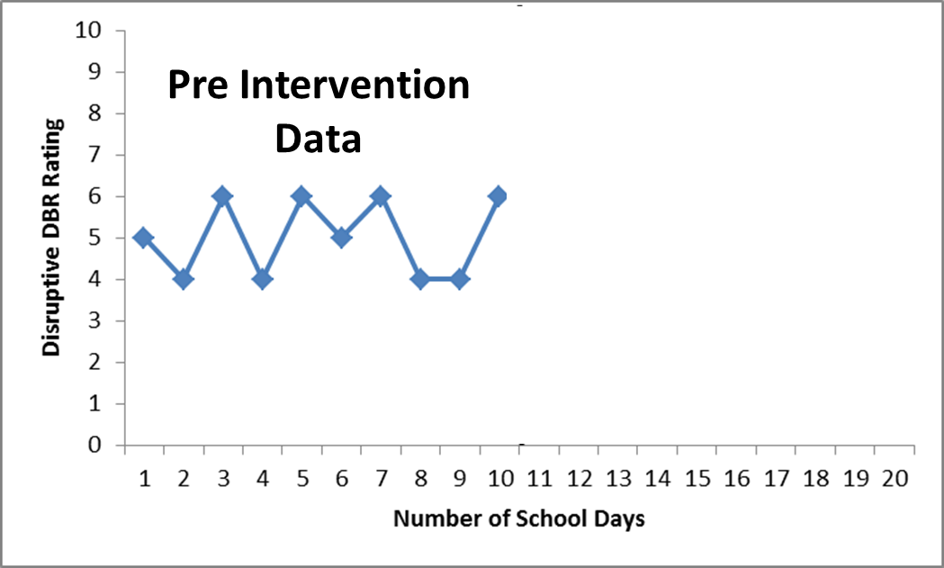
Progress Monitoring Graphs
Notes:
First, we graph our preintervention data.

Slide 86
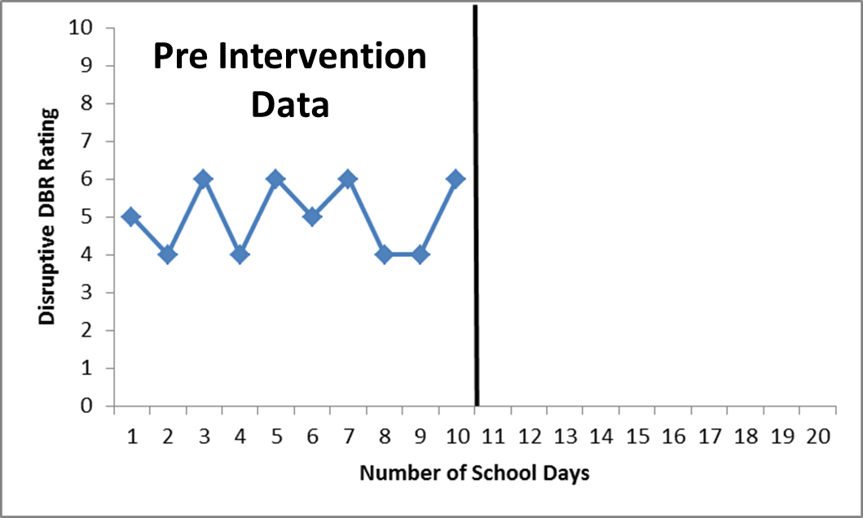
Progress Monitoring Graphs
Notes:
A vertical line, sometimes known as a phase change line, indicates when the intervention begins.

Slide 87
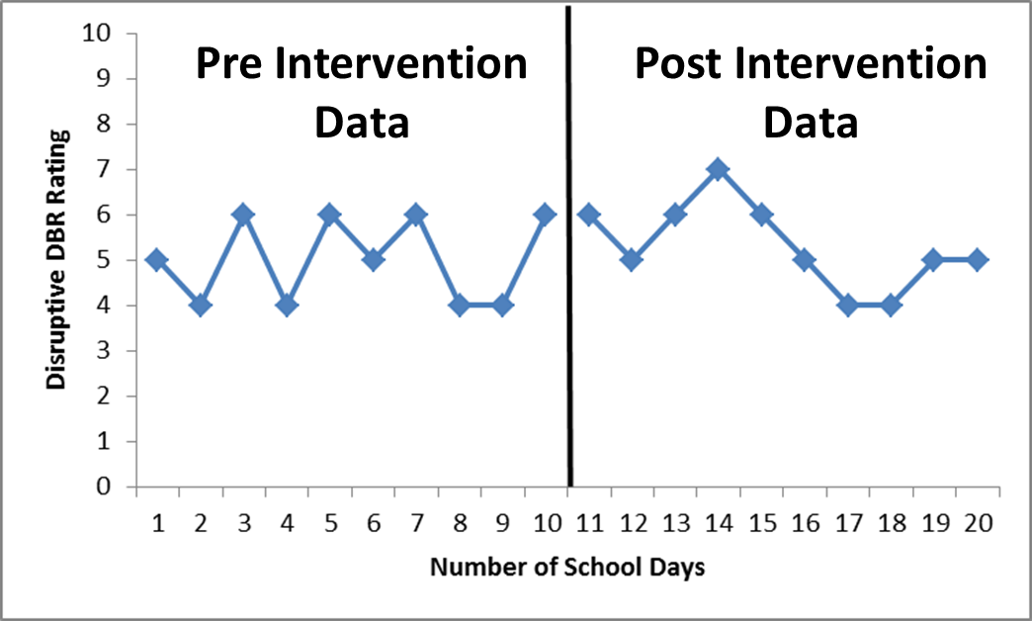
Progress Monitoring Graphs
Notes:
In this way, we can compare behavior before and during the intervention. Do the data in this graph suggest that the student is responding to the intervention?
This student does not seem to be responding—the data are very similar before and after intervention. Future slides will further explain visual analysis and provide opportunities to practice.

Slide 88
Data Evaluation Methods and Features
Student behavioral progress is typically monitored through visual analysis.
This involves examining the emergent data pattern, including the:
  Level of the data
  Trend of the data
  Variability of the data
88
Notes:
Graphed data help school personnel visually determine whether or not the intervention is working. There are a number of features school personnel might consider when looking at a graph to determine student responsiveness. We will focus on three features: level, trend, and variability.

Slide 89
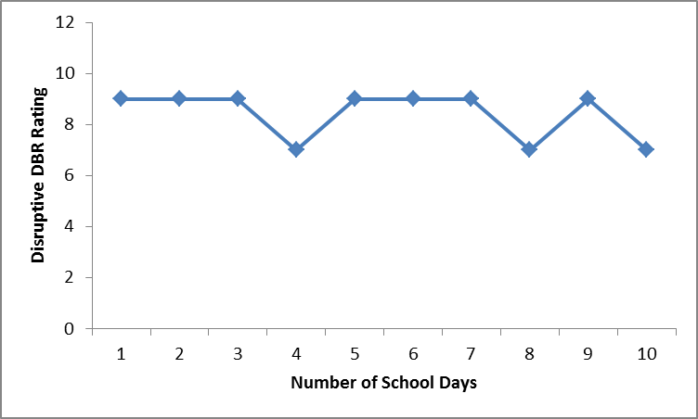
Level
The average value of a set of scores or ratings
Notes:
The average or mean value for this set of data is 8.4. Visually, you can see that most of the ratings are 9, with a few 7s.

Slide 90
Trend
Trend is the direction of the data path.
  Ascending or increasing
  Descending or decreasing
  Level or flat
Trend must be considered in light of the target behavior.
  Increasing engagement is good.
  Increasing disruptiveness is not.
90
Notes:
In addition to direction, we also consider the steepness of the trend—how fast the data are increasing or decreasing.

Slide 91
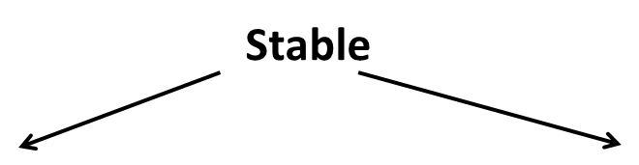
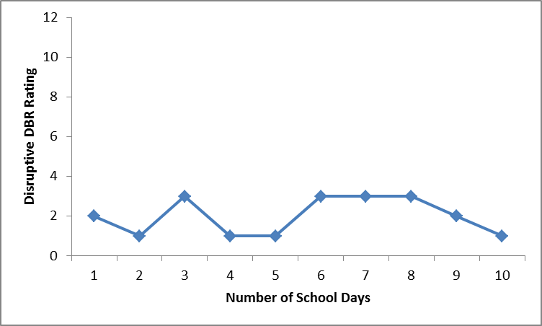
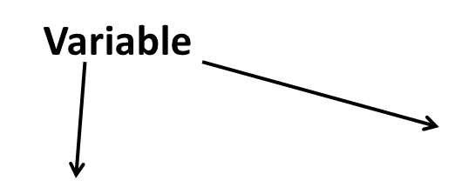
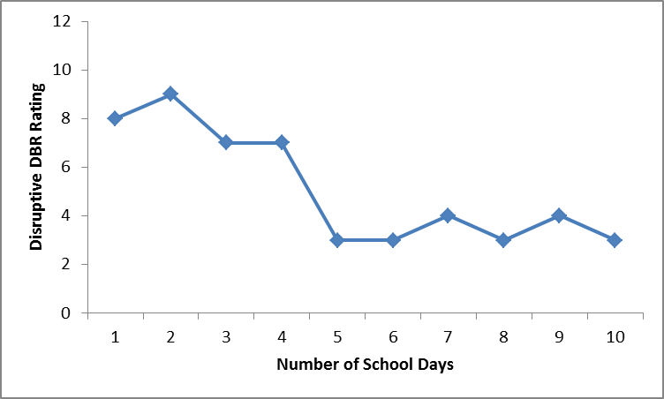
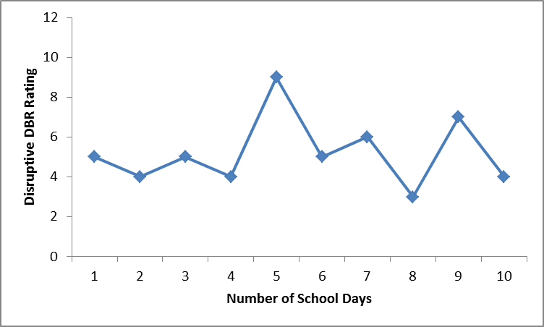
Variability
Notes:
Animated slide. Click at underlined text.
The variability of a set of data refers to the spread or consistency of the data. The top two graphs show data at very different levels, but both sets of data have a fairly flat trend with little change from one data point to the next. These data have low variability, and we would describe them as “stable.” The bottom two graphs have more inconsistent data, and we would describe the data as “variable.” In the graph on the bottom left, the level of the data decreases significantly after day 4. In the graph on the bottom right, the level of the data does not change much from the first few days of measurement to the last few days, but for days 5 through 10, the data values change greatly from one day to the next. In particular, the rating for day 5 is much higher than the rating for any other day. This outlier makes the data highly variable.

Slide 92
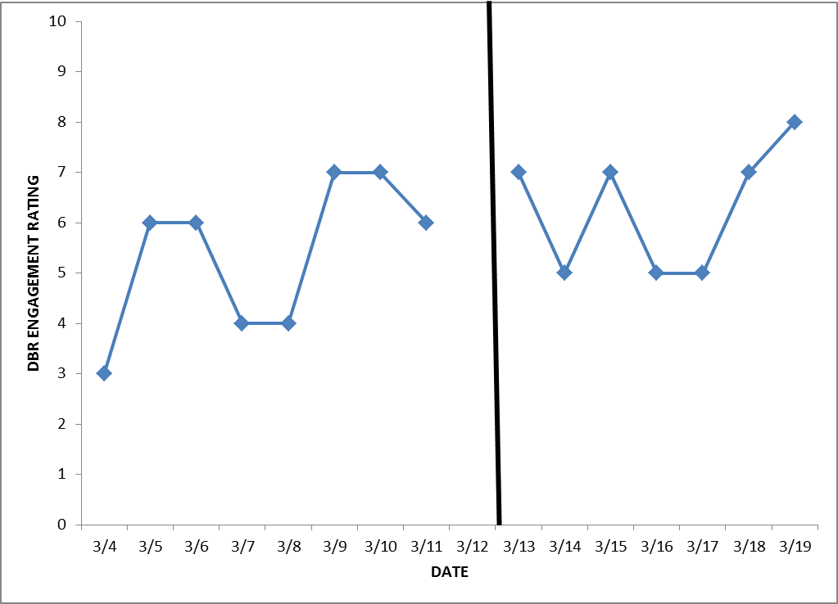
Comparing Non-Intervention and Intervention Patterns: Example 1
Notes:
In this graph, we can see that preintervention or baseline data had a slightly lower average level than the data in the intervention phase. However, both sets of data have increasing trends, and much of the data overlaps, so the change between the phases does not seem to be strong. At this point, we cannot be confident that the student is responding to this intervention. The team may decide to collect more data if they have reason to think the intervention may need more time to work, or they may consider changing the intervention.

Slide 93
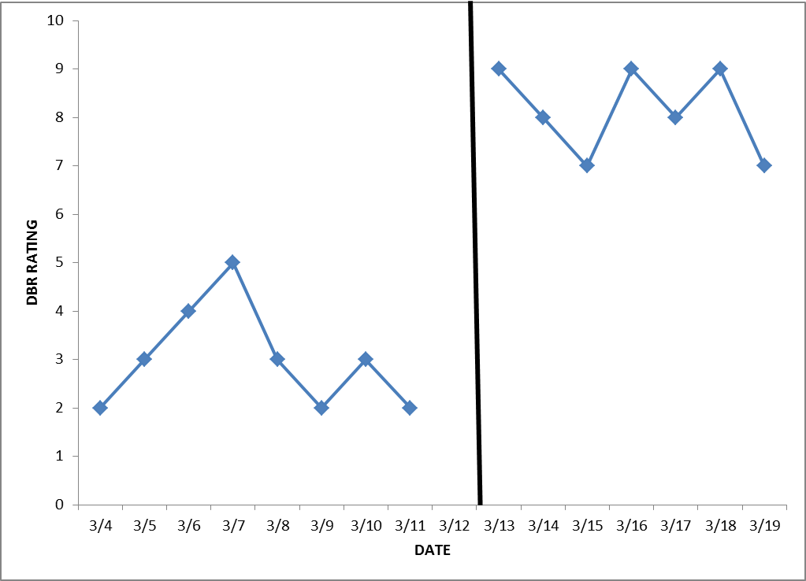
Comparing Non-Intervention and Intervention Patterns: Example 2
93
Notes:
In this case, there is a very clear change in level after the intervention is introduced. The team would likely decide that the student is responding to this intervention, depending on the goal set for this student.

Slide 94
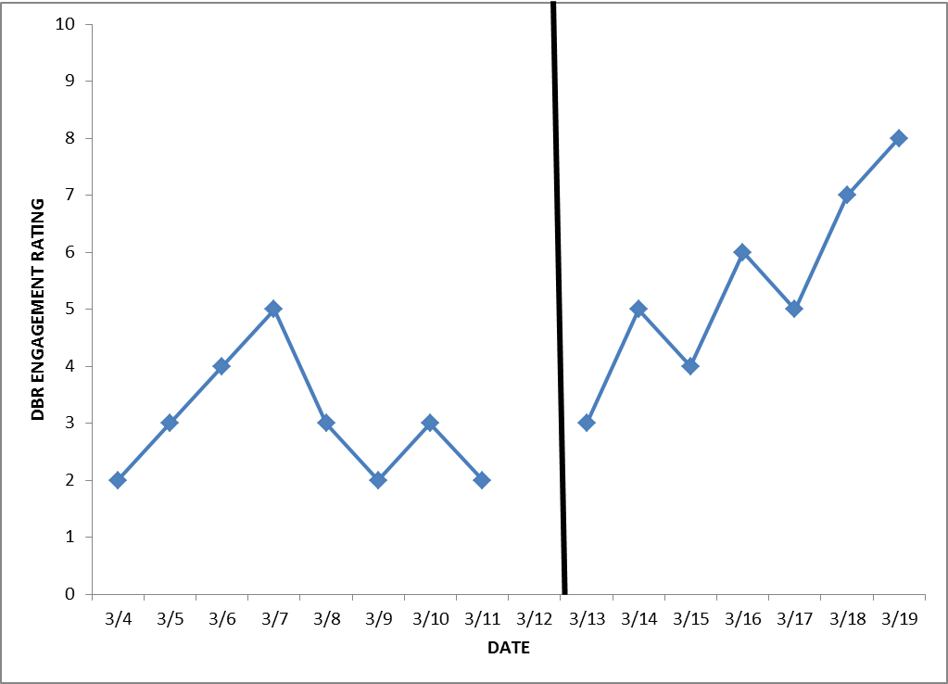
Comparing Non-Intervention and Intervention Patterns: Example 3
94
Notes:
In this case, the engagement data show a clearly ascending trend during intervention. Again, we would probably suspect this intervention is working. The student should be on track to meet his or her goal.

Slide 95
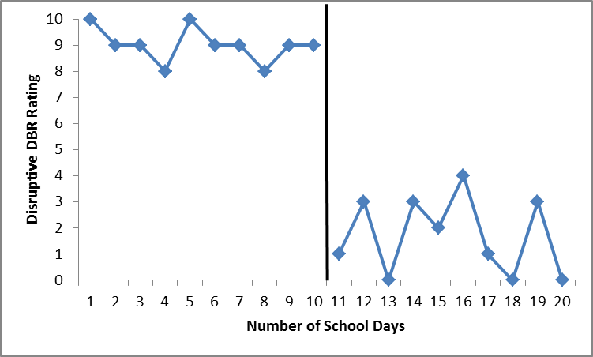
Using Means to Augment Evaluation
Visual analysis is the traditional method used for evaluation of behavior data, but means can help us quantify the changes we see in the data.
Preintervention
mean = 9.2
Postintervention mean = 3.7
95
Notes:
Animated slide. Click at underlined text.
Basic statistics such as means, or averages, can help us quantify the patterns observed through visual analysis. In this graph, the vertical line represents the start of an intervention. It is easy to see that ratings of disruptive behavior are much lower during the intervention. Means will help us describe this change. Preintervention data has a mean of rating of 9.2. The mean for the postintervention data is 3.7

Slide 96
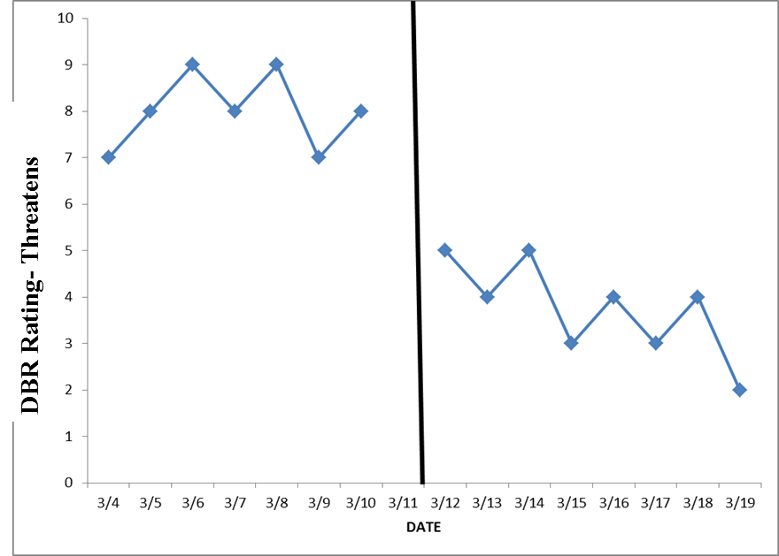
Jeff’s Target Behavior Data (Threatens)
96
Notes:
What does this graph tell us about Jeff’s threatening behavior before and after the intensive intervention was introduced?
Give participants a few moments to think about how to answer this question based on the graphed data. If time allows, discuss as a group.
During the intervention, Jeff’s threatening behavior dropped in level and showed a decreasing trend.

Slide 97
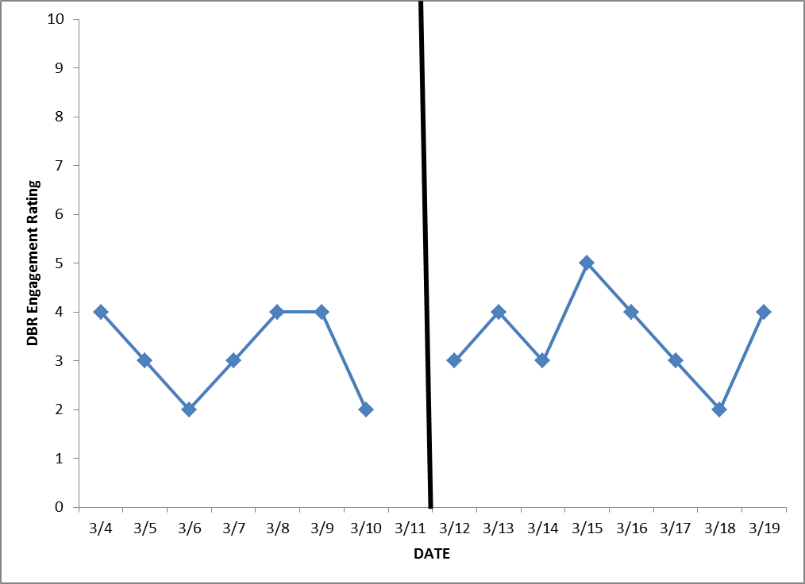
Jeff’s Target Behavior Data (Engagement)
97
Notes:
Did Jeff’s academic engagement change after the intensive intervention was introduced?
Give participants a few moments to think about how to answer this question based on the graphed data. If time allows, discuss as a group.
Jeff’s engagement was variable both before and during intervention. We cannot see any clear change in the level or trend of his engagement data.

Slide 98
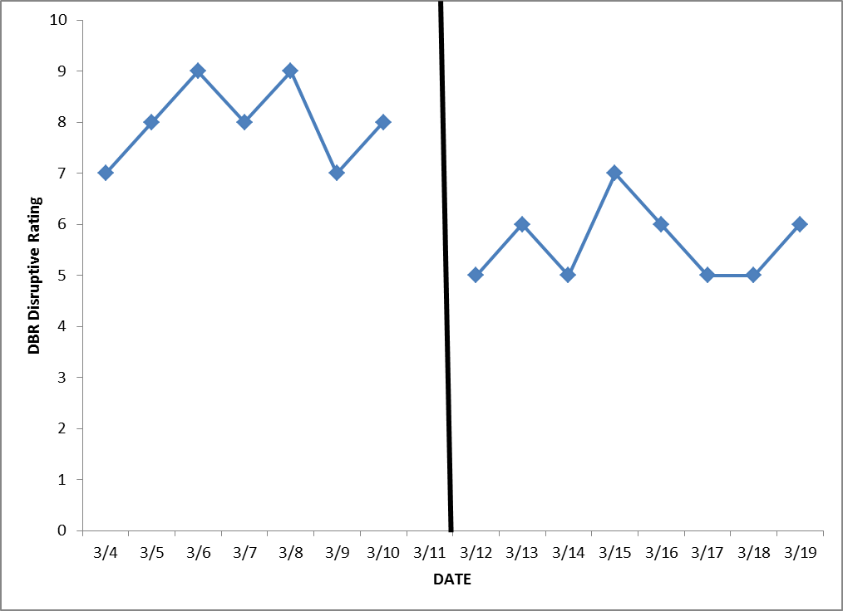
Jeff’s Target Behavior Data (Disruptive)
98
Notes:
Did Jeff’s disruptive behavior change after the intensive intervention was introduced?
Give participants a few moments to think about how to answer this question based on the graphed data. If time allows, discuss as a group.
Jeff’s disruptive ratings showed a small decrease in level after the intervention was introduced. Taken together, these three graphs suggest that the intervention has helped reduce concerning behaviors such as threats and disruptions, but it has not helped Jeff become more academically engaged.

Slide 99
Case Application
Outline a plan for evaluation.
  How will the data be entered? By whom and when?
  How will the data be graphed? By whom and when?
  How often will the data be reviewed?
Define the level of functioning that will indicate success.
  How long will progress be monitored before changing, removing, or revising the intervention?
  What will constitute success for the individual student?
99
Notes:
Review the slide. Give teams a few minutes to talk through the case application. If time allows, share as a large group.

Slide 100
Takeaways
Developing an approach to behavioral progress monitoring for this group of students requires a lot of hard work.
Only 3 percent to 5 percent of students in the school should need DBI. If more seem to qualify, consider reviewing and strengthening Tier 1 and Tier 2.
We need to individualize the assessment process just as we would the intervention process.
100
Notes:
Read slide.

Slide 101
Disclaimer
This webinar was produced under the U.S. Department of Education, Office of Special Education Programs, Award
No. H326Q110005. Celia Rosenquist serves as the project officer.
The views expressed herein do not necessarily represent
the positions or polices of the U.S. Department of Education. No official endorsement by the U.S. Department of Education of any product, commodity, service, or enterprise mentioned in this webinar is intended or should be inferred.
101

Slide 102
References
Chafouleas, S. M. (2011). V2.1 DBR: Use in assessment of student behavior [Slides]. Storrs, CT: University of Connecticut. Retrieved from http://www/directbehaviorratings.com/cms/files/pdf/dbr_for_assessment.pdf
Chafouleas, S. M., Riley-Tillman, C., & Christ, T. J. (2010). V1.3 DBR standard form – fill-in behaviors. Storrs, CT: University of Connecticut. Retrieved from http://www.directbehaviorratings.org/cms/files/pdf/V%201.3%20DBR%20Standard%20Form%20-%20Fill-in%20Behaviors.pdf
Chafouleas, S. M., Riley-Tillman, C., Christ, T. J., & Sugai, G. (2009). V1.4 DBR standard form. Storrs, CT: University of Connecticut. Retrieved from http://www.directbehaviorratings.com/cms/files/pdf/V%201.4%20DBR%20Standard%20Form%20with%203%20Standard%20Behaviors.pdf

Slide 103
References
Cooper, J. O., Heron, T. E., & Heward, W. L. (2007). Applied behavior analysis (2nd ed.). Upper Saddle River, NJ: Pearson.
National Center on Intensive Intervention. (2013a). Data-based individualization: A framework for intensive intervention. Washington, DC: Office of Special Education, U.S. Department of Education. Retrieved from http://www.intensiveintervention.org/resource/data-based-individualization-framework-intensive-intervention
National Center on Intensive Intervention. (2013b). Introduction to data-based individualization (DBI): Considerations for Implementation in academics and behavior. Washington, DC: U.S. Department of Education, Office of Special Education Programs, National Center on Intensive Intervention. Retrieved from http://www.intensiveintervention.org/resource/introduction-data-based-individualization

Slide 104

.
1000 Thomas Jefferson Street NW
Washington, DC 20007-3835
866-577-5787
www.intensiveintervention.org
ncii@air.org

