Slide 1
Using Academic Progress Monitoring for Individualized Instructional Planning
Notes:
Introduction to the module
This module is part of a series of training modules developed by the National Center on Intensive Intervention (NCII) and is aimed at district or school teams involved in the initial planning for using data-based individualization (DBI) as a framework for providing intensive intervention in academics and behavior. This module is intended to follow the first module, Introduction to Data-Based Individualization (DBI): Considerations for Implementation in Academics and Behavior. The audience for this module may include school teams supporting academic intervention and progress monitoring, interventionists, special educators, school psychologists, counselors, and administrators, as appropriate. It is assumed that the audience already has some knowledge of progress monitoring. A separate module addresses behavioral progress monitoring and can be found on NCII’s website at http://www.intensiveintervention.org. Subsequent modules will provide additional information about other components of the DBI process. More information about NCII’s approach to intensive intervention can be found in Data-Based Individualization: A Framework for Intensive Intervention (National Center on Intensive Intervention, 2013).
Instructions for using the speaker notes
Text formatted in standard font is intended to be read aloud or paraphrased by the facilitator.
Text formatted in bold is excerpted directly from the presentation slides.
Text formatted in italics is intended as directions or notes for the facilitator; italicized text is not meant to be read aloud.
Text formatted in underline indicates an appropriate time to click to bring up the next stage of animation in an animated slide.
Speaker notes for title slide
Recommended presentation resources:
An Internet connection is preferred for live demonstration of the Tools Chart (slides 25–26); it is required for the activity on slide 27.
Participants should have pen and paper for the activities (see slides 27 and 69).
Printouts of “Handout 1: Academic Progress Monitoring Overview” as a summary and “Handout 2: Setting a Goal for Andrew” for the group activity (see slide 69).
Welcome participants to the training. Introduce yourself (or selves) as the facilitator(s) and briefly cite your professional experience in regard to progress monitoring and intensive academic intervention.
Today’s presentation draws some materials from the National Center on Response to Intervention’s (NCRTI) RTI Implementer Series Module 2: Progress Monitoring. For a more complete introduction to progress monitoring, this module can be accessed online (National Center on Response to Intervention, 2012).

Slide 2
Today’s Agenda
Introductions and overview of the day
Progress monitoring in data-based individualization (DBI) context
Approaches to progress monitoring
Break
Using progress monitoring data to make instructional decisions for individual students
Closing
Notes:
Read slide.
The agenda may be changed to fit the time frame and the focus of the training.
This module takes 2.5–3.5 hours to complete (including the slide presentation and the integrated activities).

Slide 3
Learning Objectives
By the end of today, participants will
Understand the advantages and the disadvantages of using general outcome measures versus mastery measures for progress monitoring.
Access resources to identify appropriate potential progress monitoring tools.
Be able to use progress monitoring data to do the following:
Describe present levels of performance.
Set individualized academic goals.
Decide when instructional changes are needed for individual students.
Notes:
The learning objectives for this training are as follows:
Read bulleted points on slide to participants.

Slide 4
Progress Monitoring
How does it fit into the DBI process?
Notes:
The purpose of this section is to review the key elements of progress monitoring (for some), explain how progress monitoring fits into the DBI process, and make sure we are all on the same page as we move on to implementation issues.

Slide 5
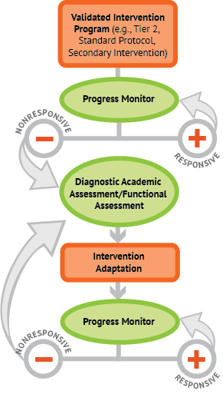

A Bird’s-Eye View of DBI
Notes:
Animated slide—click where underlined text appears to bring up arrows.
In the past, you may have used progress monitoring data to make group intervention decisions, but today we are focusing how progress monitoring is used to inform DBI. The same progress monitoring data that tells us a student is not responding to core instruction may also tell us that secondary intervention is not sufficient to help the student reach his or her academic goal. After the intervention has been adapted, we continue progress monitoring to determine if the changes have been sufficient or if we need to make additional changes.
A more complete overview of the DBI process is available in the introductory module that is available on the NCII website.

Slide 6
Types of Assessment
Type | When? | Why?
Summative | After | Assessment of Learning
Diagnostic | Before | Identify skill strengths and weakness
Formative | During | Assessment for Learning
Notes:
Animated slide—click on underlined text to circle Formative row.
Before we delve into progress monitoring assessments, it may be helpful to discuss the different kinds of assessments and how they are used.
Summative assessments are typically administered after instruction and tell us what a student learned (e.g., end-of-chapter tests, high-stakes tests, final exams).
Diagnostic assessments measure current knowledge and skills for the purpose of planning instruction (e.g., what to teach, selecting an intervention).
Formative assessments are administered during instruction and tell us how well students are responding to instruction (e.g., mastery measures, general outcome measures).
Progress monitoring is a standardized method of formative assessment.

Slide 7
Formative or Summative?
Educational researcher Robert Stake used the following analogy to explain the difference between formative and summative assessment:
“When the cook tastes the soup, that’s formative. When the guests taste the soup, that’s summative.”
(Scriven, 1991, p. 169)
Notes:
Read slide.

Slide 8
Assessments in Your School
What is an example of a summative assessment used in your school?
What is an example of a diagnostic assessment used in your school?
What is an example of a formative assessment used in your school?
Notes:
Possible examples:
Summative: state achievement tests, textbook unit tests, and final exams
Diagnostic: informal diagnostic assessments such as miscue or error analysis, decoding surveys, phonics inventories, or questioning on comprehension or problem-solving process; formal, standardized diagnostic tests such as Key Math
Formative: Oral Reading Fluency (ORF)/Passage Reading Fluency (PRF), math computation/calculation fluency (common tools: Dynamic Indicators of Basic Early Literacy Skills [DIBELS], AIMSweb, STAR)

Slide 9
Where Does Progress Monitoring
Fit In?
A standardized method of formative assessment tells us how well students are responding to instruction.
Progress monitoring tools have the following characteristics:
  Brief assessments
  Repeated measures that capture student learning
  Measures of age-appropriate outcomes
  Reliable, valid, and evidence based
Notes:
Read slide.
Later in the presentation, we will talk more about these characteristics and how we can review evidence to select appropriate tools.

Slide 10
Why Implement
Progress Monitoring?
Data allow us to…
Estimate the rates of improvement (ROI) across time.
Compare the efficacy of different forms of instruction.
Identify students who are not demonstrating adequate progress.
Determine when an instructional change is needed.
Notes:
You probably already know a lot about using progress monitoring data to place students in intervention groups or decide which interventions work best for your groups. Today we will focus on using progress monitoring data to track an individual student’s long-term growth as part of DBI.

Slide 11
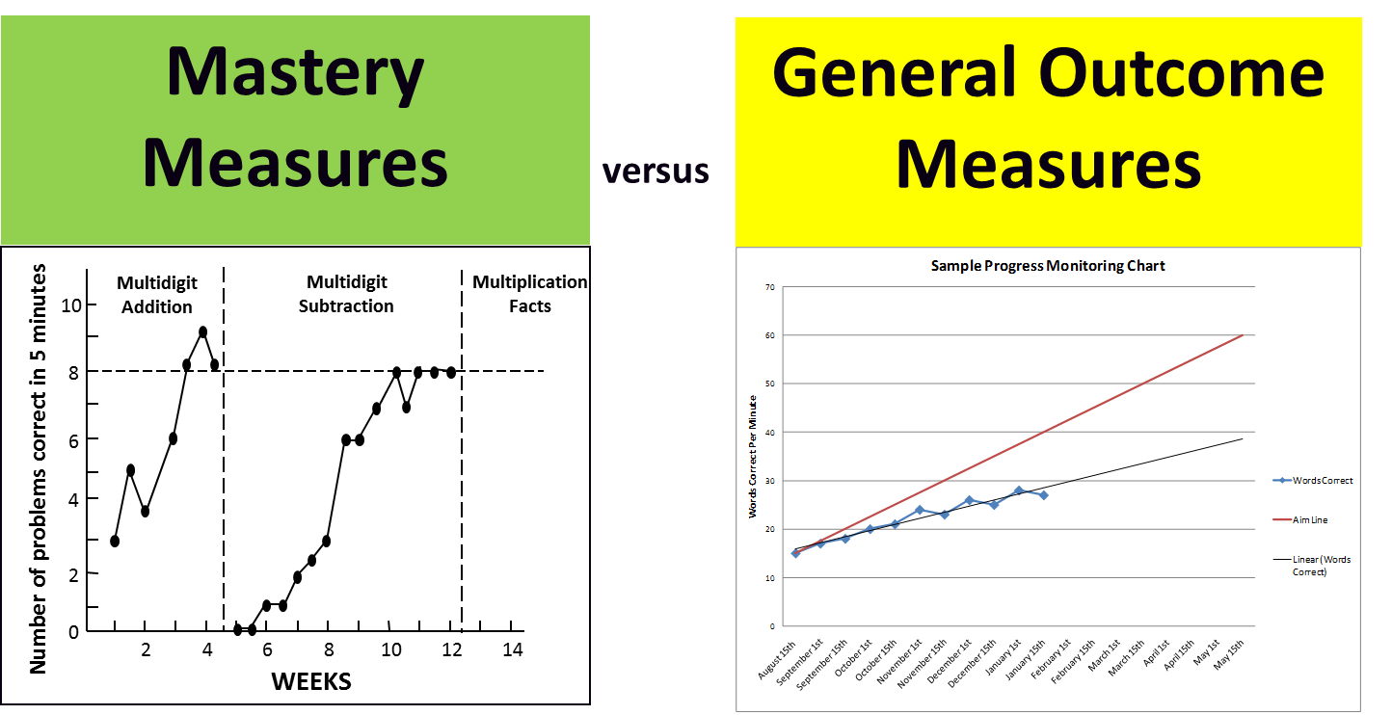
Approaches to Progress Monitoring
What is the difference?
Notes:
Animated slide—click on underlined text to remove red box.
Mastery measures and general outcome measures are two common progress monitoring approaches. One key difference between mastery measures and general outcome measures (GOMs) is the comparability of data longitudinally, or the ability to look at data across time. With GOMs, you can compare the score a student received in May to a score he or she had in September. This cannot be done with mastery measures because each subskill is tracked separately. These subskills do not necessarily correlate well with overall achievement.
This slide is adapted from slide 41 of RTI implementer series module 2: Progress monitoring (National Center on Response to Intervention, 2012).

Slide 12
Mastery Measures
Describe mastery of a single skill in a series of short-term instructional objectives.
Represent a logical, not an empirical, hierarchy of skills.
Do not reflect maintenance or generalization.
Do not relate well to overall achievement or performance on criterion measures (neither performance on a single mastery measure nor number of objectives mastered).
Notes:
Mastery measures let us know if a student is learning the specific skill currently being taught.
Examples: single digit subtraction or multidigit addition with regrouping, taught and assessed in isolation

Slide 13
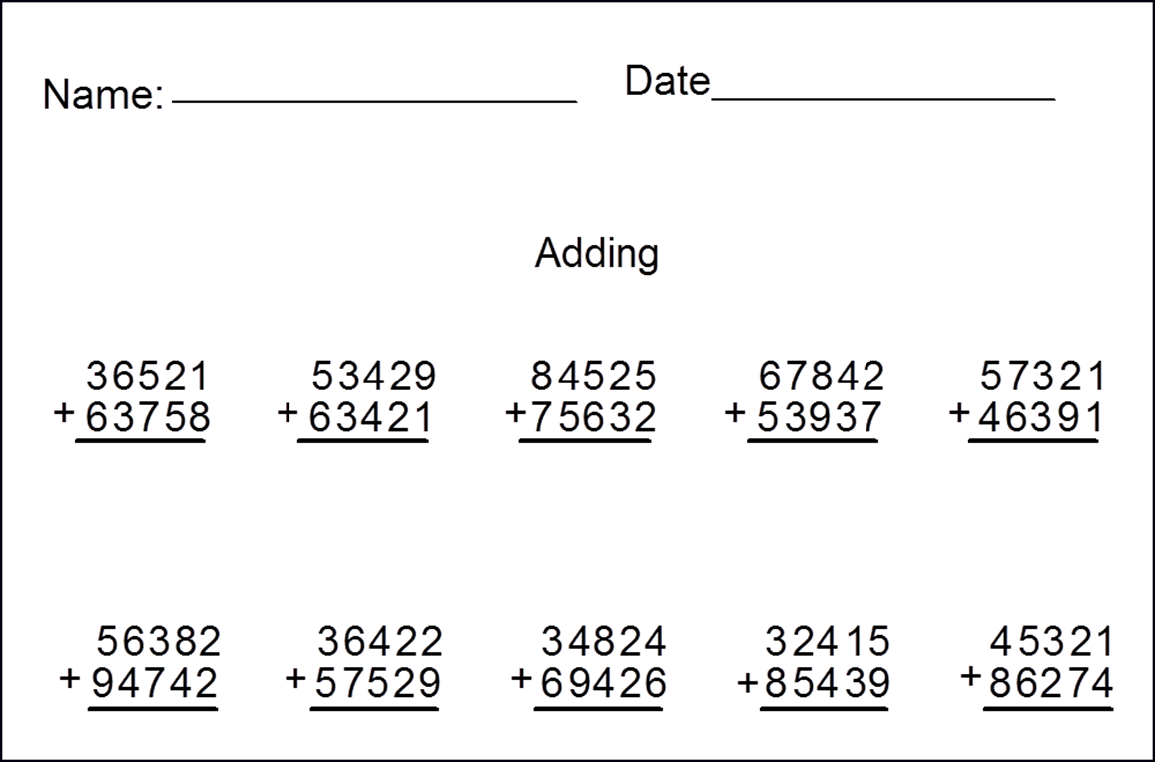
Example of a Mastery Measure: Multidigit Addition Test*
What makes this mastery measurement?
*This example is for illustrative purposes only.
Notes:
All of the problems are of the same type; mastery measures assess only one taught skill at a time.
This slide is adapted from slide 43 of RTI implementer series module 2: Progress monitoring (National Center on Response to Intervention, 2012).

Slide 14
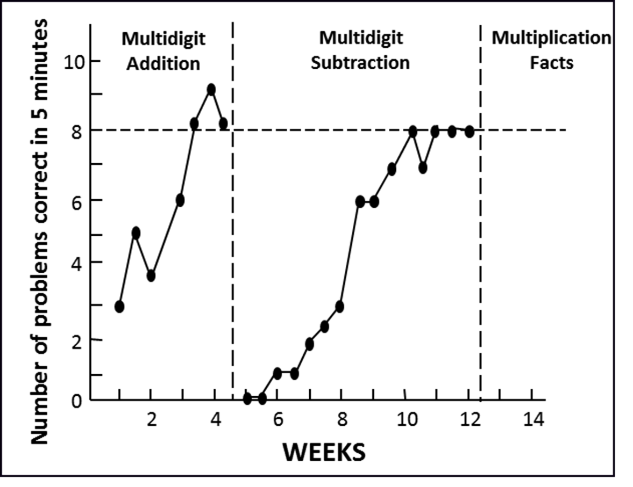
Example of a Mastery Measure Graph
Notes:
If you use mastery measures over a long period of time, you will be tracking different skills. You cannot compare the scores from multidigit subtraction to the scores from multidigit addition to see if a student is getting better in overall mathematics across time.

Slide 15
General Outcome Measures (GOM)
Reflect overall competence in the annual curriculum.
Incorporate retention and generalization.
Describe an individual student’s long-term growth and development (both current status and rate of development).
Provide a decision-making model for designing and evaluating interventions.
Notes:
GOMs often address the problems associated with mastery measures. They are program independent and can be used with any instructional approach. GOMs can serve as both screening and progress monitoring measures. Many curriculum-based measures (CBMs) are types of GOMs.

Slide 16
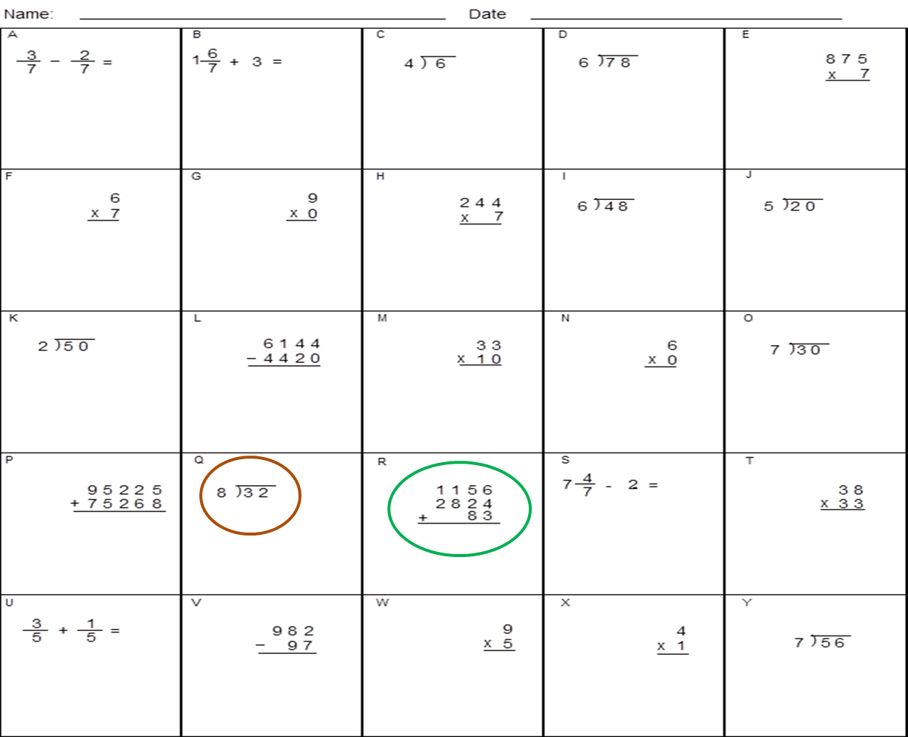
Mathematics Computation GOM Example
What makes this a general outcome measure?
*This example is for illustrative purposes only.
Notes:
A GOM reflects all skills in a yearlong curriculum, with random placement of problem types. By assessing all of the objectives in the curriculum, GOMs will be sensitive to growth as more skills are taught, regardless of the order in which they are taught. GOMs also allow teachers to determine if students are retaining taught skills and generalizing to skills that have not yet been taught.
This slide is adapted from slide 46 of RTI implementer series module 2: Progress monitoring (National Center on Response to Intervention, 2012).

Slide 17
Why Bother Monitoring Progress With General Outcome Measures
Number of Assessments/15 Weeks | Effect Size (SD) | Percentile Gain
0 | 0 | 0
1 | .34 | 13.5
5 | .53 | 20
10 | .60 | 22.5
15 | .66 | 24.5
20 | .71 | 26
25 | .78 | 28.5
30 | .82 | 29
Source: Bangert-Drowns, Kulik, and Kulik (1991); similar results found by Fuchs and Fuchs (1966).
Notes:
Animated slide—click on underlined text.
In this study by Bangert-Drowns, Kulik, and Kulik (1991), how frequently general outcome data were collected had a direct impact on student performance. Taking weekly data balances benefit with feasibility. Although collecting data twice a week was associated with slightly stronger student gains, we have to consider school resources and feasibility given the diminishing returns obtained from collecting data two or more times per week.
Note: For more information, see the following resources:
Bangert-Drowns, Kulik, and Kulik (1991).
Fuchs and Fuchs (1986).

Slide 18
Progress Monitoring Tools
  The following examples of reading and mathematics measures have been reviewed by the NCII’s technical review committee. In a few moments, we will show you how to use the Academic Progress Monitoring Tools Chart to learn more about these and other tools.
*NCII does not endorse products. Tools Chart reviews are informational, not recommendations, and any measures mentioned in this presentation are for illustrative purposes only.
Notes:
Read slide.

Slide 19
Common Reading Measures
Measures | Recommended Grades
Letter Naming Fluency (LNF) Letter Sound Fluency (LSF) Phoneme Segmentation Fluency (PSF) | K
Nonsense Word Fluency (NWF) | Late K–1
Word Identification Fluency (WIF) | 1
Passage Reading Fluency (PRF), also called Oral Reading Fluency (ORF) | Late 1–4
Maze or Maze Fluency | 4+
Notes:
For more information on selecting appropriate reading measures by grade, please see the NCRTI Screening Brief Predicting students at risk for reading and mathematics difficulties (National Center on Response to Intervention, 2013).

Slide 20
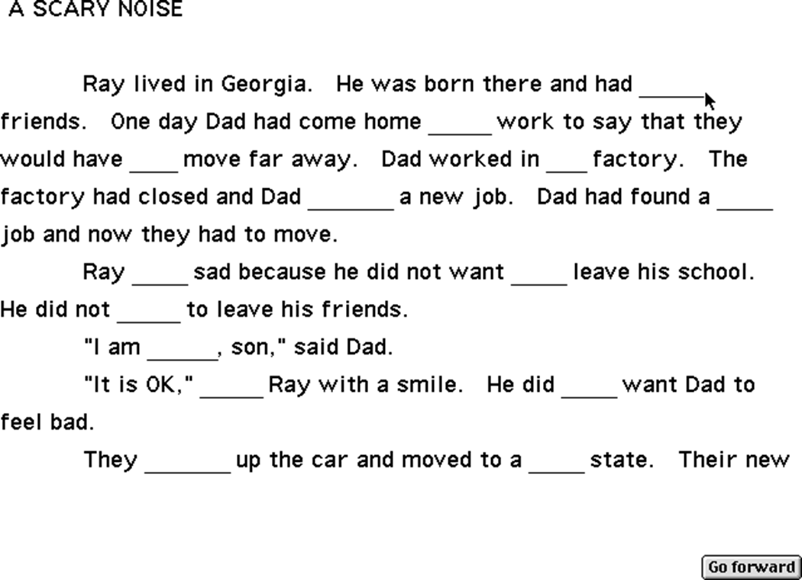
Example of a Maze Assessment
Notes:
This sample maze assessment was taken from the PowerPoint Introduction to Using CBM for Progress Monitoring in Reading (Stecker, Sáenz, & Lemons, 2007).

Slide 21
Common Mathematics Measures
Domain | Measures | Grades
Early numeracy | Oral Counting Next Number Number Identification Quantity Discrimination Missing Number | K–1
Computation | M-CBM Math Computation Number Facts | 1–8
Concepts and applications | Math Concepts and Applications Concepts Concepts/Applications | 2–8
Notes:
Review slide.
Note: Similar names for measures within a domain reflect the names of different products (by different manufacturers)
Note: Math-Curriculum Based Measurement (M-CBM) by AIMSweb has been discontinued and is no long available for purchase

Slide 22
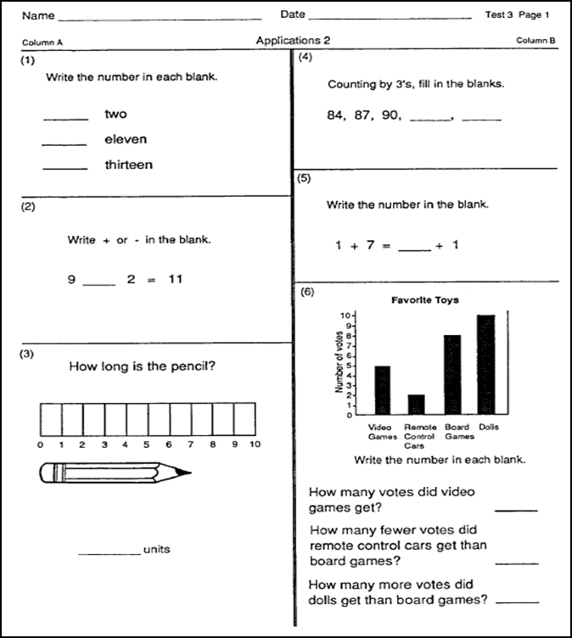
Example of Mathematics Concepts and Applications
Notes:
This sample mathematics applications assessment was taken from Introduction to Using CBM for Progress Monitoring in Reading (Stecker, Sáenz, & Lemons, 2007).

Slide 23
Considerations When Selecting or Evaluating a Tool
Skills to be measured—age and grade appropriate
Cost and training requirements
Administration and scoring time
Data management
Technical rigor (consider population)
Notes:
Technical rigor is measured against a specified population (e.g., by grade), sometimes by subgroup. Technical rigor incorporates several dimensions, which we will discuss next.

Slide 24
Dimensions of Technical Rigor
Reliability
Validity
Evidence of being sensitive to change
Alternate/parallel forms: different versions of the assessment that are of comparable difficulty
Notes:
Explanations for dimensions of technical rigor:
Reliability: Are scores accurate and consistent?
Validity: Does the assessment measure the underlying construct (the targeted skill)?
Sensitive to change: The extent to which a measure reveals long-term improvement, when improvement actually occurs.
Alternate forms: Are the different versions of the assessment of comparable difficulty?

Slide 25
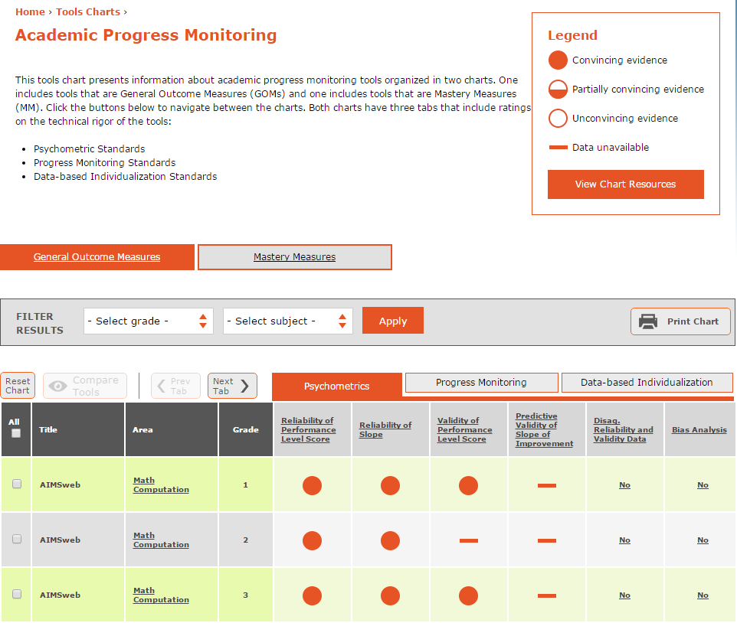
NCII Progress Monitoring Tools Chart
http://www.intensiveintervention.org/chart/progress-monitoring
Notes:
If possible, switch to a live demonstration for the next two slides, using the tools chart at http://www.intensiveintervention.org/chart/progress-monitoring. Show how to bring up additional information by clicking on different chart components. If using these animated slides, click at underlined text.
NCII has developed Academic Progress Monitoring Tools Charts that can be accessed through NCII’s website. Although NCII has made a tools chart for both mastery measures and GOMs, we will be focusing on GOMs today.
The tools may be sorted by grade level and subject. The ratings reflect three sets of standards: (1) psychometric standards, (2) progress monitoring standards, and (3) DBI standards. Click one of these tabs to see that set of standards. The bubbles on the tools chart are indicators of the technical rigor of the tools and may be filled completely, partially, or not at all. By clicking on a column title, you can sort tools by their evidence for that standard. Clicking on the info button (circled “i”) after each standard will bring up information on the standard and what the bubble ratings mean for that standard. Clicking on an evidence bubble for a tool will bring up the supporting information for the tool’s rating on that standard.
Many progress monitoring tools are available, but not all are listed on the chart. Only tools that have been submitted by the tool vendor appear on the chart. When selecting a tool, it is important to consider both the technical rigor of the tool and your needs and priorities. The tools chart does not recommend tools; it provides users with a consumer report on available tools, similar to what you may find when searching for a car.

Slide 26
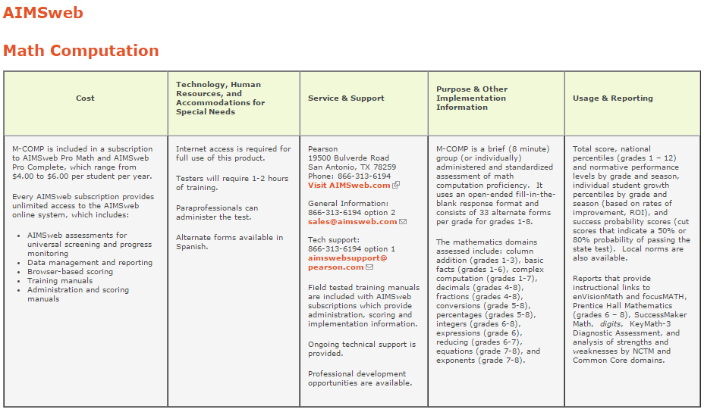
Learning More About a Progress Monitoring Tool
Notes:
Animated slide—click on underlined column headers below to bring up each circle.
Clicking on the name of an intervention will bring up a page like this.
The first part of the page provides a summary table with information on the following:
Cost of the tool
Resources needed to use the tool
Service and support
Purpose and content of assessments
Data and reports
Scrolling further down this page will bring you to the evidence for all of the technical standards.

Slide 27
Activity: Using the Tools Chart
Set the chart to show elementary reading tools and answer the following questions with a partner.
  Find at least two products offering the maze reading assessment.
  Which ORF tool has convincing evidence for disaggregated reliability and validity data?
  How many parallel forms are available for AIMSweb’s PSF measure?
  If time allows, click on the link near the top of the chart to view the Progress Monitoring Mastery Measures Tools Chart.
    Which chart has more tools reviewed?
    Which mastery measures have convincing evidence in most standards?
Notes:
Work in pairs or small groups to answer these questions using the tool chart.
Note: The Mastery Measures Tools Chart is available at http://www.intensiveintervention.org/chart/progress-monitoring-mm.
Answers:
CBM-R, Edcheckup, YearlyProgressPro
CBM-R (under DBI standards tab)
30 for K and 1 (under progress monitoring standards, click bubble under Alternate Forms, see section 2, Number of alternate forms of equal and controlled difficulty)
(a) There are many more GOMs compared to mastery measures. (b) None of the reading mastery measures have convincing evidence in any standard. Both mathematics tools have convincing evidence in all of the psychometric and progress monitoring standards. Accelerated Math has convincing evidence in three of the four DBI standards, whereas MathFacts in a Flash does not have convincing evidence for any.

Slide 28
Progress Monitoring Quick Review
What is an example of a mastery measure?
What is an example of a GOM?
Which type of progress monitoring assessment would you use if you want to track a student’s overall growth in reading during the course of the school year?
Notes:
Sample answers:
Single digit subtraction, multidigit addition with regrouping, word lists with consonant-vowel-consonant words or words starting with C
DIBELS ORF, AIMSweb PSF, LNF, mathematics computation or concepts and applications
GOM

Slide 29
Additional Considerations
Notes:
Now we will discuss additional considerations for progress monitoring for individual students with certain characteristics.

Slide 30
Should We Ever Assess Off-Level…? Consider the Purpose of the Assessment
Screening to identify students at risk for poor learning outcomes should always occur at grade level and do the following:
Determine students’ response to grade-level core instruction.
Assess performance relative to grade-level expectations.
Provide schoolwide data regarding the percentage of students in each grade level who are at or below benchmarks.
Notes:
Read slide.

Slide 31
Should We Ever Assess Off-Level…? Consider the Purpose of the Assessment
Progress monitoring should be done at grade level when possible, but the following is also applicable:
It must also match a student’s instructional level.
If a student’s performance is well below grade-level expectations, grade-level probes are unlikely to be sensitive to growth.
Off-level assessment may be warranted in these cases.
Notes:
Read slide.

Slide 32
Off-Level Assessment Procedures: Reading Example
Administer three reading fluency passages at the grade level at which you expect the student to be functioning by the end of the year.
  If the student reads < 10 correct words per minute (cwpm), use an early literacy measure (e.g., WIF).
  If 10–50 cwpm but < 85–90 percent correct, administer three passages at the next lower level.
  If > 50 cwpm, move to the highest level of text where student reads 10–50 cwpm (but not higher than grade level).
Monitor progress at this level for the entire school year.
(Fuchs & Fuchs, 2007)
Notes:
Vendors may provide product-specific instructions for determining the appropriate level of assessment. These instructions are taken from Using CBM for progress monitoring in reading (Fuchs & Fuchs, 2007).

Slide 33
Off-Level Assessment Procedures: Mathematics Example
On two separate days, administer Mathematics Computation or Concepts and Applications at the grade level at which you expect the student to be functioning at year’s end. Use the correct time limit for the test at the lower grade level.
If the student’s mean score is 10–15 digits or blanks, use this lower grade-level test.
If < 10 digits or blanks, move down one more grade level.
If > 15 digits or blanks, reconsider grade-appropriate material.
(National Center on Student Progress Monitoring, n.d.)
Notes:
Note: Participants may ask if this can occur on a single day. Ideally, assessment will occur over two separate days to get a better picture of the student’s average performance (e.g., a student may perform worse than usual on a given day as a result of factors other than the student’s mathematics skills).
As in reading, vendors may provide product-specific instructions for determining the appropriate level of assessment. These instructions are taken from Introduction to using curriculum-based measurement for progress monitoring in math (National Center on Student Progress Monitoring, n.d.).

Slide 34
How Can I Confirm or Augment Data Collected With General Outcome Measures?
In some cases, particularly when working with older students, it may be worthwhile to augment traditional progress monitoring tools. For example,
  As reading rates plateau, PRF loses its usefulness as a progress monitoring tool for older students.
  In mathematics, we may want to investigate strategy use to understand students’ errors, mathematical thinking, or low fluency.
Brief interviews can help corroborate progress monitoring data or gain new information.
Notes:
PRF is a type of ORF where students read connected text (e.g., passages). ORF is an umbrella term that encompasses PRF but may also refer to other tasks, such as word reading fluency. For the purpose of this presentation, we use PRF when referring to reading connected text.

Slide 35
Sample Interview Questions to Augment Reading GOM data
Comprehension questions for GOM probes:
What was this mostly about?
  Prompts: (a) Tell me more. (b) What more can you say?
What happened?
  Prompts: (a) What else happened? (b) What more happened?
Questions for text-based inquiry activities:
What strategy can you use to find an answer to this question?
What section of the text supports your answer?
Notes:
Read slide.

Slide 36
Sample Interview Questions to Augment Mathematics Progress Monitoring Data
What strategy did you use to get this answer?
Can you explain why your strategy produced the correct response?
For what kind of problems will this strategy work?
Notes:
Read slide.

Slide 37
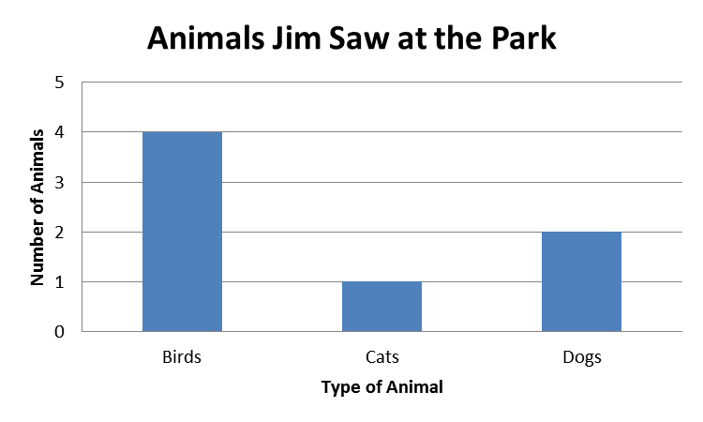
Optional Practice: Asking Students About Strategies
When Jim went to the park, how many more birds than dogs did he see?
Notes:
Directions:
Find a partner or a small group.
Assign one person to be the teacher and another to be the student.
The teacher should try to find out how the student arrived at his or her answer to this worksheet problem.

Slide 38
Optional Practice: Asking Students About Strategies
Discussion questions:
What type of questions did the teacher ask the student?
How might you vary your questions based on the type of mathematics problem or by student characteristics?
What skills did the student need to be able to solve this problem?
What terminology might the student need to explain how to solve this problem?
Notes:
Discuss these questions in your group. If time allows, discuss as a large group.
Sample answers:
Examples could include the following:
What strategy did you use to solve this problem?
How did you find this answer?
How do you know this is the answer?
Why do you think this is right?
Some questions might include specific terminology for a certain type of problem or focus on a specific step in a problem-solving strategy. Complexity of the question content and language may vary based on student age and skills.
Possible skills needed/steps to perform:
Read problem.
Read graph labels.
Identify bar graph quantities.
Identify subtraction as the operation to answer the question.
Correctly set up the subtraction problem based on the information in the problem and the graph.
Correctly compute the subtraction problem.
Bar graph, number/amount/quantity, subtract, difference, more than, strategy

Slide 39
Break
Notes:
Provide participants with a 10–15 minute break, depending on time.

Slide 40
Making Instructional Decisions for Individual Students
Using progress monitoring data to determine current status, set goals, and evaluate growth
Notes:
Now we will discuss how academic progress monitoring fits into the DBI process and can be used to make instructional decision for students with intensive needs.

Slide 41
Quick Review:
DBI Process
Notes:
Animated slide—click where underlined text appears to bring up boxes.
In the DBI process, we progress monitor to determine if a student is responsive or nonresponsive to the intervention so that we can decide if a change is needed. When we do make a change, we continue progress monitoring to see if a student’s performance improves. A student’s responsiveness is determined relative to his or her baseline performance and the goal we want him or her to achieve.

Slide 42
Steps for Using
Progress Monitoring Data
Establish a baseline.
Set a goal.
Analyze data to make decisions.
Notes:
Provide audience with Handout 1: Academic Progress Monitoring Overview.
Before we can analyze data to make instructional decisions, we need to use the data we collect to establish a baseline and set a goal. This handout will allow you to reference information about each step as we work through examples.

Slide 43
Step 1: Establish a Baseline
To begin progress monitoring, you need to know a student’s initial skill level.
A stable baseline is important for goal setting.
Baseline options:
  Use the median score of the most recent three probes (if collected in one sitting).
  Use the mean of the most recent three data points (if collected over three sittings).
Notes:
Read slide.

Slide 44
Quick Mathematics Review:
Mean and Median
Mean
Arithmetic average
Sum of all scores divided by number of scores
Median
Middle number in an ordered list
If you have an even number of scores, take the average of the two middle scores.
Notes:
Read slide.

Slide 45
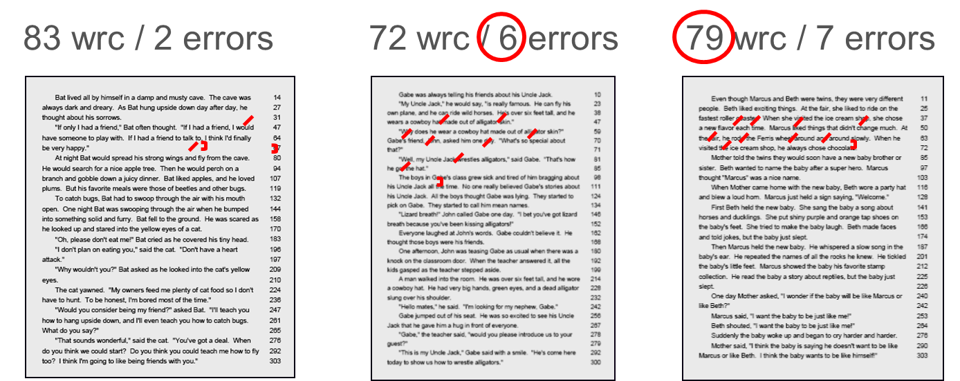
Example: Finding the Baseline Score Using the Median
Notes:
The median is used when multiple scores are collected in a single sitting, such as when three PRF passages are read. For this PRF assessment, scores are presented as words read correct (wrc) divided by errors. We take the median of both words read correctly and errors in this example. Using the median helps to reduce the influence of outliers, or extreme scores.
This slide is adapted from slide 83 of RTI implementer series module 2: Progress monitoring (National Center on Response to Intervention, 2012).

Slide 46
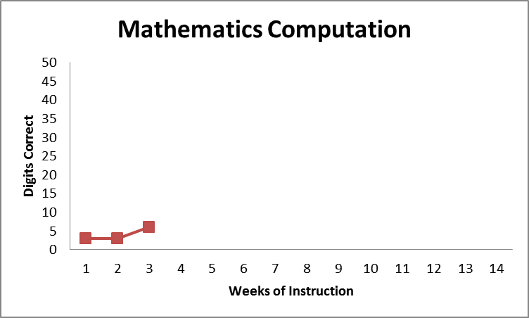
Example: Finding the Baseline Score Using Means
When baseline assessments are conducted on different days (e.g., three data points over three weeks), we use the mean of the most recent three scores (we will use this method in today’s examples).
Baseline Mean =
(3 + 3 + 6)/3 = 4
Notes:
Read slide.

Slide 47
Small Group Discussion: Baseline
When progress monitoring your students in secondary or intensive intervention, do you have a standard procedure for determining the baseline score?
If your progress monitoring tool has a data system that provides a baseline score, do you know which method is used (mean or median)?
Notes:
Give the audience time to discuss in small groups and then a chance to share or ask questions, as needed.

Slide 48
Step 2: Set Goals
There are three approaches to setting goals:
Benchmarking
National norms for weekly ROI
Intra-individual framework
Notes:
Options 1 and 2 may be a review for many of you. Many software programs use these or similar methods to set goals. Even if you use software to generate goals, it is useful to understand how they are calculated.

Slide 49
Option 1: Using Benchmarks
Benchmark: A level of performance on an assessment that is predictive of proficiency
Identify appropriate grade-level benchmark
  If progress monitoring off-level, use benchmarks for the grade of the assessment being used.
  Make sure the benchmark matches the time frame of the instructional period you want to monitor.
Mark benchmark on student graph.
Draw goal line from baseline to benchmark.
Notes:
Read slide.

Slide 50
Option 1: Setting Goals
With Benchmarking
Grade | Reading Task | Computation | Concepts and Applications
Kindergarten | 40 sounds/minute (LSF) | — | —
Grade 1 | 60 words/minute (WIF) | 20 digits | 20 points
Grade 2 | 75 words/minute (PRF) | 20 digits | 20 points
Grade 3 | 100 words/minute (PRF) | 30 digits | 30 points
Grade 4 | 20 replacements/2.5 minute (Maze) | 40 digits | 30 points
Grade 5 | 25 replacements/2.5 minute (Maze) | 30 digits | 15 points
Note: These figures are specific to certain tools and may change pending further research. This example is used for illustrative purposes only. Tools vary and may provide benchmarks for the end of the year or for fall, winter, and spring.
(NCRTI, 2012)
Notes:
Here’s a sample benchmark table. The reading tasks are from Let’s Set a Math Computation Goal for a 3rd Grader. Click to circle.
These end-of-year benchmarks are for reading assessments from Curriculum-Based Measurement in Reading and mathematics assessments from Monitoring Basic Skills Progress.
This table is adapted from slide 91 of the RTI Implementer Series Module 2: Progress Monitoring PowerPoint (National Center on Response to Intervention, 2012).

Slide 51
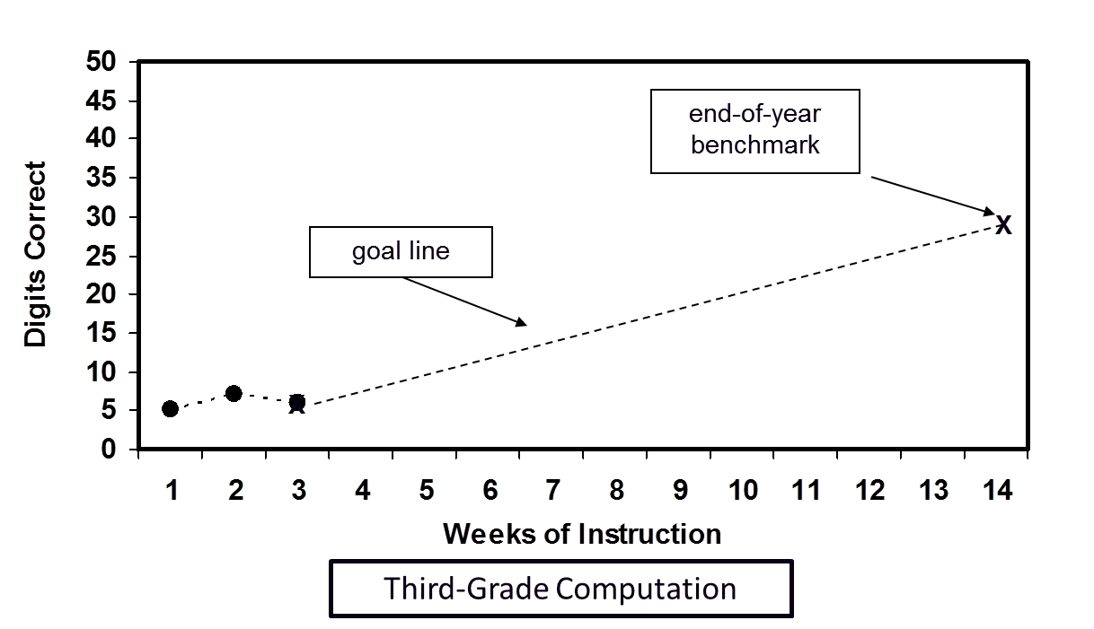
Option 1: Setting Goals With
End-of-Year Benchmarking
Notes:
On this graph, the baseline score is marked with an X at the most recent baseline data point. Another X marks the benchmark of 30 digits. The goal line connects these two points.

Slide 52
Discussion: Using Benchmarks
What are the advantages of this approach?
Easy-to-use when progress monitoring tool provides benchmarks.
Tracks progress toward grade-level expectations.
Can you think of special considerations in using this approach for students with intensive needs?
Goal may not be feasible for students performing far below grade level.
Notes:
Animated slide—click to bring up first set of bullets and then the second set.

Slide 53
Option 2: Setting Goals With Norms for Weekly Rate of Improvement
Average growth per week (ROI) for a certain measure (e.g., third-grade PRF) can be used to calculate a goal:
GOAL = ROI × # Weeks + Baseline Score
# weeks = number of weeks left in the instructional period (when we want the goal to be reached).
Baseline score is calculated using the three most recent data points.
Notes:
Read slide.

Slide 54
Example: Setting Goals With National Norms for Weekly ROI
Grade | Reading—Slope | Computation CBM—Slope for Digits Correct | Concepts and Applications CBM—Slope for Points
K | 1.0 (LSF) | — | —
1 | 1.8 (WIF) | 0.35 | No data available
2 | 1.5 (PRF) | 0.30 | 0.40
3 | 1.0 (PRF) | 0.30 | 0.60
4 | 0.40 (Maze) | 0.70 | 0.70
Note: These figures are specific to a certain tool and may change pending further research. This example is used for illustrative purposes only.
Notes:
Animated slide—click at underlined text to bring up circle.
Here is an example growth chart for elementary reading and mathematics. If we monitor progress with second-grade math computation, we would use the chart to identify 0.30 correct digits per week as the typical growth rate.

Slide 55
Example: Setting Goals With National Norms for Weekly ROI
Fourth-grade mathematics computation
Baseline scores: 10, 9, 11 (collected weekly)
Time frame: 10 weeks left in the instructional period
ROI = .7
Grade | Computation—ROI for Digits Correct
1 | .35
2 | .30
3 | .30
4 | .70
5 | .70
6 | .40
Notes:
Review slide. Sample workout on next slide.

Slide 56
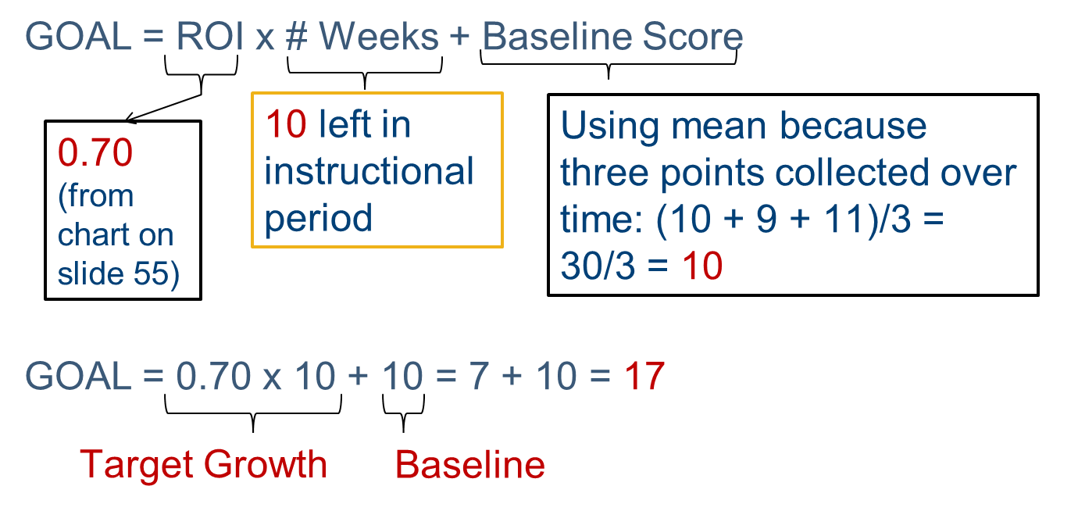
Example: Setting Goals With National Norms for Weekly ROI
Notes:
Review slide.

Slide 57
Option 2: Setting Goals With National Norms for Weekly ROI
Considerations for using ROI for goal setting:
If a student is behind, matching the ROI norm will maintain the same level of achievement gap.
Some progress monitoring tools provide recommendations for “ambitious” ROIs.
How might you estimate expected weekly growth if ROI norms are not provided?
  Use local norms.
  Estimate by dividing growth between benchmark periods by the number of weeks of instruction.
57
Notes:
Additional explanations are provided below. Use as needed.
Norms are established based on what is considered good growth. Growth may vary based on the domain being assessed.
“Realistic” is often considered what students would make given decent instruction. “Ambitious” should, at a minimum, be more than the average growth, otherwise the performance gap will be maintained, not closed. Some progress monitoring tool publishers have recommendations for using the growth rates they provide. For example, AIMSweb recommends doubling the growth rate found at the percentile rank in which the student currently performs. Using the recommendations from AIMSweb, if a student’s baseline is in the 10th to 25th percentile and the growth rate for students at that performance level is 0.6 wrc, then the ambitious growth rate would be 1.2 wrc. If 0.6 wrc were used, the student would be likely to maintain or increase the achievement gap. It is important to contact the publisher to clarify how to best use the growth rates it offers.
In comparing local versus national norms, the benefits of local norms include correlations with state testing outcomes and comparisons within the district or state. Challenges with local norms include small sample size, norms being unavailable, and the potential to lead to lower expectations. For national norms, the benefits include a large sample size and established cut scores, but the challenges include inequities in school resources, which can lead to over- or underidentification.
57

Slide 58
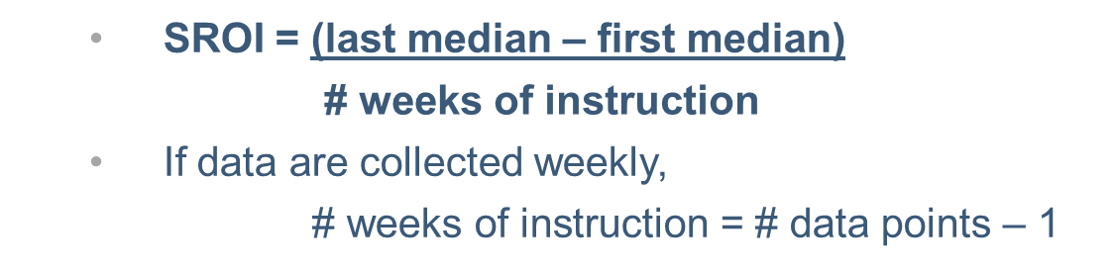
Option 3: Setting Goals With
Intra-Individual Framework
Often used for students performing far below grade level or with very low skills, where typical growth rates are not appropriate.
Use three most recent data points to calculate baseline score.
Calculate student’s ROI (SROI) based on at least eight data points. Use software when available (more accurate) or estimate using the following equation:
Notes:
The third option, intra-individual framework, is often used for setting individualized education program (IEP) goals or for those students performing far below grade level. To use this option, identify the weekly rate of improvement for the target student under baseline conditions, using at least eight data points. Because the student’s performance is being compared to his or her previous performance (not a national or local norm), enough data are needed to demonstrate the existing performance level or rate.
Software will provide a more accurate estimate of SROI. When software is not available, SROI can be estimated by hand. This formula represents just one of various approaches. When eight data points are available, the last median will be based on the last three scores, and the first median will be based on the first three scores.

Slide 59
Option 3: Setting Goals With Intra-Individual Framework
Why 1.5?
We know the current SROI is not sufficient to close the achievement gap; we want to increase growth at least by half (x 1.5).
A more ambitious goal may be set if appropriate (e.g., if after several weeks of progress monitoring, the current SROI exceeds the goal SROI).
Never lower the goal!
Notes:
Explanation of formula: SROI is multiplied by 1.5 and the number of weeks left in the instructional period. This product, representing target growth, is then added to the student’s baseline score, based on the three most recent data points, to find the goal.

Slide 60
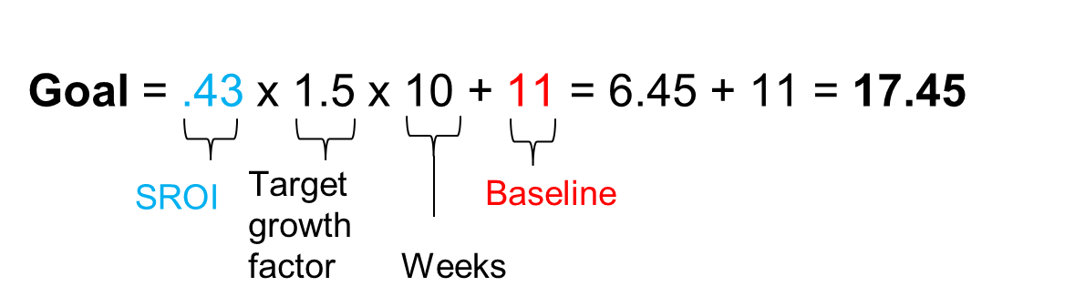
Example: Setting Goals With Intra-Individual Framework
Eight most recent scores (over seven instructional weeks): 8, 7, 9, 8, 11, 10, 11, 12
Ten weeks left in instructional period
SROI = (last median – first median)/weeks
= (11 – 8)/7 = 3/7 = .43
Baseline Score = mean of three most recent scores
= (10 + 11 + 12)/3 = 33/3 = 11
Notes:
Review slide.

Slide 61
Will Collecting Eight Data Points Delay Important Decisions?
In the previous example, SROI was calculated using eight data points from seven weeks of instruction.
This does NOT necessarily mean we have to wait seven weeks to make an instructional decision.
We can use progress monitoring data that we have already collected for this student.
  Draw data from a goal that had been set using a different option, such as benchmarks.
  Use data from the year preceding setting of the new individualized education program (IEP) goal.
Notes:
Read slide.

Slide 62
Using Progress Monitoring Data to Write Present Levels of Performance
Describe concrete, measurable skills that have relevance to overall competence in a domain (e.g., reading, mathematics).
Use a valid and reliable assessment tool.
Focus on outcomes.
  What outcomes are desired?
  What do present levels say about a student’s current progress toward meeting those outcomes?
  Compare to peers or proficiency standards.
Notes:
Read slide.

Slide 63
Describing Present Levels and Choosing a Goal for a Student Who Requires Individualized Planning
Meet Andrew:
Second grade
Specific learning disability with eligibility in basic reading
Notes:
Read slide.

Slide 64
Andrew: Initial Grade-Level Screening
Second graders at Andrew’s school are screened with second-grade PRF probes, using the median cwpm of three passages administered in one sitting.
Andrew read 7, 5, and 9 cwpm, yielding a median score of 7 cwpm.
Scores < 10 cwpm suggest PRF is too difficult for Andrew.
What should the team do?
Notes:
Read slide.

Slide 65
Andrew: Verifying Screening Scores
The team decided to administer three more passages on a different day to verify Andrew’s initial scores.
Follow-up scores: 4, 11, 6 (median is 6 cwpm).
These scores confirmed that PRF will not be a sensitive measure of growth for Andrew’s reading skills, and off-level assessment may be warranted.
Team determined first-grade WIF was more appropriate for Andrew’s skill level.
Notes:
Read slide.

Slide 66
Andrew: Team Decision on Progress Monitoring Plan
WIF scores were collected weekly so that eight scores would be available to calculate Andrew’s SROI:
  9 cwpm
  8 cwpm
  11 cwpm
  10 cwpm
  12 cwpm
  13 cwpm
  15 cwpm
  14 cwpm
Notes:
Review slide.

Slide 67
Andrew: Sample Excerpt of Present Levels of Performance (PLP)
Andrew is a second-grade boy who qualifies for special education in the area of basic reading. On second-grade PRF assessments, his median score of 7 cwpm (median of three passages administered in a single sitting) places him at high risk, suggesting he will have difficulty meeting the end of year standard of 75 cwpm. A median score of 6 cwpm on three passages administered on a separate day verified the initial score.
Notes:
Note: This example is not a comprehensive PLP section; It is intended as an excerpt to illustrate how progress monitoring data may be reported in a PLP and linked to an IEP goal (see subsequent slides).

Slide 68
Andrew: Sample Excerpt of Present Levels of Performance (PLP)
These scores also suggest that the second-grade PRF is unlikely to detect improvement in Andrew’s reading skills at this time, so his progress will be monitored using the first-grade WIF during the coming year. On WIF, he reads at a mean rate of 14 cwpm (mean of three most recent data points). This score falls within the range that suggests WIF will detect Andrew’s overall improvement in reading throughout the year.
Notes:
Read slide.

Slide 69
Handout 2: Setting a Goal for Andrew
Working alone or in small groups, set a goal for Andrew using each of the following methods:
  Benchmarking
  Weekly ROI norms
  Intra-individual framework
Assume 24 weeks of instruction between now and the end of the school year.
Notes:
Provide audience with Handout 2. Give them time to work before bringing up solutions on the following slides.

Slide 70
Andrew Option #1: Goal Setting Using Benchmarks
Grade | Reading Task
Kindergarten | 40 sounds/min (LSF)
Grade 1 | 60 words/min (WIF)
Grade 2 | 75 words/min (PRF)
Which benchmark do we use for Andrew— first grade or second grade?
Notes:
Click to bring up highlighted box after posing question.
Answer: We use the norms for the level of assessment where we are monitoring.

Slide 71
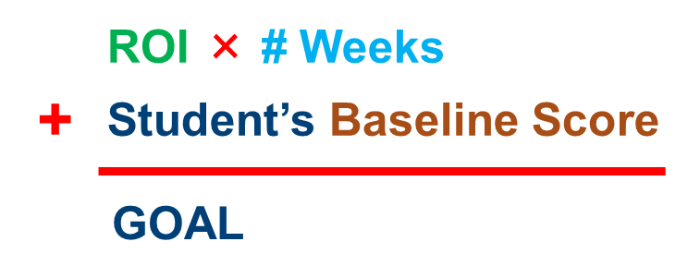
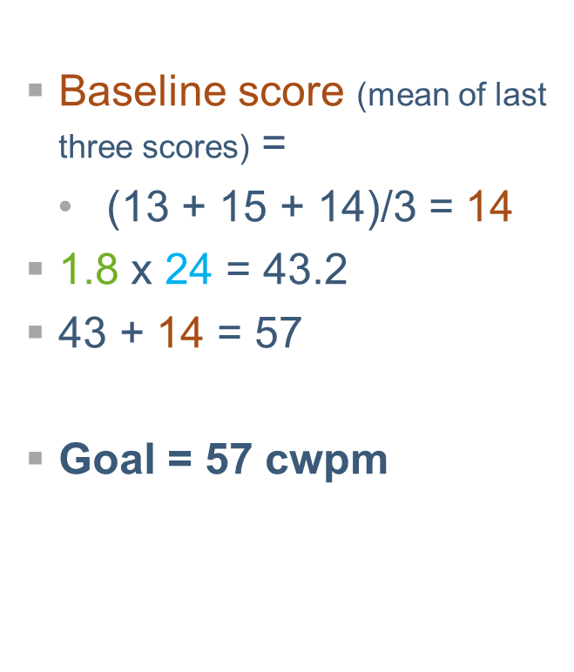
Andrew Option #2:
Weekly ROI Norms
Grade | Reading—ROI
K | 1.0 (LSF)
1 | 1.8 (WIF)
2 | 1.5 (PRF)
3 | 1.0 (PRF)
Notes:
Animated slide—click on underlined text.
To review, this is the formula for calculating a goal based on ROI norms. First, we calculate Andrew’s baseline score by taking the mean of his most recent three WIF scores. Looking at a table of Reading ROI norms by grade, we select the first-grade WIF measure because that is what we are using to monitor Andrew’s progress. We multiply this ROI by the 24 remaining weeks of instruction. We round this product to 43 and add it to the baseline score to get our goal of 57 cwpm.

Slide 72
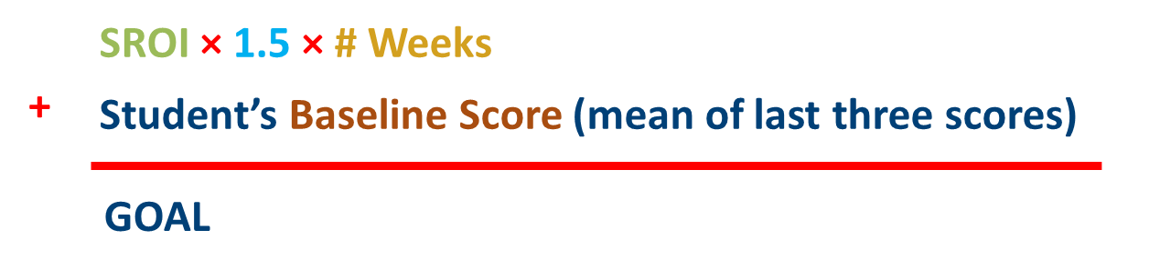
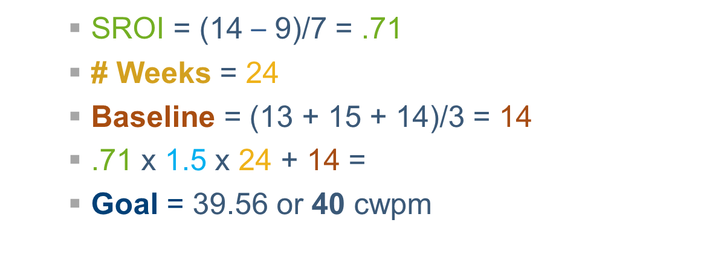
Andrew Option #3:
Intra-individual Framework
Notes:
Animated slide—click on underlined text. Reminder: SROI = (third median – first median)/weeks of instruction
This is the formula for calculating Andrew’s goal using the intra-individual framework. First, we need to calculate Andrew’s SROI. We take the median of his last three scores, which is 14, and subtract the median of the first three scores, which is 9. We then divide by 7, the number of weeks of instruction during this baseline period, to find his SROI of .71. The # Weeks is the 24 weeks of instruction left in the school year. His baseline score is the mean of his most recent three scores. Now that we have all the needed pieces, we multiply his SROI by 1.5 and 24 weeks and then add his baseline score of 14. We round to find the goal, which is 40 cwpm.

Slide 73
Choosing a Goal for Andrew
The three methods resulted in different goals:
End-of-year benchmarking: 60 cwpm
ROI norms: 57 cwpm
Intra-individual framework: 40 cwpm
Are national norms too ambitious for Andrew, or do we think we can increase his current ROI by more than 1.5x with a change in intervention?
How does his SROI compare to national or local norms for ROI?
Do we know his history of reading growth in previous school years?
Notes:
SROI = .71
National first-grade WIF ROI = 1.8

Slide 74
Choosing an Option: National Norms
Pros
Ambitious
Goal puts student on track to close achievement gap
Cons
May be unrealistic if student is very far behind
Recommendation: Use national norms if a student is close to grade level
Notes:
Animated slide—click to bring up box after reviewing pros and cons.

Slide 75
Choosing an Option: ROI
Pros
Still fairly ambitious
May be reasonable for children who can learn at the normal rate
Cons
May not close the gap with peers (may need higher than normal ROI to reach next benchmark)
Recommendation: Use ROI if a student can learn at a typical rate but the benchmark is too high
Notes:
Animated slide—click to bring up box after reviewing pros and cons.

Slide 76
Choosing an Option:
Intra-individual Framework
Pros (may be appropriate if…)
Benchmark is unrealistic.
ROI has been persistently very low.
Cognitive delays or other impairments suggest faster ROIs are not feasible.
Cons
Likely the least ambitious of the three options
Won’t close the gap with peers
Recommendation:
Data or prior experience suggest other approaches unlikely to be appropriate or realistic.
Revisit data frequently, increasing goal if possible.
Notes:
Animated slide—click to bring up box after reviewing pros and cons.

Slide 77
Andrew: Choosing a Goal
Review key information about our second grader:
  He is currently being assessed with first-grade WIF.
  His progress will be judged against first-grade benchmarks.
  His ROI is 0.71 cwpm per week.
  The national ROI norm for first-grade WIF is 1.8.
What should we do?
Notes:
Read slide.

Slide 78
Andrew: Choosing a Goal
The intra-individual framework may be most appropriate for Andrew, if the team’s knowledge of his history supports this decision.
If he exceeds his goal, it can be raised; Andrew’s teacher should watch this closely.
Notes:
Read slide.

Slide 79
Andrew: Setting IEP Goals and Objectives Using Progress Monitoring Data
Using Andrew’s WIF data to find his SROI, we have calculated an end-of-year goal of 40 cwpm based on the intra-individual framework.
Shorter-term objectives can be set by dividing the growth needed to reach his goal across reporting periods.
Given his baseline score of 14 cwpm, Andrew needs to gain 26 cwpm by the end of the year.
Notes:
Read slide.

Slide 80
Andrew: Setting IEP Goals and Objectives Using Progress Monitoring Data
If objectives are set for each of two grading periods before the final goal, Andrew needs to grow at least 8–9 cwpm per period to gain a total of 26 cwpm by the end of the year
(26/3 = 8.67).
Time Frame | Target Score | Gain Needed
Objective 1 | 22 cwpm | 8 cwpm (from baseline of 14 cwpm)
Objective 2 | 31 cwpm | 9 cwpm
End of year | 40 cwpm | 9 cwpm
Notes:
Read slide.

Slide 81
Andrew: Sample IEP Goal and Objectives
Goal: Andrew will improve his reading skills to 40 cwpm on WIF by the June reporting period. Achievement of this goal will be determined by averaging his final three WIF scores.
Long-Term Objectives
Andrew will improve his reading skills to 22 cwpm by the December reporting period. Achievement of this objective will be determined by averaging his final three WIF scores of the grading period.
Andrew will improve his reading skills to 31 cwpm by the April reporting period. Achievement of this objective will be determined by averaging his final three WIF scores of the grading period.
Notes:
Read slide.

Slide 82
Step 3: Analyzing Data to Make Decisions
Progress monitoring data help us decide when instructional changes need to be made.
  If a student is not sufficiently responding to the standardized secondary platform, begin the DBI process.
  If the response to individualized intervention is not adequate, make new adaptations or change intervention.
Notes:
Progress monitoring data help us decide when a change needs to be made but not necessarily what changes should be made (use diagnostic assessment to identify instructional needs).
Note: Informal academic diagnostic assessment will be addressed in a subsequent module.

Slide 83
Quick Review: DBI Process
Notes:
Analyzing the data will help us determine if a student is responsive or not, which will tell us if we should continue with the current intervention or make a change.

Slide 84
How Much Data Do I Need to Make a Good Decision?
As the number of data points increases, the effects of measurement error on the trend line decreases.
Christ and Silberglitt (2007) recommended six to nine data points.
More frequent progress monitoring allows instructional decisions to be made sooner.
Recommend weekly assessment for intensive interventions.
Notes:
Read slide.

Slide 85
Method #1: Four-Point Rule
After six data points have been collected, examine the four most recent data points.
If all four are above the goal line, increase the goal.
If all four are below the goal line, make an instructional change.
If the four data points are both above and below the goal line, keep collecting data until the four-point rule can be applied (or consider trend analysis—coming up).
Notes:
Read slide.

Slide 86
Practicing the Four-Point Rule
The next two slides show graphed data for students in our secondary intervention platform.
For each student, do the data suggest a need for diagnostic assessment and individualized intervention?
Notes:
Read slide.

Slide 87
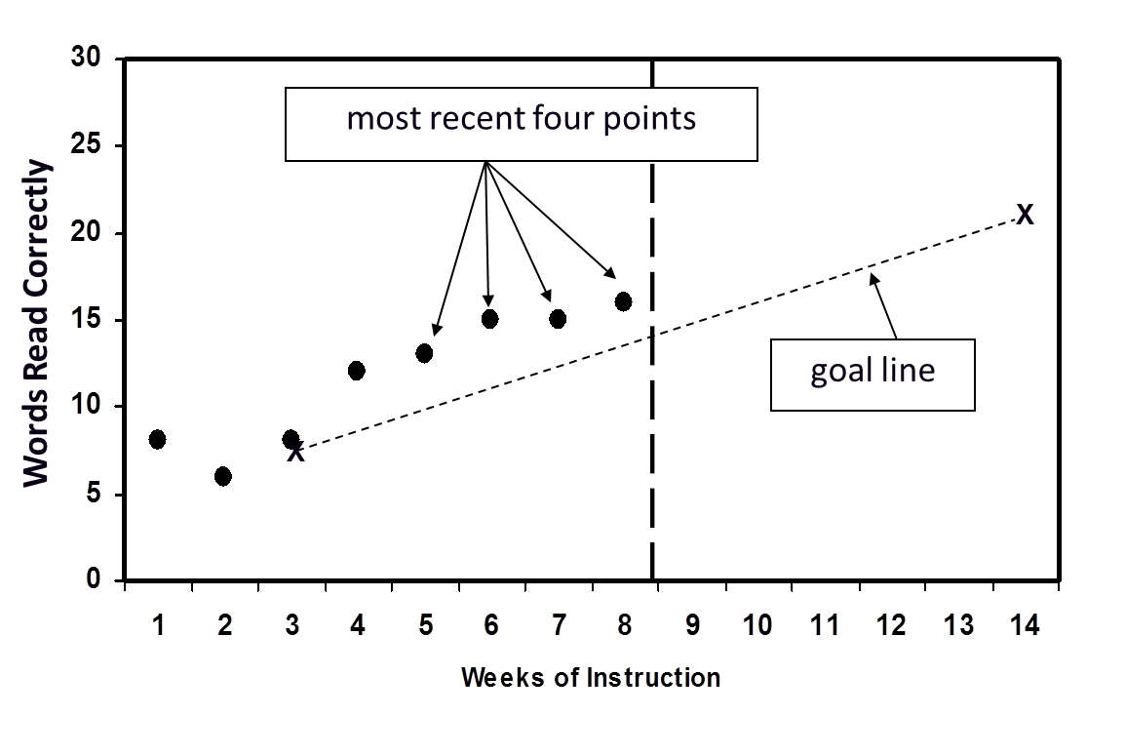
Practicing the Four-Point Rule
Alicia
Notes:
All of Alicia’s most recent four data points were above the goal line. This suggests that we should increase her goal. If she reaches the grade-level benchmark, we may consider reducing the intensity of her supports.

Slide 88
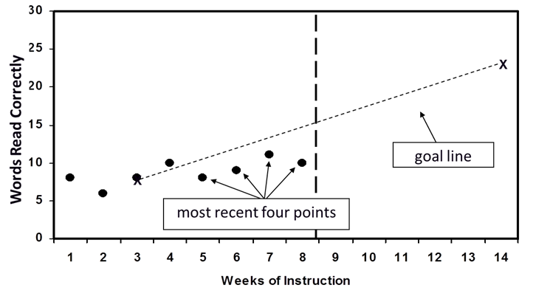
Practicing the Four-Point Rule
Mandy
Notes:
Mandy’s four most recent scores are below the goal line. Therefore, the teacher needs to change her instructional program. The end-of-year performance goal and goal line never decrease; they can increase only. The instructional program should be tailored to bring Mandy’s scores up so they match or surpass the goal line.
Discussion: The advantage of the four-point rule is that it’s easy to do because it doesn’t require calculating a trend line. The disadvantage is that it is not very sensitive. An outlier score could delay making a decision by preventing four consecutive scores falling above or below the goal line.

Slide 89
Method #2: Decision Rules Based on the Trend Line
After six to nine data points have been collected,
  Calculate the trend of current performance (by hand or with software).
  Compare to the goal line.
If the student’s trend line is steeper than the goal line, increase the goal.
If the student’s trend line is flatter than the goal line, make a change to the intervention.
If the student’s trend line and the goal line are the same, no changes need to be made.
Notes:
Read slide.

Slide 90
Practicing Trend-Line Analysis
The following slides will show graphs for two students who had the same first three scores and goal lines.
However, their later scores are different, resulting in different trend lines.
Based on the different trend lines, what instructional decisions would you make for each student?
Notes:
Read slide.

Slide 91
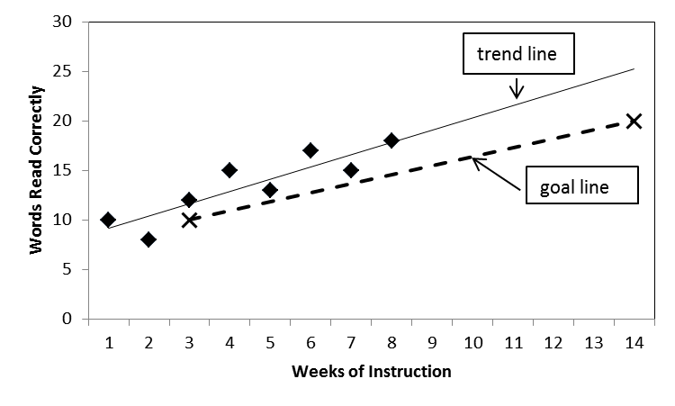
Practicing Trend-Line Analysis
Mario
Notes:
Mario’s trend line is above the goal line. This suggests that we should increase his goal. If he reaches the grade-level benchmark, we may consider reducing the intensity of his supports.
Note: Trend lines are often calculated using software. For drawing trend lines by hand, please see the RTI Implementer Series Module 2: Progress Monitoring (National Center on Response to Intervention, 2012).

Slide 92
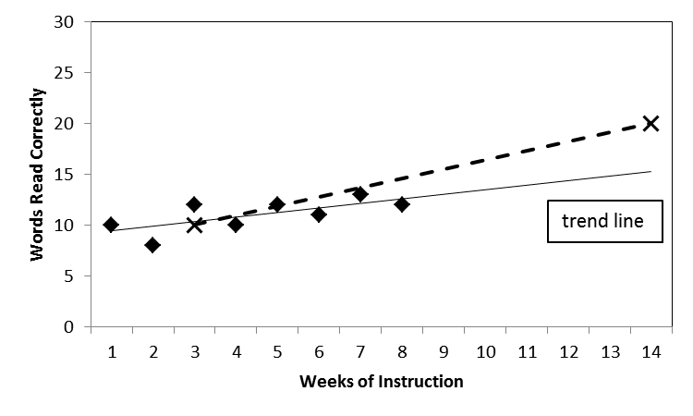
Practicing Trend-Line Analysis
Jared
Notes:
Jared’s trend line is below and flatter than the goal line, so an instructional change is needed.

Slide 93
In Summary
Progress monitoring data help us do the following:
Decide which students need DBI.
Determine a student’s response to an individualized intervention, deciding when instructional changes need to be made.
Write strong current levels of performance, goals, and objectives for IEPs or other individualized instructional planning.
Notes:
Read slide.

Slide 94
Quick Quiz
What type of assessment is progress monitoring (summative, formative, or diagnostic)?
Identify at least one challenge with mastery measurement that GOM addresses.
Which goal-setting method might you use for students performing well below their peers?
Which decision rule is more sensitive to change—the four-point method or trend-line analysis?
Notes:
Give the audience time to think about questions and then review as a group.
Answers:
Formative
Generalization, retention, comparing scores across time (across multiple skills)
Intra-individual framework
Trend line

Slide 95
Disclaimer
This module was produced under the U.S. Department of Education, Office of Special Education Programs, Award
No. H326Q110005. Celia Rosenquist serves as the project officer.
The views expressed herein do not necessarily represent the positions or polices of the U.S. Department of Education. No official endorsement by the U.S. Department of Education of any product, commodity, service, or enterprise mentioned in this website is intended or should be inferred.

Slide 96
References
Bangert-Drowns, R. L., Kulik, J. A., & Kulik, C.-L. C. (1991). Effects of frequent classroom testing. Journal of Educational Research, 85, 89–99.
Christ, T. J., & Silberglitt, B. (2007). Estimates of the standard error of measurement for curriculum-based measures of oral reading fluency. School Psychology Review, 36, 130–146.
Fuchs, L. S., & Fuchs, D. (1986). Effects of systematic formative evaluation: A meta-analysis. Exceptional Children, 53(3), 199–208.
Fuchs, L. S., & Fuchs, D. (2007). Using CBM for progress monitoring in reading. Washington, DC: National Center on Student Progress Monitoring. Retrieved from http://www.studentprogress.org/summer_institute/2007/Intro%20reading/IntroReading_Manual_2007.pdf

Slide 97
References
National Center on Intensive Intervention. (2013). Data-based individualization: A framework for intensive intervention. Washington, DC: Office of Special Education, U.S. Department of Education. Retrieved from http://www.intensiveintervention.org/resource/data-based-individualization-framework-intensive-intervention
National Center on Response to Intervention. (2012). RTI implementer series module 2: Progress monitoring [PowerPoint presentation]. Washington, DC: Author. Retrieved from http://www.rti4success.org/resourcetype/rti-implementer-series-module-2-progress-monitoring

Slide 98
References
National Center on Response to Intervention (2013). Screening briefs series—Brief #3: Predicting students at risk for reading and mathematics difficulties. Washington, DC: U.S. Department of Education, Office of Special Education Programs, National Center on Response to Intervention. Retrieved from http://www.rti4success.org/pdf/RTI%20Screening%20Brief3-Predicting%20Students.pdf
National Center on Student Progress Monitoring [n.d.]. Introduction to using curriculum-based measurement for progress monitoring in math [PowerPoint presentation]. Washington, DC: Author. Retrieved from http://www.studentprogress.org/library/Webinars.asp#PMMath
Scriven, M. (1991). Evaluation thesaurus (4th ed.). Newbury Park, CA: SAGE Publications.

Slide 99
References
Stecker, P., Sáenz, L, & Lemons, C. (2007). Introduction to using CBM for progress monitoring in reading [PowerPoint presentation]. 2007 Summer Institute on Progress Monitoring. Washington DC: National Center on Student Progress Monitoring. Retrieved from http://www.studentprogress.org/weblibrary.asp#cbm_intro

Slide 100

.
1000 Thomas Jefferson Street NW
Washington, DC 20007-3835
866-577-5787
www.intensiveintervention.org
ncii@air.org

