Slide 1
Using the Taxonomy of Intervention Intensity Within the Data-Based Individualization Process: A Behavior Example
February 2021
Notes:
Welcome to the National Center on Intensive Intervention’s (NCII’s) module on using the Taxonomy of Intervention Intensity to design and intensify behavior intervention. This module includes slides, speaker notes, and a workbook of activities.
This module is intended for individuals and teams who are interested in learning dimensions to consider when selecting a strong validated behavior platform and considering intensification. Additional modules focused on introducing the Taxonomy of Intervention Intensity and applying the taxonomy for reading and mathematics also are available. For more information about the data-based individualization (DBI) process, you may want to direct participants to the following resources:
Self-paced online module introducing intensive intervention: https://intensiveintervention.org/resource/self-paced-introduction-intensive-intervention
Read about the DBI process in detail: https://intensiveintervention.org/sites/default/files/DBI_Framework.pdf
Explore DBI topics: https://intensiveintervention.org/intensive-intervention
Handout—Breaking Down the DBI Process: Questions & Considerations: https://intensiveintervention.org/sites/default/files/NCII-placemat-508.pdf
Dr. Chris Lemons (Vanderbilt) explains intensive interventions and why they are important: https://intensiveintervention.org/resource/what-are-intensive-interventions-and-why-are-they-important
The recommended time frame for this presentation is 90 minutes, with an additional 30 minutes for activities. The length of time for the module may be adapted based on the needs of participants.
Introduce yourself (or yourselves) as the facilitator(s) and briefly cite your professional experience in regard to intensive intervention implementation.
Although permission to reprint this publication is not necessary, the citation should be:
National Center on Intensive Intervention. (2021). Using the Taxonomy of Intervention Intensity within the data-based individualization process: A behavior example. U.S. Department of Education, Office of Special Education Programs, National Center on Intensive Intervention.
Tips for using the speaker notes:
Text formatted in standard font provides a sample script for the facilitator.
Text formatted in italics is intended as directions, notes, or background information for the facilitator, including notes for animations within the slide deck.
Slides that reference handouts that can be found in the speaker notes are noted with a banner indicating the handout.

Slide 2
Learner Outcomes
At the end of the session, participants will be able to:
Define the dimensions of the Taxonomy of Intervention Intensity and explain how they support the data-based individualization (DBI) process.
Apply the dimensions of the taxonomy to evaluate or select a validated behavior intervention program.
Use the taxonomy to intensify a behavior intervention for a student who is not responsive.
Access existing resources to support evaluation and intensification.
Notes:
In this presentation, you will be introduced to the Taxonomy of Intervention Intensity and learn how it supports the data-based individualization, or DBI, process by helping to provide explicit guidance on how to select and evaluate validated behavior intervention programs to best meet students’ needs and intensify or adapt those interventions when students or groups of students do not adequately respond.
At the end of the session you will be able to:
Define the dimensions of the Taxonomy of Intervention Intensity and explain how they support the DBI process.
Apply the dimensions of the taxonomy to evaluate or select a validated behavior intervention program.
Use the taxonomy to intensify a behavior intervention for a student who is not responsive.
Access existing resources to support evaluation and intensification.
This presentation is intended to focus specifically on behavior intervention. Additional modules provide an overview of the taxonomy as well as deeper reviews of reading and math content. To access these modules, visit the NCII website (https://intensiveintervention.org/taxonomy-intervention-intensity).

Slide 3
Agenda
Review: Behavior basics and the DBI process
Go deep: The taxonomy dimensions in behavior
Case example: Using the Taxonomy of Intervention Intensity to support the DBI process to address behavior
Academic Support
Strength
Dosage
Alignment
Transfer
Comprehensiveness
Notes:
Review slide. Based on available time and focus, adjust the agenda to meet your needs.
Presenters can adapt this presentation to the needs of participants based on the objectives of the training session, the needs of the participants and their experience with DBI and the taxonomy, and time available. Presenters may consider adapting the content along the following lines:
Begin with the introduction, and spend more time helping participants understand the DBI process and the taxonomy more generally (in this case, presenters may find it helpful to draw from the Taxonomy Overview module or other DBI trainings).
Go deep into each of the taxonomy dimensions.
Pick and choose the dimensions where participants want more support.

Slide 4
Behavior Terminology: A Quick Review
Notes:
This presentation assumes some basic behavior knowledge by participants. However, this section provides a brief review of behavior terminology that will be used throughout the presentation.
For additional information and behavior basics, it may be helpful to review:
https://intensiveintervention.org/behavioral-theory-1-behavior-course
https://intensiveintervention.org/behavioral-theory-2-behavior-course

Slide 5
Three-Term Contingency
A
B
C
Antecedent
Behavior
Consequence
Notes:
You will see these foundational behavior terms included in the presentation. The ABC’s of behavior refer to the antecedent-behavior-consequence sequence. This three-term contingency allows us to understand the relationship between behavior and its consequences, given various environmental conditions.
A represents antecedent and refers to the activities or events that occur directly before a behavior. Example: Savannah was told to get her materials ready for math class.
B represents behavior and refers to anything that is seen, heard, and done. Behavior is something observable and measurable. Example: Savannah yelled at the teacher.
C represents consequence and refers to any event that happens directly after a behavior. Example: Savannah was removed from class. It is important to note that some consequences can increase behavior and some consequences can decrease behaviors.
Antecedent events and consequences can be incorporated into interventions to help reduce problem behavior and increase prosocial behavior. Consequences are linked to concepts of reinforcement and punishment. Ultimately, reducing problem behaviors requires a clear understanding of what is reinforcing a behavior. Most behavior results in either getting something or avoiding something. If we can observe what a student gains or avoids, we can begin to hypothesize the function of the behavior.

Slide 6
Reinforcement
Following a behavior, something is added or moved from the environment, and that behavior increases in the future.
Notes:
Reinforcement maintains or increases a behavior. There are two types of reinforcement: positive and negative. Both types lead to an increase in behavior. Positive reinforcement has occurred when, following a behavior, something desirable is gained. Negative reinforcement has occurred when, following a behavior, something that is disliked or aversive is removed or avoided.
Some important points to remember: There are no universal reinforcers. What is reinforcing for one student may not be reinforcing for another student. Reinforcement has only occurred if it helps sustain or increase a behavior. Thus, it is erroneous to say, “I’ve tried reinforcement, but it doesn’t work.” We only know if something is a reinforcer by observing its effect on the behavior.

Slide 7
Function of Behavior
Functions of behavior include access to or escape from:
Attention
Tangibles, activities
Demands, tasks
Sensory stimulation
Function plays a role in selecting and adapting behavioral interventions for students with a history of challenging behavior.
Notes:
Every behavior serves a function. When we successfully identify the function of a problem behavior, we can reinforce an alternate, more acceptable behavior that will replace it.
A functional behavioral assessment, or FBA, is used to determine the function of the behavior and the factors that maintain the behavior. The FBA helps teachers to understand the reason(s) (i.e., the function or functions) for a student’s behavior and then to use this information to select or adapt an intervention that will help the student learn a new, more acceptable method of getting what the student wants.

Slide 8
Data-Based Individualization

Slide 9
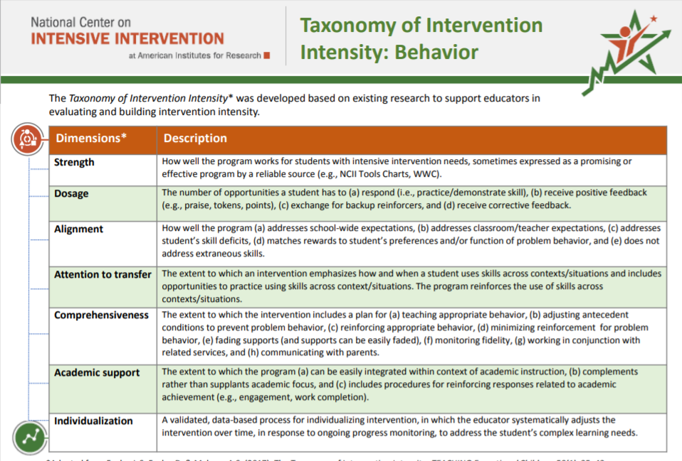
Activity: Taxonomy K-W-L
What Does It Help Me KNOW? | What More Do I WANT to Know? | How Will I LEARN More?
Handout
Notes:
Each of you has two handouts in your workbook. The first handout looks like this and includes brief definitions for each of the seven dimensions of the Taxonomy of Intervention Intensity. You will notice that the handout is two-sided (pages 3-4 in the workbook). On one side, the dimensions are defined in the context of academics, and, on the other side, the same seven dimensions are defined in the context of behavior. For this activity, we will focus on the behavior side. The second handout looks like this (click for animations). Many of you are likely familiar with K-W-L (for Know, Want to Know, Learn). This is a slightly modified version that includes space for you to document what you know from reviewing the resource, what questions you have or what you want to learn more about, and, finally, how you will learn more (page 2 of the workbook). For the next activity, you will focus on the first two columns (click for animation). Using the taxonomy overview handout, individually document what you know from reviewing the handout and what you want to know more about. You will have about 5 to 7 minutes to do this. Once you have completed documenting what you know and want to know more about, turn to your neighbor or tablemates and share some of the things that you documented.
Provide about 5 to 7 minutes for individual review, provide about 3 to 5 minutes for table or partner talk, and then provide time for group share-out. Note how you will address questions throughout the training.

Slide 10
Data-Based Individualization
A systematic method for using data to determine when and how to provide more intensive intervention
An ongoing process—not a single intervention
Intended for students with severe and persistent learning and behavioral needs
Notes:
Before we focus in on the dimensions of the Taxonomy of Intervention Intensity, we would like to present a brief review of the data-based individualization (DBI) process. DBI is a research-based process for individualizing and intensifying interventions through the systematic use of assessment data, validated interventions, and research-based adaptation strategies. DBI is the technical term for what many good teachers do naturally through the problem-solving process: Frequently review student data and make changes to their teaching based on what works for students. DBI, through a multistep process that gradually intensifies instruction and support, makes this process systematic, explicit, and tailored to meet the needs of individual students.
DBI has its origins in data-based program modification and experimental teaching, first developed at the University of Minnesota (Deno & Mirkin, 1977).
DBI is an ongoing process, not a single intervention, and it is intended for a small percentage of students with severe and persistent learning and behavioral needs, including students who:
Are not making adequate progress in their current intervention program (often, a Tier 2, evidence-based intervention)
Are not meeting individualized education program (IEP) goals
Have persistently low academic achievement
Have high-intensity or high-frequency behavior

Slide 11
Five DBI Steps
Validated intervention program, delivered with fidelity
Progress monitoring
Informal diagnostic assessment
Adaptation to validated intervention
Continued progress monitoring, with adaptations occurring whenever needed to ensure adequate progress
Notes:
The DBI process includes five iterative steps. In the DBI graphic, steps related to instruction and intervention are highlighted in orange while those related to assessment are highlighted in green.
Step 1: The DBI process builds on a validated intervention program delivered with fidelity. The validated intervention program is typically an evidence-based standard-protocol intervention. For behavior interventions, these programs may not always follow a standard program and may consist of a hodgepodge of evidence-based practices.
Step 2: Regular progress monitoring data are collected to determine whether the student is responding or not responding to the intervention. If the student is responsive, the teacher continues to provide the validated intervention program and monitors student progress until the student reaches expectations. If the data suggest that the student is not responding while other students who have received the intervention have responded, then the teacher moves to the next step of the process.
Step 3: To determine why the student is not responding, diagnostic data are collected and reviewed to identify specific skill deficits or behavior concerns that are affecting the student’s progress. These diagnostic data may include data from informal and formal academic and behavior measures. These data are used to develop a hypothesis about why the student is not responding.
Step 4: The hypothesis, along with educators’ expertise, is used to develop an individual student plan for modifying or adapting the intervention to better meet the student’s individualized needs.
Step 5: While implementing the intervention adaptations, the teacher continues to collect progress monitoring data at regular intervals to determine responsiveness. Students whose data indicate responsiveness continue with the adapted intervention. Students whose data indicate nonresponse, return to Step 3, where the teacher will analyze additional data and consider further adaptations.

Slide 12
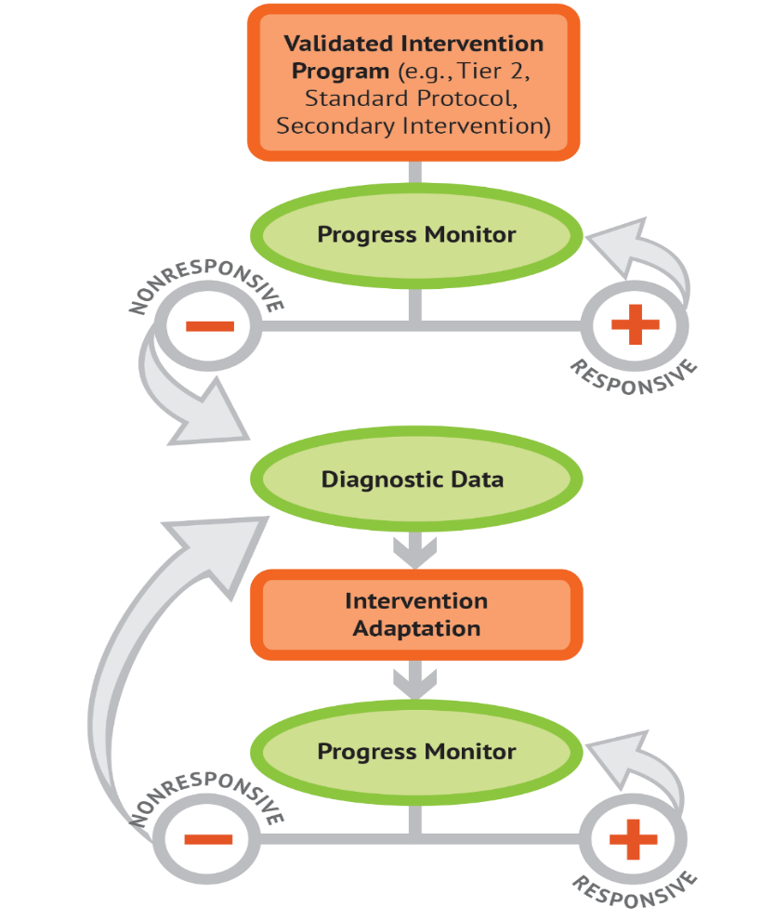
Using the Taxonomy of Intervention Intensity Within the DBI Process
Evaluate current interventions.
Select a new intervention.
Intensify the intervention.
Notes:
The seven dimensions of the Taxonomy of Intervention Intensity can help you make informed, systematic decisions in the context of the DBI process. The taxonomy primarily applies to the orange bubbles (the validated intervention program and intervention adaptation), which will be the focus of the presentation today. The taxonomy (Fuchs, Fuchs, & Malone, 2017) can be used to select or evaluate an intervention platform used as the validated intervention platform (this selection or evaluation process forms the foundation of the DBI process). The taxonomy also provides guidance on how to intensify, modify, and adapt the intervention during the intervention adaptation step of the DBI process. Note that the taxonomy and DBI are NOT mutually exclusive—the taxonomy drives the DBI process.

Slide 13
What Are Validated Interventions?
Standardized, evidence-based interventions designed for students who are at risk
Also known as . . .
Tier 2 or supplemental interventions
Small-group interventions
Notes:
Validated interventions are standardized, evidence-based interventions designed for students who are at risk. These interventions are sometimes scripted and involve detailed lesson components and a specific scope and sequence.
What do we mean by standardized? A standardized intervention:
Uses research-based instructional practices
Is consistently delivered in a specific manner to students
Typically includes a step-by-step sequence
A standardized intervention can help teachers to be efficient, not have to spend time “reinventing the wheel,” and can often be delivered with limited training. However, you must balance what’s readily available and match student needs.

Slide 14
Activity: Current Intervention Brainstorm
What behavior interventions are you currently using with students in your classroom? (Or what interventions have you used in the past)?
How do you select interventions?
How do you decide how and when to make adaptations to an intervention for a particular student?
Handout
Notes:
As we start this presentation, let's take some time brainstorm the current behavior interventions that you have in place. Use the handout in your workbook on page 5 to document any available interventions, how interventions are selected, and how you decide when to make adaptations to an intervention for a particular student.
Provide participants about 5 to 7 minutes to complete this activity in teams. Once the teams have completed the activity, have a couple teams share out some of the interventions they are using and how they select and adapt them.

Slide 15
When Selecting or Evaluating a Validated Intervention, Where Should We Start?
Readily available interventions:
What do you already have in place?
Do you have educator buy-in?
Notes:
In the previous activity, you brainstormed your currently available interventions. As illustrated in the DBI graphic, the first step is to identify a validated intervention platform. The intervention should be a validated program, matched to the student’s needs (i.e., skill deficits), that may be intensified and individualized as needed. In thinking about the validated intervention program, it is helpful to consider, what already exists at your school. It’s great to use familiar interventions when you can because they may be more likely to succeed than unfamiliar interventions. Not only will you be more familiar with existing interventions, but there may also be existing systems that support implementation, progress monitoring, and data-based decision making.
Consider the reasons the student was referred for support. What skills does the student need to learn? Does problem behavior need to be reduced? For example, if a student lacks social skills, an intervention must include a social skills teaching component. Try to identify interventions shown to address the specific needs of your student. For example, if you think a student may be accessing adult attention via problem behavior, Check-In/Check-Out may be a good fit. But if a student is likely trying to escape or avoid academic work, the support team should identify options that better match the student’s motivation or reinforcers for their problem behavior (e.g., breaks are better).

Slide 16
When Selecting or Evaluating a Validated Intervention, What Should We Consider?
Does evidence suggest that the intervention is expected to lead to improved outcomes (strength)?
Will the group size, duration, and frequency provide sufficient opportunities to respond (dosage)?
Does the intervention match the student’s identified needs (alignment)?
Does the intervention assist the student in generalizing the learned skills to general education or other tasks (attention to transfer)?
Does the intervention include elements of explicit instruction (comprehensiveness)?
Does the student have opportunities to develop the behavior skills needed to be successful (behavioral support)? Can the intervention be easily integrated into academic instruction (academic support)?
Can the intervention be individualized with a data-based process to meet student needs (individualization)?
Handout
Notes:
On the slide, you see a series of questions. These questions map to the seven dimensions of the Taxonomy of Intervention Intensity that we looked at earlier. These seven dimensions were initially proposed in a 2017 article in TEACHING Exceptional Children, by Lynn and Doug Fuchs and Amelia Malone, to help educators consider the strengths and weaknesses of their academic intervention and guide intensification (page 6-7 of the workbook). Our understanding about these dimensions and their application to behavior was expanded upon through the work of the National Center on Intensive Intervention (NCII) and the NCII technical work group.

Slide 17
Taxonomy of Intervention Intensity

Slide 18
The Taxonomy of Intervention Intensity
A system for describing an intervention in terms of seven dimensions, along which intensity can vary
This system helps special educators and interventionists:
Identify best-match validated intervention programs
Formulate adjustments to boost student progress

Slide 19
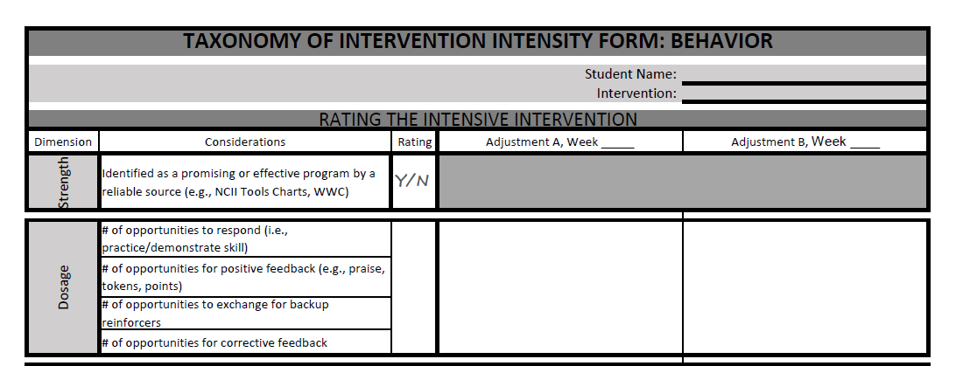
Taxonomy Ratings
Handout
0 | 1 | 2 | 3
Fails to Address Standard | Addresses Standard Minimally | Addresses Standard Moderately | Addresses Standard Well
Notes:
As we walk through each taxonomy dimension, we’ll also discuss how you and your intervention team would review and rate the dimension of a validated intervention program (page 8 of the workbook). Reviewing the intervention can help us to better understand the strengths and weaknesses of our intervention across each of the dimensions. As you can see, the rating scale we will use ranges from 0 (fails to address standard) to 3 (addresses standard well).
Please note that there are no rigid rules for rating the degree to which an intervention addresses a standard. You must consider the characteristics and needs of the student as well as the intervention context. In other words, ratings are sometimes relative rather than absolute. We’ll do our best to provide diverse examples today that illustrate a variety of scenarios.
Provide participants with 3–5 minutes to review the rating form describe how they would look at the descriptions of the dimensions and the use that information to rate the initial intervention. They can also use this form in the future as they consider adapting and individualizing the intervention based on student need.

Slide 20
Strength
Notes:
The first dimension we will discuss is strength.

Slide 21
What Do We Mean by Strength?
How well the program works for students with intensive intervention needs, sometimes expressed as a promising or effective program by a reliable source (e.g., National Center on Intensive Intervention [NCII] Tools Charts, What Works Clearinghouse [WWC]):
Has this intervention been evaluated empirically using scientifically sound, rigorous methodology?
If so, what is the reported standardized mean effect size for this intervention, or what does the visual analysis tell us?
Notes:
The strength dimension is defined as how well the intervention works for students with intensive intervention needs. This dimension can be tricky to evaluate for behavior intervention.
To understand how well the intervention works, we first need to consider the quality of the research that is being reported. We ask: Has this intervention been evaluated empirically using scientifically sound, rigorous methodology?
Yes—the intervention was tested by means of a randomized controlled trial, an appropriate quasi-experimental design, or single-case research design.
No—this intervention is based on a case study, descriptive information, or anecdote.
Although some behavior interventions may have been evaluated using a group research design, many interventions are evaluated with single-case research designs. For interventions with studies that have a group design, we look for the reported mean effect sizes to assist with rating strength. For interventions with studies that use a single-case design, use visual analysis to assess the changes in level and/or trend, and variability performance data for students closest to your target student.
Rather than identifying a numeric rating for strength, we encourage you to decide whether sufficient evidence exists for improving your target outcomes and provide a yes/no rating.
If you determine sufficient evidence does not yet exist to show that an intervention affects socially significant change in the target area (e.g., problem behavior, academic engagement) and for students with similar learning characteristics, consider looking for a validated intervention that more closely targets your student’s needs and use progress monitoring data to validate the intervention for your student.
Note: It may be helpful to provide some additional context about types of studies. In group design, participants are assigned to one of two or more experimental groups (e.g., control or intervention), and not all participants are exposed to the intervention. In single-case design, participants experience both baseline and intervention conditions. That is, study participants serve as their own control. If you are looking for additional information to explain effect sizes, view the Taxonomy Overview module. It is important to recognize that the rule of thumb effect sizes provided are for academic, not behavioral, interventions.

Slide 22
Using Effect Sizes to Evaluate Strength
A quantitative way to look at the strength of an intervention
Several factors impact the effect size. The general guidelines provided below can be used as a starting point, but other factors should be considered.
Strength | Effect Size
Small (minimum) | 0.25 to 0.34
Moderate | 0.35 to 0.49
Strong | 0.50 or larger
Notes:
Researchers will usually use two ways to describe the success or efficacy of the intervention. The first way is statistical significance. If something is statistically significant, it means that the likelihood of finding a particular result by chance is less than 5%. In other words, it is highly unlikely that the results of the study are a fluke. Significance is important to consider because it helps guard against the costly mistake of labeling something as effective when it is not.
Statistical significance tells us if something is effective—it can’t tell us how effective that thing is. That’s where effect size comes in. An effect size is a standardized measure of the strength of an intervention. To conceptualize what an effect size is, consider an assessment that has an average score of 100 and a standard deviation of 10 (meaning, on average, scores between students vary by 10 points). An effect size of 1.0 would mean that intervention students scored, on average, 10 points higher on the end-of-intervention measure.
Although several factors may impact the effect size, a general rule of thumb for educational effect sizes for academic outcomes is provided (review slide). We can use these factors as a starting place to consider the effectiveness of the intervention.
Note: Sawilowsky, S. S. (2009). New effect size rules of thumb. Journal of Modern Applied Statistical Methods, 8(2), 597–599. Available at: http://digitalcommons.wayne.edu/coe_tbf/4 revised the interpretation of effect sizes based on a review of the research and found d (.01) = very small, d (.2) = small, d (.5) = medium, d (.8) = large, d (1.2) = very large, and d (2.0) = huge.

Slide 23
How Important Are Effect Sizes?
When available, effect sizes must be interpreted with caution.
Effect sizes can be impacted by:
Study conditions
Content studied
Study population
Effect sizes are not always available.
Notes:
While effect sizes are important tools in helping us evaluate strength, they must be interpreted with caution. The study conditions can impact effect sizes (Hill, Bloom, Black, & Lipsey, 2008). Effects from research studies were usually obtained under high levels of fidelity that are often difficult to achieve in authentic classroom settings. In addition, lower effect sizes could be statistically significant in one study and not significant in another study. Because sample size largely drives the differences between groups, this must be considered. Therefore, when interpreting the importance of the effect size for behavior interventions, we must consider our context, needed content, and target population.
Depending on the study design, effect sizes may not be available. This is often the case with behavioral interventions that use a single-case design. When evaluating behavior interventions, it is important to remember that the effect size is just one piece of information we can use to understand the intervention’s potential effect. As you will see on the next slide, educators can also use visual analysis to evaluate strength the strength of behavior interventions.

Slide 24
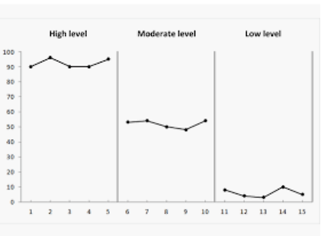
Using Visual Analysis to Evaluate Strength
Data for behavior interventions are often evaluated using visual analysis. Kazdin defines visual analysis as “reaching a judgment about the reliability or consistency of intervention effects by visually examining graphed data” (Kazdin 1982, p. 232).
Notes:
Review slide.
Single-case research is used when randomized, group designs are not feasible. Visual analysis is used to evaluate outcomes in single-case research.
Unless there is an ethical reason to begin immediate intervention, we should collect at least five data points to establish baseline performance. Ideally, these data would demonstrate stability. Highly variable data during baseline may suggest a need to collect additional baseline data and revisit the operationally defined behaviors and anchors for accuracy.
When reviewing behavior data on a graph, we assess three components:
Trend: The trend is the slope of the data and reflects the overall direction of the data path on a graph. We typically label trends as increasing, decreasing, or zero.
Level: Refer to the level of data points; we’re talking about where the data points are in relation to the vertical axis. In general terms, levels of behavior may be viewed as low, moderate, or high.
Variability: Variability is more difficult than the other characteristics because it requires an examination of the overall picture of the data. One way to help with interpretation is to draw a best-fit line through the data points. If many of those data points are close to the line, variability could be considered low.

Slide 25
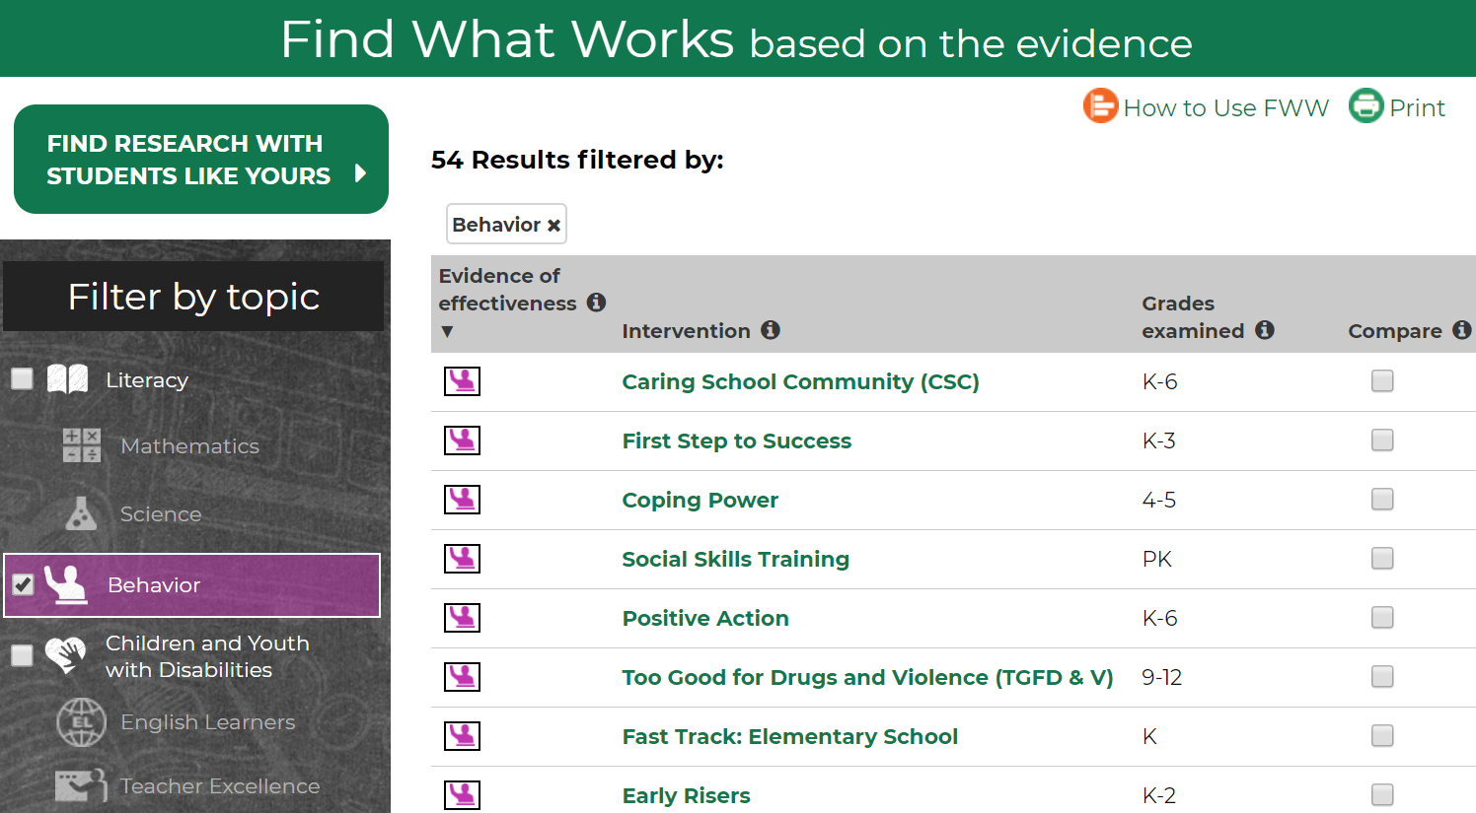
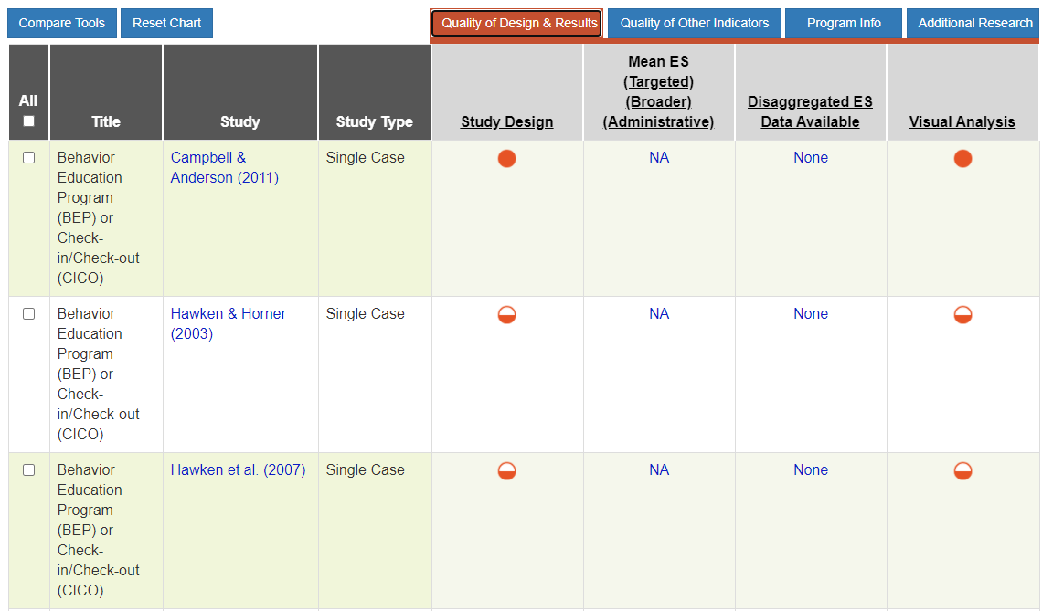
How Can I Find Information About Strength?
What Works Clearinghouse (https://ies.ed.gov/ncee/wwc/)
NCII Behavior Intervention Tools Chart (https://charts.intensiveintervention.org/bintervention)
Notes:
Two places to find information about strength include the What Works Clearinghouse and NCII Behavior Intervention Tools Charts. Both places provide reviews of interventions or intervention studies and provide information about study quality and the effectiveness of the intervention.
With both the WWC and NCII Tools Chart, it is important to consider the quality of the study in addition to the results.

Slide 26
Using WWC to Evaluate Strength
Visit the Institute of Education Sciences What Works Clearinghouse.
Select “Behavior.”
Identify interventions with purple icons that indicate “positive or potentially positive” evidence of effectiveness.
Review intervention reports to learn more about intervention and results.
Notes:
Model use of the WWC website with the group. Read slide.
One resource for evaluating the research behind a practice is the Institute of Education Sciences What Works Clearinghouse, or WWC. If you navigate to the WWC page (link embedded in slide) and select Behavior from the menu, you’ll see a list of validated interventions. (click animation) You can also filter the list in a variety of ways [review options above]. This may be a particularly helpful tool for selecting an intervention that fits your needs. The WWC provides an intervention report for the interventions reviewed. These reports include additional information about the intervention as well as the effect size (where available).
https://ies.ed.gov/ncee/wwc/

Slide 27
Using the NCII Behavior Intervention Tools Chart to Evaluate Strength
Notes:
Model use of NCII Behavior Intervention Tools Chart with the group. Read slide.
NCII also offers a behavior intervention tools chart that can be used to help identify behavioral interventions. The NCII tools chart reviews studies of behavior intervention and provides information about effect size (for group design studies) and visual analysis (for single-case design studies under the Quality of Design and Results. Numerical values are provided for the effect size and a rating from convincing to unconvincing is presented for the visual analysis. Because the NCII Tools Charts provides information at the study level you may see an intervention listed on the chart multiple times. The tools charts are interactive. You can click on the rating bubbles or numbers to find additional detail.

Slide 28
Rating Strength: Practice
Notes:
Let’s look at a snapshot of study results for Behavior Education Program or Check-In/Check-Out. Visual analysis of level, trend, variability, and immediacy of effect were used to evaluate whether Check-In/Check-Out improved student behavior. In addition, the means between phases were also compared to evaluate the effectiveness of the intervention. As we look at the study results, you will see that mean effect size includes an N/A, or not applicable. This is because this study is a single-subject design. Instead, we will focus on the column that says Visual Analysis.
Do you think this intervention shows effectiveness?
Have partners share what they think and review as a large group.
Note that the bubble for Visual Analysis in this example is full, which indicates convincing evidence. However, we may also look at the fact that other studies of the same intervention showed different results. We would want to consider the totality of the information about the intervention and not just pick and choose studies that show results.

Slide 29
Rating Strength: Practice
1
2
3
Notes:
Let’s work through this together. Here is a comparison of the Check-In/Check-Out intervention for elementary students across three studies. Before we rate the strength, let’s look at the study quality. Of the three studies, which study appears to have the highest quality? (1). Yes, the evaluation of this study was rigorous—that means I can have more confidence in the results.
Studies 2 and 3 have more open circles than the first study—that means that we can’t have as much confidence in the reported results.
Intervention study number 1 has high-quality ratings. We can be confident in this study’s findings because the study’s methodology was strong.
Now, let’s review the study results and rate the strength of the interventions.

Slide 30
Dosage
Notes:
The second dimension is dosage.

Slide 31
What Do We Mean by Dosage?
Number of opportunities to respond (i.e., practice or demonstrate skill)
Number of opportunities for positive feedback (e.g., praise, tokens, points)
Number of opportunities to exchange for backup reinforcers
Number of opportunities for corrective feedback
Notes:
To really help us understand dosage, we want to think about four things:
Review slide.
Number of opportunities to respond refers to the number of opportunities a student has to practice the skill. For some interventions, opportunities may be concentrated at the start of implementation, such as when a new functional communication skill is being taught (e.g., requesting a break or help from the teacher).
Number of opportunities for positive feedback is really getting at the schedule of reinforcement involved in the intervention. How often (in terms of number of responses or in terms of time) is reinforcement available contingent on a replacement behavior? Consider both frequency and immediacy here. If a student has opportunity to access reinforcement every 5–7 minutes, on average, provided the student is actively engaged, how might you rate the opportunities for feedback? How might your rating change if reinforcement was available at the end of the class period? End of the day?
Number of opportunities to exchange for backup reinforcers is applicable when the intervention involves a token or point system of some kind. Tokens and points aren’t valuable in and of themselves—they are valuable because they are paired with other, already reinforcing, activities, items, or sensations, much like U.S. dollars. Thus, to keep tokens, points, and so forth functioning as reinforcers, we have to embed opportunities for them to be exchanged for things of value to the student. Some factors to consider may be the age and developmental level of the target student. The younger or less mature a student is, the more often (or immediately) token exchange needs to occur. As students get older or more experienced with the system, we may be able to back off on the number and immediacy of opportunities to exchange.
Number of opportunities for corrective feedback. Corrective feedback gives students the behavior steps needed to meet their goals. When it comes to corrective feedback, it’s all about timing and delivery. Simply put, know when to give the feedback and know how to say it. With this type of feedback, students are more likely to receive the feedback as a help, instead of criticism. Corrective feedback gives students a behavior to focus on. With corrective feedback, students can focus on their replacement behaviors instead of how they appear to their peers or you. Corrective feedback focuses on the solution, not the student. It focuses on what your students can do, not on what they should have done. If the alternate behaviors meet their needs and keeps the students out of trouble, students will continue to use the behaviors you suggest.

Slide 32
Why Do We Think About Opportunities to Respond?
Increased opportunities is a structured approach to using an appropriate instructional pace to maximize engagement (Menzies et al., 2017).
Higher rates of reinforcement are predictive of higher rates of responding (Martens, 2018).
Notes:
We can think of dosage as the relative frequencies of opportunities for a target student to practice replacement behaviors and receive feedback intended to increase or decrease the prevalence of appropriate and inappropriate behavior, respectively. If there are a lot of opportunities for feedback, it will be much clearer to the student which behaviors are the best choices.
Why do we think about opportunities to respond?
From research we know that:
Increased opportunities is a structured approach to using an appropriate instructional pace to maximize engagement (Menzies et al., 2017).
Higher rates of reinforcement are predictive of higher rates of responding ( Martens, 2018).
The number of opportunities for students to respond and receive feedback are impacted by a number of factors, including:
Number of sessions (frequency of sessions)
Duration of sessions
Student–teacher ratio

Slide 33
How Would You Rate the Dosage?
Teacher holds daily, 20-minute social skills lessons for small groups of students (3–5 students)
Lessons follow direct instruction format:
Teacher models the skill of the day
Teacher and students practice skill together
Students practice in pairs, with feedback from the teacher
Notes:
In this example, the teacher holds daily, 20-minute social skills lessons for a small group of three to five students. The social skills lesson uses a direct instruction format, where the teacher models the skills of the day; the teacher and student practice the skill together; and the students practice in pairs, with feedback from their teacher. Let’s think about the components of dosage that we just discussed. If you were going to rate the dosage of this intervention on a scale of 1–3, what would you give this intervention? You can refer to the rating form that is available in your workbook.
Provide participants with 1–3 minutes to consider a rating. Prompt participants to consider how this rating might change if the intervention was provided only two or three times per week.

Slide 34
Rating Dosage: Where to Find Information
Notes:
Although the NCII Tools Chart will not provide all the information we need to make a judgement about the dosage of an intervention, it can provide some information that we can use to help us think about dosage. Specifically, the chart shares information about group size, as well as session duration and frequency. This chart will provide you with only general information, so you may want to look specifically at the intervention to learn more about the actual opportunities for student engagement. You can also find information about dosage on the What Works Clearinghouse intervention reports.

Slide 35
Turn and Talk
To what extent do these situations impact the dosage intensity in your school or district?
Instructional disruptions (testing, special events, intervention session cut short)
Larger than designed group size
Fewer sessions than intended
Lack of student engagement
Notes:
Turn and talk with your neighbors, discussing how the following situations can dilute the dosage intensity in your school or district:
Instructional disruptions (testing, special events, intervention session cut short)
Larger than designed group size
Fewer sessions than intended
Lack of engagement
(3–5 minutes to discuss) Then have a few groups share out.

Slide 36
Alignment
Notes:
The third dimension of the taxonomy is alignment.

Slide 37
What Do We Mean by Alignment?
Intervention addresses schoolwide expectations
Intervention addresses classroom and teacher expectations
Intervention addresses target student’s skill deficits
Rewards are matched to target student’s preferences and/or function(s) of behavior
Intervention can easily be adapted to address various functions of behavior
Intervention does not address extraneous skills
Notes:
Alignment is how well a program specifies reduction of behaviors of concern and incorporates a meaningful focus on appropriate behaviors we would expect for a particular context (i.e., Tier 1 class-wide behavior expectations or schoolwide context).
There are six components of alignment that we can consider when rating whether a behavior intervention is aligned to student needs. The first two components focus on alignment to overarching school or classroom expectations. The next two components focus on how the intervention matches the student’s skill deficits and matches rewards to the student preferences and/of problem behavior. The last two components focus on whether the intervention can be adapted to address various functions and does not focus on extraneous skills. We want to consider how efficient the program is, and limit time spent on skills that students have already mastered or do skills that don’t match their need. Review each of these components.

Slide 38
Why Do We Think About Alignment?
Streamlined procedures may improve implementer fidelity and student outcomes.
There should be a match between intervention and targeted skill deficits.
Notes:
Alignment is important because many interventions address a restricted set of skills. Due to the intensive needs of these students and limitations to time and resources, it is important we do not waste effort covering skills that the student has already mastered. Instead, we must focus on skill gaps.

Slide 39
In Other Words, Interventions Should Be . . .
Aligned with expectations and priorities of all stakeholders, including school at large, as well as classroom staff
Targeted to student’s individual needs related to function and preferences:
Rely on data collected as part of the progress monitoring and functional behavioral assessment (FBA) processes
Efficient:
How easily can the platform be adjusted?
Is there any wasted effort?
Notes:
Review slide.

Slide 40
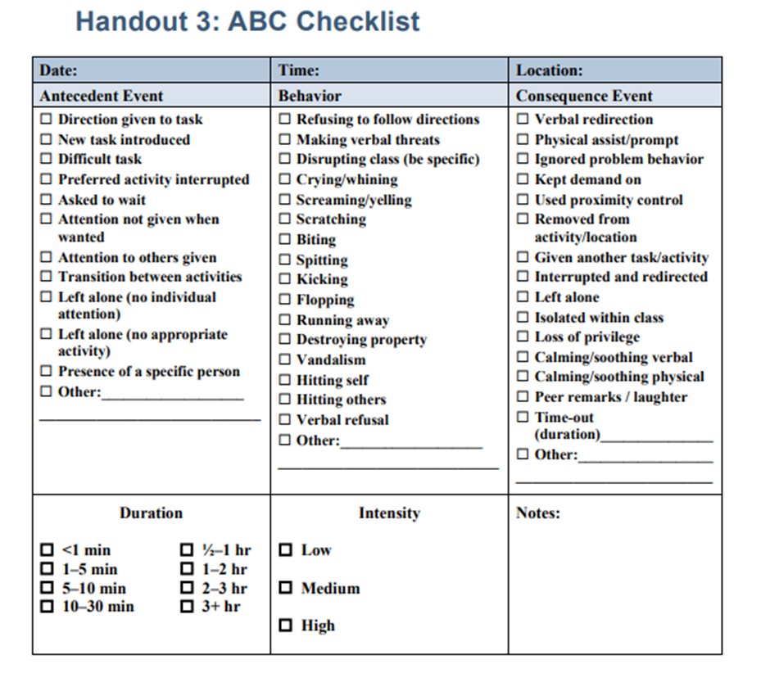
Understanding Student Needs Related to Function and Preferences
Notes:
For an intervention to be intense, it needs to be aligned to the needs of the individual student. For a student who is not meeting school or classroom expectations, this means that you need a full picture of their strengths and weaknesses. There are several different skills that students may struggle with. Here are two resources that can help you identify the function of behavior.
Using additional data can help you to determine the specific skill areas that a student is struggling with so that you can align the intervention to the student’s specific needs.
https://intensiveintervention.org/sites/default/files/HO-3c-ABC-Report-Form_508.pdf
https://intensiveintervention.org/sites/default/files/Handout_3_ABC_Checklist%20.pdf

Slide 41
Attention to Transfer
Notes:
The fourth dimension is attention to transfer. As we think about transfer, we are focused on how skills taught during an intervention make their way into the classroom and independent practice. We might also think about this as generalization.
Students with and at risk for learning or behavioral disabilities tend to struggle with generalization (applying the skills and strategies they’ve learned to other contexts). In fact, this is one of the key components of an educational disability diagnosis (inability to learn from observational learning and independently apply taught skills).
In thinking about attention to transfer, consider whether the intervention explicitly teaches students how to apply the skills taught during intervention in other contexts. Students may demonstrate mastery of taught concepts in the intervention context but fail to demonstrate mastered skills when encountering even minor differences.

Slide 42
What Do We Mean by Attention to Transfer?
Intervention emphasizes how and when a student uses skills across contexts and situations; it includes opportunities to practice using skills across contexts and situations
Intervention program’s reinforcement for use of skills across contexts and situations
Notes:
When we think about attention to transfer, we want to consider whether a behavior intervention teaches students to generalize what they learn in the intervention to novel settings or with new people. Specifically, we want to consider:
Opportunities for the student to practice the skill across different contexts or with new people that will promote generalization
Procedures for reinforcing the skill when it is displayed under a variety of circumstances, including new or unanticipated circumstances

Slide 43
Rating Attention to Transfer: Practice
Broader measures Assess outcomes that are related to the competencies or skills targeted by the program but not directly taught in the program.
In the behavioral domain, if a program taught a specific skill like on-task behavior in one classroom, a broader measure would be on-task behavior in another setting.
Notes:
On the NCII Tools Chart, under the Quality Design and Results tab, you can look at the data for the measures targeted and measures broader. The broader measures can help us to provide information about the attention to transfer because they assess outcomes that are related to the competencies or skills targeted by the program but not directly taught in the program. In the behavioral domain, if a program taught a specific skill like on-task behavior in one classroom, a broader measure would be academic performance in that setting or on-task behavior in another setting.
As we can see in this example, the measures broader received a full bubble, which means it addresses the standards well. By looking at the additional data provided for the rating, we can get information about whether this intervention has evidence of attention to transfer from a specific skill to a broader skill, from one environment to another, from one rater to another.

Slide 44
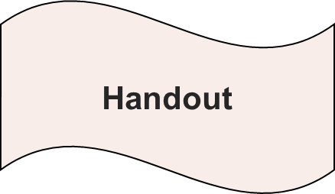
How Would You Rate the Attention to Transfer?
Notes:
Refer participants to workbook. Rating Attention to Transfer
Let’s look at an example of part of an intervention (page 9 in workbook). Review example.
Student carries goal card for “follow directions first time asked” to each setting (e.g., academic class, PE, cafeteria).
At the start of class, teacher monitors and student reviews the types of directions likely (examples: getting out materials, moving to a designated location, initiating and completing work):
Each time student follows directions immediately, they mark a tally on the self-monitoring card
Teachers in each class or context also keep a tally
At the end of each class period, student and teachers compare their data and discuss
Students exchange tallies marked by teacher, plus bonus points for agreement with teachers tallies, for rewards
Remember, attention to transfer focuses on how we consider whether a behavior intervention helps students to generalize what they learn in the intervention to novel settings. Specifically, we want to consider:
Opportunities for the student to practice the skill across different contexts that will promote generalization
Procedures for reinforcing the skill when it is displayed under a variety of circumstances, including new or unanticipated circumstances
Ask participants to consider if there is an adequate number of opportunities for students to practice targeted skills across contexts and situations.
Are existing procedures appropriate to track reinforcement of skills displayed under a variety of contexts?
Provide 3–5 minutes for participants to discuss the questions presented and share out thoughts.
Let’s discuss the questions presented. There seems to be an adequate number of opportunities to practice targeted skills of following directions as the student behavior is tracked across settings, including lunch and music. The student is also accountable for tracking progress of their own behavior and comparing data with the data collected from teachers.
The procedure to track the behavior is appropriate because it requires the student and teacher to observe the behavior and collect tally marks.

Slide 45
Comprehensiveness
Notes:
The next dimension is comprehensiveness.

Slide 46
What Do We Mean by Comprehensiveness?
Intervention includes a plan for teaching appropriate behaviors, with adequate opportunities for practice
Intervention includes plan for adjusting antecedent conditions to prevent problem behavior
Intervention includes plan for reinforcing appropriate behavior
Intervention includes plan for minimizing reinforcement for problem behavior
Intervention includes a plan for fading supports; supports can easily be faded
Fidelity of implementation can be checked or monitored easily
Intervention works in conjunction with related services
Intervention includes plan for communicating with parents
Notes:
We need to consider a number of elements when rating comprehensiveness (review slide). We will talk through these elements in more depth in the following slides.

Slide 47
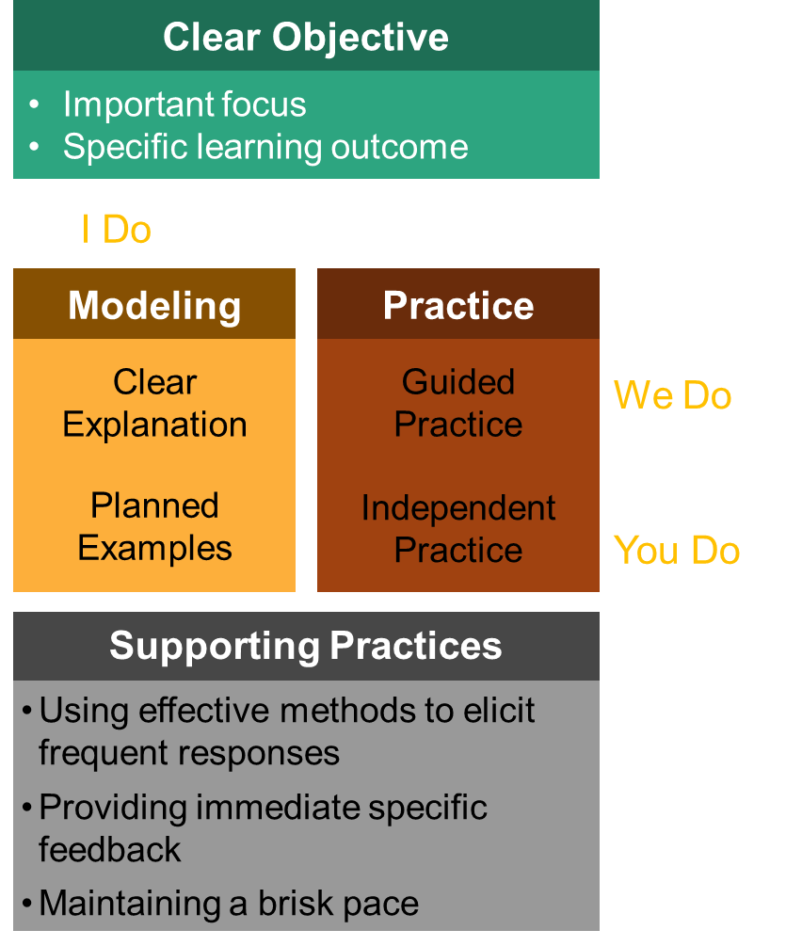
Plan for Teaching Appropriate Behaviors
Focus of teaching is on a replacement behavior
Notes:
We’ve already rated the number of opportunities to respond or practice the skill as part of the dosage dimension. Within comprehensiveness, we need to think more qualitatively. Is teaching a specific element of the protocol? Does it use a research-based approach, such as direct instruction with modeling, guided practice with feedback, and independent practice?
The first element in the comprehensiveness dimension deals with how replacement behaviors will be taught and practiced. As a reminder, a replacement behavior is a behavior we want a student to engage in, in place of a problem behavior. It’s important to teach appropriate behaviors well, with adequate opportunities to practice, such that we can (a) rule out the possibility that skill deficits impede progress and (b) ensure the student understands the skill itself. Why is the skill important to practice and model?

Slide 48
Plan for Adjusting Antecedent Conditions
Adjust antecedent events based on a
function of behavior
Notes:
The next consideration under the comprehensiveness dimension relates to antecedent adjustments. Here, it is key to consider the function of the problem behavior. Antecedent adjustments should directly target the “need” for a problem behavior. In other words, they should reduce the value of the function as a reinforcer. For example, if a problem behavior is reinforced by escape from an activity, we need to adjust the activity such that it is less stressful or unpleasant for the student. This may involve teaching prerequisite skills, breaking the task into smaller parts, or making some other change that reduces a student’s desire to escape the work. As another example, if a student engages in problem behavior to access a teacher’s attention, providing more attention independent of problem behavior may reduce the “need” for problem behavior.
In addition to reducing the need for problem behavior, antecedent adjustments may also prevent problem behavior by increasing the likelihood of more appropriate alternative behaviors. For example, visual cues or reminders to engage in an alternative behavior may contribute to reduction of problem behavior.

Slide 49
Example: Choice as an Antecedent Intervention
Does the component of the intervention address antecedent conditions that may contribute to problem behavior?
An FBA indicated . . .
Problem behavior occurs reliably during writing assignments
Escape function
Student reports hating writing because it makes his hand hurt
As part of a larger intervention package, the teacher will offer the student a choice of modality for writing during language arts block (e.g., handwrite versus type)
Notes:
Here’s an example. Let’s say a teacher is using choice as an antecedent intervention as a component of a larger intervention package.
Review example. Click for animation and ask, Does this component address antecedent conditions that may contribute to problem behavior? How would you rate it? How would your rating change if the teacher offered choice of sequence of instructional activities rather than modality?

Slide 50
Plan for Reinforcing Appropriate Behavior
Consider consequences for appropriate behavior:
Does the plan specify consequence(s) to follow appropriate behaviors some of the time or all the time?
Are those consequences likely to increase the future probability of the appropriate behaviors?
Notes:
The next component of comprehensiveness focuses on reinforcing appropriate behavior. Review slide.

Slide 51
Plan for Minimizing Reinforcement of Problem Behavior
Does the plan specify what should be done when problem behavior occurs?
Are these consequences unlikely to increase the future probability of problem behavior?
Notes:
Review slide.
For example: Does the plan specify that attention should be minimized? Are other possible reinforcers minimized?
For example: Are demands held constant? Are preferred tangible items unavailable?

Slide 52
Fading Supports
Is there a plan for fading supports? If so, can fading be done easily?
Can number of opportunities to practice, opportunities for feedback, occasions to exchange tokens or points for backup reinforcers be reduced gradually, as the student is successful?
Is there a plan to continue maintenance of expected behavior as supports are faded?
Notes:
Teachers frequently end up stopping an intervention “cold turkey” once the student demonstrates improved behavior. This often leads the student to revert to preintervention levels of behavior, which defeats the purpose of teaching and reinforcing desired behaviors. Teachers can avoid this relapse by systematically fading intervention components.
The intervention must be faded systematically by gradually reducing and eventually eliminating key elements, such as: (a) goals, (b) feedback, (c) reinforcement, (d) dosage, or (e) other intervention components.
Ensuring that newly acquired behavioral skills continue after an intervention has ended (i.e., maintenance) is the ultimate goal of behavioral interventions.

Slide 53
Implementing a Comprehensive Intervention
Fidelity of implementation can be checked or monitored easily
Intervention works in conjunction with related services
Intervention includes plan for communicating with parent
Notes:
The final three components of the comprehensiveness domain look at how the intervention is implemented, how it connects to other supports and services, and how it is communicated with parents and families.

Slide 54
Fidelity
Are intervention components described clearly enough that an observer could determine whether each component is being implemented?
Is there an existing checklist or “cheat sheet” for implementers?
Are there any permanent products (e.g., point sheets, intervention logs) that can serve as evidence of implementation?
Notes:
As part of the comprehensiveness domain, we also want to be sure that the intervention is something we will be able to implement. We might consider whether the intervention components are clearly described; if there is an existing checklist that might support us in implementing the intervention; or if permanent products have been developed, as part of the intervention, to help us to provide evidence that the intervention was delivered.

Slide 55
Works in Conjunction With Related Services
Is the intervention likely to enhance, rather than interfere with, other services?
Consider whether . . .
Related service providers may easily embed the intervention during sessions
Progress under intervention can inform other interventions
Notes:
In addition, we want to consider whether the intervention will enhance rather than interfere with other services. For example: For a student receiving speech therapy, the therapist could embed “turn taking” or “complying with request” during therapy sessions, thereby providing the student more opportunities to respond and generalize behaviors across settings. As we think about the relationship of the behavior supports to other supports provided, we need to consider whether related service providers may easily embed the intervention during sessions and whether progress under intervention can inform other interventions.
Have participants provide examples of other related service providers where skills can be practiced.

Slide 56
Procedures for Communicating With Parents
Think of an intervention you currently deliver. How are you communicating with parents regarding progress of the intervention?
Notes:
Finally, we also want to consider whether the intervention incorporates a way to communicate with parents about the intervention and student’s progress. Some interventions have methods for communicating with parents and families built into the intervention (e.g., interventions with daily report cards) while others do not. For those that do not have a communication component, when developing the communication plan we should consider”
Modality (e.g., phone, note home)
Schedule (e.g., daily, weekly, monthly)
Means of response (e.g., note is signed and returned).
For interventions that include a method of communication, we should confirm with parents and families that the modality, schedule, and means of response is appropriate and effective for them.
Click for animation. Think of an intervention you currently deliver. How are you communicating with parents regarding progress of the intervention? Turn to a neighbor and share.
.

Slide 57
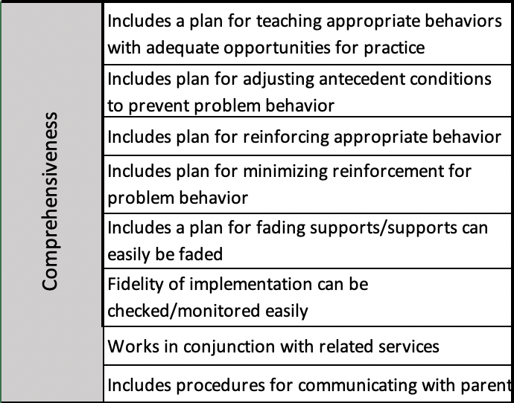
Bringing It All Together
Choose an intervention from the list you brainstormed earlier, and, using the components of the comprehensive domain, to assess which critical components are present or absent.
Notes:
Optional activity:
The comprehensiveness dimension of the taxonomy provides a structure for evaluating the degree to which a validated intervention program includes critical components of an effective behavior intervention plan.
Now choose an intervention from your list you brainstormed earlier. Using the comprehensive domain, assess which critical components are present or absent. (Refer to the rating form.)

Slide 58
Academic Support
Notes:
The extent to which academic support is provided is the next dimension of the taxonomy.

Slide 59
What Do We Mean by Academic Support?
Intervention can be easily integrated within context of academic instruction
Intervention complements, rather than supplants, academic focus
Intervention includes procedures for reinforcing responses related to academic achievement (e.g., engagement, work completion)
Notes:
Students who are experiencing behavior challenges must learn to persist despite difficulty and failure. For most students in need of intensive intervention, they have already experienced years of failure. Many of these students will have developed “learned helplessness” and task avoidance (for good reason).
Behavior intervention must be compatible with academic intervention and instruction:
Easily implemented within context of academic intervention
Complements rather than supplants academic focus
Reinforcement programmed for responses that will support academic progress

Slide 60
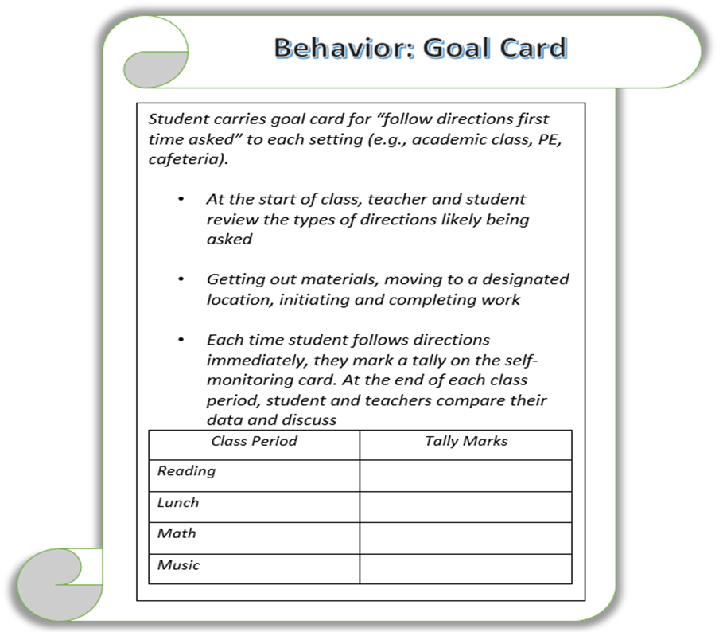
How Would We Rate Academic Support?
Notes:
Refer participants to page 10 of workbook. Rating academic support.
Let’s use our previous example from attention to transfer to consider the three subdimensions of academic support dimension and consider how we would rate the behavior goal card component of the intervention for academic support.
Example: Follows directions first time asked
Each time student follows directions immediately, the student marks a tally on the self-monitoring card.
Teachers in each class or context also keep a tally.
At the end of each class period, the student and teachers compare their data and discuss.
Students exchange tallies marked by teacher plus bonus points for agreement with teachers’ tallies for rewards.
How would you rate the ease of integration within academic instruction?
How would you rate the degree to which the self-monitoring program complements but does not supplant academic focus for instruction?
How well does the intervention reinforce responses related to academic achievement? (Note that you may want to remind participants that student is self-monitoring (with checks from teacher) “following directions the first time asked.” Rewards are available for meeting the goal and rating honestly.)
Let’s discuss the questions presented for rating academic support. The integration of the behavior support card across contexts seems appropriate because the intervention is not distracting, does not remove the student from classroom instruction, and targets skills involving academic instruction.
The self-monitoring program complements academic instruction because it requires the student to focus on following directions and keep a log of data.
To complete assignments, the student must follow directions provided by the teacher. The behavior report card reinforces this behavior, and rewards are available for the student meeting their goal.

Slide 61
Academic Support Checklist
At the end of a session, did the teacher provide feedback on student performance during academic instruction?
Was feedback delivered at natural transition points, minimizing disruption to academic routines?
Was feedback (e.g., praise, points) programmed to reinforce a variety of behaviors related to academic engagement?
Notes:
This checklist can be applied to assess a student’s behavior during academic instruction.

Slide 62
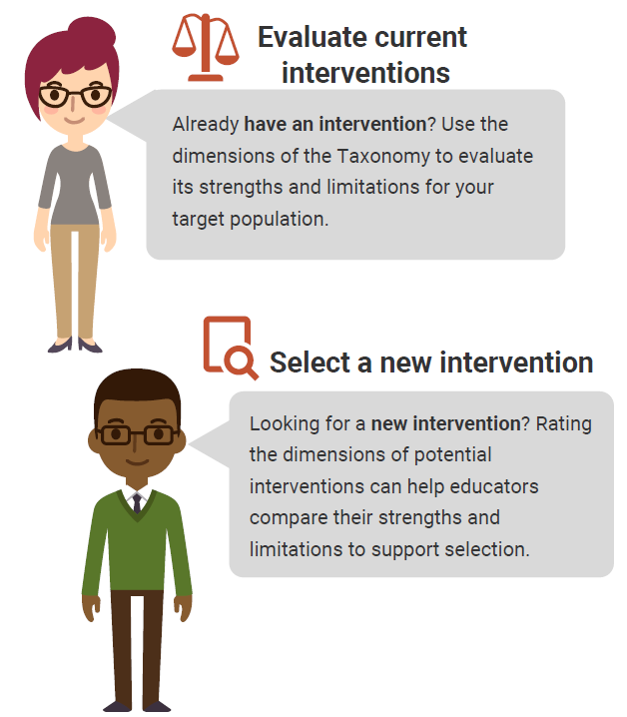
Using the Taxonomy to Find the Best Intervention
There are NO perfect interventions.
BUT
Using the Taxonomy of Intervention Intensity can help you understand the strengths and weaknesses of your current intervention and support your selection of a new intervention.
Notes:
There is no perfect intervention that will work for every student. Educators can use the dimensions of the taxonomy to learn about the strengths and weaknesses of their current intervention and guide the selection process for new interventions.
Rating an intervention across dimensions can help us to quantify our assessments of the intervention’s strengths and weaknesses and document places where we may need to supplement the intervention. In addition, rating can help us to compare interventions that we might be using or selecting or identifying one that might be a better fit for a student.

Slide 63
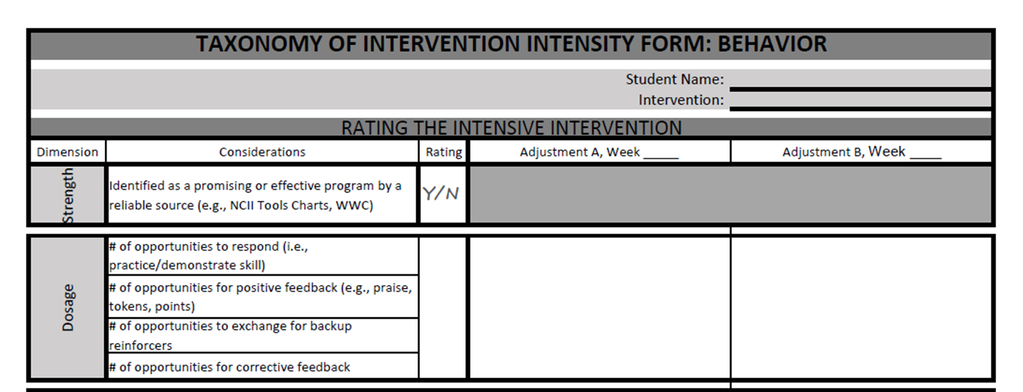
Activity: Assessing Quality of the Validated Intervention Platform
In groups of two or three people, select one behavior intervention from the list brainstormed earlier or consider rating Check-In/Check-Out.
Review the handout definitions for each dimension and the rating rubric.
Rate the intervention as designed for each dimension (0–3).
Record your responses in the third column.
Handout
Notes:
In this activity, we are going to ask you to consider one of the behavior interventions you brainstormed earlier and, as a small group, do a brief rating of the intervention. You can use one of the two websites that we discussed to identify the strength and your knowledge of the intervention to judge dosage, alignment, attention to transfer, comprehensiveness, and behavioral support. Because alignment is dependent on the skill needs of a specific student, instead consider the overarching areas that the intervention focuses on and the needs of students in your school or students you regularly work with.
The handout in your workbook on page 11 provides a place for you to note your rating and to a brief review of what to consider for each dimension.
Provide groups 5–10 minutes to complete Part 1. If time is available, groups can review a second intervention.
Have teams share out any takeaways from the activity. Were some areas easier to rate than others?

Slide 64
Individualization
A validated, data-based process for individualizing an intervention, in which the special educator or interventionist systematically adjusts the intervention over time, in response to ongoing progress monitoring data, to address the student’s complex learning needs
Notes:
The individualization dimension is the final dimension of the taxonomy. This dimension is not one that we rate as we consider the initial validated platform. In fact, the individualization dimension becomes the ongoing DBI process for intensifying and individualizing the intervention based on data. Although we don’t rate the individualization dimension when we consider the validated intervention program, we may want to consider whether the intervention is something that we can intensify and individualize. For behavior, we want to select initial protocol with function in mind but ensure the intervention may be individualized once formal diagnostic data are available and that we can align progress monitoring measures with behaviors likely to be targeted for diagnostic/functional behavior assessment.

Slide 65
What does this look like in practice?
A Behavior Case Example
Notes:
So, what does this look like in practice? This case example provides an illustration of how a school team my use the taxonomy to select and intensify an intervention for a student who is struggling behaviorally. This example is for illustrative purposes only and will not be able to provide a complete picture of everything a team might consider for a student.
In this example, we will consider James, a student at Johnson Elementary school and is reading intervention teacher, Ms. Taylor. Before we jump into this activity, lets look at James’s profile.

Slide 66
Student Profile: James
Grade: 2
Strengths: Friendly, gets along well with adults, loves imaginative superhero play
Academic concerns: Reads on a first-grade level according to standardized achievement testing. He is currently participating in a small group reading intervention for 30 minutes, three times a week.
Additional information: Lacks social problem-solving skills, struggles to initiate and maintain play routines with peers.
Target behavior(s):
During reading intervention: Swiping materials off desk and disruptive behavior
Previously attempted supports: Behavior contract that specifies if James goes 4/5 days in a week without a disruptive incident, he can have lunch with the teacher
Notes:
Review James’s student profile.
Ms. Taylor teaches the small group reading intervention and has noticed James swiping materials off desks and being disruptive quite often during the lessons in the past few weeks. She is concerned that James will not be able to make progress with his learning while engaging in these behaviors. She mentions this during the second-grade team meeting and her colleagues encourage her to collect some data on James' behavior.

Slide 67
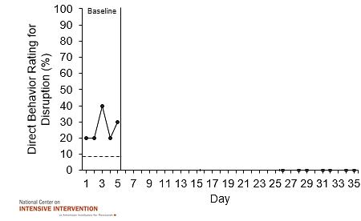
James’s Disruptions During Reading Intervention
Disruption Data During Reading Intervention
Notes:
Ms. Taylor collects baseline data on James' disruptive behavior during his reading intervention. She collects these data in addition to data collected to monitor his progress in reading.
James’s baseline data were collected during five sessions using momentary time sampling and the graph shows the percent of intervals where James was engaged in disruptive behavior. Ms. Taylor collects at least five data points to establish baseline performance. Ideally, these data would demonstrate stability. Highly variable data may suggest a need to collect additional baseline data and revisit the operationally defined behaviors and anchors for accuracy. Now that Ms. Taylor has collected enough data points for baseline data, she determines a need to implement an intervention for James.

Slide 68
Connecting With the DBI Team
Notes:
Ms. Taylor brings her concerns about James to her DBI team.

Slide 69
Do I Need a DBI Team to Implement DBI?
No. Individual teachers can independently implement DBI.
But three (or more) heads are always better than one when engaging in problem solving!
Notes:
Although Ms. Taylor does not need a team to implement DBI or rate the intervention using the dimensions of the Taxonomy of Intervention Intensity, she recognizes the value of the different expertise of her DBI team members in helping her analyze and develop an intervention that works for James.

Slide 70
Hypothesis of Function
Hypothesis of function(s) of problem behavior:
During reading instruction, James swipes materials and is disruptive to escape from reading-related academic demands.
Notes:
The team analyzes the baseline data, gathers some additional data, and looks at background information. Based on the data analysis, they develop a hypothesis about the function of James’s behavior.
Read hypothesis.
Using this hypothesis, the team brainstorms potential solutions. They consider whether the reading intervention that James’ is receiving is appropriate and if any additional reading supports are needed. They also consider a social skills intervention to help James more effectively communicate, problem solve, and address the challenges he is facing during his reading intervention.
The team determines that adding a social skills intervention into the reading intervention that Ms. Taylor is implementing might be beneficial for James and a good review for the other students in the intervention group.

Slide 71
Proposed Intervention: Social Skills Training Standard Protocol
Adult MODELS target skill.
Students ROLE PLAY with peers or adults.
Students are given FEEDBACK.
Students receive PRAISE for correct display of skills.
Students have homework to practice further in other SETTINGS.
(Willis et al., 2019)
Notes:
A couple things to keep in mind as we think about the social skills intervention the DBI team is proposing : It is a specific curriculum of a collection of practices that use a behavioral approach for teaching age-appropriate social skills and competencies that include:
Communication
Problem solving
Decision making
Self-management
Peer relations
The slide describes the standard protocol for this intervention.

Slide 72
Validated Intervention Program Social Skills
Intervention Dimensions | Rating
Strength | Yes
Dosage | 1
Alignment | 3
Attention to transfer | 2
Comprehensiveness | 2
Academic supports | 3
0 | 1 | 2 | 3
Fails to Address Standard | Addresses Standard Minimally | Addresses Standard Moderately | Addresses Standard Well
Notes:
The team further analyzes the intervention against the dimensions of the taxonomy and rates, on a 0–3 rating scale or yes/no, for how the intervention meets each of the components. The ratings provide the team an understanding of the intervention and will help guide intensification if needed. There is no perfect intervention.
Note there is only one social skills training intervention on the tools chart, Skillstreaming, which we will review, and the social skills training on the WWC website is limited to prekindergarten. Although specific research-based evidence was lacking using these resources, the team reviewed related research studies, to illustrate how educators can think through the process of implementing a social skills training program (Willis et al., 2019).
For strength, the team gives the intervention a rating of yes because it was tested by means of a randomized controlled trial. The study, however, did not describe the unit(s) used for primary data analysis.
The team looks at dosage. Here, the team is really focused on the opportunities that James will have to practice the targeted skill and receive feedback. In this case, they believe the small group size and frequency will provide James opportunities to respond, but they rate it as lower because it is a limited amount of time prior to the reading intervention. They think James might need more corrective feedback. They give this intervention a 1 for James as they note that this might be something that they will need to intensify.
Next, the team considers alignment. Here they are looking at the match to James’s needs and whether there are components that focus on things that James has already mastered. How well a program specifies reduction of behaviors of concern and incorporates a meaningful focus on appropriate behaviors we would expect for a particular context such as following classroom and schoolwide expectations. In addition, Ms. Taylor and colleagues want to consider whether this connects to age-appropriate behavior skills. In this case, they are mostly pleased that the intervention fits James’s needs.
As they consider a rating for attention to transfer, they note the intervention provides opportunities for the student to practice the skill across different contexts that will promote generalization and provides procedures for reinforcing the skill when it is displayed under a variety of circumstances, including new or unanticipated circumstances. The team provides a rating of 2 for attention to transfer.
Next, they look at comprehensiveness. There are a number of elements that we need to consider when rating comprehensiveness. The team reflects on the following elements to determine a rating.
Intervention includes a plan for teaching appropriate behaviors with adequate opportunities for practice (yes)
Intervention includes plan for adjusting antecedent conditions to prevent problem behavior (no)
Intervention includes plan for reinforcing appropriate behavior (yes)
Intervention includes plan for minimizing reinforcement for problem behavior (no)
Intervention includes a plan for punishment of problem behavior if positive reinforcement–based supports are determined insufficient (no)
Intervention includes a plan for fading supports; supports can easily be faded (no)
Fidelity of implementation can be checked or monitored easily (no)
Intervention works in conjunction with related services (yes)
Intervention includes plan for communicating with parents (yes)
Overall, the team gives it a 2. They think it does an adequate job of introducing new skills and providing immediate feedback and praise; however, there may be a need for additional support with monitoring skills across context and fading supports.
Last, they look at academic support. They know that James has difficulty with reading instruction, so they want to ensure that the intervention incorporates strategies to address this. The team considers whether the intervention complements rather than supplant academic focus? Also, is the reinforcement programmed for responses that will support academic progress? The team gives it a 3 because the intervention is easily implemented in the context of academic and behavior and complements an academic focus. The team also agrees providing behavior-specific praise will encourage academic progress.

Slide 73
Initial Plan
 | Initial Implementation
Reading Intervention | James attends a reading intervention with 5 other students three times a week for 30 minutes. Instruction focuses on both decoding and comprehension.
Social Skills Intervention | Ms. Taylor will incorporate 5 minutes of social skills training during the start of each reading intervention period.
Notes:
Based on the review of the intervention, the team decided to implement the social skills training program. Ms. Taylor will incorporate 5 minutes of social skills training prior to the start of each reading intervention period.
She completes the Skillstreaming pre-assessment for James and identifies five key social skill lessons she will teach. Her plan is to focus on one skill each week.

Slide 74
James: Disruption Data
Disruption Data During Reading Intervention
Baseline
Intervention
Should you intensify and individualize the intervention?
Notes:
Ms. Taylor and her team set a goal of less than 10% disruptive behavior and began the social skills intervention.
Ms. Taylor continued to collect data after the implementation of the social skills intervention and brought the data back to the DBI team. In addition to the disruption data, she shares that James is making progress toward his reading goal. The team analyzed the data. Should they intensify and individualize the intervention?
Let's review the graph. Remember, visual analysis is the process of reaching a judgment about the reliability or consistency of intervention effects by visually examining graphed data.
Trend: Trend relates to the overall direction of the data path on a graph. We typically label trends as increasing, decreasing, or zero. How would you rate the trend of James’s data?
Level: Refers to the level of data points; we’re talking about where the data points are in relation to the vertical axis. In general terms, levels of behavior may be viewed as low, moderate, or high. What would you rate the level of James’s data?
Variability: Variability is more difficult than the other characteristics because it requires an examination of the overall picture of the data. One way to help with interpretation is to draw a best-fit line through the data points. If many of those data points are close to the line, variability could be considered low.

Slide 75
Using the Taxonomy to Inform Intensification
Revisit the taxonomy.
Identify dimensions with relatively weak ratings.
Consider which dimensions are most likely to change student outcomes and can be easily implemented.
Prioritize two or three areas for intensification; document changes on the taxonomy rating form.
Notes:
The team members look back at their initial ratings to consider where there were weaker ratings and what they might need to intensify based on James’s needs.

Slide 76
Revised Plan
 | Initial Implementation | Intensified Implementation
Social Skills Intervention Intensification | Ms. Taylor will incorporate 5 minutes of social skills training during the reading intervention. | Ms. Taylor will increase the dosage to add an additional 10 minutes of individualized social skills training for James in addition to the five minutes of social skills training that will continue to occur for the reading group. This will provide additional practice opportunities aligned to the specific skill needs for James and with intentional focus on transferring those skills across settings.
Reading Intervention | James attends a reading intervention with 5 other students 3 times a week for 30 minutes. Instruction focuses on both decoding and comprehension. | James attends a reading intervention 3 times a week with 3 other students for 30 minutes. Additional practice opportunities and explicit instruction will focus on decoding.
Notes:
After the introduction of the intervention and the initial data review conducted by the DBI team, the team determined that James’s social skills intervention should be intensified. The team decided to intensify the domains of dosage by increasing the number of social skills group sessions James would attend during the week and focusing on the domain of attention to transfer by increasing the number of opportunities to practice targeted prosocial skills. James was encouraged to practice prosocial skills across school settings, including classrooms, lunchroom, art, and gym. The team also emphasizes the practice of the targeted prosocial skills during James’ reading intervention block.
The team also revisits the reading intervention that Ms. Taylor is using with James to determine if it is necessary to intensify the reading supports being provided. The team determines they will ensure additional practice opportunities for James by minimizing the number of participants in the reading group from 5 to 3 with two additional students whose data also shows a need related to more targeted explicit instruction and practice opportunities in decoding.

Slide 77
James: Disruption Data
Disruption Data During Reading Intervention
Baseline
Intervention
Adjustment A
Should you intensify and individualize the adapted intervention?
Notes:
Mrs. Taylor continued to collect data after the team made the intensification. What do you think? Should they further intensify and individualize the intervention?

Slide 78
James: Disruption Data
Disruption progress monitoring Data During Reading
Baseline
Intervention
Adjustment A
Adjustment B
Should you intensify and individualize the intervention?
Notes:
Although James is closer to his goal of less than 10% disruptive behavior, the team decided that some additional intensification was needed. They returned to the taxonomy and intensified areas within James’s plan. Mrs. Taylor continued to collect data after the second adjustment. After reviewing James’s data, is he responding to the intervention, or should they intensify and individualize the intervention?
If a student isn’t making ambitious growth, despite an intensified plan, don’t fret! As a reminder, DBI is an ongoing and iterative process that may require multiple rounds of adaptation. Using the taxonomy to systematically build an intensified intervention plan can help educators as they support students with intensive academic or behavioral needs.

Slide 79
Review and Wrap-Up
Notes:
As we wrap up, we will highlight a few areas where you can learn more about the taxonomy and behavior supports.

Slide 80
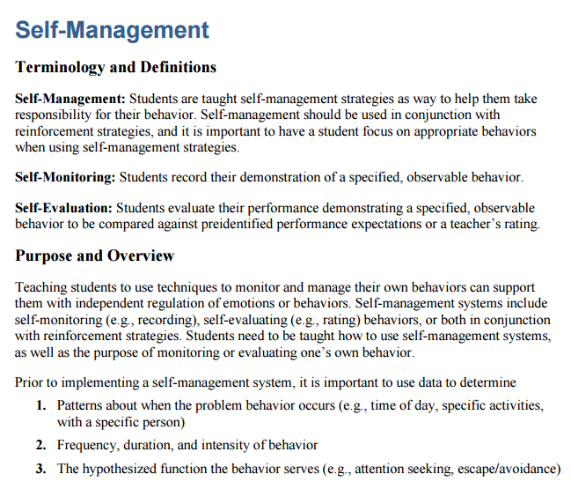
Resources to Learn More About Behavioral Principles and Strategies
https://intensiveintervention.org/intervention-resources/ behavior-strategies-support-intensifying-interventions
https://intensiveintervention.org/intensive-intervention-behavior-course
Notes:
NCII includes information to support your consideration of the behavior supports. The behavior strategies can help support teachers working with students who have challenging behaviors. Each strategy incorporates key terminology, an overview of the purpose, and all associated materials. The strategies also integrate approaches for intensification for students with more challenging behaviors.
Behavior Support for Intensive Intervention also provides a deep review of how educators can support student behavior in the classroom. This eight-part module series includes video lectures, activities, and more. The materials are organized around three overarching areas: antecedent modification, self-management, and reinforcement strategies.

Slide 81
Learn More About the Taxonomy of Intervention Intensity
https://intensiveintervention.org/taxonomy-intervention-intensity
Notes:
If you are interested in learning more about the Taxonomy of Intervention Intensity, the NCII website includes a page focused on the taxonomy. On that page, there are four recorded webinars that go deeper into applying the taxonomy to different content areas and training materials providing an overview, an application of the taxonomy for mathematics and an application of the taxonomy for reading.

Slide 82
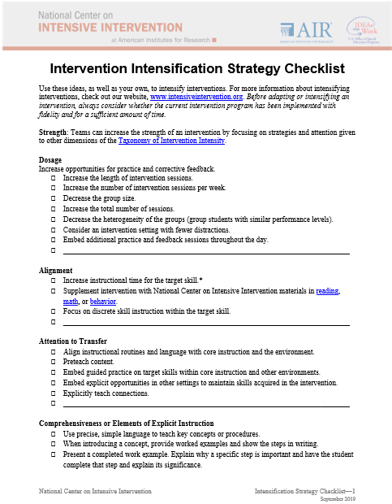
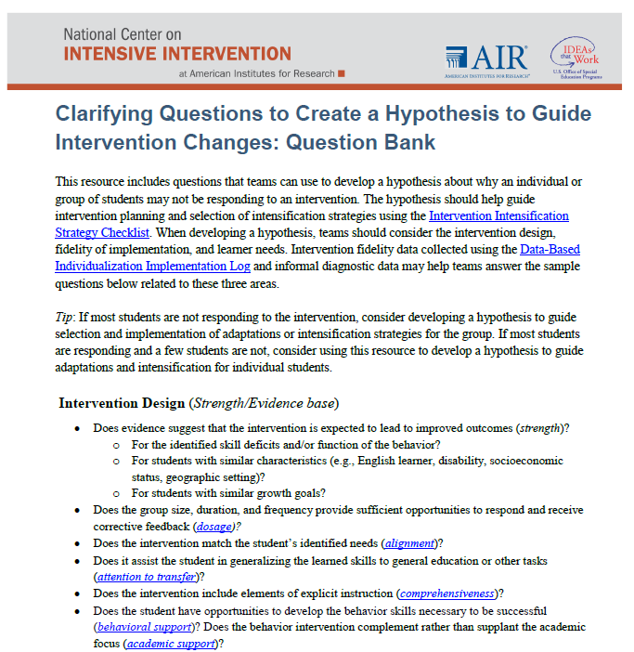
Resources to Support Intensification Decisions
Notes:
On the Taxonomy page there are also tools and handouts that can be used by teams as they implement the DBI process. For example, the Intensification Strategy Checklist Handout and Clarifying Questions to Create a Hypothesis to Guide Intervention Changes: Question Bank include guiding questions and considerations as teams consider why a student is struggling and how to intensify supports.

Slide 83
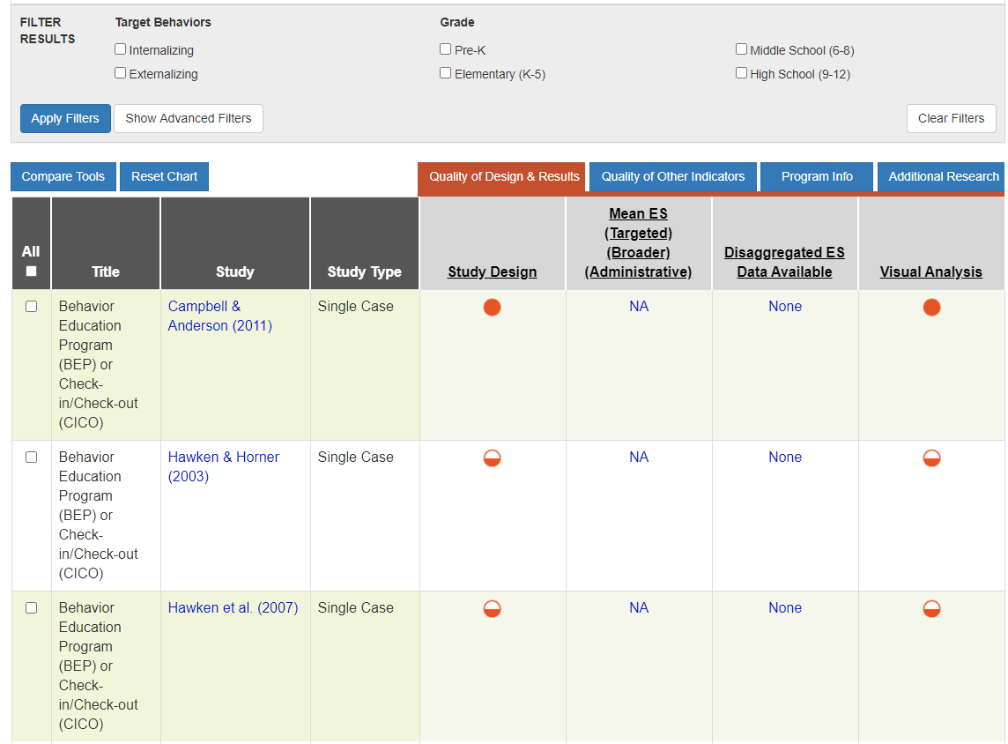
Resources to Evaluate Strength
Behavior Intervention Tools Chart
https://charts.intensiveintervention.org/bintervention
Notes:
The Behavior Intervention Tools Chart, seen here, was one of the tools we used to help us to evaluate the strength dimension. This tools chart presents information about behavioral intervention programs. This is one of six tools charts on the NCII website. In addition to the NCII tools charts, you also might want to visit the WWC and Best Evidence Encyclopedia sites.

Slide 84
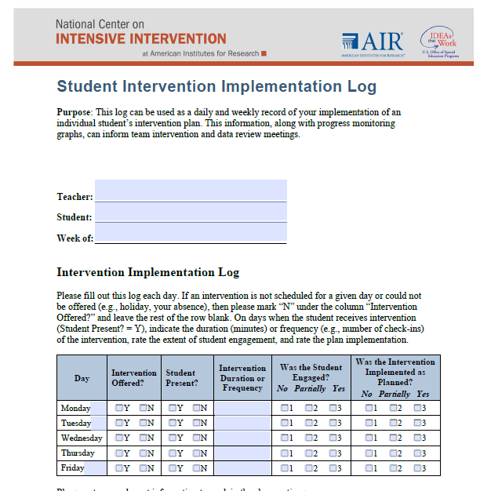
Resources to Monitor Fidelity of Implementation
https://intensiveintervention.org/implementation-support/fidelity-resources
Notes:
As we discussed, it is important for educators to consider the dimensions when designing and intensifying intervention, but it also is important to consider the implementation of the intervention. Although we did not discuss how to monitor fidelity implementation of an intervention in detail, there are fidelity tools and resources, including the daily and weekly log, to help educators monitor fidelity of implementation over time.

Slide 85
Activity: Taxonomy K-W-L
What Does It Help Me KNOW? | What More Do I WANT to Know? | How Will I LEARN More?
Handout
Notes:
Return to the handouts we used at the start of this session (pages 2-4). Consider what was discussed today. On your K-W-L handout, take about 5–10 minutes to note what the document helps you know and what you want to know more about.

Slide 86
Taxonomy of Intervention Intensity: Review
Notes:
The Taxonomy of Intervention Intensity is designed to support special educators and interventionists in understanding their validated intervention programs. For those students who do not respond to the intervention as designed, the taxonomy can be used to help teams and educators make decisions about how the intervention can be individualized to better meet their needs.

Slide 87
Things to Remember
DBI is ongoing and intense—relatively few students should need it (3% to 5% of the school population).
Academic and behavior supports do not exist in isolation.
There is no perfect intervention, but it is important to understand your intervention’s strengths and limitations and to start with a strong foundation.
Don’t make too many intervention adaptations at the same time.
Notes:
DBI is intense—relatively few students should need it.
If more than 3% to 5% of students in a school appear to require DBI, consider evaluating the core instruction, schoolwide behavior supports, and Tier 2 intervention programs.
DBI often takes sustained and iterative cycles of adaptation over time.
Academic and behavior supports do not exist in isolation.
They are often most successful when combined to meet students’ individual needs.
There is no perfect intervention.
We do have access to a growing repository of interventions that have shown evidence of effectiveness, but we need to consider the dimensions of the taxonomy to guide our decision-making process and understand the multiple dimensions that can help to ensure that we have a strong intervention.
Even when we can’t start with a standardized program, the taxonomy can guide our understanding of what we are providing.
Don’t make too many intervention adaptations at the same time.
It may be tempting to try everything at once because you want to help a student as soon as possible, but if you make all possible changes at the same time, you won’t know which change works for the student (any improvement in performance could be the result of one or more adaptations). Fewer changes also may make implementation more sustainable.

Slide 88
Reflection
What am I most excited about? | What am I unsure of or want to learn more about? | What changes will I make as a result of what I learned today?
Notes:
As we end the day, take a moment to reflect on what we covered. What are you most excited about? What questions do you still have? What changes will you make? Take 5 minutes to reflect and then share with a neighbor.

Slide 89
Thank you!
Thank you!

Slide 90
References
Fuchs, L. S., Fuchs, D., & Malone A. S. (2017). The taxonomy of intervention intensity. Teaching Exceptional Children, 50(1), 35–43.
Kazdin, A.E. (1982). Single-case research designs: Methods for clinical and applied settings. New York: Oxford University Press, Inc.
Martens, B. K. (2018). The student should help the teacher: A view from 30 years as an ABA trainer. Behavior Analysis in Practice, 11(3), 184–186.
Menzies, H. M., Lane, K. L., Oakes, W. P., & Ennis, R. P. (2017). Increasing students’ opportunities to respond: A strategy for supporting engagement. Intervention in School and Clinic, 52(4), 204–209.
National Center on Intensive Intervention. (2013). Data-based individualization: A framework for intensive intervention. Produced by the American Institutes for Research. https://intensiveintervention.org/

Slide 91
References
Sawilowsky, S. S. (2009). New effect size rules of thumb. Journal of Modern Applied Statistical Methods, 8(2), 597–599. Available at: http://digitalcommons.wayne.edu/coe_tbf/4.
Willis, D., Siceloff, E. R., Morse, M., Neger, E., & Flory, K. (2019). Stand-alone social skills training for youth with ADHD: A systematic review. Clinical Child and Family Psychology Review, 22(3), 348–366.

Slide 92
NCII Disclaimer
This presentation was produced under the U.S. Department of Education, Office of Special Education Programs, Award No. H326Q160001. Celia Rosenquist serves as the project officer. The views expressed herein do not necessarily represent the positions or policies of the U.S. Department of Education. No official endorsement by the U.S. Department of Education of any product, commodity, service, or enterprise mentioned in this presentation is intended or should be inferred.

