Slide 1
Module 8
Intensifying Behavioral Support
Jennifer Freeman, PhD
Don Briere, PhD
Brandi Simonsen, PhD

Slide 2
Acknowledgements
Much of the content shared in this module was developed by members of the OSEP-funded National Technical Assistance Center for Positive Behavioral Interventions and Supports.
Thank you to:
  Members of classroom workgroup:
    Brandi Simonsen, Jennifer Freeman, Jessica Swain-Bradway, Robert Putnam, Heather George, Steve Goodman, Barb Mitchell, Kimberly Yanek, Kathleen Lane & Jeffrey Sprague
  Members of the Northeast PBIS Network:
    Susannah Everett, Adam Feinberg, George Sugai, Brandi Simonsen & Jennifer Freeman

Slide 3
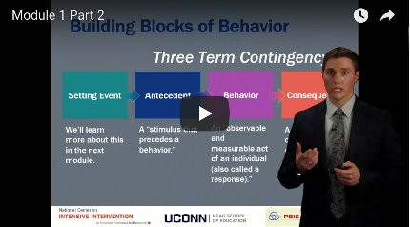
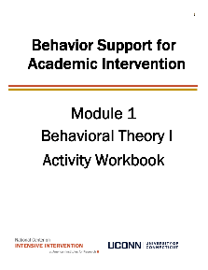

Orientation to Module Tools and Resources
Module Videos
Module Workbook
Module Readings and Additional Resources

Slide 4



Orientation to Module Elements
Activities
Module Quiz – Self Assessment
  Do you know the basic content presented in this module?
Coaching Activities
  Can you implement the content presented in this module in your classroom effectively?
Discussion Board Post
Workbook Quiz
Stop and Jot

Slide 5
Getting the Most Out of This Module
Pre-service
Become fluent with content and basic theory
New Teachers
Focus on moving from knowledge to practice
Experienced Teachers
Use activities as a self-reflection opportunity
Consider how you might coach or teach the skills/content to a new teacher in your building
Set a new implementation goal for yourself
Review resources to extend your learning with respect to culturally and contextually relevant implementation
Look for examples of implementation in your clinic placements
Video record or ask for feedback on your implementation of key practices during your student teaching
Set implementation goals and either self-monitor or ask for peer/coach feedback on your use of key skills
When a practice isn’t working use your understanding of theory to help you modify or intensify a practice to improve outcomes

Slide 6
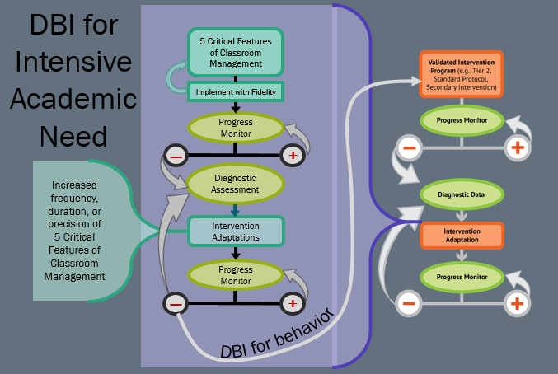
DBI for Intensive Academic Need

Slide 7
Module Objectives
By the end of Module 8 you should be able to:
Describe the decision-making process to indicate Tier 2 is appropriate
Identify critical features of Tier 2
Discuss how to modify Tier 2 interventions to meet the needs of more students
Highlight critical elements of a Functional Behavior Assessment (FBA)
Choose a desired and replacement behavior
Complete a Competing Pathway Model
Begin to identify strategies to make the problem behavior irrelevant, inefficient, and ineffective

Slide 8
Intensifying Behavioral Interventions
Part 1
How do we intensify supports for small groups of students?

Slide 9
Prevention Logic For All
Redesign of teaching environments…not students
Prevention Objectives
Prevention Actions
Decrease development of new problem behavior | Prevent worsening & reduce intensity of existing problem behavior | Eliminate triggers & maintainers of problem behavior | Add triggers & maintainers of prosocial behavior | Teach, monitor, & acknowledge prosocial behavior
Incidence
Prevalence
Biglan (1995); Mayer (1995); Walker et al. (1996)

Slide 10
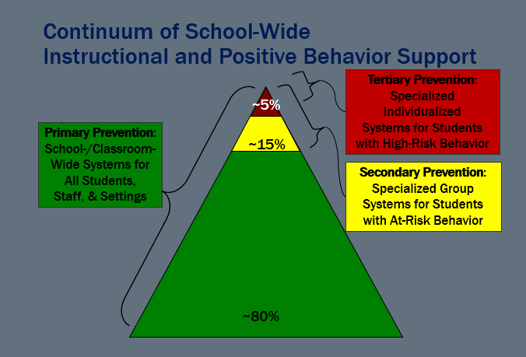
Continuum of School-Wide Behavior Supports
~80% of Students

Slide 11
Secondary Supports: Who Benefits?
Students who continue to demonstrate challenging behavior despite school and classroom supports
being in place
Approximately 10 to 15% of the student population
Likely to be students with both
academic and behavioral difficulties
Without effective school-wide prevention, we cannot reliably identify students who benefit from secondary supports

Slide 12
Common Elements of Tier 2 Practices
Consistent, standardized implementation across students
Easily accessible (e.g., within a few days of referral)
Continuous availability
Implemented by all school staff
Consistent with and extra doses of school-wide expectations and interventions
Targeted and explicit skill instruction
Acknowledgements of appropriate behavior
Increased adult support
Frequent performance feedback for targeted behaviors
Plans for generalization and maintenance
(Crone, Hawken, & Horner, 2010)
Taxonomy of Intervention Intensity
Strength
Dosage
Alignment
Attention to Transfer
Comprehensiveness
Behavioral Support
Individualization

Slide 13
PCBS Practices Decision-Making Guide:
3 Key Questions
PCBS Practices Decision-Making Guide:
3 Key Questions
Are the foundations of effective PCBS in place?
Are proactive and positive PCBS practices implemented consistently?
Do data indicate that students are still engaging in problem behavior?

Slide 14
Problem solving behavior part 1
Do data indicate that students are still engaging in problem behavior?
Are students still engaging in problem behavior?
Are behaviors minor or major expectation violations?
Well done! Monitor outcomes and adjust as needed
Use brief, specific error correction & other strategies
How many students are involved (many or few)?
Review, adjust & intensify CWPBIS. Ask for help!
Request additional (tier 2 & 3) support for students.
Yes
No
Minor
Major
Many
Few

Slide 15
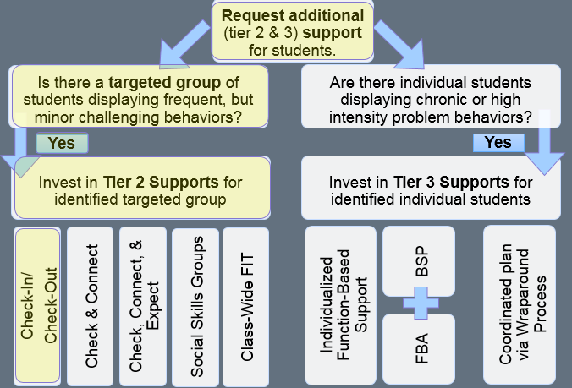
Additional Supports 1

Slide 16
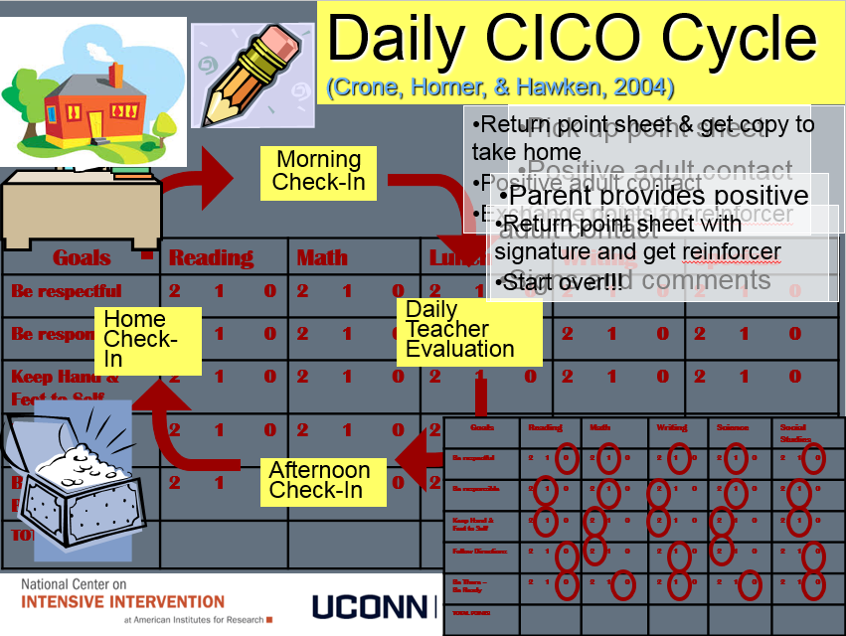
Daily CICO Cycle

Slide 17
Modifying CICO
For additional examples of point sheets click here
If CICO is effective
  Continue with CICO and begin planning for a transition to self-management
If CICO is not effective there are modifications you can make to the system to better align with student need
See this online module for more information about modifying CICO

Slide 18
Moving Toward Self-Management
Involves individuals managing, monitoring, and/or evaluating their own behavior.
Embed self-management strategies as driven by the data
  Manage own CICO account
  Use natural signals for monitoring as much as possible
  Self-monitor
  Self-record, check for accuracy
  Fewer check points during the day
    Maintain AM and PM times for awhile

Slide 19
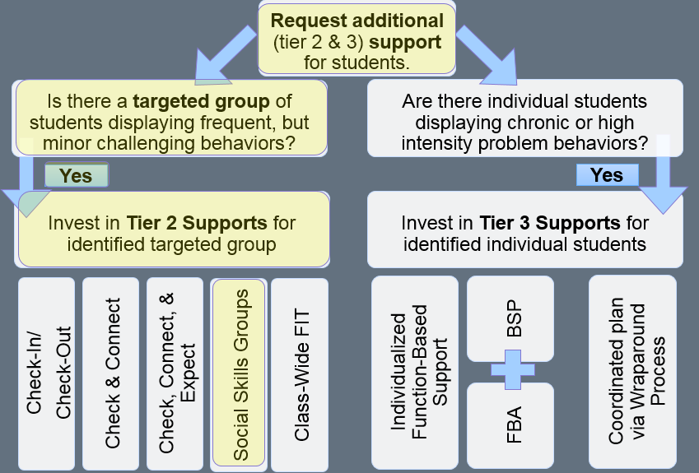
Additional support 3

Slide 20
Other Tier 2 Interventions
Social Skills Groups
Social Skills Groups: Social skills training includes direct instruction of appropriate social behavior. Direct instruction includes modeling of appropriate behavior, feedback on behavior, and opportunities to practice appropriate behavior in a natural setting. (hawken et al., 2009).
Social Skills Groups Practice Features:
  Increased positive adult contact
  Direct social skills training
  Direct link to school-wide behavioral goals and expectations
  Frequent feedback (Daily or weekly)
  Increased home-school communication
  Positive reinforcement contingent on meeting skill based goals

Slide 21
Social Skills Training Process
Students grouped based on target skills
Students attend a regular (e.g., weekly) social skills lesson where skills are directly taught, practiced, and reinforced.
Students receive feedback on their behavior from adults in small groups and throughout the day
Target skills and examples for use at home are shared with parents
Review module 3 for more information about designing social skills lesson plans
Also see MOPBIS for more information and tools on teaching tier 2 social skills

Slide 22
Packaged Curricula
Check out these resources for packaged social skills programs
  Resources social skills curicula and programs (2014)
  CASEL program guides
Big Question: Is it evidence based?
  ”Social skills are often taught through a combination of large group instruction, small skill groups, and individual social skills instruction. Does the program or curriculum provide this flexibility?
  Evidence-based social skills programs will always include direct instruction, modeling, roleplaying the skill, practicing the skill in different settings, and performance feedback. Are these types of delivery methods provided or possible?
  Performance deficits, skill deficits, and fluency deficits need to be determined when choosing social skills programming. Does the program distinguish these and provide strategies to address each?
  Self-management without any or minimal cues and prompts is the eventual goal of social skills instruction. Does the program lead to effective self-management”
Resource Brief, September, 2014. Ann O’Connor, Jenna Strawhun, Natalie Hoff & Reece L. Peterson, University of Nebraska-Lincoln.

Slide 23
Additional Support 2

Slide 24
Other Tier 2 interventions
Other Tier 2 Interventions
Class-wide FIT
Class-Wide Function-Related Intervention Teams (FIT):
Designed to:
  help students who need more than universal supports
  be implemented at the class-wide level
  incorporate individualized components
  address attention – a common function of problem behavior
  be implemented during “problem” times during the day
Kamps & Wills, 2009

Slide 25
CW-FIT Components
See https://cwfit.ku.edu/ for more information on CW-FIT
Teaching:
  Direct instruction of key social skills
    How to gain the teacher’s attention
    Following directions
    Ignoring inappropriate behaviors
    Other optional skills
Group contingency
  Teams compete for points (individual students can also self-monitor)
  Points are awarded every 2-5 minutes to groups displaying appropriate behavior
  Groups that meet their goal earn a reward

Slide 26
Review:
Common Elements of Tier 2 Practices
Consistent, standardized implementation across students
Easily accessible (e.g., within a few days of referral)
Continuous availability
Implemented by all school staff
Consistent with and extra doses of school-wide expectations and interventions (behavioral and academic)
Targeted and explicit skill instruction
Acknowledgements of appropriate behavior
Increased adult support
Frequent performance feedback for targeted behaviors
Plans for generalization and maintenance
(Crone, Hawken, & Horner, 2010)
Taxonomy of Intervention Intensity
Strength
Dosage
Alignment
Attention to Transfer
Comprehensiveness
Behavioral Support
Individualization

Slide 27
Intensifying Behavioral Support
Part 2
How do we intensify supports for individual students?

Slide 28
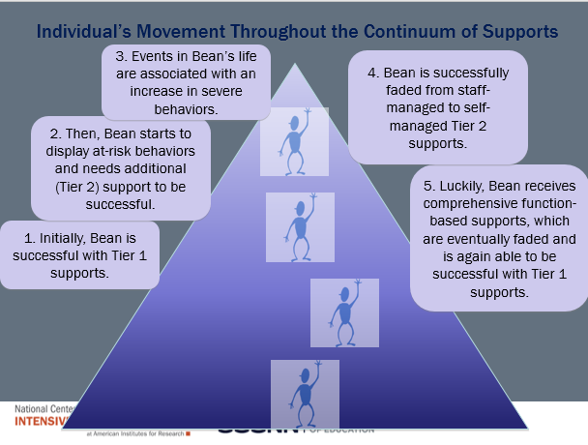
Individual’s movement throughout the continuum of supports

Slide 29
Individual Student Systems
Behavioral competence at school & district levels
Team- & data-based decision making
Targeted social skills & self-management instruction
Individualized instructional & curricular accommodations
Function-based behavior support planning
Comprehensive person-centered planning & wraparound processes

Slide 30
Additional support examples
Request additional (tier 2 & 3) support for students
Is there a targeted group of students displaying frequent, but minor challenging behaviors?
Are there individual students
displaying chronic or high
intensity problem behaviors?
Yes
Yes
Invest in Tier 2 Supports for identified targeted group
Invest in Tier 3 Supports for identified individual students
BSP
Individualized Function-Based Support
Coordinated plan via Wraparound Process
Check-In/
Check-Out
Social Skills Groups
Check, Connect, & Expect
Class-Wide FIT
Check & Connect
FBA

Slide 31
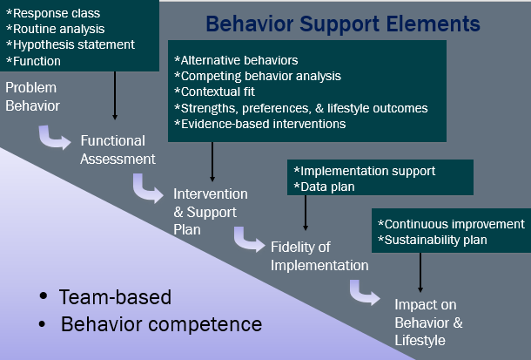

Behavior support elements

Slide 32
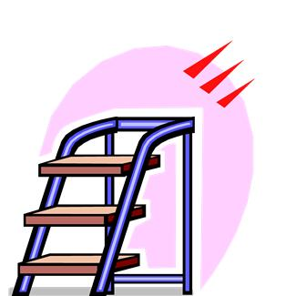

3 Basic Steps:
Developing interventions for Individual Students
3. Develop intervention strategies
Training
Required
2. Choose replacement behaviors
1. Look at the function of behavior

Slide 33


Remember Functions
S^{R+}
S^{R-}

Slide 34
1. Look at the Function of Behavior
What typically precedes?
What do the behaviors look like?
What typically follows?
Antecedent
Behavior
Consequence
Based on observing these patterns across time, what is the probable function of the behavior?

Slide 35
Let’s Review an Intensive Example
When Adam is told that he must wait for a favorite activity, he screams, hits, kicks, and destroys property. After this behavior, staff immediately allow him to do his favorite activity. In the future, Adam continues to scream, hit, etc., whenever he is told to wait.

Slide 36
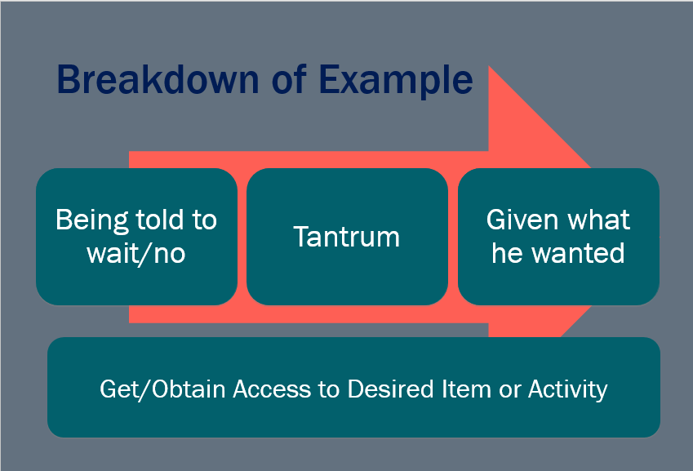
Breakdown of Example

Slide 37
Activity 8.1: Stop and Jot
Determining Function
In your workbook, jot down several sources of information you would use to collect information to help determine function of behavior for a student in your classroom.

Slide 38
Activity 8.1: Review
Determining Function
Remember to consider existing data that will help you understand the full context of the behavior problem. Let’s look at some additional data sources that should be included in an FBA.
This resource from NCII provides some examples of ABC data collection forms.

Slide 39
FBA: Collecting Information
An FBA involves collecting information from multiple sources through a variety of methods across time, including:
Records Reviews
Interviews
Direct Observations
Experimental Analysis (Structural/Functional)
Review relevant school records to look for patterns across time
Interview parents, teachers, staff, and student about patterns
Systematically observe behaviors and the context in which they occur
Occasionally, a trained person will need to conduct additional analyses

Slide 40
FBA: Collecting Information
An FBA involves collecting information from multiple sources through a variety of methods across time, including:
Records Reviews
Interviews
Direct Observations
Experimental Analysis (Structural/Functional)
Additional Resources:
You can find additional examples of data collection forms and protocols here
This tool will help you assess FBAs
Training
Required

Slide 41
Activity 8.2: Analyze an Example
Determining Function
Given the case study in your workbook, Identify:
  the target (or problem) behavior,
  the antecedents that typically precede the behavior, and
  the function of the behavior.
Use this information to write a hypothesis statement.

Slide 42
Activity 8.2: Review
Determining Function
What typically precedes?
What do the behaviors look like?
What typically follows?
Antecedent
Behavior
Consequence
Difficult task- especially a writing-intensive assignment
Talks out, makes noises, runs around the room
Jessica is sent out of the room to the principal or ISS- no work
Escape or avoid difficult task

Slide 43

3 Basic Steps:
Developing interventions for Individual Students
3. Develop intervention strategies
Training
Required
2. Choose replacement behaviors
1. Look at the function of behavior

Slide 44
Fundamental Rule
“You should not propose to reduce a problem behavior without also identifying alternative, desired behaviors person should perform instead of problem behavior.”
(O’Neill et al., 1997, p. 71)

Slide 45

2. Choose a Desired Behavior
The desired behavior should be what is expected given the same antecedent event/condition. It likely results in different consequences.
DESIRED BEHAVIOR
NATURAL CONSEQUENCE
(in typical instructional conditions)
PROBLEM BEHAVIOR
MAINTAINING CONSEQUENCE (FUNCTION)

Slide 46
2. Choose a Replacement Behavior
The replacement behavior should be more efficient and effective.
PROBLEM BEHAVIOR
MAINTAINING CONSEQUENCE (FUNCTION)
REPLACEMENT BEHAVIOR
HELP

Slide 47
Replacement vs. Desired Behavior
Often, the replacement behavior is different from what we ultimately want the student to do—the desired behavior.
We use a shaping process to teach the learner to shift from the replacement behavior to the desired behavior.
To illustrate the relationships among the summary statement (or testable hypothesis), the replacement behavior, and the desired behaviors, we can use the Competing Pathway Model.

Slide 48
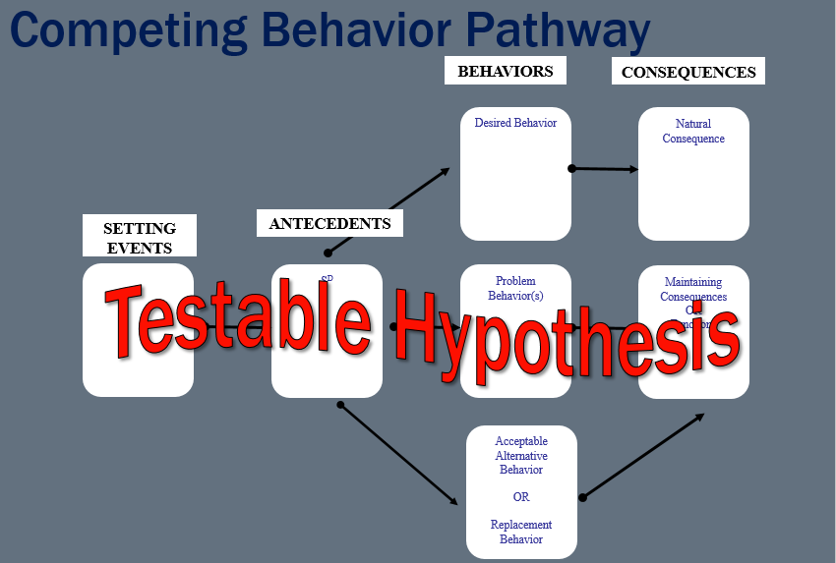
Competing Behavior Pathway

Slide 49
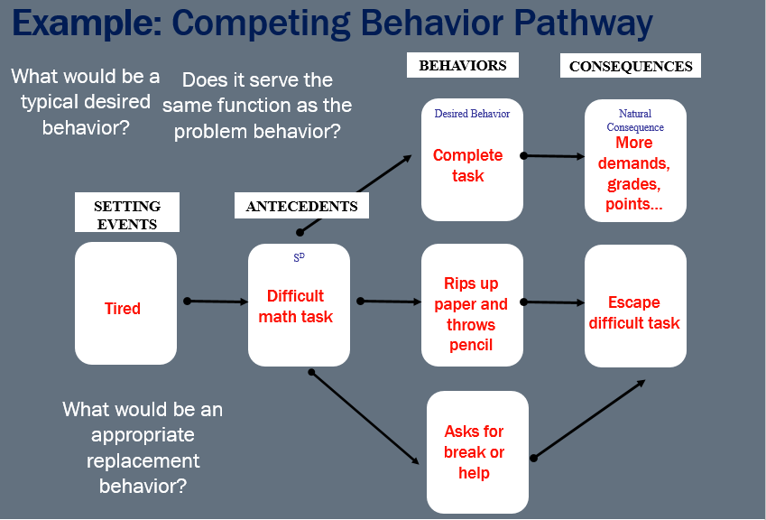
Example of a competing behavior pathway

Slide 50
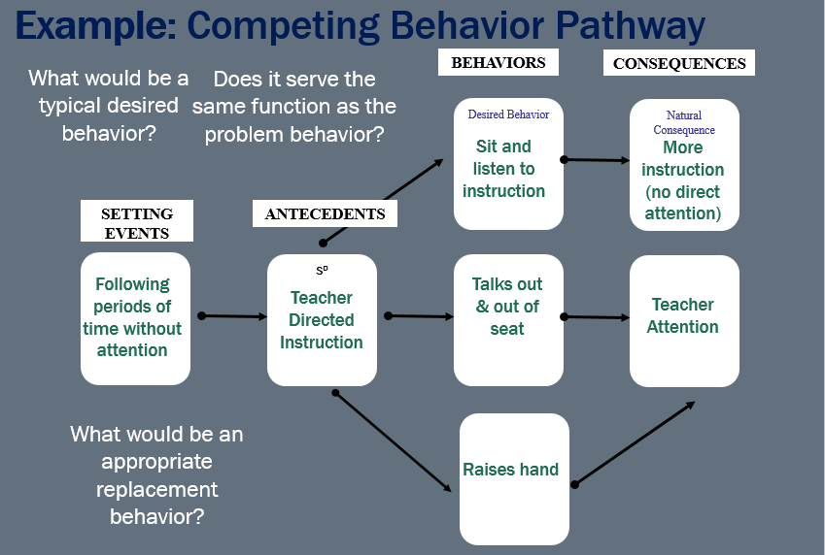
Example: Competing Behavior Pathway

Slide 51
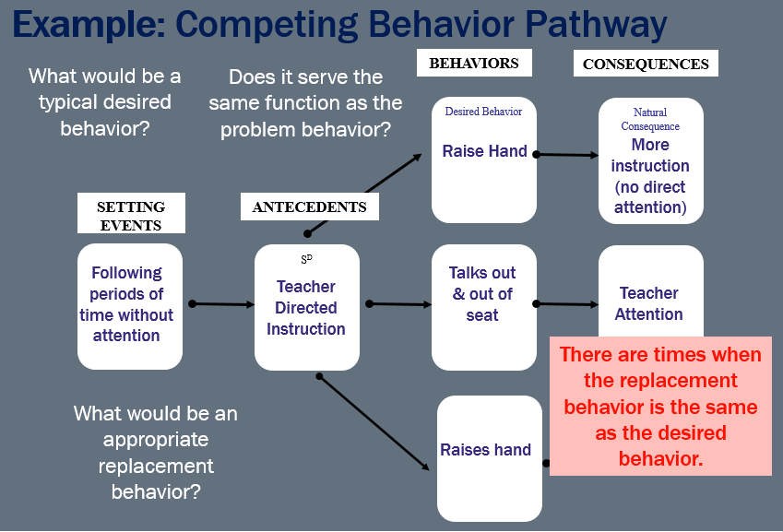
Example: Competing Behavior Pathway

Slide 52
Activity 8.3
Activity 8.3: Discussion Board Post
Competing Pathway
Develop a competing behavior pathway for Jessica (the student in your workbook case study).
Post your version of the competing pathway on the discussion board.
Review the pathways posted by your colleagues offering feedback and additional ideas for replacement behaviors

Slide 53
Activity 8.3 Review
Activity 8.3: Review
BEHAVIORS
CONSEQUENCES
Desired Behavior
Natural Consequence
More demands, grades, points…
Complete task?
SETTING EVENTS
ANTECEDENTS
Problem Behavior(s)
Maintaining Consequences
OR
Functions
Difficult writing task
Talks out, makes noises, runs around
?
Escape difficult task
Acceptable
Alternative Behavior
OR
Replacement
Behavior
Asks for break or help?

Slide 54
3 basic steps part 2
3 Basic Steps:
Developing interventions for Individual Students
3. Develop intervention strategies
Training
Required
2. Choose replacement behaviors
1. Look at the function of behavior

Slide 55
3. Develop Intervention Strategies
Based on our understanding of the context of problem behavior, we then begin to develop intervention strategies.
ANTECEDENT
MANIPULATIONS
instructional STRATEGIES
CONSEQUENCE
MANIPULATIONS
Ways to prevent the occurrence of behavior
Ways to teach replacement behavior AND shape replacement behavior into desired behavior
Ways to (a) increase occurrences of replacement and desired behaviors and (b) decrease occurrences of target behaviors
…to make the problem behavior
IRRELEVANT
…to make the problem behavior
INEFFICIENT
…to make the problem behavior
INEFFECTIVE

Slide 56
More specifically…
SETTING EVENT
MANIPULATIONS
ANTECEDENT
MANIPULATIONS
WAYS TO TEACH
BEHAVIORS
CONSEQUENCE
MANIPULATIONS
Minimize the likelihood
Neutralize
Withhold antecedent
Add prompts
Increase reinforcement for desired behavior
Redesign the environment
  Physical arrangement
  Predictability
  Choice
  Instructional variables
Add Prompts and/or pre-corrections
Develop objectives
Teach replacement behavior
Shift from replacement to desired behavior
Increase function-based reinforcement for replacement behavior
Increase reinforcement for desired behavior
Prevent reinforcement for problem behaviors
Training
Required

Slide 57
More Detail Re: Earlier Example
Adam is a 12 year-old boy who lives in a group home that serves four other adolescents (3 boys and 1 girl) with various levels of disabilities. He is always assigned a 1:1 staff.
Adam has lived in group homes for the past 3-4 years. In his previous placement, he was successfully attending school (a process which took months to achieve). He was moved from that group home to the current placement to be closer to his mother.
Upon moving, he regressed into using his problem behaviors (hitting, kicking, biting, spitting, pushing, scratching, etc.). He was removed from school because of his problem behaviors.

Slide 58
1. Determine Function
What typically precedes?
What do the behaviors look like?
What typically follows?
Antecedent
Behavior
Consequence
Being told to wait/no
Tantrum
Given what he wanted
Based on observing these patterns across time, what is the probable function of the behavior?
Get/Obtain Access to Desired Item or Activity

Slide 59
Activity 8.4: Stop and Jot
2. Choose a Replacement Behavior
Given that the probable function of Adam’s behavior is to get or obtain access to desired items, activities, or attention from preferred people, what would you select as a replacement behavior? Jot a couple of ideas in your workbook.
Remember, must be the behavior that should be more efficient and effective at achieving the function than the problem behavior.

Slide 60
Activity 8.4: Review
2. Choose a Replacement Behavior
What did you consider?
Asking for a break?
Grumbling – but not having a tantrum?
Choosing an alternative activity while he waits?
Remember, must be the behavior that should be more efficient and effective at achieving the function than the problem behavior.

Slide 61
3. Develop Intervention Strategies
ANTECEDENT
MANIPULATIONS
INSTRUCTIONAL STRATEGIES
CONSEQUENCE
MANIPULATIONS
Visual Schedule
Predictable routines
Provide choices
Prompt Adam to engage in replacement behavior prior to denial/delay
Role play situations in which Adam wants something. Have him practice replacement skills
Intensive social skills instruction
Immediately reinforce use of replacement behaviors (praise and access)
Ensure no access when Adam engages in problematic behaviors

Slide 62
Activity 8.5: Analyze an Example
Developing Interventions
Start with the competing pathway you developed for Jessica.
Develop intervention strategies to prevent, teach, and reinforce the replacement and desired behavior you identified

Slide 63
Activity 8.5: Review
ANTECEDENT
MANIPULATIONS
INSTRUCTIONAL STRATEGIES
CONSEQUENCE
MANIPULATIONS
Provide choices
Chunk assignments
Provide appropriate academic accommodations
Prompt Jessica to engage in replacement behavior prior to giving a difficult assignment
Role play situations in which Jessica is given difficult work and asks for a break
Intensive academic skill instruction.
Immediately reinforce use of replacement behaviors (praise and break from work)
Ensure no escape from work when Jessica engages in problematic behaviors
This is just one example: See this resource for more ideas about how to prevent teach and reinforce behavior.

Slide 64
Implementing a Plan
See modules 6+7 for data collection strategies
Train staff to run the plan.
Set up system to monitor the effects of the intervention on the rate of client’s problematic behaviors and acquisition of replacement behaviors (collect data).
Make changes to the plan based on data.
  Was your hypothesis wrong?
  Are staff consistently implementing the plan?
  Do you need to re-train staff?
Also see additional resources for tier 3 intensive behavior support at PBIS.org and intensiveintervention.org

Slide 65
Additional Support for students diagram
Request additional (tier 2 & 3) support for students
Is there a targeted group of students displaying frequent, but minor challenging behaviors?
Are there individual students
displaying chronic or high
intensity problem behaviors?
Yes
Yes
Invest in Tier 2 Supports for identified targeted group
Invest in Tier 3 Supports for identified individual students
BSP
Individualized Function-Based Support
Coordinated plan via Wraparound Process
Check-In/
Check-Out
Social Skills Groups
Check, Connect, & Expect
Class-Wide FIT
Check & Connect
FBA

Slide 66
Next Steps
Module 8 Quiz
Classroom Application Activity

