Slide 1
Module 6
Defining, Measuring, and Monitoring Behavior
Jennifer Freeman, PhD
Don Briere, PhD
Brandi Simonsen, PhD

Slide 2
Acknowledgements
Much of the content shared in this module was developed by members of the OSEP-funded National Technical Assistance Center for Positive Behavioral Interventions and Supports.
Thank you to:
  Members of classroom workgroup:
    Brandi Simonsen, Jennifer Freeman, Jessica Swain-Bradway, Robert Putnam, Heather George, Steve Goodman, Barb Mitchell, Kimberly Yanek, Kathleen Lane & Jeffrey Sprague
  Members of the Northeast PBIS Network:
    Susannah Everett, Adam Feinberg, George Sugai, Brandi Simonsen & Jennifer Freeman

Slide 3
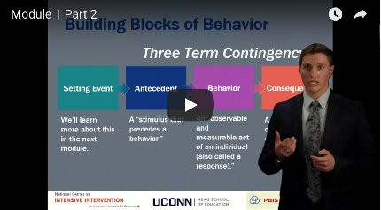
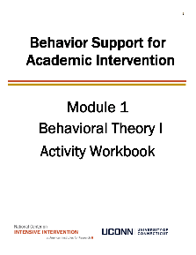

Orientation to Module Tools and Resources
Module Videos
Module Workbook
Module Readings and Additional Resources

Slide 4



Orientation to Module Elements
Activities
Module Quiz – Self Assessment
  Do you know the basic content presented in this module?
Coaching Activities
  Can you implement the content presented in this module in your classroom effectively?
Discussion Board Post
Workbook Quiz
Stop and Jot

Slide 5
Getting the Most Out of This Module
Pre-service
Become fluent with content and basic theory
New Teachers
Focus on moving from knowledge to practice
Experienced Teachers
Use activities as a self-reflection opportunity
Consider how you might coach or teach the skills/content to a new teacher in your building
Set a new implementation goal for yourself
Review resources to extend your learning with respect to culturally and contextually relevant implementation
Look for examples of implementation in your clinic placements
Video record or ask for feedback on your implementation of key practices during your student teaching
Set implementation goals and either self-monitor or ask for peer/coach feedback on your use of key skills
When a practice isn’t working use your understanding of theory to help you modify or intensify a practice to improve outcomes

Slide 6
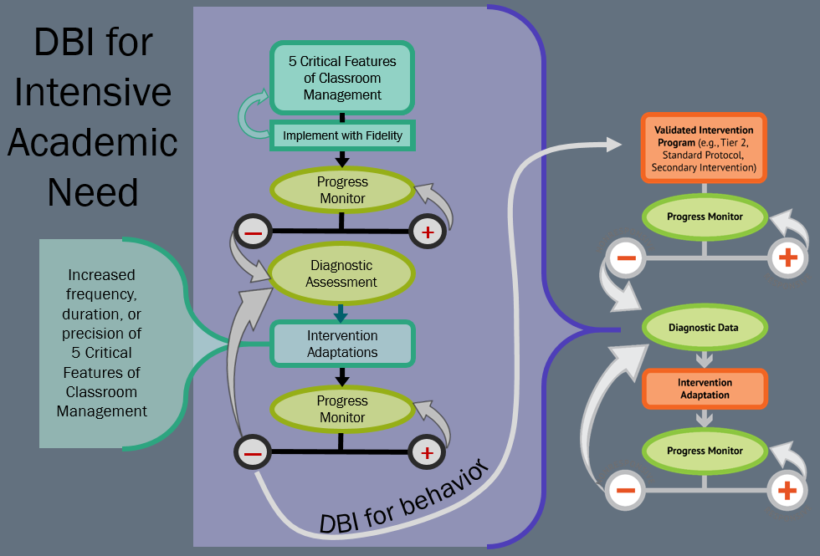
DBI for Intensive Academic Need Flow Chart

Slide 7
Module Objectives
By the end of Module 6 you should be able to:
    select an appropriate target behavior
    write an operational definition for a target behavior
    identify relevant dimensions of behavior
    choose a measurement system based on relevant dimensions of behavior
    use graphing conventions to create meaningful visual displays of data
Part 1
Part 2
Part 3
Part 4
Part 5

Slide 8
Defining, Measuring, and Monitoring Behavior
Part 1
How do we select an appropriate target behavior?

Slide 9
Module Objectives
By the end of Module 6 you should be able to:
    select an appropriate target behavior
    write an operational definition for a target behavior
    identify relevant dimensions of behavior
    choose a measurement system based on relevant dimensions of behavior
    use graphing conventions to create meaningful visual displays of data
Part 1
Part 2
Part 3
Part 4
Part 5

Slide 10
Why Measure Behavior?
Purpose | Question
Screening | Who needs support? When is an instructional change needed?
“Diagnostic”: identify specific strengths and needs to guide your instruction and support | How should we adjust instruction? On which behaviors/skills? What will you do?
Progress Monitor to improve your instruction and support Fidelity of implementation Student outcomes | When is an instructional change needed?
Outcome | Did it work?

Slide 11
Key Steps in Measuring Behavior
Select target behavior(s)
Define target behavior(s)
Identify relevant dimension(s) of behavior(s)
Determine best procedure(s) for measuring behavior(s) given definition, dimensions, and context.
Summarize data visually to guide decision making

Slide 12
1. Selecting a Target Behavior:
Social Significance
Does it increase access to…
  …reinforcement…
    …from natural environment?
    …from others?
  …other (less restrictive) environments where other behaviors can be learned/performed?
Is it important as a…
  …prerequisite for another functional skill?
  …behavioral cusp or pivotal behavior?
Is it age appropriate?
If a behavior is targeted for reduction, is there an adaptive replacement?
Do you have the “right” behavior (not a related or verbal one)?
(Cooper, Heron, & Heward, 2007, pp. 55-61)

Slide 13
1. Selecting a Target Behavior
Prioritizing Behaviors
“Does this behavior pose any danger to student or others?”
“How often” does (or will) the behavior occur?
“How long-standing is the problem or skill-deficit?”
“Will changing this behavior produce higher rates of reinforcement for the person?”
“What will be the relative importance of this target behavior to future skill development and independent functioning?”
“Will changing this behavior reduce negative or unwanted attention from others?”
“Will this new behavior produce reinforcement of significant others?”
“How likely is success in changing this target behavior?
“How much will it cost to change this behavior?”
(Cooper, Heron, & Heward, 2007, pp. 62-63, emphasis added)

Slide 14
Activity 6.1: Stop and Jot: Selecting an appropriate target behavior
Identify a behavior concern for a student you have worked with.
Which behavior(s) are higher priority? Why?
Please Pause Video & Complete Activity 6.1

Slide 15
Activity 6.1: Review
Remember to consider the social significance of a target behavior and consider how you will prioritize behavior(s) to address
Once you have prioritized your behavior(s), you will now look to establish a clear definition

Slide 16
Defining, Measuring, and Monitoring Behavior
Part 2
How do we write an operational definition?

Slide 17
Module Objectives
By the end of Module 6 you should be able to:
    select an appropriate target behavior
    write an operational definition for a target behavior
    identify relevant dimensions of behavior
    choose a measurement system based on relevant dimensions of behavior
    use graphing conventions to create meaningful visual displays of data
Part 1
Part 2
Part 3
Part 4
Part 5

Slide 18
2. Defining a Target Behavior
Develop an Operational Definition
  What is it?
    Concrete description of target behavior.
    Should include examples/non-examples.
    Stated in terms of dimensions of behavior.
  Why is it important?
    We need an objective and agreed-upon definition of behavior to aid with observation, intervention, and discussion.

Slide 19
Observable and Measurable?
Target behavior: Anna is not prepared for class.
Replacement behavior: Anna will be prepared for class.
No – let’s try again…
Target behavior: Anna does not have her book or a pencil at the start of class.
Replacement behavior: Anna will have her book and pencil at the start of class.
Yes – that’s better!

Slide 20
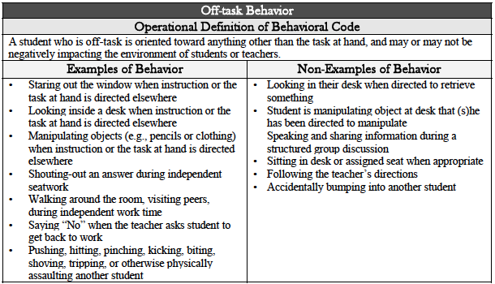
DBI Off Task Behavior Examples of Behavior and Non Behavior

Slide 21
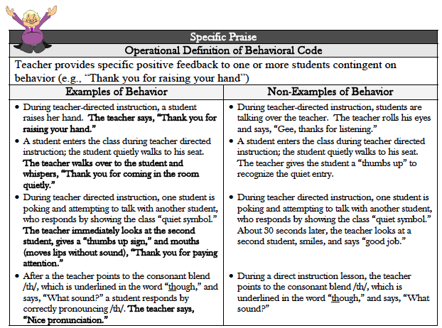
Specific Praise for Examples of Behavior and Non Behavior

Slide 22
Activity 6.2: Stop & Jot:
Write an operational definition
Return to the behaviors you identified in Activity 6.1
Develop an operational definition for your target behavior, including examples and non examples.
Please Pause Video & Complete Activity 6.2

Slide 23
Activity 6.2: Review
Check your Operational Definition
  Is it?
    Concrete description of target behavior.
    Should include examples/non-examples.
    Stated in terms of dimensions of behavior.
  Remember
    We need an objective and agreed upon definition of behavior to aid with observation, intervention, and discussion.

Slide 24
Defining, Measuring, and Monitoring Behavior
Part 3
How do we use the dimensions of behavior to help us refine our definition?

Slide 25
Module Objectives
By the end of Module 6 you should be able to:
    select an appropriate target behavior
    write an operational definition for a target behavior
    identify relevant dimensions of behavior
    choose a measurement system based on relevant dimensions of behavior
    use graphing conventions to create meaningful visual displays of data
Part 1
Part 2
Part 3
Part 4
Part 5

Slide 26
3. Identify relevant dimension(s) of behavior(s)
Why do we need dimensions?
  All behavior occurs within a context.
  It may not be the actual form of the behavior that is inappropriate, but the duration, intensity, or rate with which the behavior occurs in a given context.
  For example, it is natural to be off-task some of the time. It is a problem if you are off task 80% of the time.

Slide 27
7 Dimensions of Behavior
7 Dimensions of Behavior
Frequency
Rate
Duration
Latency
Topography
Force
Locus

Slide 28
7 Dimensions of Behavior Focus on Frequency
7 Dimensions of Behavior
Frequency
Rate
Duration
Latency
Topography
Force
Locus
Definition: the number of times an individual engages in a behavior within an observation period.
Measure by: counting incidents of behavior (tally)
Examples: Number of student talk outs during 15 minutes of direct instruction. Number of opportunities to respond during 20 minutes of teacher directed instruction.

Slide 29
7 Dimensions of Behavior Focus on Rate
7 Dimensions of Behavior
Frequency
Rate
Duration
Latency
Topography
Force
Locus
Definition: frequency ÷ time
Measure by: counting incidents of behavior and dividing by units of time (e.g., minutes, hours)
Examples: Student turned in homework 3/5 days per week. Teacher delivered specific praise 2 times per minute during teacher instruction.

Slide 30
7 Dimensions of Behavior Focus on Duration
7 Dimensions of Behavior
Frequency
Rate
Duration
Latency
Topography
Force
Locus
Definition: how long an individual engages in a behavior
Measure by: timing how long an individual engages in… …each individual behavior …one behavior throughout observation (cumulative)
Example: Student was on task for 15 consecutive minutes during individual work time.

Slide 31
7 Dimensions of Behavior Focus on Latency
7 Dimensions of Behavior
Frequency
Rate
Duration
Latency
Topography
Force
Locus
Definition: the amount of time between the instruction and a behavior
Measure by: timing interval between instruction and when student begins to perform
Example: Student begins working on task 5 minutes after instruction was given. Student arrives for class 7 minutes after the bell signaled the beginning of class.

Slide 32
7 Dimensions of Behavior Focus on Topography
7 Dimensions of Behavior
Frequency
Rate
Duration
Latency
Topography
Force
Locus
Definition: the “shape” of a behavior or what it looks like
Measure by: observing and recording exactly how the individual performs the target behavior.
Example: Saying hello while looking at the ground vs. making eye contact and extending your hand while saying hello.

Slide 33
7 Dimensions of Behavior Focus on Force
7 Dimensions of Behavior
Frequency
Rate
Duration
Latency
Topography
Force
Locus
Definition: the intensity of a behavior
Measure by: observation (subjective) or apparatus designed to measure intensity
Example: Student hit hard enough to leave a bruise/scratch. Student spoke loudly enough to be heard. Sound sensitive traffic lights in cafeterias.

Slide 34
7 Dimensions of Behavior Focus on Locus
7 Dimensions of Behavior
Frequency
Rate
Duration
Latency
Topography
Force
Locus
Definition: where the behavior occurs (e.g., setting, target location on “victim’s” body)
Measure by: observing and recording
Example: Student engages in teasing behavior in the hallway. Student hits her head on her right temple.

Slide 35
Activity 6.3: Discussion Board
Refine your definition
Return to the operational definition you developed in Activity 6.2.
Identify (one or more) key dimensions that are particularly relevant for your setting.
Refine your operational definition using your identified dimensions.
Please Pause Video & Complete Activity 6.3

Slide 36
Activity 6.3: Review
Which dimensions did you focus on?
Is your operational definition more explicit now?
  Is it observable/measurable?
Did you consider how you might measure your behavior now that you have selected dimensions?
  Some operational definitions may use multiple dimensions
    Multiple dimensions may require multiple measurement approaches

Slide 37
Defining, Measuring, and Monitoring Behavior
Part 4
How do we choose a measurement system?

Slide 38
Module Objectives
By the end of Module 6 you should be able to:
    select an appropriate target behavior
    write an operational definition for a target behavior
    identify relevant dimensions of behavior
    choose a measurement system based on relevant dimensions of behavior
    use graphing conventions to create meaningful visual displays of data
Part 1
Part 2
Part 3
Part 4
Part 5

Slide 39
4. Determine the Best Procedure for Measuring Behavior
Decide who is going to take data.
  Will they be just observing?
  Or will they be teachers?
Decide how data will be collected.
  Observation?
  Permanent product?
Weigh practicality vs. precision.

Slide 40
Systems for Measurement
Anecdotal Reports
Permanent Product
Event Based Systems (Tally)
Time Based Estimates
  Interval recording
    Partial
    Whole
  Momentary Time Sampling
Time Based: Duration/Latency

Slide 41
Systems for Measurement
What is it?
Written description of virtually everything that is going on within a setting for a particular learner.
When would we use it?
To measure topography, locus, and force(?)
Generating operational definitions.
Developing a task analysis (“how to” steps)
Writing A-B-C notes to identify possible function and behavior chains at play for a particular student.
Anecdotal Reports
Permanent Product
Event Based Systems (Tally)
Time Based Estimates
    Interval recording
        Partial
        Whole
    Momentary Time Sampling
Time Based: Duration/Latency

Slide 42
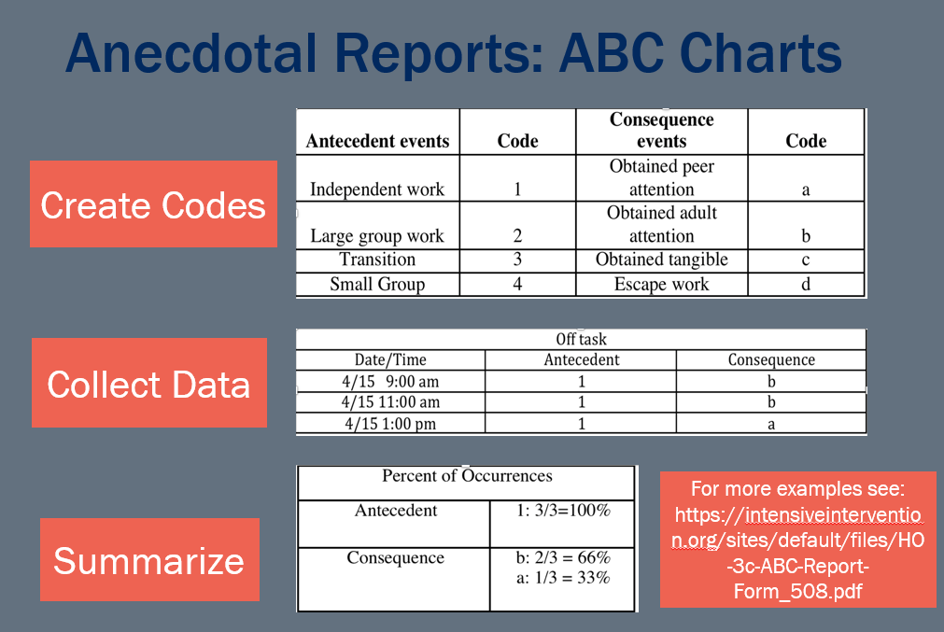
Anecdotal Reports: ABC Charts

Slide 43
Systems for Measurement
What is it?
Permanent and tangible effects or outcomes of a behavior.
When would we use it?
  Frequency/Rate— math problems correct per minute?
  Locus—where did the fight occur?
  Topography—letter formation
  Force—amount of property destruction
Anecdotal Reports
Permanent Product
Event Based Systems (Tally)
Time Based Estimates
    Interval recording
        Partial
        Whole
    Momentary Time Sampling
Time Based: Duration/Latency

Slide 44
Systems for Measurement
Anecdotal Reports
Permanent Product
Event Based Systems (Tally)
Time Based Estimates
    Interval recording
        Partial
        Whole
    Momentary Time Sampling
Time Based: Duration/Latency
What is it?
Tally of the number of times a student engages in a behavior in an observation period.
When would we use it?
To measure frequency of low-frequency, discrete behaviors (e.g., # of curse words).
Convert to rate by dividing # by units of time in observation period.

Slide 45
Example of frequency recording tool
Student: Jack |  |  | Observer: Mr. Brown
Behavior: Inappropriate talk-outs (no hand raise)
 | Time |  | Notation of occurrences | Total occurrences
 | Start | Stop
2/15/2010 | 9:00 | 10:00 | √√√√√√ | 6
2/16/2010 | 2:00 | 3:00 | √√√ | 3

Slide 46
Systems for Measurement
What are they?
Ways to estimate the number of times a behavior occurs.
When would we use them?
Used for higher frequency discrete behaviors or behaviors of longer duration.
Interval recording yields a slightly more accurate estimate.
Time sampling is more practical if you are doing two things at once (i.e., teaching and recording data).
Anecdotal Reports
Permanent Product
Event Based Systems (Tally)
Time Based Estimates
    Interval recording
        Partial
        Whole
    Momentary Time Sampling
Time Based: Duration/Latency

Slide 47
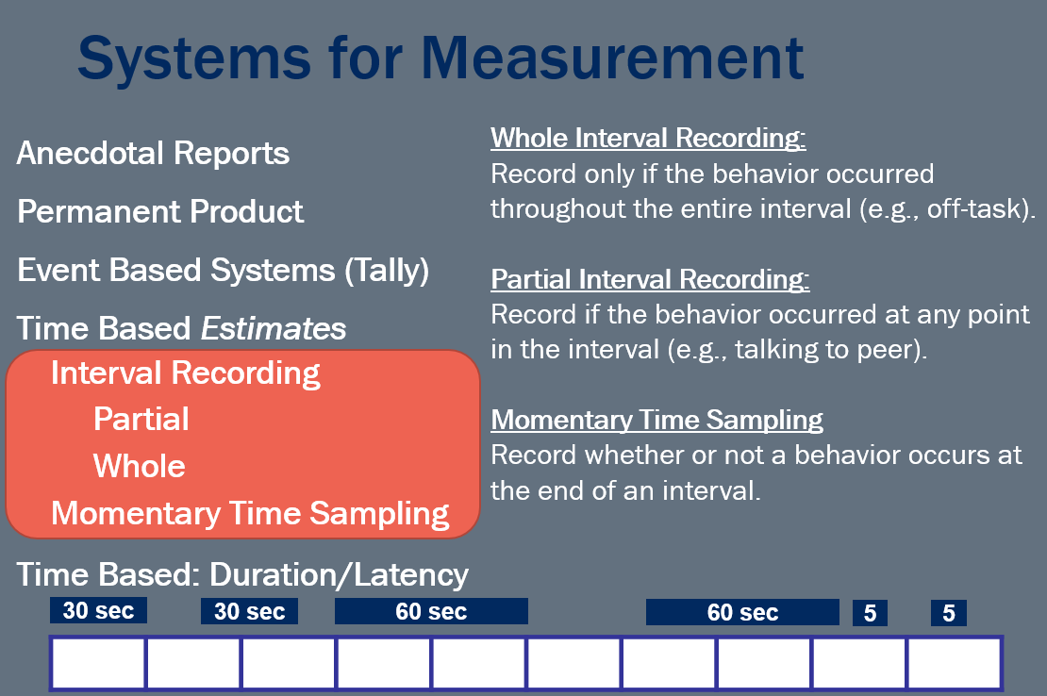
Systems for Measuresment with a Focus on Inteval Recording

Slide 48
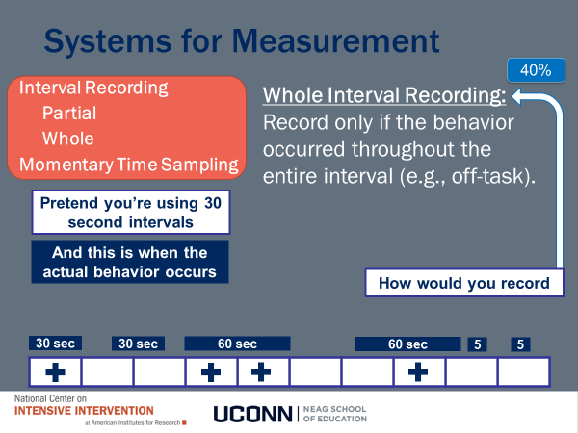
Systems for Measuerment: Whole Interval Recording

Slide 49
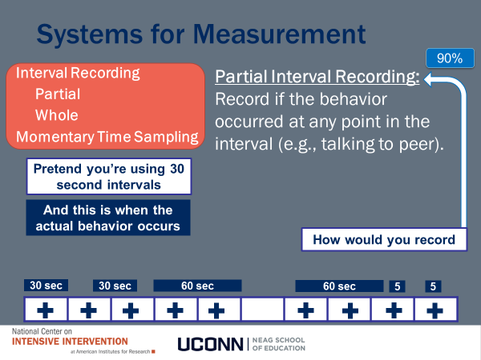
Systems for Measurement: Partial Interval Recording

Slide 50
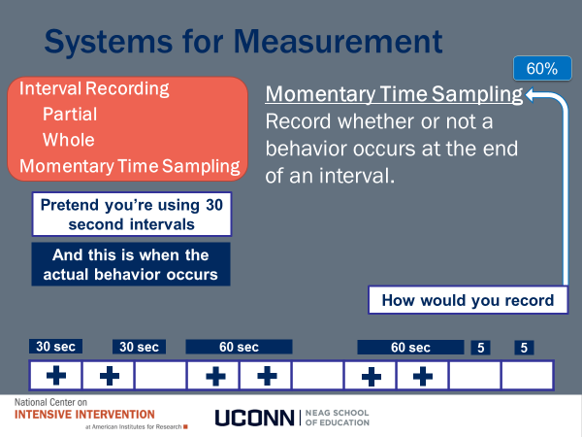
Systems for Measurement: Momentary Time Sampling

Slide 51
Activity 6.4: Workbook Quiz
Selecting an interval recording system
If… | Then choose… | Which will yield…
Continuous desired behavior, such as on-task behavior | Whole-interval recording | Percentage of intervals with target behavior
The behavior occurs at a very high frequency and very rapidly (e.g., talking, head-banging, hand-flapping) | Partial-interval recording | Percentage of intervals with target behavior
It is difficult to continuously monitor the student or the observer needs a low-effort data collection method | Momentary time sampling | Percentage of observations with target behavior
Please Pause Video & Complete Activity 6.4

Slide 52
Systems for Measurement
Anecdotal Reports
Permanent Product
Event Based Systems (Tally)
Time Based Estimates
    Interval recording
        Partial
        Whole
    Momentary Time Sampling
Time Based: Duration/Latency
How do we do it?
Either start a stop watch after the instruction and stop it when the behavior starts (latency).
Or, we would start the stop watch when the behavior starts and stop it as soon as it stops (duration).

Slide 53
Example of recording tool
Student: Jack |  | Observer: Paul;
Behavior: Rocking in seat
Date | Behavior begins | Behavior ends | Total duration
2/16/2010 | 9:15 | 9:21 | 6 minutes
 | 10:37 | 10:52 | 15 minutes
 | 1:18 | 1:28 | 10 minutes
 | 1:40 | 1:43 | 3 minutes
Total for day |  |  | 34minutes

Slide 54
Teacher Behavior Example – Which Dimension and How do you measure?
Teacher Behavior Example:
Which Dimension?
How do we measure?
Frequency
Rate
Duration
Latency
Topography
Force
Locus

Slide 55
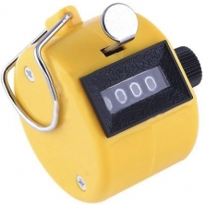
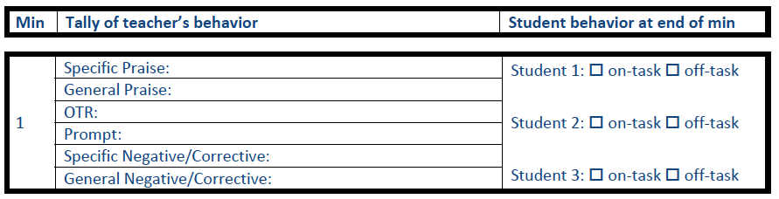
Teacher Behavior Example – Looking at Rate
Teacher Behavior Example:
Anecdotal Reports
Permanent Product
Event Based Systems (Tally)
Time Based Estimates
    Interval Recording
        Partial
        Whole
    Momentary Time Sampling
Time Based: Duration/Latency
Frequency
Rate
Duration
Latency
Topography
Force
Locus
Rate

Slide 56
Student Behavior Example
Student Behavior Example:
Which Dimension?
How do we measure?

Slide 57
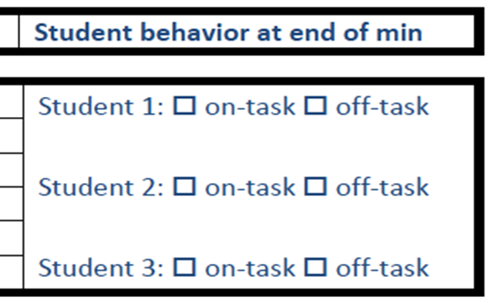
Student Behavior Example Looking at Duration/Rate and Estimate Duration/Rate
Student Behavior Example:
Which Dimension?
How do we measure?
Duration & Rate
Frequency
Rate
Duration
Latency
Topography
Force
Locus
Anecdotal Reports
Permanent Product
Event Based Systems (Tally)
Time Based Estimates
    Interval Recording
        Partial
        Whole
    Momentary Time Sampling
Time Based: Duration/Latency
Estimate Duration & Rate

Slide 58
Student Behavior Example looking at Duration/Rate and Estimate Duration/Rate
Student Behavior Example:
Which Dimension?
How do we measure?
Duration & Rate
Frequency
Rate
Duration
Latency
Topography
Force
Locus
Anecdotal Reports
Permanent Product
Event Based Systems (Tally)
Time Based Estimates
    Interval Recording
        Partial
        Whole
    Momentary Time Sampling
Time Based: Duration/Latency
Estimate Duration & Rate

Slide 59
Student Behavior Example Looking at Duration/Rate and Estimate Duration/Rate
Student Behavior Example:
Which Dimension?
How do we measure?
Duration & Rate
Frequency
Rate
Duration
Latency
Topography
Force
Locus
Anecdotal Reports
Permanent Product
Event Based Systems (Tally)
Time Based Estimates
    Interval Recording
        Partial
        Whole
    Momentary Time Sampling
Time Based: Duration/Latency
Estimate Duration & Rate

Slide 60
Activity 6.5: Stop & Jot:
Select an appropriate measurement system
Return to the operational definition you refined in Activity 6.3
Select the measurement system that best measures the dimension/s of interest
Develop your data collection tool
Anecdotal Reports
Permanent Product
Event Based Systems (Tally)
Time Based Estimates
    Interval Recording
        Partial
        Whole
    Momentary Time Sampling
Time Based: Duration/Latency
Please Pause Video & Complete Activity 6.5

Slide 61
Activity 6.5: Review
Remember to consider practicality vs. precision.
Anecdotal Reports
Permanent Product
Event Based Systems (Tally)
Time Based Estimates
    Interval Recording
        Partial
        Whole
    Momentary Time Sampling
Time Based: Duration/Latency

Slide 62
Defining, Measuring, and Monitoring Behavior
Part 5
How do we summarize our data to guide decision making?

Slide 63
Module Objectives
By the end of Module 6 you should be able to:
    select an appropriate target behavior
    write an operational definition for a target behavior
    identify relevant dimensions of behavior
    choose a measurement system based on relevant dimensions of behavior
    use graphing conventions to create meaningful visual displays of data
Part 1
Part 2
Part 3
Part 4
Part 5

Slide 64
To graph or not to graph:
Purpose of Visual Displays
1. “provide…immediate access to on-going visual record”
4. “visual analysis is a conservative method for determining the significance of behavior change”
2. “explore interesting variations in behavior as they occur”
5. “enable and encourage independent judgments and interpretations”
3. Aid in interpretation of data
6. “effective sources of feedback to the people whose behavior they represent”
(Cooper, Heron & Heward, 2007, p. 128)

Slide 65
Choose an Appropriate Graph
Use a line graph to summarize and show trends across time.
Use bar or pie graphs to summarize/comparing data in categories (e.g., antecedents vs consequences, different types of behaviors).

Slide 66
Choose an Appropriate Summary Score
Simonsen & Myers (2015, Figure 4.5)

Slide 67
Line Graphs
Line graphs are great ways to represent data across time
They allow you to detect patterns in your data
Graphing Conventions
  Graphs have units of time going across horizontal X axis and a units of behavior going up the vertical Y axis.
  Different data points (geometric shapes) and data paths (lines) are used to represent different types of information.
In line graphs, the use the following:
  Continuity Breaks are used if data collection is not continuous (e.g., if student is sick for a week during observations).
  Phase lines are used to separate “phases on graph”
    Data may be taken before an intervention (baseline phase).
    Data may be taken during an intervention (intervention phase)

Slide 68
Line Graph Example
Title
Phase Change Line
Data point
Dimension of Behavior
Y-Axis
X-Axis
Time variable

Slide 69
Pie Graphs
Useful for representing percentages of things (individuals, events, etc.) that fall into certain categories

Slide 70
Bar Graphs
They are also useful for representing percentages of things (individuals, events, etc.) that fall into certain categories
And, they can be used to represent data across time when data paths would be too confusing to represent in a line graph

Slide 71
Simple Bar Graph Examples

Slide 72
Activity 6.6: Stop & Jot:
Create a visual summary
Return to the measurement system you selected in Activity 6.5
Identify an appropriate type of graph and sketch a graph of hypothetical data.
Which graphing features should you include to maximize the interpretation of your data?
Please Pause Video & Complete Activity 6.6

Slide 73
Activity 6.6: Review
Remember
Use a line graph to summarize and show trends across time.
Use bar or pie graphs to summarize/compare data in categories (e.g., antecedents vs consequences, different types of behaviors).

Slide 74
Let’s consider an example to bring this all together
Kelly is a student who is often off-task. In addition, she has gotten into trouble for talking out in class and walking out of the room without permission.
  How would you know what to take data on?
    Which behaviors are highest priority?
  Which dimensions would you choose? Why?
  Who would take the data?
  How will it be collected?

Slide 75
Here is one possible approach
  You could consider
    An estimate of how much time Kelly was off-task.
    The frequency of talk-outs and walk-outs.
  Her teacher will collect and summarize the data.

Slide 76
Kelly’s Measurement System
Date: __________ Time Started: ______
 | 1 | 2 | 3 | 4 | 5 | 6 | 7 | 8 | 9 | 10
Off Task
Tally of Talk-outs (T) and Walkouts (W)
T: W:
Momentary Time Sampling
Event- Based
Event- Based

Slide 77
Example: Graph for Kelly
If you were currently implementing a plan to improve Kelly’s off task behavior, would you change the plan based on this data?
Why or Why not?

Slide 78
Defining, Measuring, and Monitoring Behavior
Closing

Slide 79
Module Objectives
By the end of Module 6 you should be able to:
select an appropriate target behavior
write an operational definition for a target behavior
identify relevant dimensions of behavior
choose a measurement system based on relevant dimensions of behavior
use graphing conventions to create meaningful visual displays of data

Slide 80
What’s next
  Module 6 Quiz
  Classroom Application

