Slide 1
Module 4
Consequence Strategies to Increase Behavior
Jennifer Freeman, PhD
Don Briere, PhD
Brandi Simonsen, PhD

Slide 2
Acknowledgements
Much of the content shared in this module was developed by members of the OSEP-funded National Technical Assistance Center for Positive Behavioral Interventions and Supports.
Thank you to:
Members of classroom workgroup:
Brandi Simonsen, Jennifer Freeman, Jessica Swain-Bradway, Robert Putnam, Heather George, Steve Goodman, Barb Mitchell, Kimberly Yanek, Kathleen Lane & Jeffrey Sprague
Members of the Northeast PBIS Network:
Susannah Everett, Adam Feinberg, George Sugai, Brandi Simonsen & Jennifer Freeman

Slide 3
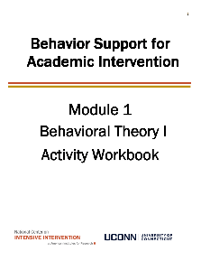
Orientation to Module Tools and Resources
Module Videos
Module Workbook
Module Readings and Additional Resources

Slide 4
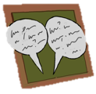
Orientation to Module Elements
Activities
Module Quiz – Self Assessment
Do you know the basic content presented in this module?
Coaching Activities
Can you implement the content presented in this module in your classroom effectively?
Discussion Board Post
Workbook Quiz
Stop and Jot

Slide 5
Getting the Most Out of This Module
Pre-service
Become fluent with content and basic theory
New Teachers
Focus on moving from knowledge to practice
Experienced Teachers
Use activities as a self-reflection opportunity
Consider how you might coach or teach the skills/content to a new teacher in your building
Set a new implementation goal for yourself
Review resources to extend your learning with respect to culturally and contextually relevant implementation
Look for examples of implementation in your clinic placements
Video record or ask for feedback on your implementation of key practices during your student teaching
Set implementation goals and either self-monitor or ask for peer/coach feedback on your use of key skills
When a practice isn’t working use your understanding of theory to help you modify or intensify a practice to improve outcomes

Slide 6
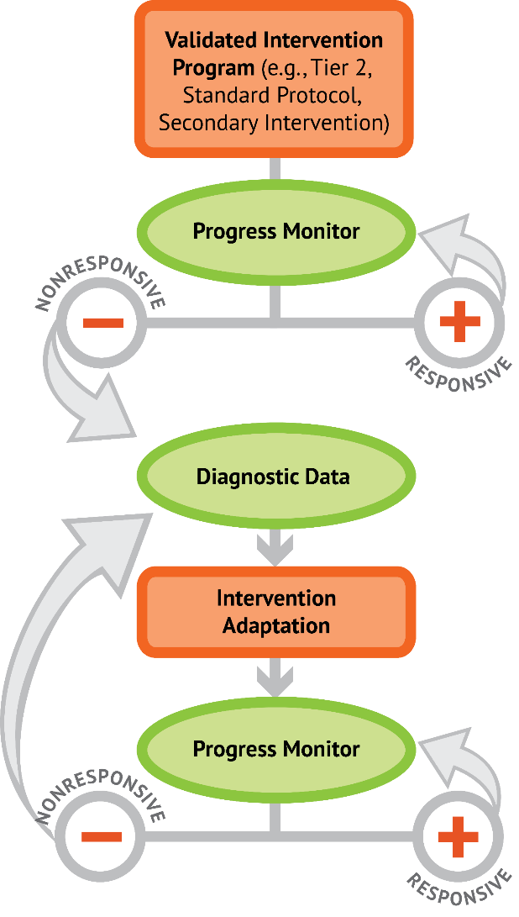
5 Critical Features of Classroom Management
5 Critical Features of Classroom Management
Implement with Fidelity
Implement with Fidelity
Progress Monitor
_
+
Increased frequency, duration, or precision of
5 Critical Features of Classroom Management
Diagnostic Assessment
Intervention Adaptations
Progress Monitor
_
+
DBI for behavior

Slide 7
Module Objectives
By the end of Module 4 you should be able to :
Part 1 | Describe consequence strategies to increase behavior
Part 2 & 3 | Establish a continuum of strategies to acknowledge appropriate behavior Behavior Specific Praise Other Strategies to Acknowledge Appropriate Behavior
Part 4 | Appropriately adjust use of reinforcement

Slide 8
Consequence Strategies to Increase Behavior
Part 1
Why is reinforcement important?

Slide 9
Module Objectives
By the end of Module 4 you should be able to :
Part 1 | Describe consequence strategies to increase behavior
Part 2 & 3 | Establish a continuum of strategies to acknowledge appropriate behavior Behavior Specific Praise Other Strategies to Acknowledge Appropriate Behavior
Part 4 | Appropriately adjust use of reinforcement

Slide 10
Common Teacher Questions
Why do I need to acknowledge appropriate behavior
(provide reinforcement)?
If my content is engaging and related to my students’ lives, won’t they just want to behave appropriately in order to learn?
If I give a student something (tangible), aren’t I bribing them/extrinsically motivating them so they won't develop intrinsic motivation but will come to expect something for demonstrating what they should be doing
Shouldn’t students just
know how to behave?
I set and taught my expectations; shouldn’t I just expect them to meet these expectations?
Should I really use valuable class time to reinforce expectations?
If my students like me as a person, won’t they behave appropriately to please me?

Slide 11
Reinforcement vs. Punishment
Reinforcement
Punishment
when a consequence
of a behavior functions to increase the likelihood
of future occurrences of that behavior
when a consequence
of a behavior functions to decrease the likelihood
of future occurrences of that behavior

Slide 12
Behavior is likely to occur again when it is reinforced
When a student gets something desirable following a behavior, that behavior is strengthened and more likely to occur again
If a student is removed from the classroom after refusing to do a difficult assignment, the student will likely act up later when he does not want to (or cannot) complete work
If a student is given verbal praise for persisting with a difficult assignment, the student is likely to persist on later difficult assignments

Slide 13
Benefits of Acknowledgement Systems
Creates positive student-to-teacher interactions
Clarifies classroom expectations for appropriate behavior
Increases the likelihood that desired behaviors will be repeated by letting students know what they are doing is “right”
Reduces the need for engaging in time-consuming disciplinary measures

Slide 14
Acknowledgement Systems for Older Students?
Adolescents typically have a heightened flight or fight response and may perceive neutral interactions as threatening¹
Adolescents typically need a more intense experience to recognize it as rewarding²
Adolescents may need acknowledgement that is:
Frequent
Varied
Meaningful
Specific and genuine
As soon after the expected behavior is displayed as possible
¹ (Blakemore et al., 2007)
² (Sprague, 2008)

Slide 15
Are extrinsic rewards potentially detrimental to increasing or maintaining intrinsic motivation?
Is the “intrinsic vs extrinsic motivation” question the right one to be asking?
Use of rewards following appropriate behavior is directly related to both initial, and durable academic and social success.
A review of the research literature indicates there is no evidence that external rewards are detrimental to intrinsic motivation
“For high-interest tasks, verbal rewards are found to increase free choice and task interest.”
“When tasks … are of low initial interest, rewards increase free-choice, and intrinsic motivation…”
Loud and quiet praise – Both are better than none
(Akin-Little, Eckert Lovett & Little, 2004; Blaze, Olmi, Mercer, Dufrene, Tingstorm, 2014; Cameron, Banko & Pierce, 2001; Reiss, 2005)

Slide 16
Effective use of reinforcement
Rewards are especially important for helping motivate a student to build early competence (fluency) with new skills.
Acquisition
Fluency
Maintenance
Generalization

Slide 17
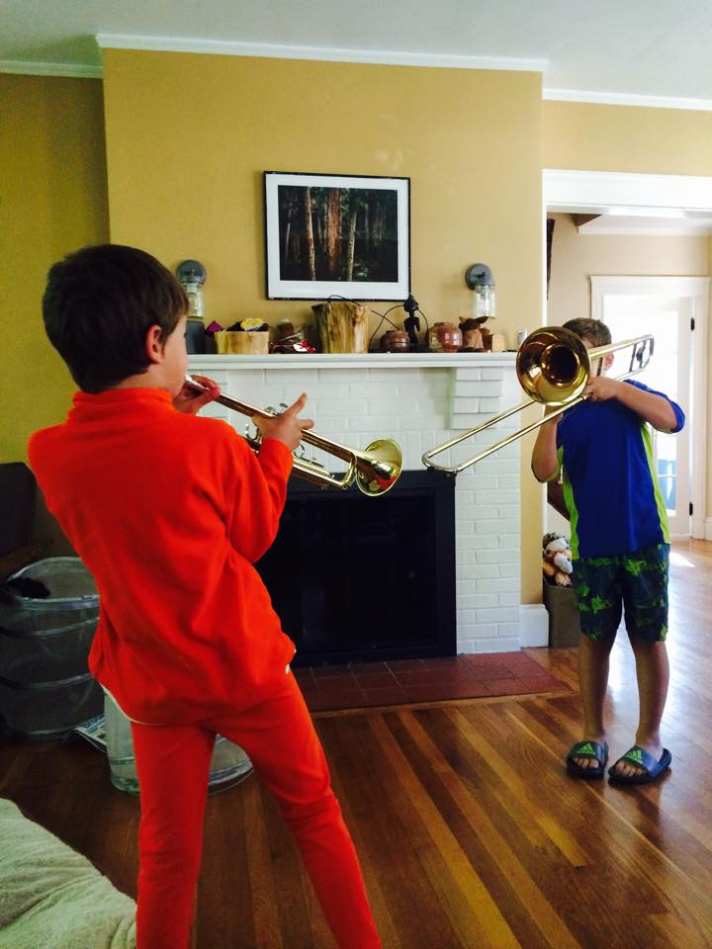
Using Rewards Well
Remember:
The power of Positive Behavioral Interventions and Supports is in the teaching, not the rewards!
Reward “behavior” not people.
Embed rewards in the activity/behavior you want to encourage.
Use many different kinds of rewards (objects, activities, privileges, attention, natural consequences) and ask kids what would motivate them. (remember it can change across time!)
(Horner & Spaulding Retrieved from https://cse.google.com/cse/publicurl?q=praise&cx=007043712608328557950:ub8cgv-o36s)

Slide 18
Big ideas: Using Reinforcement
Rather than debating about intrinsic versus extrinsic reinforcers, consider effective versus ineffective reinforcement.
Remember that the same student may need different levels of support
in different settings or subject areas
across different stages of learning (regardless of setting)
What is reinforcing for one student may not be for another student, so find effective reinforcers (consider interest surveys)
Some reinforcement is naturally occurring- sometimes we need a little more- when learning a new skill or something we are not as interested in
Variety!

Slide 19
Activity 4.1: Discussion Board Reinforcement
How would you describe the difference between reinforcement and rewards to a colleague?
What questions or concerns do you have about the use of rewards?
Please Pause Video & Complete Activity 4.1

Slide 20
Activity 4.1: Review
For more information about the effective use of reinforcers check out this resource
https://intensiveintervention.org/sites/default/files/Reinforcement_Strategies_508.pdf

Slide 21
Consequence Strategies to Increase Behavior
Part 2
What is specific praise and how do I use it effectively?

Slide 22
Module Objectives
By the end of Module 4 you should be able to :
Part 1 | Describe consequence strategies to increase behavior
Part 2 & 3 | Establish a continuum of strategies to acknowledge appropriate behavior Behavior Specific Praise Other Strategies to Acknowledge Appropriate Behavior
Part 4 | Appropriately adjust use of reinforcement

Slide 23
PCBS Practices
Decision-Making Guide: 3 Key Questions
Are the foundations of effective PCBS in place?
Provide high rates of varied opportunities to respond.
+
Use prompts and active supervision.
+
Acknowledge behavior with specific praise & other strategies.
Elementary Example:
During educator-directed instruction, a student raises her hand. The educator says, “Thank you for raising your hand.”
HS Example:
The teacher quietly states, “I really appreciate how you facilitated your group discussion. Peers had many ideas, and you managed it well.”
Non-Example:
“Thank you for trying to act like a human.” (This, at best, is sarcasm, not genuine praise.)
Are proactive and positive PCBS practices implemented consistently?
Do data indicate that students are still engaging in problem behavior?
Brief Video

Slide 24
Rationale Why provide contingent praise?
Delivering contingent praise for
academic behavior increased participants’
correct responses (Sutherland & Wehby, 2001)
work productivity and accuracy (Craft, Alber, & Heward, 1998; Wolford, Heward, & Alber, 2001)
language and math performance on class work (Roca & Gross, 1996)
academic performance (Good, Eller, Spangler, & Stone, 1981)
appropriate social behavior increased participants’
on-task behavior (Ferguson, & Houghton, 1992)
student attention (Broden, Bruce, Mitchell, Carter, & Hall, 1970)
compliance (Wilcox, Newman, & Pitchford, 1988)
positive self-referent statements (Phillips, 1984)
cooperative play (Serbin, Tonick, & Sternglanz, 1977)
(Simonsen, Fairbanks, Briesch, Myers, & Sugai, 2008)

Slide 25
Rationale Why provide specific praise?
Increasing the number of behavior specific praise statements was associated with an increase in on-task behavior¹
Providing contingent praise in conjunction with either establishing classroom rules in isolation² or classroom rules paired with ignoring inappropriate behavior³ was associated with increased appropriate classroom behavior
¹ (Sutherland, Wehby, & Copeland, 2000)
² (Becker, Madsen, & Arnold, 1967)
³ (Yawkey, 1971)
(Simonsen, Fairbanks, Briesch, Myers, & Sugai, 2008)
Bottom line, research indicates is a good idea!

Slide 26
Activity 4.2: Workbook Quiz Specific Praise
If the scenario on the PowerPoint is an example of specific praise, give us a “thumbs up.”
If the scenario is NOT an example of specific praise, give us a “thumbs down.”
Please Pause Video & Complete Activity 4.2

Slide 27
Examples & Non-examples Is this specific praise?
During educator-directed instruction, a student raises her hand.
The educator says, “Thank you for raising your hand.”
It’s a positive verbal statement that occurs immediately after and specifically names the expected behavior.

Slide 28
Examples & Non-examples Is this specific praise?
During educator-directed instruction, students are talking over the educator. The educator rolls his eyes and says, “Gee, thanks for listening.”
This is sarcasm, not specific praise.

Slide 29
Examples & Non-examples Is this specific praise?
A student enters the class during educator-directed instruction; the student quietly walks to his seat. The educator walks over to the student and whispers, “Thank you for coming in the room quietly.”
It’s a positive verbal statement that occurs immediately after and specifically names the expected behavior.

Slide 30
Examples & Non-examples Is this specific praise?
A student enters the class during educator-directed instruction; the student quietly walks to his seat. The educator gives the student a “thumbs up” to recognize the quiet entry.
This is general and non-verbal.

Slide 31
Examples & Non-examples Is this specific praise?
During educator-directed instruction, one student is poking and attempting to talk with another student, who responds by showing the class “quiet symbol.” The educator immediately looks at the second student, gives a “thumbs up sign,” and mouths (moves lips without sound), “Thank you for paying attention.”
It’s a positive verbal statement that occurs immediately after and specifically names the expected behavior.

Slide 32
Examples & Non-examples Is this specific praise?
During educator-directed instruction, one student is poking and attempting to talk with another student, who responds by showing the class “quiet symbol.” About 1 minute later, the educator looks at a second student, smiles, and says “good job.”
This is general and
not clearly contingent.

Slide 33
Examples & Non-examples Is this specific praise?
After a student identifies that s/he is upset and selects a self-calming strategy, the educator says, “You did a really nice job of identifying that you were upset and choosing a strategy that helped you calm down
It’s a positive verbal statement that occurs immediately after and specifically names the expected behavior.

Slide 34
Examples & Non-examples Is this specific praise?
During a direct instruction lesson, the educator points to the consonant blend /th/, which is underlined in the word “though,” and says, “What sound?”
This is an opportunity to respond.

Slide 35
Examples & Non-examples Is this specific praise?
After the student responds correctly by explaining the concept of conservation of energy the teacher says, “Nice job including all the major points in your answer.”
It’s a positive verbal statement that occurs immediately after and specifically names the expected behavior.

Slide 36
Examples & Non-examples Is this specific praise?
During a physics lesson the educator asks groups of students to work together to explain the concept conservation of energy.
This is an opportunity to respond.

Slide 37
Critical Features So, what is specific praise?
Verbal statement (i.e., not look or gesture)
Deliver immediately after the behavior
Especially for young students or those with disabilities
Specifically state the desired behavior demonstrated
If you use other rewards, remember to pair specific praise
with other rewards (e.g., delivery of tokens or points).

Slide 38
Activity 4.3: Stop and Jot Script behavior-specific praise statements
In your workbook, write three (or more) specific praise statements that you will use in your classroom to recognize appropriate social behavior.
Also, consider how you would modify these based on students’ learning histories, setting, ability, age, etc.
Please Pause Video & Complete Activity 4.3

Slide 39
Activity 4.3: Review
Double check your specific praise statements to be sure they clearly name the behavior you want to see more of
Consider how you might modify the praise statement for a student who preferred private or non-verbal feedback

Slide 40
Consequence Strategies to Increase Behavior
Part 3
What other strategies can I use to increase behavior?

Slide 41
Module Objectives
By the end of Module 4 you should be able to :
Part 1 | Describe consequence strategies to increase behavior
Part 2 & 3 | Establish a continuum of strategies to acknowledge appropriate behavior Behavior Specific Praise Other Strategies to Acknowledge Appropriate Behavior
Part 4 | Appropriately adjust use of reinforcement

Slide 42
PCBS Practices
Decision-Making Guide: 3 Key Questions
Are the foundations of effective PCBS in place?
Provide high rates of varied opportunities to respond.
+
Use prompts and active supervision.
+
Acknowledge behavior with specific praise & other strategies.
Elementary Example:
During educator-directed instruction, a student raises her hand. The educator says, “Thank you for raising your hand.”
HS Example:
The teacher quietly states, “I really appreciate how you facilitated your group discussion. Peers had many ideas, and you managed it well.”
Non-Example:
“Thank you for trying to act like a human.” (This, at best, is sarcasm, not genuine praise.)
Are proactive and positive PCBS practices implemented consistently?
Do data indicate that students are still engaging in problem behavior?

Slide 43
Other Strategies to Acknowledge
 | Elementary Example: | HS Example: | Non-example:
Behavior Contract | Class Constitution signed by all | Integrity Pledge signed by all | Zero Tolerance Acknowledgement
Group Contingency | “If all students will hand in homework #2 by the due date, next Friday we will play State Bingo instead of a formal test review.” | “If we generate 5 questions that are examples of ‘Synthesis’ by 2:15, you may sit where you would like for the last 20 minutes of class.” | Making the goal unattainable or undeliverable, or singling out a student for failing to meet goal.
Token Economy | “Group 2, you were all respectful during your discussion, and each of you earned a “star buck” to use in the school-wide store.” | “Alyiah, you were very respectful when your peer came in and asked for space. You’ve earned 10 bonus points toward your behavior goal.” | Providing points or tokens without (a) specific praise or (b) demonstrated behaviors

Slide 44
Other Strategies to Acknowledge
 | Elementary Example: | HS Example: | Non-example:
Group Contingency | “If all students will hand in homework #2 by the due date, next Friday we will play State Bingo instead of a formal test review.” | “If we generate 5 questions that are examples of ‘Synthesis’ by 2:15, you may sit where you would like for the last 20 mins of class.” | Making the goal unattainable or undeliverable, or singling out a student for failing to meet goal.

Slide 45
How To Implement
Clearly define the target behavior
Choose an effective reward
Set appropriate performance criterion
It is important that the goals are clearly identified
Select the most appropriate type of group contingency
Monitor individual and group performance

Slide 46
Considerations for using Group Contingencies
Group contingencies can be an efficient way to reinforce desired behaviors.
Without careful monitoring, potentially harmful situations can arise:
Peer pressure can turn into ridicule
Negative stigma or social status can result
May or may not be fair to all
So, monitor closely and apply the contingencies consistently and systematically.
(Lewis-Palmer & Sugai, 1999)

Slide 47
Group Contingencies
“All for one”
“One for all”
“To each his/her own”
Interdependent Group Contingency
Dependent
Group Contingency
Independent
Group Contingency

Slide 48
“All for one” Interdependent Group-Oriented Contingency
Definition: In order to receive reinforcement, the whole group must perform at a pre-determined level.
Carefully set up these contingencies so that they generate “positive peer pressure”
Teach students how to support each other
Ensure all students CAN meet the standard
Carefully monitor for students who may need additional support
The whole class is ready to start work when the class period starts so the whole group gets 2-3 minutes of free time at the end of class.
If everyone turns in HW assignments on time this week we will not have HW on Friday.

Slide 49
“One for all” Dependent Group-Oriented Contingency
Definition: Performance of an individual (or small group) results in consequences for the whole group
Brittany was able to earn a reinforcer for her entire class when she participated in group discussion appropriately.
When lab group 2 completed their assignment correctly, the whole class earned extra free time.
Carefully design these contingencies so that they are no-fail.
The student/s will earn the reinforcer; it is just a matter of how long it takes.

Slide 50
“To each his/her own” Independent Group-Oriented Contingency
Definition: The same goal is set for all learners in the group; however, consequences are delivered individually—they are based on the performance of each individual rather than the group.
Carefully design these contingencies so that they are focused on outcome, not speed
Ensure students who work more slowly have an equal opportunity for reinforcement
When each of you finishes your quiz, you may take a brief break and read or draw quietly.

Slide 51
Activity 4.4: Workbook Quiz Group Contingencies
Match each of the following examples with one of the types of group contingencies
1. When George successfully generates a specific praise statement, the rest of the class is given an extra credit point on the assignment.
2. If 99% of you get this answer right, the whole group will be given a pizza party.
3. When each of you finishes with your activity, you are allowed to take a 10 minute break.
4. If Devin can stand up and give a 5 minute presentation on the pros and cons of each group contingency, you will all get out of this presentation 10 minutes early.
Please Pause Video & Complete Activity 4.4

Slide 52
Activity 4.4: Workbook Quiz Group Contingencies- Review
Match each of the following examples with one of the types of group contingencies
1. When George successfully generates a specific praise statement the rest of the class is given an extra credit point on the assignment.
2. If 99% of you get this answer right, the whole group will be given a pizza party.
3. When each of you finishes with your activity, you are allowed to take a 10 minute break.
4. If Devin can stand up and give a 5 minute presentation on the pros and cons of each group contingency, you will all get out of this presentation 10 minutes early.
Dependent Group Contingency
(One for All)
Interdependent Group Contingency
(All for One)
Independent Group Contingency
(To Each His/Her Own)
Dependent Group Contingency
(One for All)

Slide 53
Activity 4.5: Discussion Board Group Contingencies
Identify (and operationally define) an appropriate behavior you’d like to see more of in your classroom.
Select a group contingency type that fits the needs of your group
Describe how you would set this up in your classroom (e.g., what type of reinforcer will you use? How will you introduce this to your students?)
What questions or concerns do you have about the use of group contingencies?
Please Pause Video & Complete Activity 4.5

Slide 54
Activity 4.5: Review
Remember
Clearly define the target behavior
Choose an effective reward
Set appropriate performance criterion
It is important that the goals are clearly identified
Select the most appropriate type of group contingency
Monitor individual and group performance

Slide 55
Other Strategies to Acknowledge
 | Elementary Example: | HS Example: | Non-example:
Behavior Contract | Class Constitution signed by all | Integrity Pledge signed by all | Zero Tolerance Acknowledgement

Slide 56
Behavioral Contracts
A written document that specifies a contingency for an individual student or in this case…whole class
Contains the following elements:
Operational definition of BEHAVIOR
Clear descriptions of REINFORCERS
OUTCOMES if student fails to meet expectations.
Special BONUSES that may be used to increase motivation or participation.
(Wolery, Bailey, & Sugai, 1988)

Slide 57
Class-wide Behavior Contract

Slide 58
Individual Behavior Contract

Slide 59
Ten Basic Rules for Behavioral Contracting
Payoff (reward) should be immediate.
Initially call for and reward successful approximations.
Reward frequently with small amounts.
Call for and reward accomplishments.
Reward the performance after it occurs.
The contract must be fair.
The terms must be clear.
The contract must be honest.
The contract must be positive.
Contracting must be used systematically (and consistently).
(Homme, Csanyi, Gonzales, & Rechs, 1970)
(As stated in Alberto & Troutman, 1999, pp. 249-250)

Slide 60
Activity 4.6: Discussion Board Behavior Contracts
Identify (and operationally define) an appropriate behavior you’d like to see more of in your classroom from either a group of students or an individual.
Draft a behavior contract using the 10 basic rules for behavior contracting.
Describe the steps you will take to set up this procedure in your classroom (e.g., what type of reinforcer will you use? How will you introduce this to your students?)
What questions or concerns do you have about the use of behavior contracts?
Please Pause Video & Complete Activity 4.6

Slide 61
Activity 4.6: Review
Remember
Review more behavior contract examples here: https://intensiveintervention.org/sites/default/files/Behavior_Contracts_508.pdf
Payoff (reward) should be immediate.
Initially call for and reward successful approximations.
Reward frequently with small amounts.
Call for and reward accomplishments.
Reward the performance after it occurs.
The contract must be fair.
The terms must be clear.
The contract must be honest.
The contract must be positive.
Contracting must be used systematically (and consistently).

Slide 62
Other Strategies to Acknowledge
 | Elementary Example: | HS Example: | Non-example:
Token Economy | “Group 2, you were all respectful during your discussion, and each of you earned a “star buck” to use in the school-wide store.” | “Alyiah, you were very respectful when your peer came in and asked for space. You’ve earned 10 bonus points toward your behavior goal.” | Providing points or tokens without (a) specific praise or (b) demonstrated behaviors

Slide 63
Establishing a Token Economy
Determine and teach the target skills
Select tokens
Identify what will be back-up reinforcers
Identify the number of tokens required to receive back-up reinforcers
Define and teach the exchange and token delivery system
Define decision rules to change/fade the plan
Determine how the plan will be monitored
(Guidelines from Sulzer-Azaroff & Mayer, 1991)

Slide 64
Considerations for Token Economies
A token can easily provide immediate feedback about student behavior, while delaying the presentation of the back-up reinforcer.
Allows you to avoid satiation of reinforcers.
Beware of counterfeiters.
Do you plan on only giving tokens for appropriate behavior? Or, will you implement a response cost procedure?

Slide 65
Activity 4.7: Discussion Board Token Economy
Identify (and operationally define) an appropriate behavior you’d like to see more of in your classroom from either a group of students or an individual.
Develop a token economy using the steps provided.
Describe the steps you will take to implement this procedure in your classroom (e.g., what type of reinforcer will you use? How will you introduce this to your students?)
What questions or concerns do you have about the use of a token economy?
Please Pause Video & Complete Activity 4.7

Slide 66
Activity 4.7: Review
Remember
Determine and teach the target skills
Select tokens
Identify what will be back-up reinforcers
Identify the number of tokens required to receive back-up reinforcers
Define and teach the exchange and token delivery system
Define decision rules to change/fade the plan
Determine how the plan will be monitored

Slide 67
Other Strategies to Acknowledge
 | Elementary Example: | HS Example: | Non-example:
Behavior Contract | Class Constitution signed by all | Integrity Pledge signed by all | Zero Tolerance Acknowledgement
Group Contingency | “If all students will hand in homework #2 by the due date, next Friday we will play State Bingo instead of a formal test review.” | “If we generate 5 questions that are examples of ‘Synthesis’ by 2:15, you may sit where you would like for the last 20 minutes of class.” | Making the goal unattainable or undeliverable, or singling out a student for failing to meet goal.
Token Economy | “Group 2, you were all respectful during your discussion, and each of you earned a “star buck” to use in the school-wide store.” | “Alyiah, you were very respectful when your peer came in and asked for space. You’ve earned 10 bonus points toward your behavior goal.” | Providing points or tokens without (a) specific praise or (b) demonstrated behaviors

Slide 68
Consequence Strategies to Increase Behavior
Part 4
How will you know when to adjust your use of reinforcement?

Slide 69
Module Objectives
By the end of Module 4 you should be able to :
Part 1 | Describe consequence strategies to increase behavior
Part 2 & 3 | Establish a continuum of strategies to acknowledge appropriate behavior Behavior Specific Praise Other Strategies to Acknowledge Appropriate Behavior
Part 4 | Appropriately adjust use of reinforcement

Slide 70
How will you know when to adjust your use of reinforcement?
Use your data!
Consider time of year, time of day, and specific needs of your students.
Remember, specific contingent praise should always be present in your classroom.
Also consider various Schedules of Reinforcement.

Slide 71
SCHEDULES OF CONSEQUENCES: THE BASICS
Noncontingent
Contingent
Continuous
Intermittent
Extinction
Reinforce after a certain number of responses.
Ratio
Praise every 3rd attempt to shoot a basket.

Slide 72
SCHEDULES OF CONSEQUENCES: THE BASICS
Noncontingent
Contingent
Continuous
Intermittent
Extinction
Reinforce first response after a specified interval of time.
Ratio
Interval
Praise the first answer after a five minute interval has passed.

Slide 73
SCHEDULES OF CONSEQUENCES: THE BASICS
Noncontingent
Contingent
Continuous
Intermittent
Extinction
Reinforce response that continues for a specified period of time.
Ratio
Interval
Response Duration
Deliver praise if a student has been in their seat for 3 whole minutes.

Slide 74
SCHEDULES OF CONSEQUENCES: THE BASICS
Noncontingent
Contingent
Continuous
Intermittent
Extinction
Ratio
Interval
Response Duration
Fixed
Variable
Fixed
Variable
Fixed
Variable

Slide 75
Schedules of Reinforcement
 | Fixed | Variable
Ratio | Fixed Ratio (FR): Reinforce after every N^{th} response | Variable Ratio (VR): Reinforce after an average of N responses
Interval | Fixed Interval (FI): Reinforce first response after interval of N minutes | Variable Interval (VI): Reinforce first response after interval of an average of N minutes
Response Duration | Fixed Response Duration: Reinforce after behavior has continued for a set # of minutes. | Variable Response Duration: Reinforce after behavior has continued for an average # of minutes
In general, variable schedules produce “smoother” behavior patterns

Slide 76
Example: Continuous Reinforcement
All Trials | Teacher Prompt/Question | Student Response | Consequence: Reinforcement Given
Example: Reinforcement after every prompt/question | “Who is ready for recess?” “Please put away your materials.” “Line up by the door when I call your row.” | Target student shows desired behaviors. OR Target student does not engage in problem behavior. | Teacher provides reinforcement after each prompt/question.
See https://intensiveintervention.org/sites/default/files/Sample_Reinforcement.docx for more information

Slide 77
Example: Intermittent- Fixed Ratio
Every ____ Number of Trials | Teacher Prompt/Question | Student Response | Consequence: Reinforcement Given
Example: Reinforcement after every second prompt/question | “Who is ready for recess?” “Please put away your materials.” “Line up by the door when I call your row.” | Target student shows desired behavior | Teacher provides reinforcement only after second prompt/question
See https://intensiveintervention.org/sites/default/files/Sample_Reinforcement.docx for more information

Slide 78
Example: Intermittent- Variable Ratio
Unpredictable Number of Occurrences | Teacher Action | Student Response | Consequence: Reinforcement Given
Example: Reinforcement after a variable number of complete assignments | Teacher varies the number of complete assignments needed to earn a reinforcer | Student completes assignments | Teacher provides reinforcement after one of the complete assignments
See https://intensiveintervention.org/sites/default/files/Sample_Reinforcement.docx for more information

Slide 79
Example:
Intermittent- Fixed Duration
Fixed-Interval Reinforcement Schedule
Every ____ Amount of Time | Teacher Action | Student Response | Consequence: Reinforcement Given
Example: Reinforcement after every 30 seconds of on-task behavior | Teacher uses a timer to determine when to deliver a reinforcer | Student shows desired behavior for 30 seconds | Teacher provides reinforcement after 30 seconds
See https://intensiveintervention.org/sites/default/files/Sample_Reinforcement.docx for more information

Slide 80
Example:
Intermittent- Variable Duration
Unpredictable Amount of Time | Teacher Action | Student Response | Consequence: Reinforcement Given
Example: Reinforcement after a variable amount of time of silent reading | Teacher can use a timer and set different times or can choose random intervals to deliver the reinforcer | Target student shows desired behavior | Teacher provides reinforcement after 10 seconds and then again after one minute
See https://intensiveintervention.org/sites/default/files/Sample_Reinforcement.docx for more information

Slide 81
Consider the following timeline for acknowledgement plans
Immediate/High frequency/Predictable
Delivered at a high rate for a short period while teaching new behaviors or responding to problem behavior
Name behavior and tie back to class-wide expectation
Intermittent/Unexpected
Use to maintain a taught behavior
Brings “surprise” attention to certain behaviors or at scheduled intervals
Long-term Celebrations
Celebrate/acknowledge accomplishment
Includes ALL kids, all adults

Slide 82
Consider the following types of acknowledgement
Design structures and mechanisms for regular recognition of positive behaviors, events, and activities of the school.
Staff-Student
Student-Staff
Develop ways to identify, communicate, and publicly recognize excellence
Create ways for students to share appreciation of staff
Staff-Staff
School-Student
Create and promote opportunities for staff/administration to recognize and appreciate other staff
Attendance, grades, behavior, state assessment, improvement, etc.
(e.g., Attendance Campaign)

Slide 83
Activity 4.8: Stop and Jot Timing of reinforcement
In your workbook jot some notes regarding each of the following:
For which behaviors will you use frequent high rates of reinforcement?
For which will you use intermittent reinforcement to promote maintenance?
When and how might you fade reinforcement of mastered skills?
How can you encourage other forms of reinforcement (e.g., student to student, student to staff)
Please Pause Video & Complete Activity 4.8

Slide 84
Activity 4.8: Stop and Jot: Review
Remember:
Immediate/High frequency/Predictable
Delivered at a high rate for a short period while teaching new behaviors or responding to problem behavior
Name behavior and tie back to class-wide expectation
Intermittent/Unexpected
Use to maintain a taught behavior
Brings “surprise” attention to certain behaviors or at scheduled intervals
Long-term Celebrations
Celebrate/acknowledge accomplishment
Includes ALL kids, all adults

Slide 85
Module Objectives
By the end of Module 4 you should be able to :
Part 1 | Describe consequence strategies to increase behavior
Part 2 & 3 | Establish a continuum of strategies to acknowledge appropriate behavior Behavior Specific Praise Other Strategies to Acknowledge Appropriate Behavior
Part 4 | Appropriately adjust use of reinforcement

Slide 86
PCBS Practices
Decision-Making Guide: 3 Key Questions
Are the foundations of effective PCBS in place?
Provide high rates of varied opportunities to respond.
Use prompts and active supervision.
Acknowledge behavior with specific praise & other strategies.
+
+
Are proactive and positive PCBS practices implemented consistently?
Do data indicate that students are still engaging in problem behavior?

Slide 87
Other Strategies to Acknowledge
 | Elementary Example: | HS Example: | Non-example:
Behavior Contract | Class Constitution signed by all | Integrity Pledge signed by all | Zero Tolerance Acknowledgement
Group Contingency | “If all students will hand in homework #2 by the due date, next Friday we will play State Bingo instead of a formal test review.” | “If we generate 5 questions that are examples of ‘Synthesis’ by 2:15, you may sit where you would like for the last 20 minutes of class.” | Making the goal unattainable or undeliverable, or singling out a student for failing to meet goal.
Token Economy | “Group 2, you were all respectful during your discussion, and each of you earned a “star buck” to use in the school-wide store.” | “Alyiah, you were very respectful when your peer came in and asked for space. You’ve earned 10 bonus points toward your behavior goal.” | Providing points or tokens without (a) specific praise or (b) demonstrated behaviors

Slide 88
Next Steps
Module 4 Quiz
Coaching Application Activity

