Slide 1
Module 1 Behavioral Theory I
Jennifer Freeman, PhD
Don Briere, PhD
Brandi Simonsen, PhD

Slide 2
Acknowledgements
Much of the content shared in this module was developed by members of the OSEP-funded National Technical Assistance Center for Positive Behavioral Interventions and Supports.
Thank you to:
Members of classroom workgroup:
Brandi Simonsen, Jennifer Freeman, Jessica Swain-Bradway, Robert Putnam, Heather George, Steve Goodman, Barb Mitchell, Kimberly Yanek, Kathleen Lane & Jeffrey Sprague
Members of the Northeast PBIS Network:
Susannah Everett, Adam Feinberg, George Sugai, Brandi Simonsen & Jennifer Freeman

Slide 3
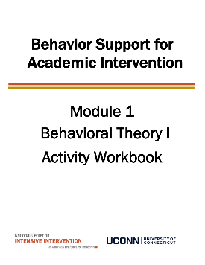
Orientation to Module Tools and Resources
Module Videos
Module Workbook
Module Readings and Additional Resources

Slide 4
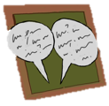
Orientation to Module Elements
Activities
Module Quiz – Self Assessment
Do you know the basic content presented in this module?
Discussion Board Post
Stop and Jot
Evaluate an example
Workbook Quiz

Slide 5
Activity 1.1: Stop and Jot What do you know about behavior support?
What do you know?
What do you want to know?
Please pause the video to complete Activity 1.1

Slide 6
Getting the Most Out of This Module
Pre-service
Become fluent with content and basic theory
New Teachers
Focus on moving from knowledge to practice
Experienced Teachers
Use activities as a self-reflection opportunity
Consider how you might coach or teach the skills/content to a new teacher in your building
Set a new implementation goal for yourself
Review resources provided to extend your learning with respect to culturally and contextually relevant implementation
Look for examples of implementation in your clinic placements
Video record or ask for feedback on your implementation of key practices during your student teaching
Set implementation goals and either self-monitor or ask for peer/coach feedback on your use of key skills
When a practice isn’t working, use your understanding of theory to help you modify or intensify a practice to improve outcomes

Slide 7
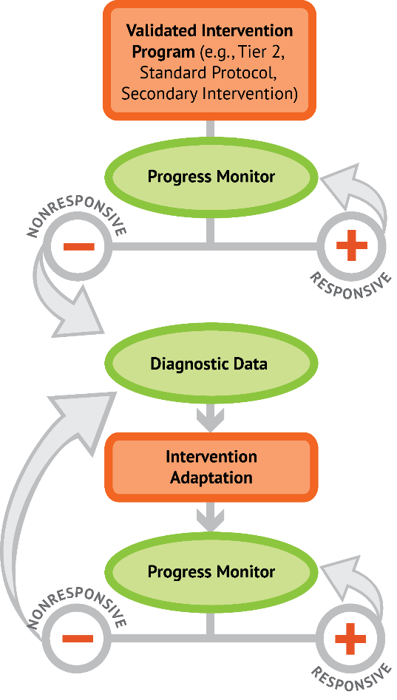
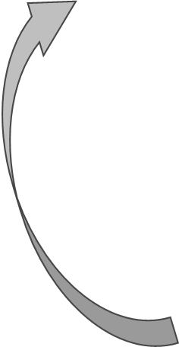
DBI Intensive Academic Need
DBI for
Intensive Academic Need
5 Critical Features of Classroom Management
5 Critical Features of Classroom Management
Implement with Fidelity
Implement with Fidelity
Progress Monitor
_
+
Increased frequency, duration, or precision of
5 Critical Features of Classroom Management
Diagnostic Assessment
Intervention Adaptations
Progress Monitor
_
+
DBI for behavior

Slide 8
Module Objectives
By the end of Module 1 you should be able to:
Describe the rationale and importance of behavior support
Define and identify elements of basic behavioral theory
Three-term contingency
Reinforcement
Punishment
Extinction
Define and describe function of behavior
Part 1
Part 2
Part 3
Part 4

Slide 9
Behavioral Theory I
Part 1
Why do we need to focus on behavior?

Slide 10
United States, we have a problem!
12% of beginning public school teachers leave within their first 2 years
50% leave within their first 5 years
(Boyd, Grossman, Ing, Lankford, Loeb, & Wyckoff, 2011; DeAngelis, & Presley, 2011; Feng, 2006; Henke, Zahn, & Carroll, 2001; Ingersoll, 2001; Ingersol, Merril, May, 2012; Johnson & Birkeland, 2003; Ingersoll & Smith, 2003; Kaiser & National Center for Educational Statistics, 2011; Kukla-Acevedo, 2009; Luekens, Lyter, Fox, & Changler, 2004; Smith & Ingersoll, 2004; Torres, 2012; Zabel & Zabel, 2002)

Slide 11
Why do teachers leave?
Most consistently listed factors:
Lack of pedagogical training
School environment
Poor student behavior and motivation
Inadequate pre-service training on classroom management
Lack of support and training for handling student behaviors
(Boyd, Grossman, Ing, Lankford, Loeb, & Wyckoff, 2011; Chesley & Jordan, 2012; Feng, 2006; Halford, 1998; Henke, Zahn, & Carroll, 2001; Ingersoll, 2001; Ingersol, Merril, May, 2012; Johnson & Birkeland, 2003; Kukla-Acevedo, 2009; Lane, Wehby, & Barton-Arwood, 2005; Luekens, Lyter, Fox, & Changler, 2004; Stough, 2006; Torres, 2012; Zabel & Zabel, 2002)

Slide 12
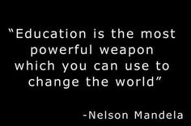
So teaching is hard….
…why do you do it?

Slide 13
Activity 1.2: Stop and Jot Effective teacher behaviors
Use this video to prompt your thinking Then respond to the following question in your workbook:
What 3 words would you use to describe the classroom environment of the most effective teacher you’ve had?
https://www.youtube.com/watch?v=VXCl2fMsdTU
Please pause the video to complete Activity 1.2

Slide 14
Our job in this course is to boil down some of these big concepts into concrete skills, which when implemented translate back into great teaching

Slide 15
Goal of Teaching
Student Achievement
Good Teaching
Classroom Management
Behavior problems disrupt learning. Engaging instruction prevents behavior problems.
(Gest & Gest, 2005; Stronge, Ward, & Grant, 2011)

Slide 16
In Other Words….
Support Student Behavior to Promote Student Success
Effective behavior
support leads to:
Increase in Appropriate Behavior
Examples:
On-Task
Prosocial
Increase in Academic Performance
Examples:
Engagement
Achievement
Decrease in Inappropriate Behavior
Examples:
Off-Task
Disruptive
(Lewis et al., 2004; Simonsen et al., 2008)

Slide 17
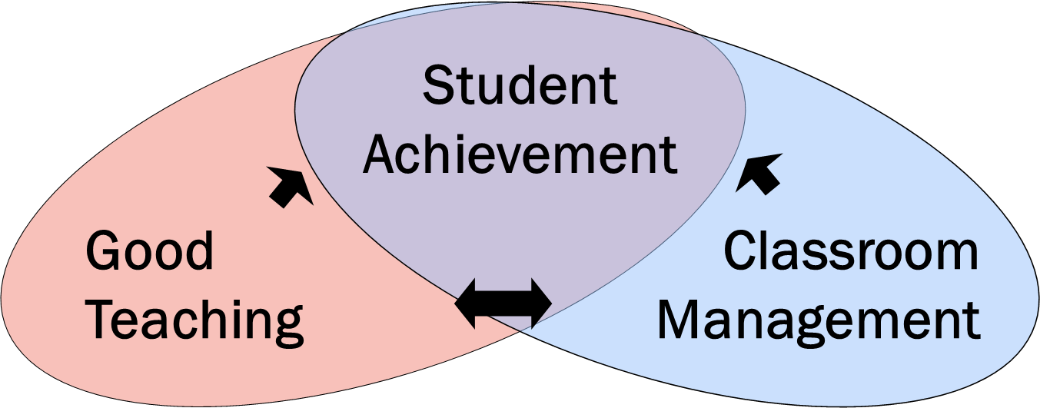
Bottom Line
Classroom & behavior management is a critical component of student success
The good news is we know what this looks like!
(Gest & Gest, 2005; Stronge, Ward, & Grant, 2011)

Slide 18
Research-Based Classroom Management
Maximize structure in your classroom.
Post, teach, review, monitor, and reinforce a small number of positively stated expectations.
Actively engage students in observable ways.
Establish a continuum of strategies to acknowledge appropriate behavior.
Establish a continuum of strategies to respond to inappropriate behavior.
(Simonsen, Fairbanks, Briesch, Myers, & Sugai, 2008)

Slide 19
But we don’t seem to be using them
 | Specific Praise | General Praise | OTR | Corrective/Reprimand
Reinke et al. (2012)¹ | 0.13 | 0.43 | 1.43 | 0.67
Scott et al. (2011)² | 0.06 (overall positive) |  | 0.57 | 0.07
Hirn & Scott (2014)³ | 0.03 (overall positive) |  | 0.47 Group 0.06 Indiv. | 0.08
Pas et al. (2015)⁴ | 0.12 (approval) |  | 0.93 | 0.27
¹ Based on observations of 33 elementary teachers in schools implementing PBIS with fidelity
² Based on > 1000 observations of elementary and high school teachers in schools not identified as implementing PBIS
³ Based on 827 observations of high school teachers
⁴ Based on observations of 1262 high school teachers prior to PBIS implementation

Slide 20
Do states require classroom management instruction?
Does it have to be research based?
(Freeman, Simonsen, Briere, & MacSuga-Gage, 2014)

Slide 21
Challenges of Past Responses to Problem Behavior
Overuse of reactive management (zero tolerance)
Adoption of non-evidence-based practices
Information not used to guide decision making
Lack of investment in classroom teachers
Use of “train-n-hope” approach to teaching & learning

Slide 22
Get tough slide doesn’t work
“Get Tough” Doesn’t Work So why do we keep doing it?
Student Acts Out
Teacher says no and gives initial consequence
Student becomes disrespectful
Teacher sends student to office
Student escapes class
What did the student learn?
What did the teacher learn?

Slide 23
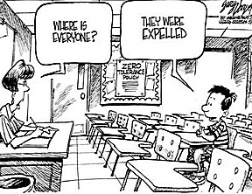
“Get Tough” Approach
Fosters environments of control
Triggers and reinforces antisocial behavior
Shifts accountability away from school
Devalues child-adult relationship
Weakens relationship between academic and social behavior programming

Slide 24
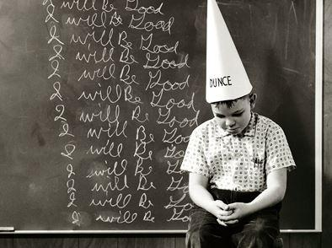
Science of behavior has taught us that students….
The power of PBIS is not in the rewards;
it is in the teaching!
…are NOT born with “bad behaviors”
…do NOT learn when presented contingent aversive consequences
...DO LEARN better ways of behaving by being taught directly & receiving positive feedback

Slide 25
Positive Behavioral Interventions and Supports (PBIS) Logic
Successful individual student behavior support is linked to host environments or school climates that are effective, efficient, relevant, and durable.
(Zins & Ponti, 1990)

Slide 26
Supporting culturally equitable outcomes
PBIS is a data-driven framework to organize empirically-supported prevention and intervention practices
Supporting Culturally Equitable
Outcomes
OUTCOMES
Supporting
Culturally
Knowledgeable
Staff Behavior
Supporting
Culturally Valid
Decision
Making
SYSTEMS
DATA
PRACTICES
Supporting Culturally Relevant
Evidence-based Interventions
(www.pbis.org)

Slide 27
Activity 1.3: Discussion Board Effective teacher behaviors
Have you seen a “get tough” approach used in schools or classrooms? Was it effective? Why or Why not? Share your initial impressions of the PBIS logic.
Please pause the video to complete Activity 1.3

Slide 28
Behavioral Theory I
Part 2
What are the elements of basic behavioral theory?

Slide 29
Activity 1.4: Stop and Jot Thinking about Behavior
Take a moment to consider:
What are some typical patterns of behavior you have seen in classrooms?
Why do you think they continue?
Please pause the video to complete Activity 1.4

Slide 30
Activity 1.4: Review
What are some typical patterns of behavior you have seen in classrooms? Some examples…
Non-compliance, disrespectful, pencil tapping, throwing objects, work refusal, swearing, ...
Why do you think they continue?
In one way or another, the behavior "works" for the student or teacher.
In this module we will explore the science behind behavior to help us better understand why students and teachers behave the way they do.

Slide 31
Conceptual Foundations of CW-PBIS
Behaviorism
ABA
PBS
SW-PBIS
CW-PBIS
Apply setting-wide to support all

Slide 32
Why does this matter?
A basic understanding of the science of behavior change gives us tools to observe, measure, teach, and correct behaviors effectively and efficiently.
Moves us away from perceptions, opinions, and assumptions about motivations or intentions to a conversation that recognizes that
Behavior is communication, and
Behavior occurs in the context of an antecedent and consequence.

Slide 33
Building Blocks of Behavior
Three Term Contingency
Setting Event
Antecedent
Behavior
Consequence

Slide 34
Building Blocks of Behavior
Three Term Contingency
Setting Event
Antecedent
Behavior
Consequence
We’ll learn more about this in the next module.
A “stimulus that precedes a behavior.”
An ”observable and measurable act of an individual (also called a response).”
A stimulus change that occurs contingent on a behavior.

Slide 35
Let’s look at an example: Jonas
When Jonas is asked to complete an independent assignment, he disrupts his peers and refuses to begin the assignment. After this behavior, the teacher immediately sits with him and helps him complete the work.
Antecedent
Behavior
Consequence

Slide 36
Another example: Emily
At home, Emily has several chores (feed the dog, do her laundry, and clean up her room). On Monday, Emily was tired. Her mom reminded her to do her chores, but Emily said “No” and went up to her room. When Emily’s favorite episode came on TV later she was not allowed to watch because her chores were not done.
Antecedent
Behavior
Consequence

Slide 37
Activity 1.5: Workbook Quiz What’s the “antecedent”?
Antecedent
The teacher said, “line up,” and the students pushed in their chairs and made a line at the door.
The teacher said, “put your books away,” and the students put their books back in their backpacks.
When he was given a difficult math assignment, he put is head down and refused to begin the work.
The principal entered the room to observe math instruction, and the teacher provided more opportunities to respond.
She felt mad, so she hit.
??
Please pause the video to complete Activity 1.5

Slide 38
Activity 1.6: Workbook Quiz Which one is NOT a behavior?
Behavior
One of these things is not like the other…
1.
Hits
Spits
Angry
Bites
2.
Hurts
Cries
Slaps
Whines
3.
Smiles
Laughs
Wiggles
Happy
Please pause the video to complete Activity 1.6

Slide 39
Activity 1.7: Workbook Quiz Observable and Measurable?
Behavior
Gets out of desk and hits other students
Has school phobia
Spacey
Reads 120 wpm
Says she hears voices
Emotionally disturbed
Doesn't like classmates
Please pause the video to complete Activity 1.7

Slide 40
Activity 1.8: Workbook Quiz What’s the “consequence”?
Consequence
After the students lined up, they were allowed to go to recess.
After the teacher yelled at the class, they were quiet.
When she hit, she felt bad.
After the students put away their lab materials, they were allowed to leave for lunch.
After the student ripped up his paper, the teacher walked away.
??
Please pause the video to complete Activity 1.8

Slide 41
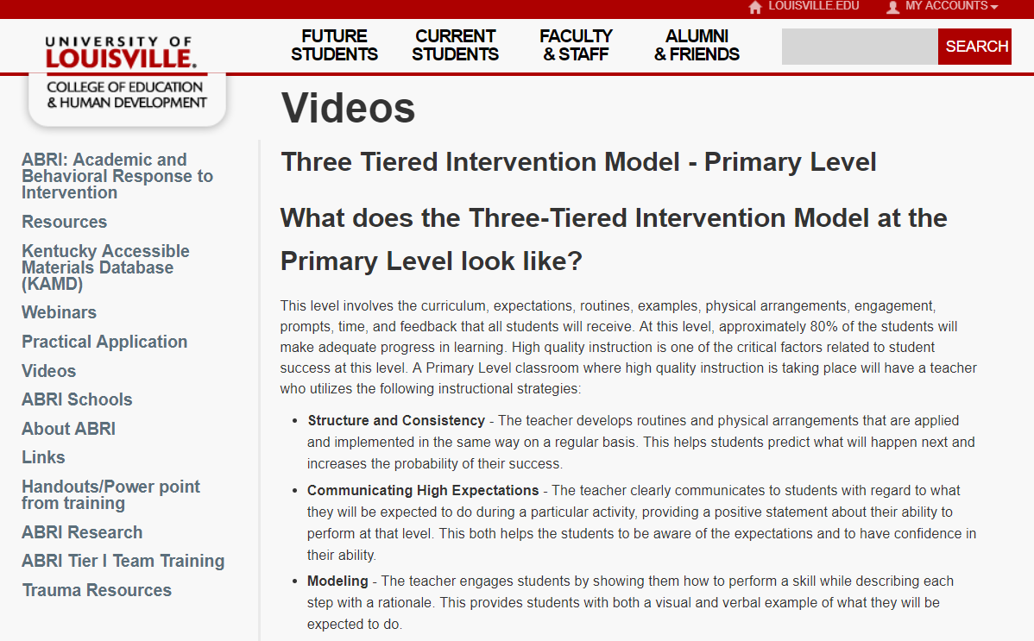
Activity 1.9: Evaluate an Example ABC’s in “real life”
Let’s use two videos to practice identifying the ABC’s.
After we do the first one together, please use the second one to complete Activity 1.9 in your workbook
Terry Scott, Ph,D,
Associate Dean and Professor
University of Louisville

Slide 42
Activity 1.9
Activity 1.9: Evaluate an Example Video 1
Link to Video: https://www.youtube.com/watch?v=VXCl2fMsdTU

Slide 43
Activity 1.9:
Activity 1.9: Evaluate an Example Video 1 - Review
What occurs right before the problem behavior? What are other individuals doing in the environment? Where is the student when the problem behavior occurs? Who is near the student when the problem behavior occurs? | What is the student doing that is disruptive or undesired? | What happens immediately after the undesired or problem student behavior? | Are you aware of anything additional that may be impacting the student’s behavior?
Antecedent | Behavior | Consequence | Comments
T said “it’s time for the assembly” and students stop working to line up at the door.
S (Roy) continues working and does not line up at the door.
T asks S to “show him” how to line up and S goes to line up at the door.

Slide 44
Activity 1.9 video 2
Activity 1.9: Evaluate an Example Video 2
Link to Video: Video 2: http://video.louisville.edu/vod/flashmgr/sefrey01/Video/1438280021295-iPhone.mp4

Slide 45
Activity 1.9 activity review
Activity 1.9: Evaluate an Example Video 2 - Review
What occurs right before the problem behavior? What are other individuals doing in the environment? Where is the student when the problem behavior occurs? Who is near the student when the problem behavior occurs? | What is the student doing that is disruptive or undesired? | What happens immediately after the undesired or problem student behavior? | Are you aware of anything additional that may be impacting the student’s behavior?
Antecedent | Behavior | Consequence | Comments
2
1
3
Please pause the video to complete Activity 1.8

Slide 46
Behavioral Theory I
Part 3
What are the elements of basic behavioral theory?

Slide 47
ABC’s of Behavior
Now that we understand that antecedents, behaviors, and consequences are…
what?
…OBSERVABLE and MEASURABLE,
we can go into more depth with types of consequences and types of antecedents.

Slide 48
Reinforcement vs. Punishment
Reinforcement: when a consequence of a behavior functions to increase the likelihood of future occurrences of that behavior
Punishment: when a consequence of a behavior functions to decrease the likelihood of future occurrences of that behavior

Slide 49
Reinforcement and punishment
Reinforcement and Punishment
Action**
Give (+)
Take (--)
Effect*:
Inc. ( )
Positive
Negative
Reinforcement
Reinforcement
Dec. ( )
Positive
Negative
Punishment
Punishment
* What is the future probability of behavior?
** What changes in the environment as a result of the behavior?

Slide 50
Building blocks of behavior.
Building Blocks of Behavior
Types of Consequences
4
Setting Event
Antecedent
Behavior
Consequence
Action
Give
Take
Putting it all together:
Future
Probability
Reinforcement
Positive
Negative
Effect on
Future Behavior
S^{R+}
S^{R-}
Future
Probability
Punishment
S^{P+}
S^{P-}

Slide 51
Jonas
When Jonas is asked to complete an independent assignment, he disrupts his peers and refuses to begin the assignment. After this behavior, the teacher immediately sits with him and helps him complete the work. In the future, Jonas continues to disrupt peers and refuses to complete work whenever he is told to work independently.

Slide 52
Breakdown of Example: Jonas
Antecedent (S^{D})
Behavior(s)
Consequence
When Jonas is told to complete an independent assignment
he disrupts his peers and refuses to begin
Jonas’ teacher sits with him to complete his work
Positive reinforcement
Action
(+ or -- )
Jonas’ teacher…GIVES him access to attention
Effect
(⬆ or ⬇)
In the future, Jonas continues to “disrupt his peers and refuse”

Slide 53
Emily
At home, Emily has several chores (feed the dog, do her laundry, and clean up her room). On Monday, Emily was tired. Her mom reminded her to do her chores, but Emily said “No” and went up to her room. When Emily’s favorite episode came on TV later she was not allowed to watch because her chores were not done. (Her mom took her TV privileges away). In the future, Emily is less likely to say no and disappear to her room when asked to complete her chores.

Slide 54
Breakdown of Example: Emily
Antecedent (S^{D})
Behavior(s)
Consequence
Emily is reminded to complete her chores
Says “no” and disappears to her room
She is not allowed to watch her favorite TV episode
Negative punishment
Action
(+ or -- )
Her mom TAKES away her screen time
Effect
(⬆ or ⬇)
In the future, Emily is less likely to say no and go to her room

Slide 55
Henry
When Henry is presented with difficult school work, he complains and puts his head down on his desk. Henry’s teacher takes his work away. In the future, Henry continued to complain and put his head down whenever he was presented with difficult work.

Slide 56
Breakdown of Example: Henry
Antecedent (S^{D})
Behavior(s)
Consequence
When Henry is presented with school work
He complains and puts his head down
Henry’s teacher…takes his work away
Negative reinforcement
Action
(+ or -- )
Henry’s teacher…TAKES his work away
Effect
(⬆ or ⬇)
In the future, Henry continues to mumble and put his head down

Slide 57
Mark
During lunch with peers, Mark made a derogatory comment toward one of his peers. The peer punched him. In the future, Mark was less likely to make derogatory comments (at least toward that peer).

Slide 58
Breakdown of Example: Mark
Antecedent (S^{D})
Behavior(s)
Consequence
During lunch with peers
Mark made a derogatory comment
The peer punched him
Positive punishment
Action
(+ or -- )
Peer “gave” a punch
Effect
(⬆ or ⬇)
less likely to make derogatory comments

Slide 59
Activity 1.10: Discussion Board Share your examples of antecedents and consequences
Develop an example for each type of consequence (Positive and Negative Reinforcement and Positive and Negative Punishment)
Please pause the video to complete Activity 1.10

Slide 60
Remember!
You only know if a consequence is reinforcing or punishing by looking at the effect on future behavior.

Slide 61
Building Blocks of Behavior
3 Types of Antecedents
Setting Event
Antecedent
Behavior
Consequence
Discriminative
Stimulus (S^{D})
Reinforcement
Response
S-Delta (S▵)
S^{D} Minus (S^{D-})
Punishment

Slide 62
Building Blocks of Behavior
3 Types of Antecedents
Setting Event
Antecedent
Behavior
Consequence
Discriminative
Stimulus:
With your friends
Reinforcement: Peers laugh
You tell a sarcastic joke
Nothing: they don’t get it….
S-Delta:
With little kids
Punishment: You are corrected or provided with disapproving looks
S^{D} Minus: With your boss or family members who don’t appreciate sarcasm

Slide 63
Building Blocks of Behavior
3 Types of Antecedents
Setting Event
Antecedent
Behavior
Consequence
Which type of antecedent is the most likely to occasion the behavior?
Discriminative
Stimulus (S^{D})
Reinforcement
Response
S-Delta (S▵)
S^{D} Minus (S^{D-})
Punishment
When most people say “antecedent,” they mean “discriminative stimulus, as they’re referring to the antecedent that occasions the behavior (due to prior history of reinforcement in its presence)

Slide 64
Building blocks of behavior extinction.
Building Blocks of Behavior
Extinction
Setting Event
Antecedent
Behavior
Consequence
Response
Reinforcement
When the consequences that function to reinforce a behavior (i.e., reinforcers) are withheld or prevented from occurring,
the behavior will eventually disappear. This is called extinction.
An extinction burst is a temporary increase in behavior following the removal of reinforcement.

Slide 65
Sarah
Every time Sarah talks out in class, the teacher gives her attention. Realizing that this is reinforcing her behavior, the teacher stops giving her attention for talking out.
At first, Sarah increases the amount of talking out in an attempt to get the teacher’s attention (it’s always worked in the past).
Over time, Sarah stops talking out for teacher attention.
Extinction
Extinction
Burst
Extinguished

Slide 66
Karen
After realizing that Karen was being positively reinforced for her problem behavior, her teacher decided to no longer give Karen help and attention when she engages in problem behavior.
Initially, Karen became more disruptive in class.
Over time, Karen eventually stopped engaging in problem behavior when she was presented with difficult work.
Extinction
Extinction
Burst
Extinguished

Slide 67
Activity 1.11: Stop and Jot Your examples of extinction
Develop an example to illustrate extinction.
Develop an example of an extinction burst
Please pause the video to complete Activity 1.11

Slide 68
Activity 1.11: Review
Remember extinction is when the consequences that function to reinforce a behavior (i.e., reinforcers) are withheld or prevented from occurring. Then, the behavior will eventually disappear.
An extinction burst is a temporary increase in behavior following the removal of a reinforcement.

Slide 69
Behavioral Theory I
Part 4
How Do We Determine the Function of Behavior?

Slide 70
Function of Behavior
All behavior serves a function:
Learners trying to get or obtain desired activities, tangible items, attention, or stimulation (S^{R+}).
Learners trying to avoid or escape aversive activities, items, attention, or stimulation (S^{R-}).

Slide 71
Another look at function
Positive
Reinforcement
Negative
Reinforcement

Slide 72
Building blocks of behavior: focusing functions of behaviors.
Building Blocks of Behavior
Focus on Function of Behavior
Setting Event
Antecedent
Behavior
Consequence
Discriminative Stimulus (S^{D})
Behavior
Reinforcement
When an individual is exhibiting problematic (or any) behaviors, look at the function:
What typically precedes the problematic behaviors?
What typically follows the problematic behaviors?
What function are the behaviors serving for that individual?

Slide 73
Jonas
Get/Obtain Attention
When Jonas is asked to complete an independent assignment, he disrupts his peers and refuses to begin the assignment. After this behavior, the teacher immediately sits with him and helps him complete the work. In the future, Jonas continues to disrupt peers and refuses to complete work, whenever he is told to work independently.
Assuming this is a consistent pattern…
What is the function of Jonas’ behavior?
Get or Obtain Something or
Escape or Avoid Something

Slide 74
Henry
Escape/Avoid Activity
When Henry is presented with difficult school work, he complains and puts his head down on his desk. Henry’s teacher takes his work away. In the future, Henry continued to complain and put his head down whenever he was presented with difficult work.
Assuming this is a consistent pattern…
What is the function of Henry’s behavior?
Get or Obtain Something or
Escape or Avoid Something

Slide 75
More Practice
A high school teacher is delivering a lesson on music theory. In the middle of the lecture, a student calls out repeatedly. Each time, the teacher calls on the student and allows them to ask their question or share their opinion.
Hypothesized function of
the student’s behavior:
A parent asks a child to clean up their room. The child begins to whine and scream. The parent gives up, and the child does not clean.
Hypothesized function of
the child’s behavior:
Get or Obtain Teacher Attention
Escape or Avoid Cleaning

Slide 76
Let’s put it all together:
During teacher lecture, Martha repeatedly and loudly calls out (without raising her hand). Each time, the teacher gives her a look, a redirection, or occasionally calls on her.
Teacher lecture (limited attention)
Calling out repeatedly
Teacher attention
Antecedent?
Behavior?
Consequence?
What Function?
Get/obtain Attention

Slide 77
Let’s put it all together:
When given a difficult writing assignment Susannah regularly throws her pencil down, rips up her paper, and puts her head down. Her teacher ignores this behavior (and Susannah never completes her assignment).
Difficult writing assignment
Throw pencil, rip paper, head down
Nothing (doesn’t do assignment)
Antecedent?
Behavior?
Consequence?
What Function?
Escape Task

Slide 78
Let’s put it all together:
In the hallway with peers, Tim often teases, trips, or pushes a student who talks and walks a little slower than others. Each time, Tim’s peers laugh and pat him on the back.
Transition with peers
Teases, trips, pushes
Peers laugh and pat on back
Antecedent?
Behavior?
Consequence?
What Function?
Peer attention

Slide 79
Activity 1.12: Stop and Jot Your examples of function
Return to the antecedent, behavior, consequence chains you noted in the video in Activity 1.9. Assuming those patterns continued over time, what is the hypothesized function of each of the behaviors you noted above?
Now develop your own example based on your experiences.
Day | Time | Antecedent | Behavior | Consequence | Hypothesized Function
Please pause the video to complete Activity 1.12

Slide 80
Activity 1.12: Review
Let’s review the first video together.
What did we come up with?
Day | Time | Antecedent | Behavior | Consequence | Hypothesized Function
T said “it’s time for the assembly” and students stop working to line up at the door.
S (Roy) continues working and does not line up at the door.
T asks S to “show him” how to line up and S goes to line up at the door.
Obtain Teacher Attention

Slide 81
Activity 1.13: Discussion Board Function discussion
How does an understanding of the context in which behavior occurs (ABC) help you develop interventions?
Share a time you think you have seen a mismatch between function and intervention?
Please pause the video to complete Activity 1.13

Slide 82
Activity 1.13: Resources
Resource | Link
Blank ABC Report Form and Function Related Interventions | https://intensiveintervention.org/sites/default/files/HO-3c-ABC-Report-Form_508.pdf
Completed ABC Report Form (Example) | https://intensiveintervention.org/sites/default/files/Handout4-%20ABC_Report_Form_Example%20.pdf
ABC Checklist | https://intensiveintervention.org/sites/default/files/Handout_3_ABC_Checklist%20.pdf
Common Problem Behaviors and Some Usual Suspects for Functional Antecedents and Consequences | https://intensiveintervention.org/sites/default/files/Handout2-Common_Problem_Behaviors%20.pdf

Slide 83
PBIS Big Ideas
4 PBIS Elements
Continuum of Support
Supporting Social Competence &
Academic Achievement
Tertiary Prevention:
Specialized
Individualized
Systems for Students with High-Risk Behavior
~5%
OUTCOMES
Primary Prevention:
School-/Classroom-
Wide Systems for
All Students,
Staff, & Settings
~15%
Supporting
Staff Behavior
SYSTEMS
DATA
Supporting
Decision
Making
Secondary Prevention:
Specialized Group
Systems for Students with At-Risk Behavior
PRACTICES
Supporting
Student Behavior
~80% of Students

Slide 84
Review of “Big Ideas”
Setting Event
Antecedent
Behavior
Consequence

Slide 85
Building Blocks of Behavior
Three Term Contingency
Setting Event
Antecedent
Behavior
Consequence
We’ll learn more about this in the next module.
A “stimulus that precedes a behavior.”
An ”observable and measurable act of an individual (also called a response).”
A stimulus change that occurs contingent on a behavior.

Slide 86
Building blocks of behavior 4 types of consequences.
Building Blocks of Behavior
Types of Consequences
4
Setting Event
Antecedent
Behavior
Consequence
Action
Give
Take
Putting it all together:
Future
Probability
Reinforcement
Positive
Negative
Effect on
Future Behavior
S^{R+}
S^{R-}
Future
Probability
Punishment
S^{P+}
S^{P-}

Slide 87
Building Blocks of Behavior
3 Types of Antecedents
Setting Event
Antecedent
Behavior
Consequence
Which type of antecedent is the most likely to occasion the behavior?
Discriminative
Stimulus (S^{D})
Reinforcement
Response
S-Delta (S▵)
S^{D} Minus (S^{D-})
Punishment
When most people say “antecedent,” they mean “discriminative stimulus, as they’re referring to the antecedent that occasions the behavior (due to prior history of reinforcement in its presence)

Slide 88
Another look at function
Positive
Reinforcement
Negative
Reinforcement

Slide 89
Focus on function of behavior.
Building Blocks of Behavior
Focus on Function of Behavior
Setting Event
Antecedent
Behavior
Consequence
Discriminative Stimulus (S^{D})
Behavior
Reinforcement
When an individual is exhibiting problematic (or any) behaviors, look at the function:
What typically precedes the problematic behaviors?
What typically follows the problematic behaviors?
What function are the behaviors serving for that individual?

Slide 90
What’s next
Module 1 Self-Assessment Quiz

