Slide 1
Assess with Purpose Student Focused Assessments for the Synchronous and Asynchronous Learner

Slide 2
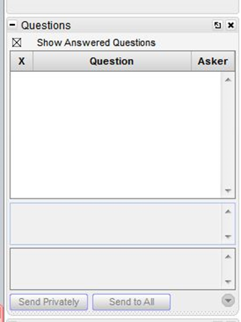
Webinar Format & Questions
Throughout the presentation, submit your questions into the question pod.
For technical issues/questions, a webinar team member will try to assist you as soon as possible.
For content related questions, there will be a time for Q & A at the end of the presentations. Submit your questions and we will share them with the presenters.

Slide 3
Welcome and Introductions
FOLLOW @ProjectSTAIR on Twitter
SUBSCRIBE Project STAIR YouTube
Notes:
.

Slide 4
Session Outcomes
Participants will learn about the types of assessments within a DBI framework.
Participants will learn tips and strategies for assessing students during synchronous and asynchronous learning.

Slide 5
Webinar Presenters
Leanne Ketterlin-Geller
Elizabeth Thomas
Jiyung Hwang
Tessa Arsenault

Slide 6
We want to meet you!
Share in the question pod:
What state are you listening from? ​
What is your role within education?​
Did you attend the first webinar of the series on DBI?
Y-Yes
N-No

Slide 7
Project STAIR
Funded by the Office of Special Education Programs of the U.S. Department of Education
Researchers from:
University of Missouri
Southern Methodist University
The University of Texas at Austin
Funding period: 2018-2022

Slide 8
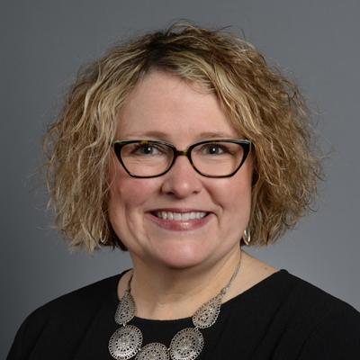
Teams
University of Missouri, Erica Lembke
Southern Methodist University,
Leanne Ketterlin-Geller
The University of Texas at Austin,
Sarah Powell

Slide 9
Goals and Description of Project STAIR
Early intervention in middle schools
Goal: preparation for Algebra 1 in high school
Student Success in Algebra-Readiness Concepts and Skills
Data Based Individualization
Explicit Instruction
Problem Solving Structures
Visual Representations
Fluency Building
Universal Screening
Diagnostic Assessment
Progress Monitoring
Evidence-based Instructional Strategies
Formative Assessment
Professional Development and Ongoing Support
Data Based Individualization

Slide 10
What is DBI?
systematic
Data-
Based
Individualization
relies on data
helps individualize instruction

Slide 11
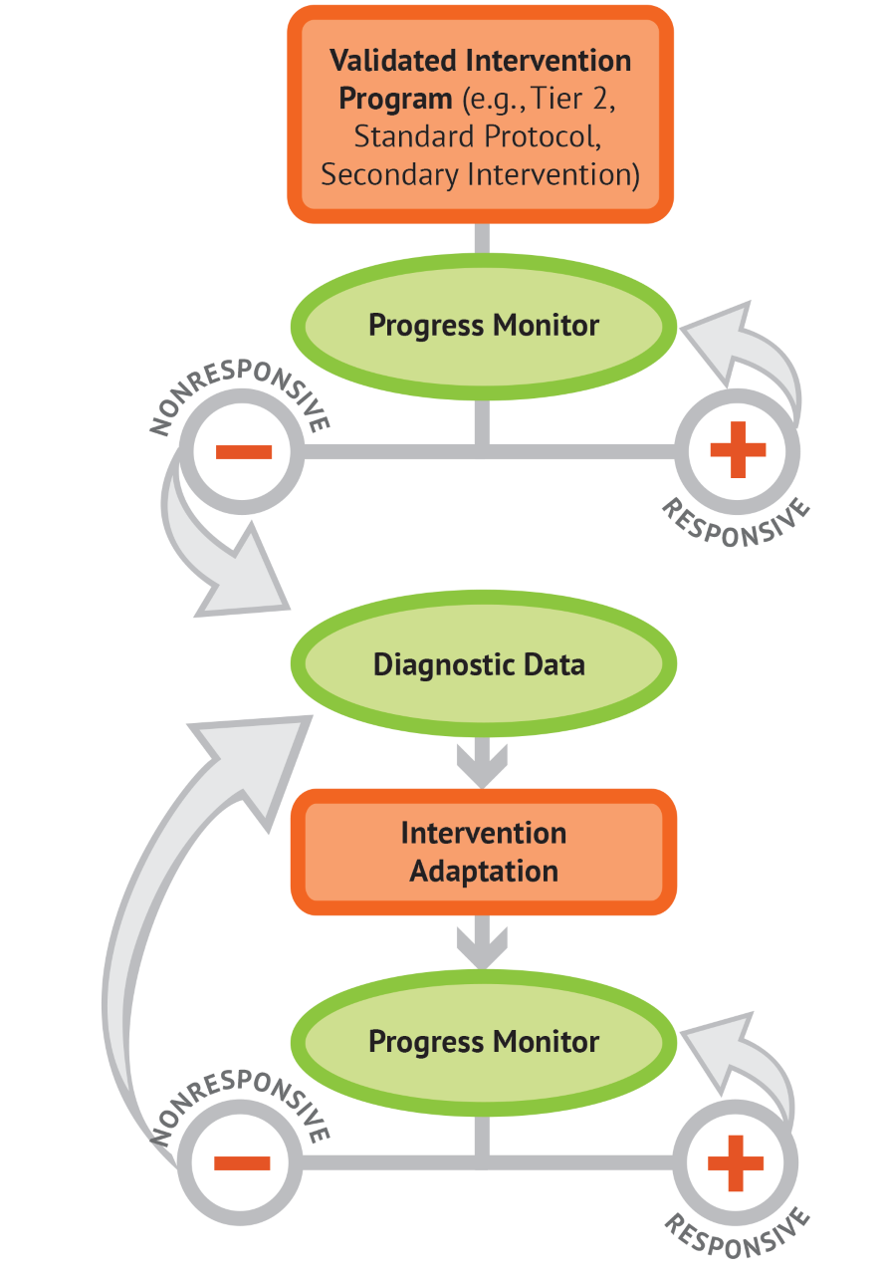
Define DBI
Two primary components
Assessment
Instruction

Slide 12
Define DBI
Two primary components
Assessment
Instruction

Slide 13
Evidence Supporting Assessment

Slide 14
The Role of Formative Assessment
This meta-analysis synthesizes findings from 42 interventions on instructional approaches that enhance the mathematics proficiency of students with learning disabilities
Providing
ongoing formative assessment data to teacher
Providing formative assessment data to students with LD
Gersten et al., (2009)

Slide 15
What is effect size?

Slide 16
The Role of Formative Assessment
Relative Effect Size
Small
Large

Slide 17
The Role of Formative Assessment
Relative Effect Size
Small
Large
1- Providing teachers with feedback on student progress
2- Providing teachers with feedback plus options for addressing instructional needs
3- Providing feedback to students on their mathematics performance
4- Providing feedback to students with goals

Slide 18
The Role of Formative Assessment
Relative Effect Size
4- Providing feedback to students with goals (ES = 0.17, p = .29)
Small
Large
1- Providing teachers with feedback on student progress (ES = 0.21, p=<.05)
3- Providing feedback to students on their mathematics performance (ES = 0.23, p=<.05)
2- Providing teachers with feedback plus options for addressing instructional needs (ES = 0.34, p=.10)

Slide 19
Assessments for DBI
Establish present level of mathematics performance
and use this information to set ambitious goals
Universal Screener
Monitor student’s progress toward the goal
Progress Monitoring Measure
Diagnose student’s persistent misconceptions
and errors
Diagnostic Assessment
Monitor student’s progress toward the goal
Progress Monitoring Measure

Slide 20
School Level Experience
Share in the question pod:
What universal screeners are used at your school?
A-Renaissance Star
B-iReady
C-MAP (by NWEA)
D-easyCBM
E-other_____
F-none

Slide 21
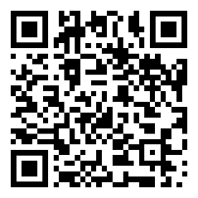
Technically Sound Assessment Leads to Sound Data-Based Decisions

Slide 22
Universal Screening

Slide 23
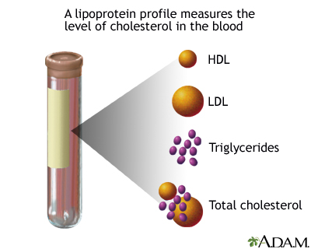
What is Universal Screening?
Well-baby check-up
Cholesterol tests
Tune-up for your car

Slide 24
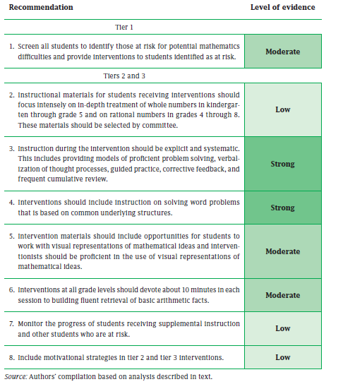
Screen all Students
Screen all students to identify those at risk for potential mathematics difficulties and provide interventions to students identified as at risk.

Slide 25
Interpreting Results from Universal Screeners
Screen all students
Administer Universal Screening using standardized procedures from your district
Identify students at-risk or underperforming
Administer Tier 2 Interventions per your school plan
Identify students with intensive needs in math
Students with IEPs in math
Lowest performing on Universal Screener
Who needs intervention?
Given this data, who needs intensive intervention?

Slide 26
Examine Universal Screening Report

Slide 27
How do you use screening data within a DBI framework?
1
Establish that there is a Tier 2 validated intervention program in place
2
Progress monitor
Establish a present level
Collect frequent assessment data
Use decision rules
Set an ambitious long term goal

Slide 28
Progress Monitoring

Slide 29
What do you think?
Share in the question pod:
Which students should you progress monitor?
A-All students
B-Students performing as expected
C-Students at-risk or underperforming
D-B and C
E-None
F-I don’t know

Slide 30
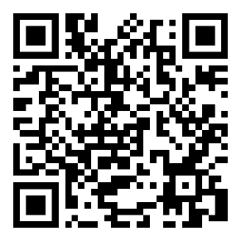
Technically Sound Assessment and Data-Based Decisions

Slide 31
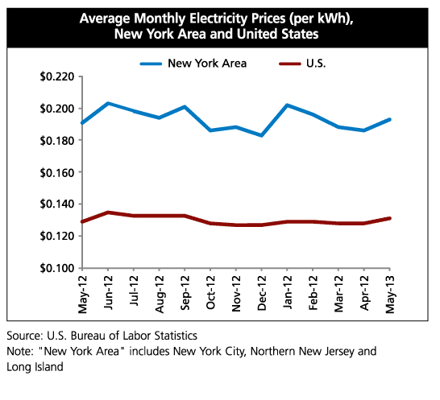
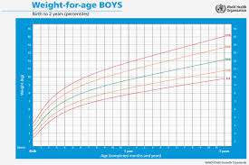
What is Progress Monitoring?
Exercise Tracker
Average Monthly Electricity
Prices in NY & US
Baby Growth Chart

Slide 32
Monitor Student Progress
Monitor the progress of students receiving supplemental instruction and other students who are at risk.

Slide 33
Interpreting Results from Progress Monitoring Measures
1. Set annual goal for individual
2. Monitor individual progress
towards goal

Slide 34
Interpreting Results from Progress Monitoring Measures
1. Set annual goal for individual
3. Establish Trend line
4. Evaluate and modify instruction on basis of rate of progress toward goal
2. Monitor individual progress
towards goal

Slide 35
Make Decisions from Progress Monitoring Results

Slide 36
Using Progress Monitoring Assessments Within a DBI Framework
1
Establish that there is a Tier 2 validated intervention program in place
2
Progress monitor
3
Based on student responsiveness:
Establish a present level
Collect frequent assessment data
Continue the Tier 2 program with progress monitoring
Collect Diagnostic data
Use decision rules
Set an ambitious long term goal

Slide 37
Diagnostic Assessments

Slide 38
Previous Experience
Share in the question pod:
Which diagnostic assessments have you used before?
A- Error Analysis
B- Math Interviews
C- Intervention or curricula-specific tools
D- Standardized diagnostic tool
E- other_____
F- none

Slide 39
What is a Diagnostic Assessment?
Car diagnostics
Medical diagnostic tests

Slide 40
Interpreting Results and Making Decisions from a Diagnostic Assessment

Slide 41
Using Diagnostic Assessments with a DBI Framework
1
Establish that there is a Tier 2 validated intervention program in place
2
Progress monitor
3
Based on student responsiveness:
Establish a present level
Collect frequent assessment data
Continue the Tier 2 program with progress monitoring
Collect Diagnostic data
Use decision rules
Set an ambitious long term goal
4
Make an instructional change based on hypothesis
5
Continue to monitor progress to determine if student is/is not responsive to instruction

Slide 42
Assessment in the Virtual Classroom

Slide 43
Know Your Students’ IEP Accommodations

Slide 44
Awareness of Inequities

Slide 45
Know Your Purpose for Assessing

Slide 46
Preparedness and Communication are Key

Slide 47
How are you?
Share in the question pod:
How do you feel about conducting assessments virtually?
A
B
C
D

Slide 48
Assessment with Purpose
Session Outcomes
Participants will learn about the types of assessments within a DBI framework.
Participants will learn tips and strategies for assessing students during synchronous and asynchronous learning.

Slide 49
Questions
Send questions through the chat!

Slide 50
Remember Our Next Webinar
How to Teach Mathematics and Make Adaptations Within a DBI Framework (Nov 4)

Slide 51
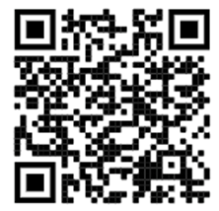
Use Project STAIR Videos
https://www.youtube.com/channel/UCE2puwDtUSNXFONIOhmYmvA/playlists

Slide 52
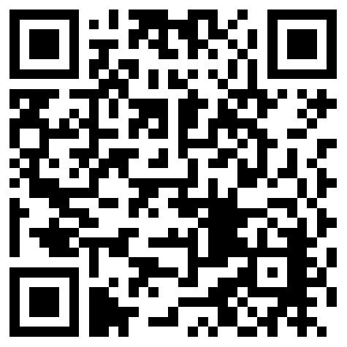
Thank You

