Slide 1
So What do I do Now?
Strategies for Intensifying Intervention when Standard Approaches Don’t Work
    April 29, 2014
  Sharon Vaughn, Ph.D. Rebecca Zumeta, Ph.D.
    University of Texas-Austin AIR

Slide 2
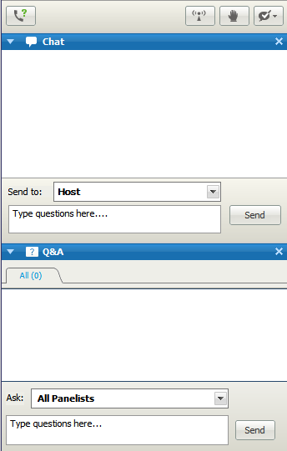
A note about questions…
Please type questions related to technical issues in the Chat box.
Please type questions related to webinar content in the Q&A box.
Notes:
To help us be the most responsive to your requests throughout this webinar, we ask that you please type any questions related to technical issues or general questions in the chat box on your screen. We ask that you use the Q&A box to type questions related to the webinar content, that you would like our presenters and center staff to address.

Slide 3
Session Objectives
Quick review of data-based individualization
Discuss four categories of practices for intensification
Introduce examples of these practices
Answer your questions
Notes:
During today’s session, our objectives are to….(read or paraphrase bullets on slide).
Review research recommendations for intensifying academic intervention
Discuss four categories of practices for intensification, and underlying elements
Plan for intensive intervention with your students
Plan for common barriers to implementation

Slide 4
What can we learn from research about intensive intervention?
Little empirical research demonstrating specific effective intervention programs for the lowest 3-5% of readers
Intervention practices are typically based on expert recommendations from a body of research.
Monitoring progress is essential to determine impact and intensity required for individual students.

Slide 5
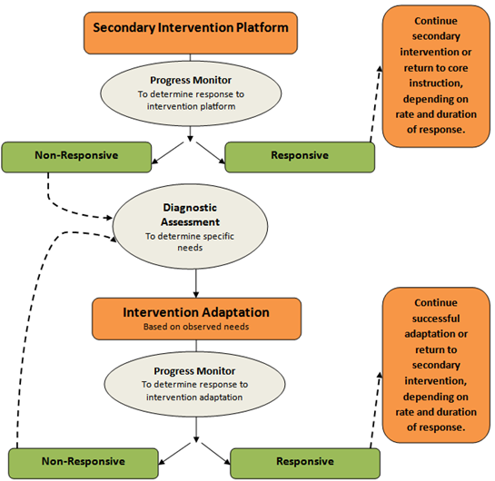
Our approach to intensive intervention:
Data-based Individualization (DBI)
Intensification
Evidence
Notes:
Rebecca
Adapting interventions to make them more intense lies at the heart of the data-based individualization (DBI) process. (Review other elements of the graphic as needed.) The strategies we’ll discuss today provide you with methods for adapting your secondary intervention platforms when you find they are insufficient for specific students. As we’ll also discuss, use of precise progress monitoring data (note lower “Evidence” arrow) to determine the impact of these instructional adaptations is also an essential part of effective intensive intervention. These data provide the evidence base to help teachers/teams determine whether or not the intervention program is effective for the individual student and when changes may be needed.
For a more complete overview of the DBI process, visit: http://www.intensiveintervention.org/resource/introduction-data-based-individualization.

Slide 6
Categories of Practice for Organizing & Planning Intensive Intervention
Change Dosage or Time
Change the Learning Environment to Promote Attention and Engagement
Combine Cognitive Processing Strategies with Academic Learning
Modify Delivery of Instruction
(Vaughn et al., 2013)
Notes:
Today’s conversation will be organized about ways to intensify intervention along the following four dimensions. You may notice that the first and second dimensions already occur frequently in your school. These are typically the most common methods of intensification. We’ve called these quantitative changes to instruction in prior modules. Quantitative changes typically refer to changes that increase the amount of instruction a student receives. The third and fourth dimensions are consistent with qualitative changes, or adaptations that change the method or content of instruction/intervention delivered. We’ll spend time discussing each of four dimensions now, but will spend most of the time on dimensions three and four because you may be less familiar with them.
To read more, see: Vaughn, S., Wanzek, J., Murray, C. S., & Roberts, G. (2012). Intensive interventions for students struggling in reading and mathematics: A practice guide. Portsmouth, NH: RMC Research Corporation, Center on Instruction. Retrieved from http://www.centeroninstruction.org/files/Intensive%20Interventions%20for%20Students%20Struggling%20in%20Reading%20%26%20Math.pdf.

Slide 7
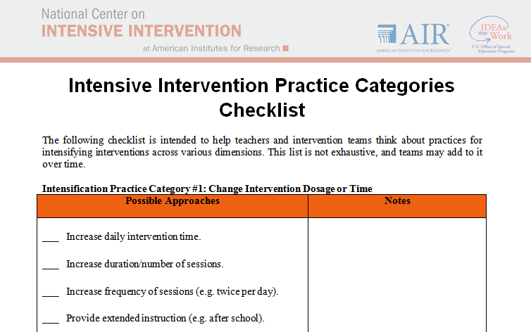
Handout: Intensive Intervention Practice Categories Checklist

Slide 8
Practice #1: Change Dosage or Time

Slide 9
Practice #1: Change Dosage or Time
Methods for increasing quantity of instruction:
  Minutes per day
  Minutes per session
  Sessions per week
  Total number of sessions
Notes:
As mentioned previously, practice 1, changing the dosage or time in instruction, is a change that may already be happening in your school. It is a change that can occur quickly by (read or paraphrase slide)

Slide 10
Why should I change intervention time?
  When well designed, increased time accelerates learning by:
  Allowing for more instruction.
  Providing more practice with feedback.
  Increasing students’ engaged learning time.
  Students with intensive needs often require 10-30 times the number of practice opportunities as their peers to learn new information—This takes time!
Notes:
You may ask why should I change intervention time? When the amount of time that the student spends in an intervention is increased it allows for more instruction to take place, provides more practice with feedback since the teacher is present and increases students’ engaged learning time. All of these accelerate student learning. Please note that to achieve the greatest results in most cases, increasing the time should be combined with changes to content and method of delivery. Students with intensive needs often require 10-30 times the number of practice opportunities as their peers to learn new information—This takes time!

Slide 11
What is the suggested duration of intensive intervention?
Consider:
  Students further behind need more intervention time.
  Students provided less appropriate Tier I instruction need more intervention time.
  Older students will likely need more time in intervention than younger students.
  * Research on the number of sessions varies, but at least 8-16 weeks, often longer.
Notes:
Determining the duration of an intervention depends on student-related and school-related factors, consider:
Students further behind need more intervention time.
Students provided less appropriate Tier I instruction need more intervention time.
Older students will likely need more time in intervention than younger students.
Additionally, the research on the number of sessions varies, but it is suggested that intervention should last at least 8-16 weeks, and often longer. Older students will likely need much more time, depending on how far behind they are, and the nature of their instructional deficits. Students’ progress data should drive decisions about when they are ready to exit intensive levels of support (Vaughn et al., 2012).

Slide 12
What are the suggested length and frequency of intensive intervention?
Consider:
How far the student is below grade-level
The length and frequency of the previous interventions
The complexity of the learning tasks
Student stamina and attention span
* Evidence suggests that students with intensive needs may benefit from 60-120 min of intervention per day.
Notes:
When thinking of the length and frequency it’s important to consider:
How far the student’s achievement is below grade-level
The length and frequency of the previous interventions
The complexity of the learning tasks (e.g., letter naming in kindergarten is less cognitively complex than comprehension of a third grade science textbook).
Student stamina and attention span
To maintain attention and engagement with younger students, staff may consider two sessions per day. Evidence suggests that students with intensive needs may benefit from 60-120 min of intervention per day. However, this time may be broken up into several sessions throughout the day (Vaughn et al., 2012).

Slide 13
How should I use the additional time in intervention?
Use the additional time to accelerate learning by:
Maximizing engaged learning time
Minimizing waiting and transitions
Teaching additional skills and strategies
Providing additional practice opportunities with feedback
Delivering more explicit, systematic (step-by-step) instruction
Monitoring student progress to ensure that the additional learning time increases student mastery of skills.
Notes:
The following is a list of ways to use additional teaching time. We’ll discuss several of these practices in further detail later in the session. (paraphrase slide)
As mentioned previously, more time by itself isn’t enough. More time is likely to be the most useful when combined with changes to content and the method of delivery.

Slide 14
Strategies for Adding Intervention Time
Double dip: Rather than a single intervention block, students might receive intervention at different times during the day (e.g., 20 min in the morning and 20 min the afternoon rather than a single 40 min session) (Gersten et al., 2008; Vaughn et al., 2012).
Use entry or exit routines: Provide independent or peer-mediated practice opportunities for students to minimize wait time and allow multiple small groups to run at once.
Reinforce groups for following routines independently.
Notes:
Some suggestions for adding intervention time include:
Double dip: Rather than a single intervention block, students might receive intervention at different times during the day (e.g., 20 min in the morning and 20 min the afternoon rather than a single 40 min session) (Gersten et al., 2008; Vaughn et al., 2012).
When interventions are broken up over multiple sessions in a day it can help address scheduling challenges, facilitate pre-teaching and reinforcement of new concepts, and support young students who are likely to have shorter attention spans and less stamina than older students. For example, a student may start the morning with 30 minutes of phonological coding and decoding practice and then spend 30 minutes practicing reading connected text in the afternoon. Again, this not only addresses scheduling issues, but also helps to ensure that student stamina and/or attention spans do not become a barrier to learning.
Use entry or exit routines: Provide independent or peer-mediated practice opportunities for students (e.g., math facts practice, letter-writing, paired oral reading) to minimize wait time and allow multiple small groups to run at once.
Reinforce groups for following routines independently.
Entry and exit routines that provide opportunities for practice of skills may allow interventionists to manage multiple overlapping small groups. In addition, incorporation of these routines may reduce the time students spend waiting, and increase engagement. Reinforcement (e.g., verbal praise, points towards a reward, a sticker chart) helps to promote on-task behavior and allows teachers to manage a larger number of students.

Slide 15
Strategies for Adding Intervention Time (cont).
Sample entry routine:
  Student comes into the classroom, gets a timer and does practice with math facts, writing down the scores on a recording sheet.
Sample exit routine:
  Student finished with the lesson does an oral reading fluency practice either alone or with a partner.

Slide 16
Practice #2: Change the Learning Environment to Promote Attention and Engagement
Notes:
Adding dosage/time is just one piece of the puzzle; however, it alone is often not sufficient. In the following section, we’ll discuss
how making changes to the learning environment may increase attention and engagement of students who have intensive intervention needs, and their implications for designing instruction/intervention.

Slide 17
Practice #2: Change the Learning Environment to Promote Attention and Engagement
  Reduce group size
  Group students with similar needs
  Change the instructional setting to reduce noise and other distractions and promote academic engagement.
Notes:
Altering the group or learning environment may increase attention and engagement by minimizing distractions and increasing the number of student-teacher interactions that are relevant to a particular student. This not only increases individual interactions between a student and teacher, but homogeneity within the group means that it’s more likely that all of the activities within the group will be relevant for all students.

Slide 18
What is the ideal group size for providing intervention?
Small groups, up to 4 students, may provide the most intensive intervention at the elementary level.
Research has not identified one ideal intervention group size that increases outcomes for all or most students, particularly in older students in grades 6-12.
Notes:
Group size recommendations: 1-4 students at the elementary level; Less is known about secondary grades, but some data suggest groups may be up to 10-15 students (Vaughn et al., 2012).
Again, these are intervention changes you probably already make in your school, so we’re not going to spend much time talking about them. As with the first strategy, they are unlikely to be effective unless the instruction is an appropriate match in terms of content and method(s) of delivery. We’ll talk more about those issues now.

Slide 19
Reducing Group Size with Limited Resources
Develop entry or exit routines that provide independent or peer-mediated practice opportunities for students.
Reinforce groups for following routines independently.
Use peers, parent volunteers, paraeducators, or computer programs for practice activities.
Use teacher time for instruction and assessment of new skills.
Notes:
One limitation that many schools face is how to reduce group size with their limited resources. The following is a list of ways to accomplish this:
Develop entry or exit routines that provide independent or peer-mediated practice opportunities for students. Some sample routines could be; students finishing the practice section of the lesson taught earlier or on the previous day, peer/partner reading (can be used with students at the same level, or students who are at different levels e.g., a younger student reading to an older struggling student), or something as “simple” as students coming into the intervention room and gathering all of the materials they need and sit quietly and read.
Reinforce groups for following routines independently. Reinforcers can be something like a token economy, where students earn small tokens or “money”, and then use those later to redeem for a bigger prize.
Use peers, parent volunteers, paraeducators, or computer programs for practice activities. There are many great advantages to having peers, parents volunteers and paraeducators listen to students do practice. Using these supports will leave the teacher free to do the heavy lifting in terms of using teacher time for instruction and assessment of new skills.

Slide 20
Why small homogeneous groups?
Increases engaged interaction opportunities between student(s) and teacher
Provides more opportunities for practice with feedback
Allows teachers to match instruction to specific student needs
Better able to monitor on-task behavior and engagement
Notes:
Small homogeneous groups have many advantages. Some of which are:
Increases engaged interaction opportunities between student(s) and teacher
Provides more opportunities for practice with feedback
Allows teachers to match instruction to specific student needs, making instruction more relevant
Teachers are better able to monitor on-task behavior and engagement

Slide 21
Practice #3: Combine Cognitive Processing Strategies with Academic Learning
Notes:
In the following section, we’ll discuss common cognitive characteristics of students who have intensive intervention needs, and their implications for designing instruction/intervention.
Note to participants that in this webinar, we will focus more on this area. Previous research focused solely on cognitive processing. We are not talking about these things in isolation but mechanisms for considering these practices as we teach.

Slide 22
Considerations when Designing Intensive Intervention
Academic interventions should also support cognitive processes such as:
Memory
Self-regulation and self-monitoring
Attribution
Attention
Notes:
Review bullets—you will cover these processes in more detail in the following slides.

Slide 23
Memory

Slide 24
How does poor memory impede academic success?
Students with memory problems may have difficulty recalling:
A sentence or description they just read
Components of a multi-step math problem
Steps in a sequence (e.g., math operations, independent work, organizational routines)
Multi-step directions
Previous learning that relates to new information
Information presented in one modality (e.g., auditory only)
(Swanson, Zheng, & Jerman, 2009).
Notes:
Let’s talk more about these cognitive characteristics and why they have implications for students’ learning. As you’ll notice, many of these processes share characteristics and related implications. Let’s start by talking about ways in which problems with memory can impact students’ academic progress (review slide).
Possible discussion question: Are there any other ways you’ve observed poor memory manifesting itself in your students’ academic work?
Allow time for participants to respond.

Slide 25
Indicators that a student struggles with poor memory
Low scores for digit span or other measures of working memory on cognitive assessments.
Frequently forgetting steps in a process or routine, or requiring more prompting than peers.
Need for repeated presentation of new material in order to remember it.
Not recalling information taught during the previous lesson/day/week (depending on context).
Gets lost easily.
Notes:
The following are indicators that a student may have difficulties with memory (discuss slide). Can you think of additional indicators?

Slide 26
What practices help students reduce the impact of poor memory while engaged in academic learning?

Slide 27
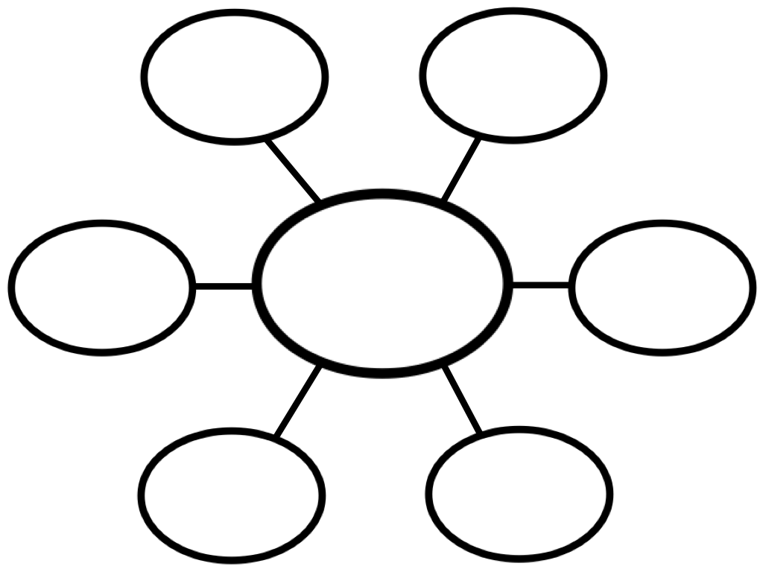
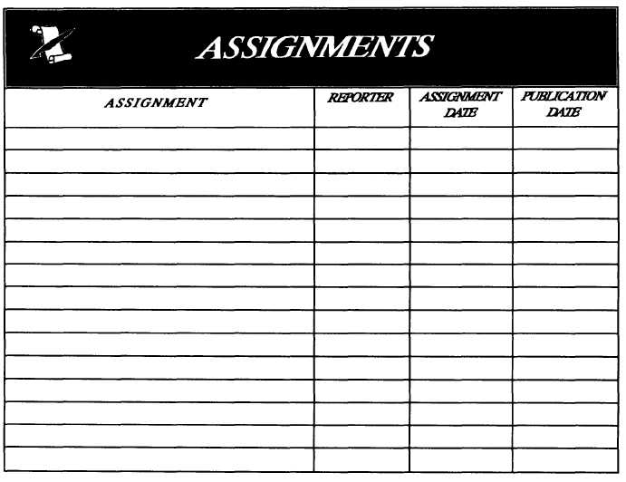

Teach strategies for taking notes and organizing information
Teach students to ask for help if they need information repeated
Teach students to write down assignments, and include in daily routines
Use graphic organizers and key words and phrases for notes
Notes:
Review slide. If time allows, consider asking participants to add to this list, or share strategies they have used in the past to help students develop note-taking skills.
Teach students to record assignments and due dates in a planner/calendar/assignment sheet
Use graphic and other text organizers to help students take notes and remember what they read.
Write key words/phrases, not entire sentences/paragraphs when taking notes.
Encourage students to self-advocate and ask for help if they need information repeated.

Slide 28

Present information using more than one modality
  Speak and write/draw/project information as you present it
  Repeat important instructions, key words, etc.
  Model procedures to provide students with a visual image of the steps
  Teach students to visualize information in text, including stories, word problems, etc.
Notes:
Students with intensive needs—particularly where memory or attention are impacted—often need information presented in more than one way. For example…(review slide).
Speak and write/draw/project information as you present it
Repeat important instructions, key words, etc.
Model procedures to provide students with a visual image of the steps
Teach students to visualize information in text, including stories, word problems, etc.

Slide 29

Teach routines for important procedures
  Use consistent routines
  Provide a cue sheet/poster for multi-step processes
  Review steps regularly reteach as needed.
1. Get your coat and backpack
2. Pick up your sack lunch in the hall bin.
3. Check your mailbox
4. Put papers in your accordion folder.
Notes:
Students with intensive needs are more successful when they have consistent routines to help them remember procedures. Students will need teachers to use consistent routines to help them remember what needs to happen each day and/or class period. Teachers can also provide a cue sheet or poster for multi-step processes until students can complete them independently. (Pictures can be used for older students or students who need visual reminders. Actual pictures of the student completing the task are beneficial). Teachers should review steps regularly and reteach as needed.

Slide 30
Review prior learning before presenting new information
Have students:
  retell information from the previous lesson
  summarize key points using just a few words or phrases
  predict/explain how the new information may relate to prior learning.
Notes:
Students with intensive needs often need to review prior learning before they learn new information. This review of information, or accessing of background knowledge, can help students with intensive intervention needs connect the new material to previous learning making it more likely that the students will remember. It also allows teachers to informally assess students mastery of previous content, which can help clear up any myths or misconceptions students may have.
Some ways in which teachers can review prior learning are:
Have students retell information from the previous lesson (or lessons).
Have students summarize key points using just a few words or phrases.
Explain how the information they are about to learn relates to prior learning

Slide 31
Other Strategies
Teacher model out-loud verbal rehearsal of what students need to remember
Develop a mnemonic device
Use visual or verbal cues as reminders
Check for understanding frequently
Notes:
Other strategies for helping students with poor memory include:
Having the teacher model out-loud verbal rehearsal of what students need to remember (e.g., “I can count by 2s, 3s, 4s, etc., to help me with addition and multiplication.”).
Having the teacher develop or use an already existing mnemonic device to help students remember information or routines
- The use of visual or verbal cues as reminders
- Having the teacher check for understanding frequently

Slide 32
Self- regulation
Notes:
In this next section we will talk about, and then I will model for you, self-regulation strategies to help students with intensive intervention needs.

Slide 33
What is self-regulation?
Self-regulation comprises:
Planning and setting goals for learning
Monitoring learning and progress toward goals
Regulation of language and memory to support learning (e.g., self-talk, use of strategies)
Attention
Notes:
Self-regulation is a learners ability to take ownership of his/her learning. (paraphrase or read slide)
Self-regulation comprises:
Planning and setting goals for learning
Monitoring learning and progress toward goals
Regulation of language and memory to support learning (e.g., self-talk, use of strategies)
Attention

Slide 34
Poor self-regulation and executive function impede academic learning.
Students with deficits in these areas:
  demonstrate minimal use of self-directed strategies
  often exhibit behavior problems due to inattention and poor impulse control.
  have difficulty taking in new information
  lack the ability to monitor their learning
Notes:
Why does poor self-regulation and executive function impede academic learning? Because students with deficits in these areas demonstrate minimal use of self-directed strategies—They need to be explicitly taught. Students also, often exhibit behavior problems due to inattention and poor impulse control. Their inattention makes intake of new information difficult, and their lack of monitoring of learning makes it difficult for students to be aware of what they do and do not know, and when they should request help.

Slide 35
How can I teach students to use self-regulation strategies in their academic work?
Many of the memory practices we have discussed will help students with poor self-regulation.
In particular, also:
  Model thinking-aloud when you introduce new concepts
  Provide specific feedback
  Include students in goal setting and monitoring
  Explicitly teach and model use of strategies and routines
Notes:
Many of the memory practices we’ve already discussed will help students with poor self-regulation.
In particular, also:
Model thinking-aloud when you introduce new concepts
Provide specific feedback
Include students in goal setting and monitoring
Explicitly teach and model use of strategies and routines

Slide 36
Modeling Think Aloud Strategies
Model how you approach tasks and solve problems by talking out loud as you:
  Reflect on text
  Implement strategies for answering text-based questions
  Solve word problems
  Give yourself feedback
  Check work
Notes:
It is important to model think aloud strategies for students with intensive intervention needs. All students will benefit from hearing how you approach tasks and solve problems. Some students will not realize that they may already be doing self talk, as they do it automatically, but other students do not know that it is a strategy that is often used by adults. It may be fun to point out to students that they should watch and listen to an adult when the adult can’t find something like keys. Adults engage in think aloud strategies all the time!
Read or paraphrase slide.

Slide 37
Let’s Practice
Clare has 6 red water balloons, 5 blue water balloons, and 4 green water balloons. How many blue and green water balloons does she have in all?
Answer: 9 blue and green water balloons
Notes:
Model how you might use a think aloud strategy to solve this math problem. Use a whiteboard, overhead, or chart paper to write out the problem and model your thinking as you solve the problem. Or, use the sample script on the following slides.

Slide 38
Clare has 6 red water balloons, 5 blue water balloons, and 4 green water balloons. How many blue and green water balloons does she have in all?
Sample Script: (Read math problem.) The question is asking me how many blue and green water balloons in all. I’m going to underline the question and circle “blue and green balloons” in the question to remind me of the question and the label for my answer.
Notes:
Remember to do the task as you say the script. For example, as you say, “I’m going to under the question…” be sure that you are actually underlining the question. Things in parenthesis are actions that you should do.

Slide 39
Clare has 6 red water balloons, 5 blue water balloons, and 4 green water balloons. How many blue and green water balloons does she have in all?
Sample Script: Next, I look back at the problem and I see there are 5 blue (circle) and 4 green (circle) balloons. I don’t need the information about red balloons because the question doesn’t ask me about them. I’ll cross that out so it doesn’t confuse me. (Cross out, “6 red water balloons.”)
.

Slide 40
Clare has 6 red water balloons, 5 blue water balloons, and 4 green water balloons. How many blue and green water balloons does she have in all?
Sample Script: The question asks how many blue and green balloons in all, so I know I need to add 5 + 4. If I start with 5 and count 4 more (5—6, 7, 8, 9) on my fingers, I get 9. So, my answer is 9 (write 9).
5 + 4 = 9
.

Slide 41
Clare has 6 red water balloons, 5 blue water balloons, and 4 green water balloons. How many blue and green water balloons does she have in all?
Sample Script: Now it’s time to label my answer. I’m looking back at the question and I see that I circled blue and green water balloons because that’s what the question asks about, so I know that’s my label (write the label).
5 + 4 = 9 blue and green water balloons

Slide 42
Clare has 6 red water balloons, 5 blue water balloons, and 4 green water balloons. How many blue and green water balloons does she have in all?
Sample Script: I’m going to check my answer to make sure it makes sense. The question asked me, “How many blue and green water balloons?” Does it make sense that 5 blue plus 4 green equals 9? (Pause to check adding) Yes, it does. My answer is 9 blue and green water balloons. I’m confident in my answer because I worked and checked carefully.
5 + 4 = 9 blue and green water balloons
Notes:
Debrief about what participants just saw.
Possible discussion questions: What components of the self-talk that you just observed, were most useful and important?
Allow time for participants to respond.
As you can see self-talk has a lot of components to it. It is important that we are showing the students exactly what we are thinking as we are thinking of it. Students need to know and see that solving problems and answering questions is an active task, not just something to muddle through. They need to know that they can and should be making marks on their papers (assuming it’s not in a book), and that they need to re-read parts to ensure they get the correct answer.

Slide 43
How can I provide feedback as students use self-regulation strategies?
Offer feedback specific to the task or the process.
Highlight the behaviors that lead to improved work.
Help students link their behavior to outcomes.
Notes:
Review contents of the slide and ask participants to generate examples of specific feedback.

Slide 44
Example
Say this…
“I see you’re using the problem-solving steps we practiced yesterday, and all of your answers so far are correct. I can tell you’re working carefully and getting better at math.”
Rather than…
“Good job.”
Notes:
It is important to provide specific feedback to students using self-regulation strategies so that students know what it is that they are doing right. Just telling a student, “good job”, does not tell them what they did that was a “good job”, and does not give them feedback on how to replicate it. Further, saying “good job”, implies that you think they are doing a good job and takes the ownership away from them. Part of the power of self-regulated strategies is to empower the student. We want students to think and feel like they are doing a “good job”. When students take more ownership over their learning then they are more likely to remember what they are learning.

Slide 45
What are some examples of strategies that help students monitor their own learning?
Ask students to read the text aloud and think about what the author is saying.
When checking work, teach students to ask, “Does my answer make sense?”

Slide 46

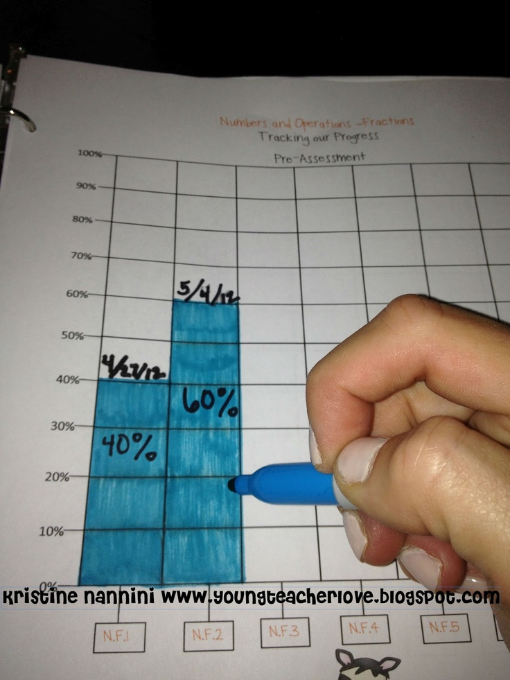

What are some examples of strategies that help students monitor their own learning?
Involve students in setting goals and monitoring their own academic gains with progress monitoring data.
Keep track (with the student) of how many trials it takes for a student to achieve mastery of a new skill
Teach students to ask themselves questions to determine if they are working well and making progress.
Notes:
Research indicates that when students are aware of their goals, they achieve better. When monitoring the number of trials needed to reach mastery, use six-cycle graph paper (http://facstaff.gpc.edu/~apepper/ajpsemiloggraphs.pdf), daily recording sheets, or a color-coded bar graph (e.g., use blue for +1 facts, green for +2 facts, red for doubles facts) to keep track of how long it takes the student to reach mastery on different skills.

Slide 47
What are some examples of strategies that help students monitor their own learning?
Teach students to be metacognitive and to identify “breakdowns” in their understanding.
When solving word problems, students should ask themselves whether they understand the question.
Teach students to ask for help when they need it.

Slide 48
Attribution
Notes:
In this next section we will talk about how maladaptive attributions can impede academic success and strategies to help students with intensive intervention needs develop more functional attribution.

Slide 49
How does maladaptive attribution impede academic success?
Attribution: A person’s beliefs about the causes of his or her academic failures and successes.
Students with maladaptive attribution may think that failure is due to stable, internal causes that cannot be changed, and that success is due to unstable causes such as luck.
  Internal Attribution Error: “I did poorly on the spelling test because I’m stupid.”
  External Attribution Error: “I was really lucky to get an ‘A’ on my spelling test because the teacher gave easy words.”
Notes:
Review slide. Ask participants to think about more functional attribution statements.

Slide 50
How can I support students to develop more functional attribution?
Consider integrating attribution and motivation training and supports:
  Help students to develop strategies or scripts when they engage in negative self-talk, and reinforce them for using them.
  Include students in goal-setting and monitoring to help them connect their hard work to increased academic success.
  Celebrate progress, and provide explicit feedback that connects it to their use of new/appropriate learning strategies, skills, or behaviors.

Slide 51
Examples of Self-Talk
I did well on the spelling test because I studied hard and learned the words.
If I work hard, I can learn to do new things even if they’re hard.
Sometimes things don’t go my way even when I work hard, but it’s not necessarily my fault. This happens to everybody sometimes. I should keep trying my best.
Notes:
Ask participants to suggest other examples.

Slide 52
Practice #4: Modify Delivery of Instruction
Notes:
In the following section, we’ll discuss how modifying the delivery of instruction can affect students with intensive intervention needs, and their implications for designing instruction/intervention.

Slide 53
Modifying Delivery of Instruction
  1. Consider the instructional match & prioritize skills to teach
  2. Systematic Instruction
  3. Explicit Instruction
  4. Precise, simple language
  5. Frequent opportunities for student response
  6. Specific feedback and error correction procedures
  7. Opportunities for practice, development of fluency, and review
Notes:
Next, we’ll talk about ways you can modify how you deliver academic content to make it more intensive. We’ll discuss the following strategies (briefly review slide).

Slide 54
Summary
Organizing these decisions into four categories of instructional practice may help you plan intervention and guide the changes you make:
  Time/dosage
  Learning environment
  Combine cognitive strategy instruction with academic learning
  Modify instructional delivery
Make a small number of intervention changes at a time.
Use data to determine whether your intervention is working for the student.

Slide 55
“It all works out in the end…. If it hasn’t worked out, it’s not the end yet.”
Notes:
This adage (unknown source) is relevant to the DBI process because it’s about perseverance. DBI helps us find programs that work for our neediest students, even when our initial attempts are not successful. Insufficient progress means that we haven’t found the right solution yet, not that we should stop trying to intervene. DBI helps us know when changes are needed, and allows us to inform those changes so that in the end, intervention works for the individual student.

Slide 56
Questions?
Sharon Vaughn
srvaughn@austin.utexas.edu
Rebecca Zumeta
rzumeta@air.org
1000 Thomas Jefferson St. NW
Washington, DC 20009
www.intensiveintervention.org
ncii@air.org
Notes:
Facilitators: Add your name to this slide.

Slide 57
While permission to redistribute this webinar is not necessary, the citation should be:
National Center on Intensive Intervention. (2014). So What do I do Now? Strategies for Intensifying Intervention when Standard Approaches Don’t Work. Washington, DC: U.S. Department of Education, Office of Special Education Programs, National Center on Intensive Intervention.

Slide 58
References
Courtade-Little, G., & Browder, D.M. (2005). Aligning IEPs to Academic Standards for Students with Moderate and Severe Disabilities. Verona, WI: Attainment Company.
Fuchs, L. S., Fuchs, D., Prentice, K., Burch, M., & Paulsen, K. (2002). Hot Math: Promoting mathematical problem solving among third- grade students with disabilities. Teaching Exceptional Children, 31(1), 70-73.
Fuchs, L.S., Fuchs, D., Craddock, C., Hollenbeck, K.N., Hamlett, C.L., & Schatschneider, C. (2008). Effects of small-group tutoring with and without validated classroom instruction on at-risk students’ math problem solving: Are two tiers of prevention better than one? Journal of Educational Psychology, 100, 491-509.
Fuchs, L.S., Fuchs, D., Powell, S.R., Seethaler, P.M., Cirino, P.T., & Fletcher, J.M. (2008). Intensive intervention for students with mathematics disabilities: Seven principles of effective practice. Learning Disability Quarterly, 31, 79-92.

Slide 59
References
Gersten, R., Compton, D., Connor, C.M., Dimino, J., Santoro, L., Linan-Thompson, S., and Tilly, W.D. (2008). Assisting students struggling with reading: Response to Intervention and multi-tier intervention for reading in the primary grades. A practice guide. (NCEE 2009-4045). Washington, DC: National Center for Education Evaluation and Regional Assistance, Institute of Education Sciences, U.S. Department of Education. Retrieved from http://ies.ed.gov/ncee/wwc/publications/practiceguides/.
International Reading Association Common Core State Standards (CCSS) Committee. (2012). Literacy implementation guidance for the ELA Common Core State Standards [White paper]. Retrieved from http://www.reading.org/Libraries/association-documents/ira_ccss_guidelines.pdf
Powell, S.R., & Fuchs, L.S. (2013). Reaching the mountaintop: Addressing the Common Core Standards in Mathematics for Students with Mathematics Difficulties. Learning Disabilities Research and Practice, 28(1), 28-37.
Vaughn, S., Wanzek, J., Murray, C. S., & Roberts, G. (2012). Intensive interventions for students struggling in reading and mathematics: A practice guide. Portsmouth, NH: RMC Research Corporation, Center on Instruction. Retrieved from http://www.centeroninstruction.org/files/Intensive%20Interventions %20for%20Students%20Struggling%20in%20Reading%20%26%20Math.pdf.

Slide 60
NCII Disclaimer
This presentation was produced under the U.S. Department of Education, Office of Special Education Programs, Award No. H326Q110005. Celia Rosenquist serves as the project officer. The views expressed herein do not necessarily represent the positions or polices of the U.S. Department of Education. No official endorsement by the U.S. Department of Education of any product, commodity, service or enterprise mentioned in this website is intended or should be inferred.

